Slide 1
Java AWT and Swing
Chapter 11

Slide 2
What is java swing
Java Swing is a part of Java Foundation Classes (JFC) that is used to create window-based applications. It is built on the top of AWT (Abstract Windowing Toolkit) API and entirely written in java.
Java Swing provides platform-independent and lightweight components.
The javax.swing package provides classes for java swing API such as JButton, JTextField, JTextArea, JRadioButton, JCheckbox, JMenu, JColorChooser etc.

Slide 3
Difference between AWT and Swing
No. | Java AWT |  |  | Java Swing
1) | AWT components dependent. | are | platform- | Java swing components are platform- independent.
2) | AWT components are heavy weight. |  |  | Swing components are light weight.
3) | AWT doesn't support pluggable look and feel. |  |  | Swing feel. | supports | pluggable | look | and
4 ) | AWT provides less components than Swing. |  |  | Swing provides more powerful components such as tables, lists, scrollpanes, colorchooser, tabbedpane etc.
5) | AWT doesn't follows MVC(Model View Controller) where model represents data, view represents presentation and controller acts as an interface between model and view. |  |  | Swing follows MVC.

Slide 4

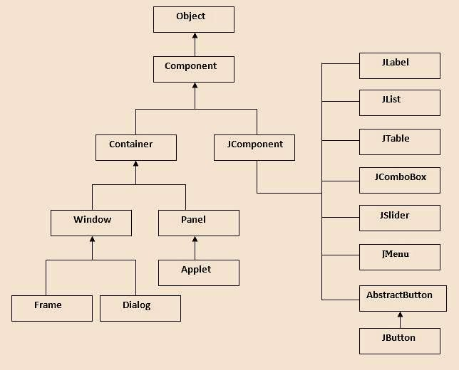
Hierarchy of Java Swing classes

Slide 5
Commonly used Methods of Component class
Method | Description
public void add(Component c) | add a component on another component.
public void setSize(int width,int height) | sets size of the component.
public void setLayout(LayoutManager m) | sets the layout manager for the component.
public void setVisible(boolean b) | sets the visibility of the component. It is by default false.

Slide 6
Java JButton
Declaration of JButton class.
public class JButton extends AbstractButton implements Access ible
Commonly used Constructors of JButton:
Constructor | Description
JButton() | It creates a button with no text and icon.
JButton(String s) | It creates a button with the specified text.
JButton(Icon i) | It creates a button with the specified icon object.

Slide 7
Commonly used Methods of AbstractButton class:
Methods | Description
void setText(String s) | It is used to set specified text on button
String getText() | It is used to return the text of the button.
void setEnabled(boolean b) | It is used to enable or disable the button.
void setIcon(Icon b) | It is used to set the specified Icon on the button.
Icon getIcon() | It is used to get the Icon of the button.
void setMnemonic(int a) | It is used to set the mnemonic on the button.
void addActionListener(ActionListener a) | It is used to add the action listener to this object.

Slide 8
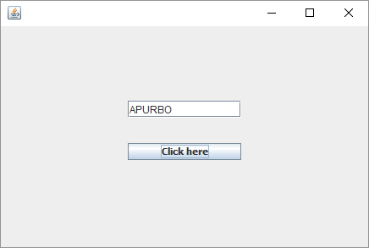
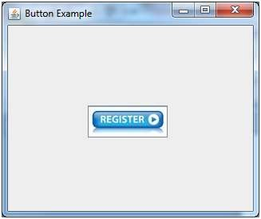
Example of Java JButton

Slide 9
Java JPasswordField
The object of a JPasswordField class is a text component specialized for password entry. It allows the editing of a single line of text. It inherits JTextField class.
JPasswordField class declaration
public class JPasswordField extends JTextField
Commonly used Constructors JPasswordField:
Constructor | Description
JPasswordField() | Constructs a new JPasswordField, with a default document, null starting text string, and 0 column width.
JPasswordField(int columns) | Constructs a new empty JPasswordField with the specified number of columns.
JPasswordField(String text) | Constructs a new JPasswordField initialized with the specified text.
JPasswordField(String text, int columns) | Construct a new JPasswordField initialized with the specified text and columns.

Slide 10

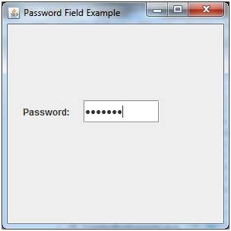
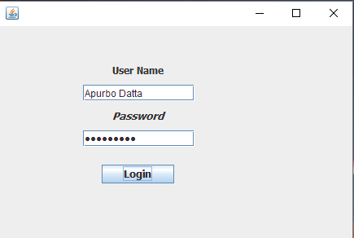
Java JPasswordField Example
Java JPasswordField Example with ActionListene

Slide 11
Java JLabel
The object of JLabel class is a component for placing text in a container. It is used to display a single line of read only text. The text can be changed by an application but a user cannot edit it directly. It inherits JComponent class.
JLabel class declaration
public class JButton extends AbstractButton implements Acc essible

Slide 12
Commonly used Constructors of JLabel:
Constructor | Description
JLabel() | Creates a JLabel instance with no image and with an empty string for the title.
JLabel(String s) | Creates a JLabel instance with the specified text.
JLabel(Icon i) | Creates a JLabel instance with the specified image.
JLabel(String s, Icon i, int horizontalAlignment) | Creates a JLabel instance with the specified text, image, and horizontal alignment.

Slide 13
Commonly used Methods of JLabel:
Methods | Description
String getText() | t returns the text string that a label displays.
void setText(String text) | It defines the single line of text this component will display.
void setHorizontalAlignment(int alignment) | It sets the alignment of the label's contents along the X axis.
Icon getIcon() | It returns the graphic image that the label displays.
int getHorizontalAlignment() | It returns the alignment of the label's contents along the X axis.

Slide 14
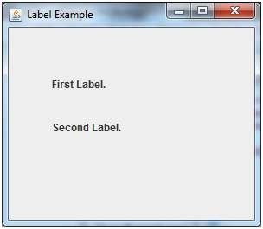

Java JLabel Example

Slide 15
Java JTextField
The object of a JTextField class is a text component that allows the editing of a single line text. It inherits JTextComponent class.
JTextField class declaration
public class JTextField extends JTextComponent implements SwingCo nstants

Slide 16
Commonly used Constructors of JTextField :
Constructor | Description
JTextField() | Creates a new TextField
JTextField(String text) | Creates a new TextField initialized with the specified text.
JTextField(String text, int columns) | Creates a new TextField initialized with the specified text and columns.
JTextField(int columns) | Creates a new empty TextField with the specified number of columns

Slide 17
Commonly used Methods:
Methods | Description
void addActionListener(ActionListener l) | It is used to add the specified action listener to receive action events from this textfield.
Action getAction() | It returns the currently set Action for this ActionEvent source, or null if no Action is set.
void setFont(Font f) | It is used to set the current font.
void removeActionListener(ActionListener l) | It is used to remove the specified action listener so that it no longer receives action events from this textfield.

Slide 18
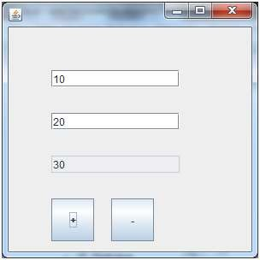
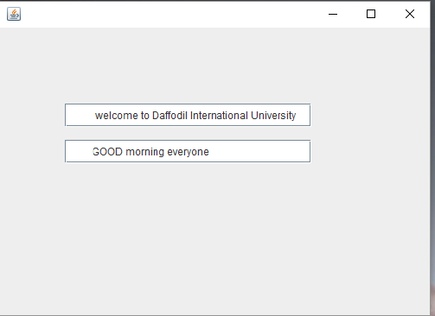
Java JTextField Example

Slide 19
Java JTextArea
The object of a JTextArea class is a multi line region that displays text. It allows the editing of multiple line text. It inherits JTextComponent class
JTextArea class declaration
public class JTextArea extends JTextComponent
Commonly used Constructors of JTextArea:
Constructor | Description
JTextArea() | Creates a text area that displays no text initially.
JTextArea(String s) | Creates a text area that displays specified text initially.
JTextArea(int row, int column) | Creates a text area with the specified number of rows and columns that displays no text initially.
JTextArea(String s, int row, int column) | Creates a text area with the specified number of rows and columns that displays specified text.

Slide 20
Commonly used Methods of JTextArea:
Methods | Description
void setRows(int rows) | It is used to set specified number of rows.
void setColumns(int cols) | It is used to set specified number of columns.
void setFont(Font f) | It is used to set the specified font.
void insert(String s, int position) | It is used to insert the specified text on the specified position.
void append(String s) | It is used to append the given text to the end of the document.

Slide 21
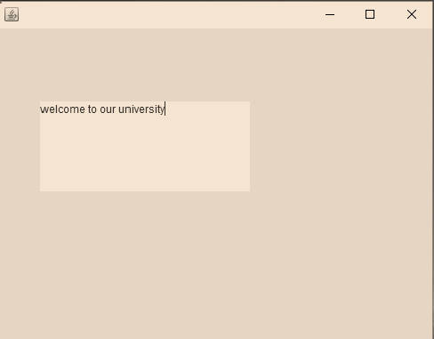
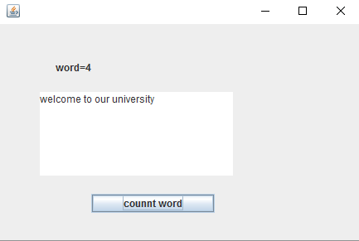
Java JTextArea Example
Java JTextArea Example with ActionListener

Slide 22
Java JCheckBox
The JCheckBox class is used to create a checkbox. It is used to turn an option on (true) or off (false). Clicking on a CheckBox changes its state from "on" to "off" or from "off" to "on ".It inherits JToggleButton class.
JCheckBox class declaration
public class JCheckBox extends JToggleButton implements Accessible

Slide 23
Commonly used Constructors:
Constructor | Description
JJCheckBox() | Creates an initially unselected check box button with no text, no icon.
JChechBox(String s) | Creates an initially unselected check box with text.
JCheckBox(String text, boolean selected) | Creates a check box with text and specifies whether or not it is initially selected.
JCheckBox(Action a) | Creates a check box where properties are taken from the Action supplied.
Commonly used Methods:
Methods | Description
AccessibleContext getAccessibleContext() | It is used to get the AccessibleContext associated with this JCheckBox.
protected String paramString() | It returns a string representation of this JCheckBox.

Slide 24
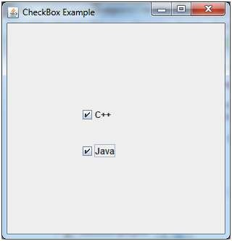
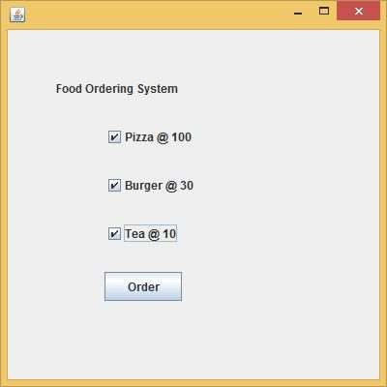
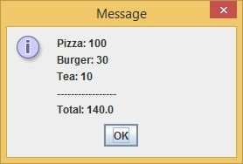
Java JCheckBox Example with ItemListene
Java JCheckBox Example

Slide 25
Java JRadioButton
The JRadioButton class is used to create a radio button. It is used to choose one option from multiple options. It is widely used in exam systems or quiz.
It should be added in ButtonGroup to select one radio button only.
JRadioButton class declaration:
public class JRadioButton extends JToggleButton implements A ccessible
Commonly used Constructors of JRadioButton:
Constructor | Description
JRadioButton() | Creates an unselected radio button with no text.
JRadioButton(String s) | Creates an unselected radio button with specified text.
JRadioButton(String s, boolean selected) | Creates a radio button with the specified text and selected status.

Slide 26
Commonly used Methods:
Methods | Description
void setText(String s) | It is used to set specified text on button.
String getText() | It is used to return the text of the button.
void setEnabled(boolean b) | It is used to enable or disable the button.
void setIcon(Icon b) | It is used to set the specified Icon on the button.
Icon getIcon() | It is used to get the Icon of the button.
void setMnemonic(int a) | It is used to set the mnemonic on the button.
void addActionListener(ActionListener a) | It is used to add the action listener to this object.

Slide 27
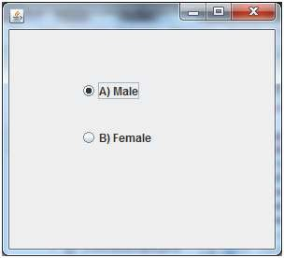
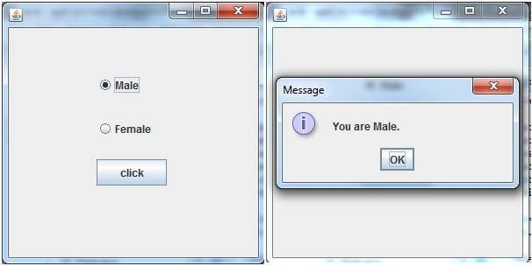
Java JRadioButton Example
Java JRadioButton Example with ActionListene

Slide 28
Java JComboBox
The object of Choice class is used to show popup menu of choices. Choice selected by user is shown on the top of a menu. It inherits JComponent class.
JComboBox class declaration
public class JComboBox extends JComponent implements ItemSelectable, ListDataListener, ActionListen er, Accessible
Commonly used Constructors Of JComboBox:
Constructor | Description
JComboBox() | Creates a JComboBox with a default data model.
JComboBox(Object[] items) | Creates a JComboBox that contains the elements in the specified array.
JComboBox(Vector<?> items) | Creates a JComboBox that contains the elements in the specified Vector.

Slide 29
Commonly used Methods Of JComboBox :
Methods | Description
void addItem(Object anObject) | It is used to add an item to the item list.
void removeItem(Object anObject) | It is used to delete an item to the item list.
void removeAllItems() | It is used to remove all the items from the list.
void setEditable(boolean b) | It is used to determine whether the JComboBox is editable.
void addActionListener(ActionListener a) | It is used to add the ActionListener.
void addItemListener(ItemListener i) | It is used to add the ItemListener.

Slide 30
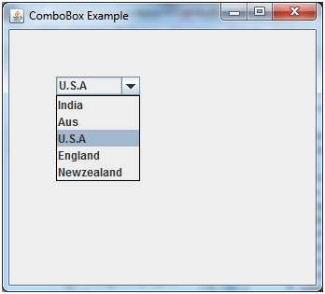
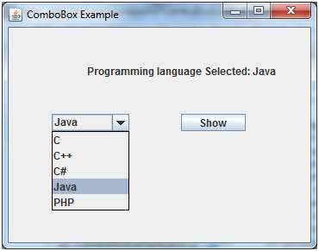
Java JComboBox Example with ActionListen
Java JComboBox Example

Slide 31
Java JTable
The JTable class is used to display data in tabular form. It is composed of rows and columns.
Commonly used Constructors of JTable:
Constructor | Description
JTable() | Creates a table with empty cells.
JTable(Object[][] rows, Object[] columns) | Creates a table with the specified data.

Slide 32
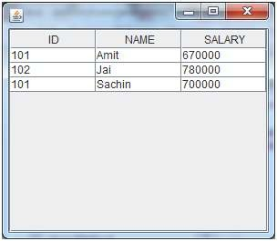
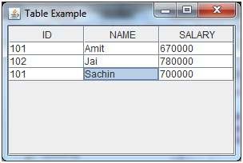
Java JTable Example
Java JTable Example with ListSelectionListen
If you select an element in column NAME, name of the element will be displayed on the console:
Table element selected is: Sachin

Slide 33
Java JList
The object of JList class represents a list of text items. The list of text items can be set up so that the user can choose either one item or multiple items. It inherits JComponent class.
JList class declaration
public class JList extends JComponent implements Scrollable, Accessible e
Commonly used Constructors of JList :
Constructor | Description
JList() | Creates a JList with an empty, read-only, model.
JList(ary[] listData) | Creates a JList that displays the elements in the specified array.
JList(ListModel<ary> dataModel) | Creates a JList that displays elements from the specified, non-null, model.

Slide 34
Commonly used Methods of JList :
Methods | Description
Void addListSelectionListener(ListSelectionListener listener) | It is used to add a listener to the list, to be notified each time a change to the selection occurs.
int getSelectedIndex() | It is used to return the smallest selected cell index.
ListModel getModel() | It is used to return the data model that holds a list of items displayed by the JList component.
void setListData(Object[] listData) | It is used to create a read-only ListModel from an array of objects.

Slide 35
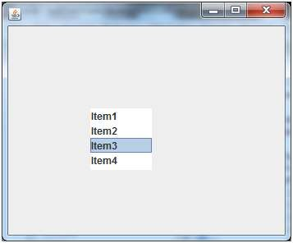
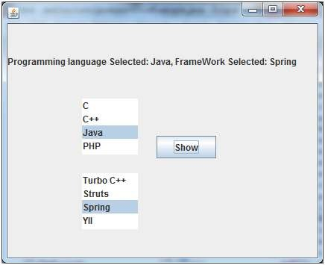
Java JList Example with ActionListen
Java JList Example

Slide 36
Java JPanel
The JPanel is a simplest container class. It provides space in which an application can attach any other component. It inherits the JComponents class.
It doesn't have title bar.
JPanel class declaration
public class Jpanel extends JComponent implements Accessible

Slide 37
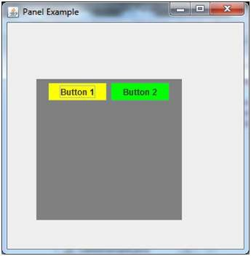
Commonly used Constructors of JPanel :
Constructor | Description
JPanel() | It is used to create a new JPanel with a double buffer and a flow layout.
JPanel(boolean isDoubleBuffered) | It is used to create a new JPanel with FlowLayout and the specified buffering strategy.
JPanel(LayoutManager layout) | It is used to create a new JPanel with the specified layout manager.
Java JPanel Example

Slide 38
Java JProgressBar
The JProgressBar class is used to display the progress of the task. It inherits JComponent class.
JProgressBar class declaration
public class JProgressBar extends JComponent implements SwingConstants, Accessible
Commonly used Constructors:
Constructor | Description
JProgressBar() | It is used to create a horizontal progress bar but no string text.
JProgressBar(int min, int max) | It is used to create a horizontal progress bar with the specified minimum and maximum value.
JProgressBar(int orient) | It is used to create a progress bar with the specified orientation, it can be either Vertical or Horizontal by using SwingConstants.VERTICAL and SwingConstants.HORIZONTAL constants.
JProgressBar(int orient, int min, int max) | It is used to create a progress bar with the specified orientation, minimum and maximum value.

Slide 39
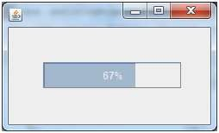
Commonly used Methods:
Method | Description
void setStringPainted(boolean b) | It is used to determine whether string should be displayed.
void setString(String s) | It is used to set value to the progress string.
void setOrientation(int orientation) | It is used to set the orientation, it may be either vertical or horizontal by using SwingConstants.VERTICAL and SwingConstants.HORIZONTAL constants.
void setValue(int value) | It is used to set the current value on the progress bar.
Java JProgressBar Example

Slide 40
Java JSlider
The Java JSlider class is used to create the slider. By using JSlider, a user can select a value
from a specific range.
Commonly used Constructors of JSlider class
Constructor | Description
JSlider() | creates a slider with the initial value of 50 and range of 0 to 100.
JSlider(int orientation) | creates a slider with the specified orientation set by either JSlider.HORIZONTAL or JSlider.VERTICAL with the range 0 to 100 and initial value 50.
JSlider(int min, int max) | creates a horizontal slider using the given min and max.
JSlider(int min, int max, int value) | creates a horizontal slider using the given min, max and value.
JSlider(int orientation, int min, int max, int value) | creates a slider using the given orientation, min, max and value.

Slide 41

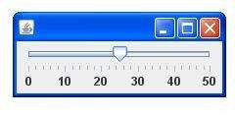
Commonly used Methods of JSlider class
Method | Description
public void setMinorTickSpacing(int n) | is used to set the minor tick spacing to the slider.
public void setMajorTickSpacing(int n) | is used to set the major tick spacing to the slider.
public void setPaintTicks(boolean b) | is used to determine whether tick marks are painted.
public void setPaintLabels(boolean b) | is used to determine whether labels are painted.

Slide 42
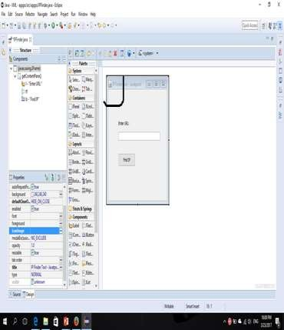
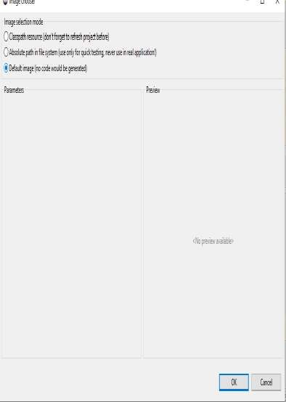
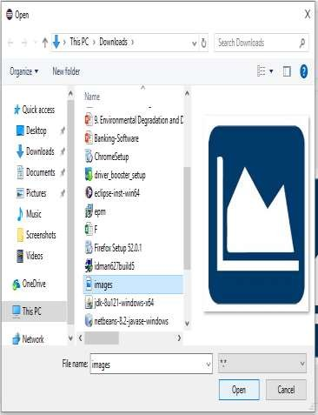
How to change TitleBar icon in Java Swing

Slide 43

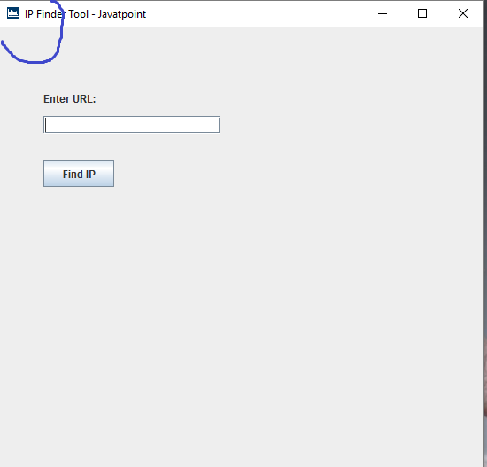
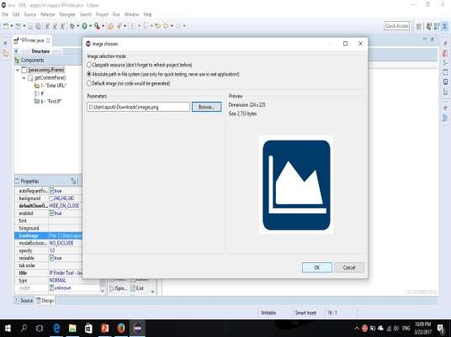

Slide 44
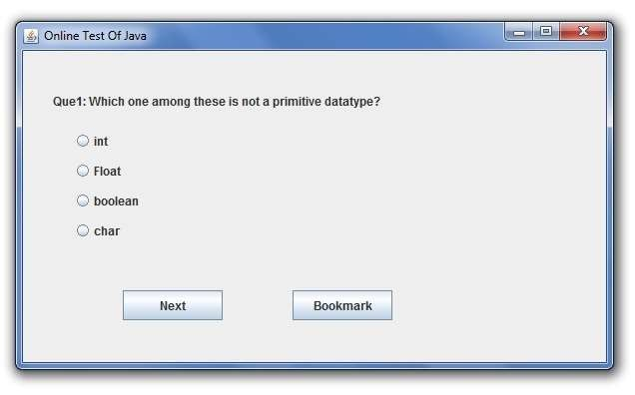
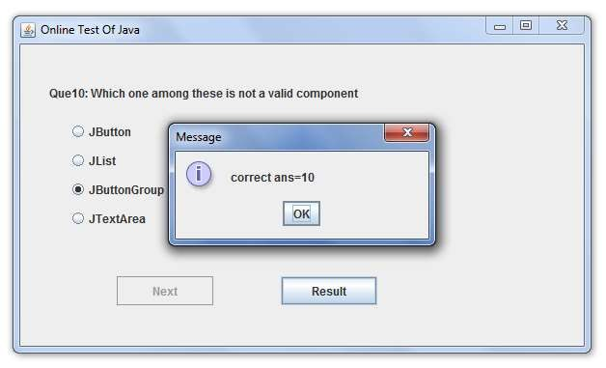
Some Java Swing Apps
Online Exam

Slide 45
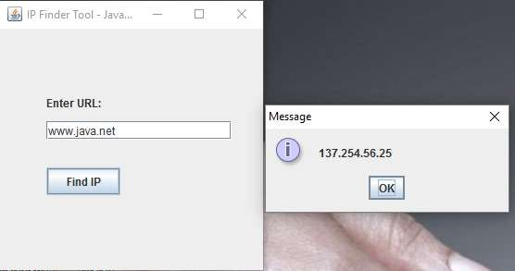
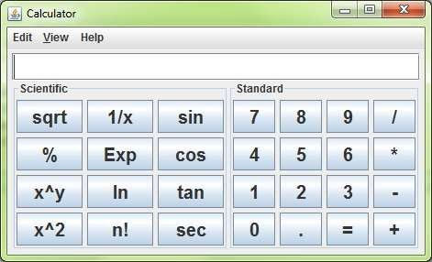
Calculator
IP Finder

