Slide 1
Chapter 12 Introduction to Java Applet

Slide 2
What is an Applet?
It is a special type of program that is embedded in the webpage to generate the dynamic content.
It runs inside the browser and works at client side.
Applet is mostly used in games and animation.

Slide 3
Advantages & Disadvantages
Advantages
It works at client side so less response time.
Secured.
It can be executed by browsers running under many platforms, including Linux, Windows, Mac, etc.
Disadvantages
Plugin is required at client browser to execute applet.

Slide 4



Hierarchy of Applet
Object
Component Container Panel Applet JApplet

Slide 5




Life Cycle of an Applet
Applet is initialized
Applet is started Applet is painted Applet is stopped Applet is destroyed

Slide 6
Life Cycle Methods for Applet
(java.applet.Applet class)
Method | Description
public void init() | Used to initialized the Applet. It is invoked only once.
public void start() | Invoked after the init() method or browser is maximized. It is used to start the Applet.
public void stop() | Used to stop the Applet. It is invoked when Applet is stop or browser is minimized.
public void destroy() | Used to destroy the Applet. It is invoked only once.

Slide 7
Life Cycle Methods for Applet
(java.awt.Graphics class)
Method | Description
public void paint(Graphics g) | Used to paint the Applet. It provides Graphics class object that can be used for drawing oval, rectangle, arc etc.

Slide 8
How to run an Applet?
By html file
To execute the applet by html file, create an applet and compile it.
After that create an html file and place the applet code in html file.
Now click the html file.

Slide 9
How to run an Applet? (2)
By appletviewer tool
To execute the applet by appletviewer tool, create an applet that contains an applet tag in comment and compile it.
After that run it by: appletviewer myapplet.java in the command line.

Slide 10
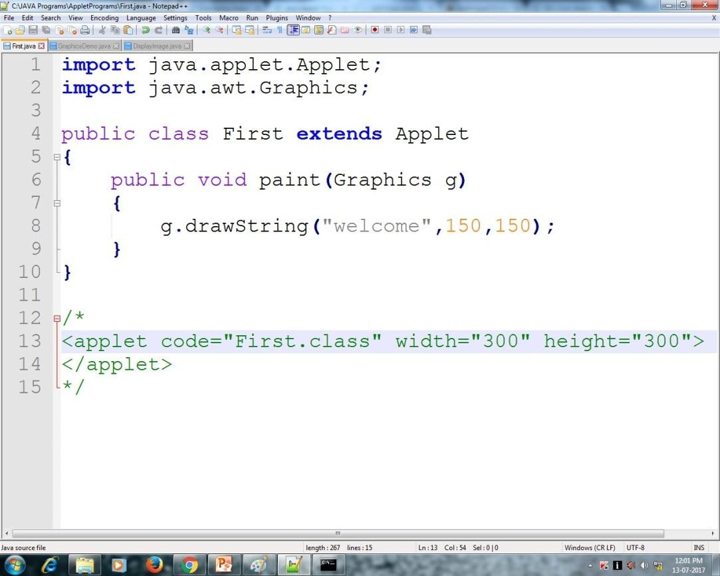
Example

Slide 11
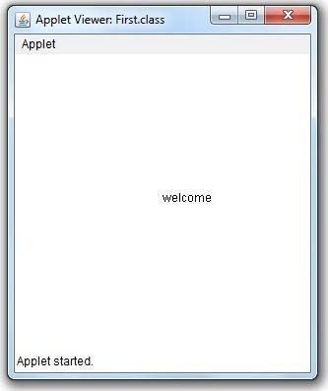
Output

Slide 12
Displaying Graphics in Applet
(java.awt.Graphics class)
Method | Description
public abstract void drawString(String str, int x, int y) | Used to draw the specified string.
public void drawRect(int x, int y, int width, int height) | Draws a rectangle with the specified width and height.
public abstract void fillRect(int x, int y, int width, int height) | Used to fill rectangle with the default color and specified width and height.
public abstract void drawOval(int x, int y, int width, int height) | Used to draw oval with the specified width and height.

Slide 13
Method | Description
public abstract void fillOval(int x, int y, int width, int height) | Used to fill oval with the default color and specified width and height.
public abstract void drawLine(int x1, int y1, int x2, int y2) | Used to draw line between the points(x1, y1) and (x2, y2).
public abstract void drawArc(int x, int y, int width, int height, int startAngle, int arcAngle) | Used draw a circular or elliptical arc.

Slide 14
Method | Description
public abstract void fillArc(int x, int y, int width, int height, int startAngle, int arcAngle) | Used to fill a circular or elliptical arc.
public abstract void setColor(Color c) | Used to set the graphics current color to the specified color.
public abstract void setFont(Font font) | Used to set the graphics current font to the specified font.

Slide 15
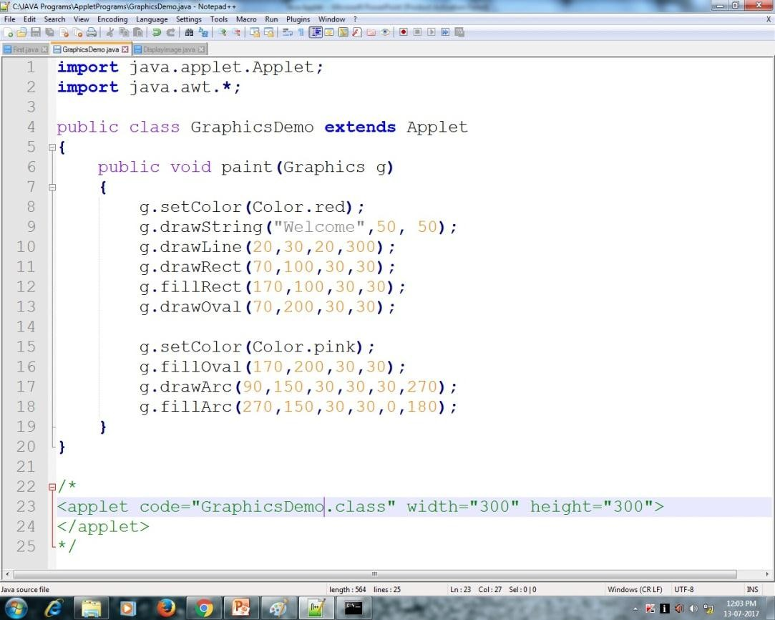
Example

Slide 16
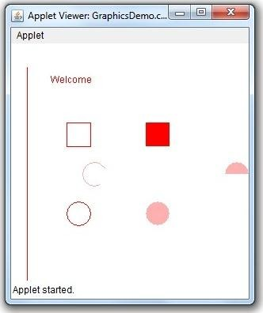
Output

Slide 17
Displaying Image in Applet
Class | Method | Description
java.awt.Graphics | public abstract boolean drawImage(Image img, int x, int y, ImageObserver observer) | Used to draw the specified image.
java.applet.Applet | public Image getImage(URL u, String image) | Used to return the object of Image.

Slide 18
Displaying Image in Applet (2)
Class | Method | Description
java.applet.Applet | public URL getDocumentBase( ) | Used to return the URL of the document in which the applet is embedded.
java.applet.Applet | public URL getCodeBase() | Used to return the base URL.

Slide 19
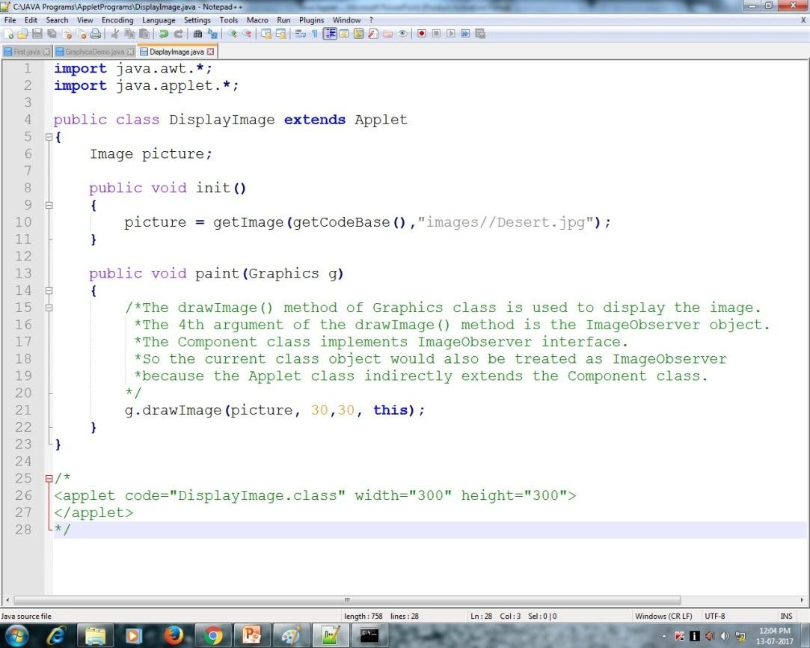
Example

Slide 20
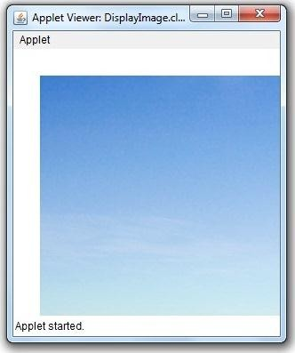
Output

Slide 21
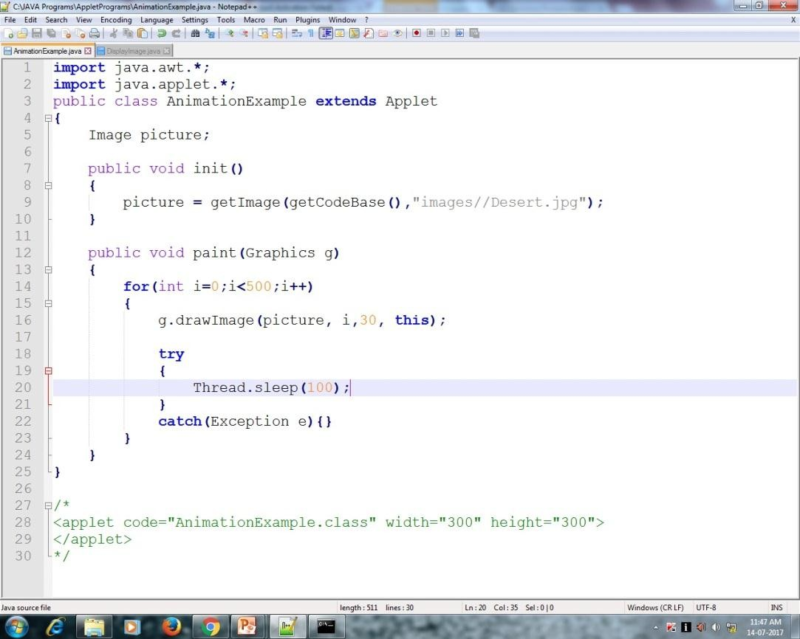
Animation in Applet

Slide 22
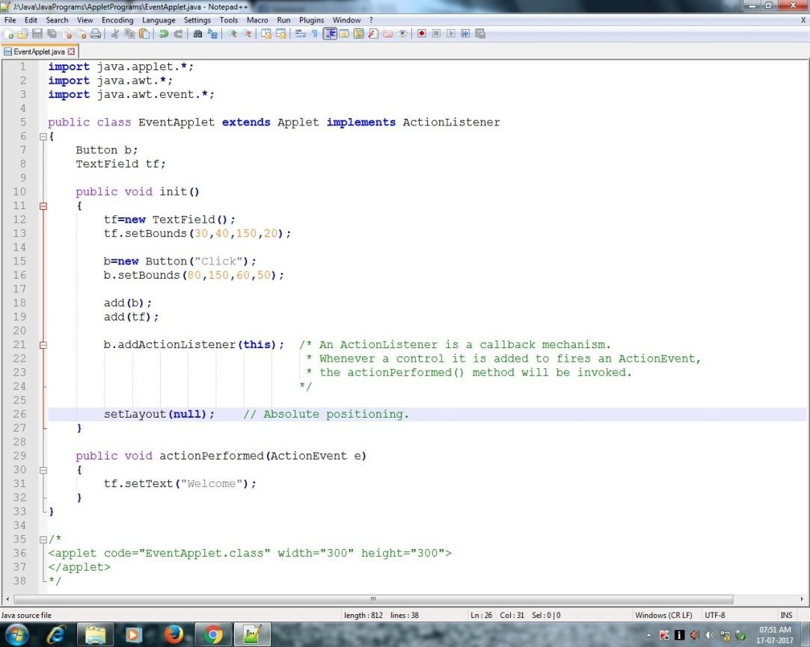
EventHandling in Applet

Slide 23
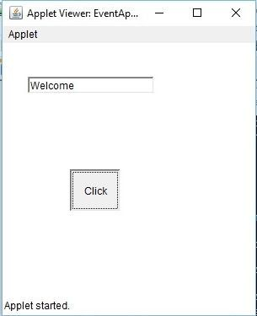
Output

Slide 24
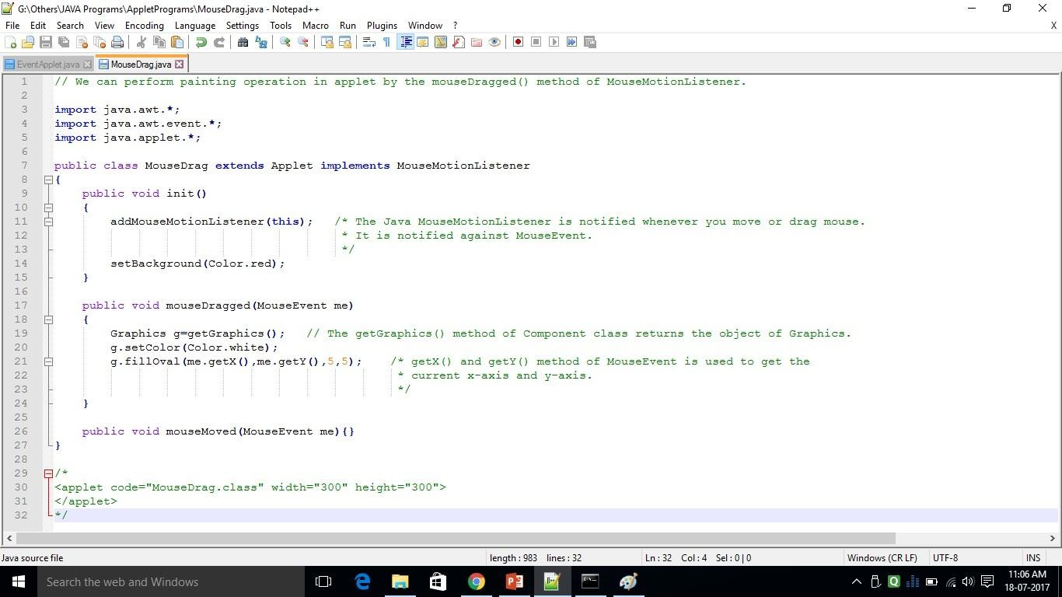
Painting in Applet

Slide 25
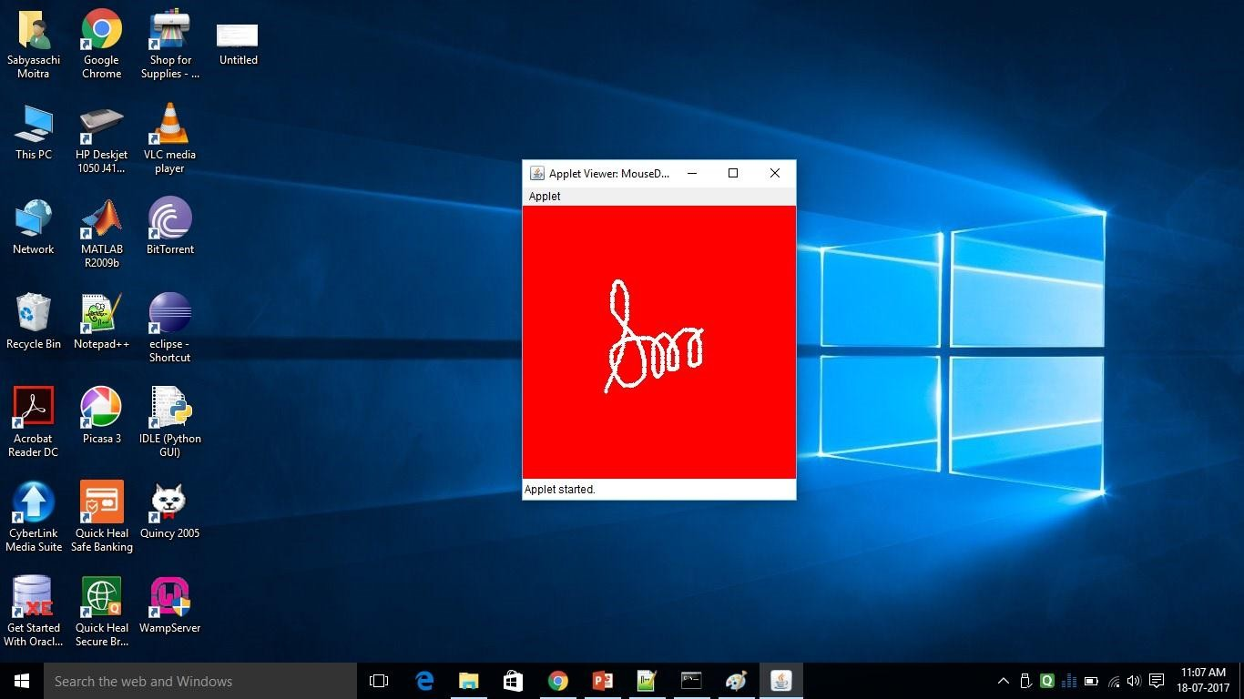
Output

Slide 26
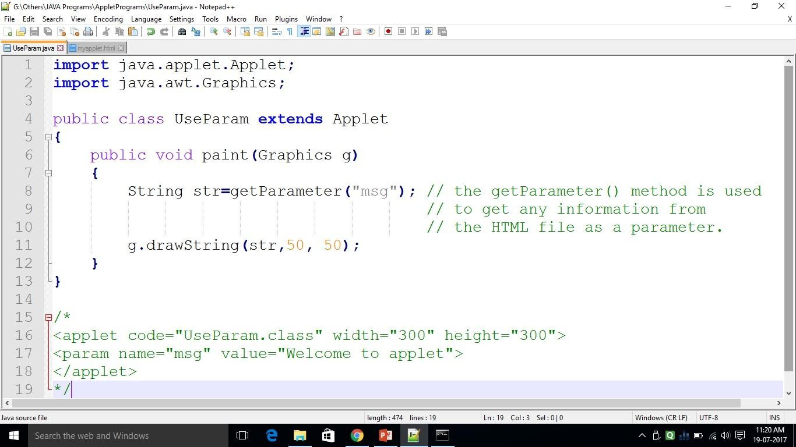
Parameter in Applet

Slide 27
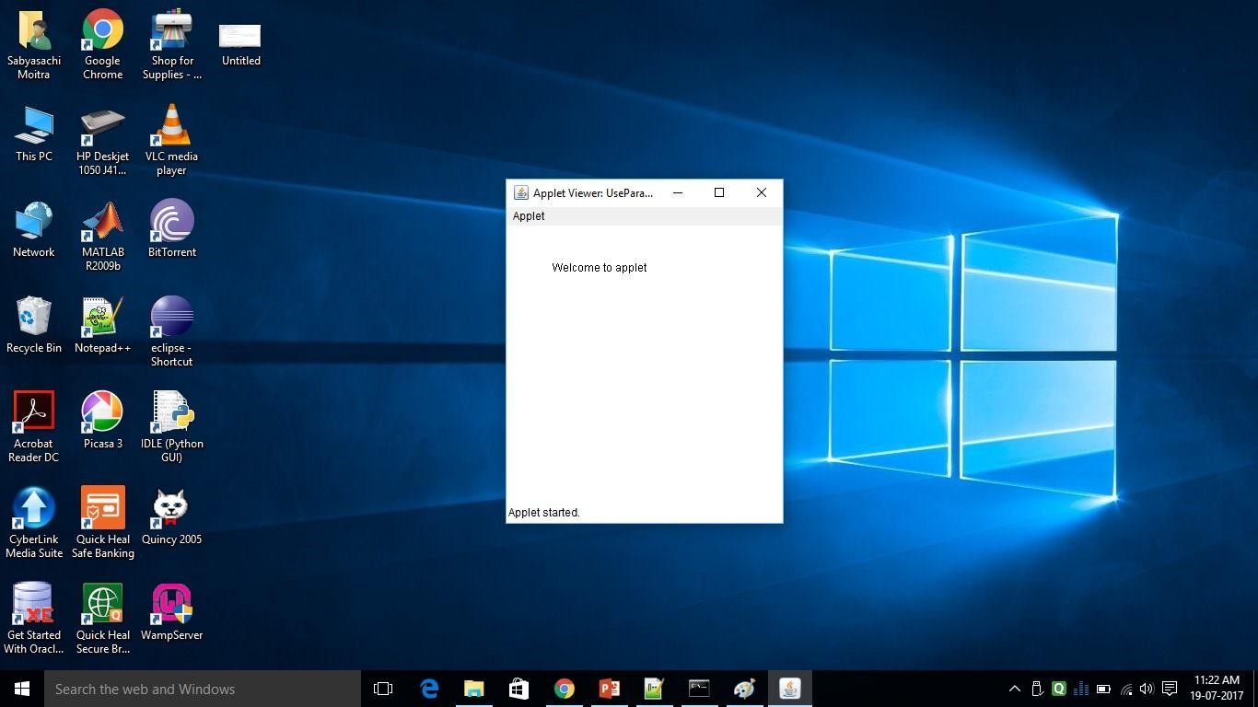
Output

Slide 28
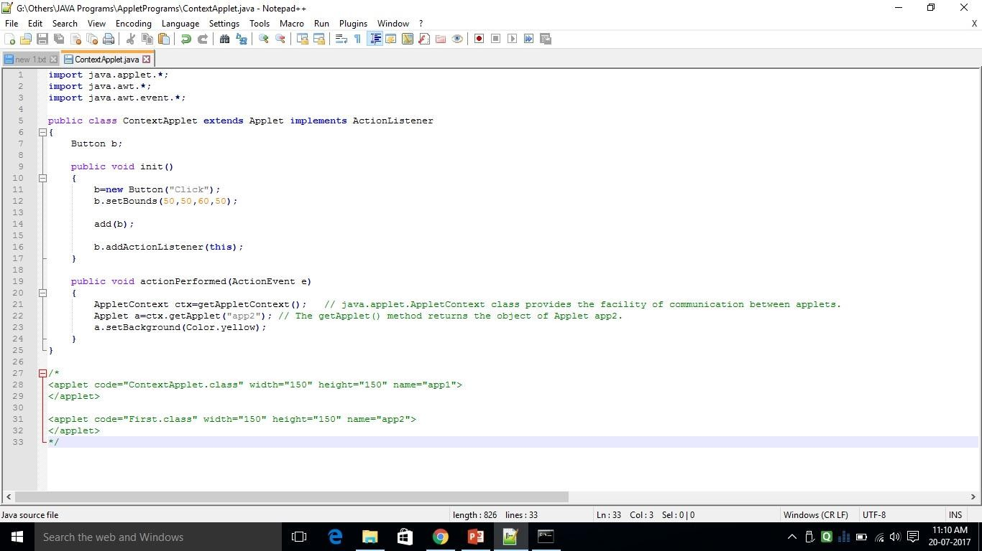
Applet Communication

Slide 29
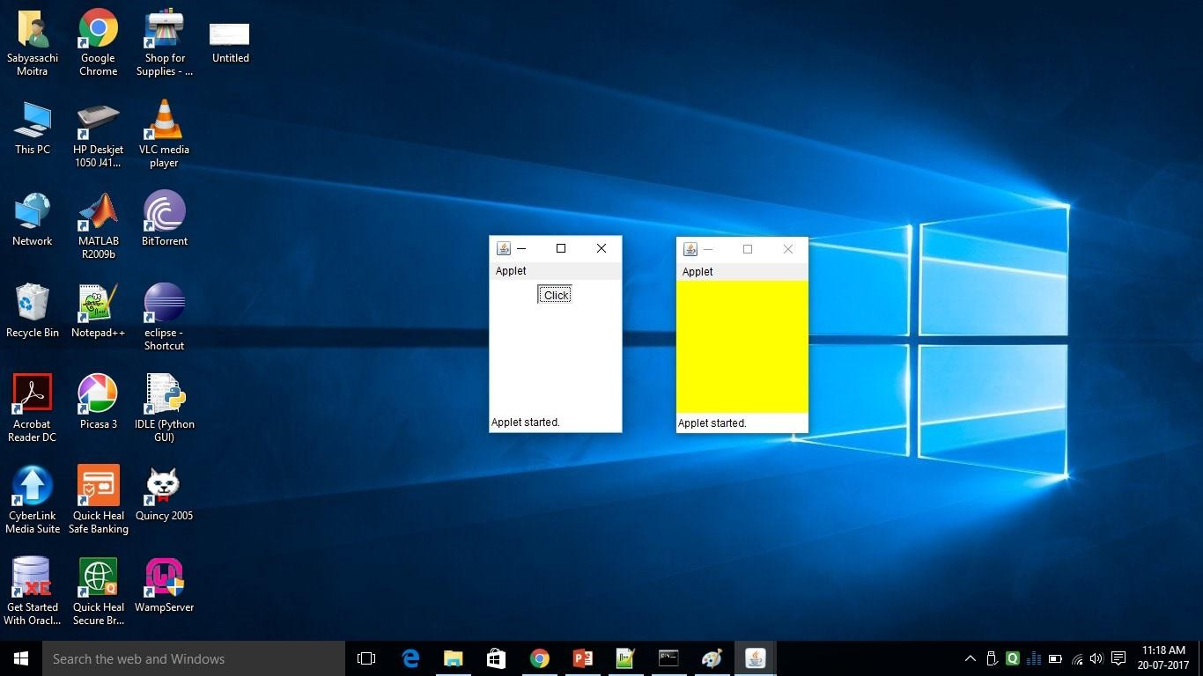
Output

Slide 30
The End

