Slide 1
Chapter 13
Database Programming Using JDBC

Slide 2
What is JDBC?
JDBC API is a Java API that can access any kind of tabular data, especially data stored in a Relational Database.
JDBC works with Java on a variety of platforms, such as Windows, Mac OS, and the various versions of UNIX.
JDBC stands for Java Database Connectivity, which is a standard Java API for database-independent connectivity between the Java programming language and a wide range of databases.
The JDBC library includes APIs for each of the tasks mentioned below that are commonly associated with database usage.
Making a connection to a database.
Creating SQL or MySQL statements.
Executing SQL or MySQL queries in the database.
Viewing & Modifying the resulting records.

Slide 3
Applications of JDBC
Fundamentally, JDBC is a specification that provides a complete set of interfaces that allows for portable access to an underlying database. Java can be used to write different types of executables, such as −
Java Applications
Java Applets
Java Servlets
Java ServerPages (JSPs)
Enterprise JavaBeans (EJBs).
All of these different executables are able to use a JDBC driver to access a database, and take advantage of the stored data.

Slide 4
The JDBC 4.0 Packages
The java.sql and javax.sql are the primary packages for JDBC 4.0.
It offers the main classes for interacting with your data sources.
The new features in these packages include changes in the following areas −
Automatic database driver loading.
Exception handling improvements.
Connection and statement interface enhancements.
National character set support.
SQL 2003 XML data type support.
Annotations.

Slide 5
What is JDBC Driver?
JDBC drivers implement the defined interfaces in the JDBC API, for interacting with your database server.
For example, using JDBC drivers enable you to open database connections and to interact with it by sending SQL or database commands then receiving results with Java.
The Java.sql package that ships with JDK, contains various classes with their behaviours defined and their actual implementations are done in third-party drivers.
Third party vendors implements the java.sql.Driver interface in their database driver.

Slide 6
JDBC Drivers Types
JDBC driver implementations vary because of the wide variety of operating systems and hardware platforms in which Java operates. Sun has divided the implementation types into four categories, Types 1, 2, 3, and 4, which is explained below −
Type 1: JDBC-ODBC Bridge Driver
Type 2: JDBC-Native API
Type 3: JDBC-Net pure Java
Type 4: 100% Pure Java

Slide 7
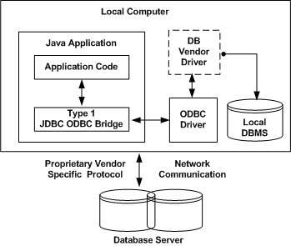
Type 1: JDBC-ODBC Bridge Driver
In a Type 1 driver, a JDBC bridge is used to access ODBC drivers installed on each client machine. Using ODBC, requires configuring on your system a Data Source Name (DSN) that represents the target database.
When Java first came out, this was a useful driver because most databases only supported ODBC access but now this type of driver is recommended only for experimental use or when no other alternative is available.

Slide 8
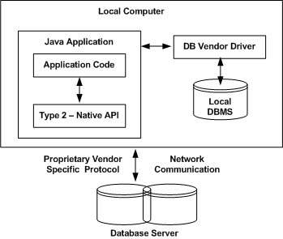
Type 2: JDBC-Native API
In a Type 2 driver, JDBC API calls are converted into native C/C++ API calls, which are unique to the database.
These drivers are typically provided by the database vendors and used in the same manner as the JDBC-ODBC Bridge. The vendor-specific driver must be installed on each client machine.
If we change the Database, we have to change the native API, as it is specific to a database and they are mostly obsolete now, but you may realize some speed increase with a Type 2 driver, because it eliminates ODBC's overhead.

Slide 9
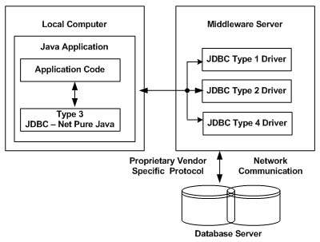
Type 3: JDBC-Net pure Java
In a Type 3 driver, a three-tier approach is used to access databases. The JDBC clients use standard network sockets to communicate with a middleware application server.
The socket information is then translated by the middleware application server into the call format required by the DBMS, and forwarded to the database server.
This kind of driver is extremely flexible, since it requires no code installed on the client and a single driver can actually provide access to multiple databases.

Slide 10
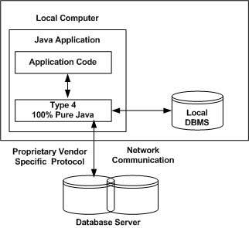
Type 4: 100% Pure Java
In a Type 4 driver, a pure Java-based driver communicates directly with the vendor's database through socket connection.
This is the highest performance driver available for the database and is usually provided by the vendor itself.
This kind of driver is extremely flexible, you don't need to install special software on the client or server. Further, these drivers can be downloaded dynamically.

Slide 11
Which Driver should be Used?
If you are accessing one type of database, such as Oracle, Sybase, or IBM, the preferred driver type is 4.
If your Java application is accessing multiple types of databases at the same time, type 3 is the preferred driver.
Type 2 drivers are useful in situations, where a type 3 or type 4 driver is not available yet for your database.
The type 1 driver is not considered a deployment-level driver, and is typically used for development and testing purposes only.

Slide 12
JDBC Connection
After you've installed the appropriate driver, it is time to establish a database connection using JDBC.
The programming involved to establish a JDBC connection is fairly simple. Here are these simple four steps −
Import JDBC Packages: Add import statements to your Java program to import required classes in your Java code.
Register JDBC Driver: This step causes the JVM to load the desired driver implementation into memory so it can fulfill your JDBC requests.
Database URL Formulation: This is to create a properly formatted address that points to the database to which you wish to connect.
Create Connection Object: Finally, code a call to the DriverManager object's getConnection( ) method to establish actual database connection.

Slide 13
Import JDBC Packages
The Import statements tell the Java compiler where to find the classes you reference in your code and are placed at the very beginning of your source code.
To use the standard JDBC package, which allows you to select, insert, update, and delete data in SQL tables, add the following imports to your source code −
import java.sql.* ; // for standard JDBC programs import java.math.* ; // for BigDecimal and BigInteger support

Slide 14
Register JDBC Driver
You must register the driver in your program before you use it. Registering the driver is the process by which the Oracle driver's class file is loaded into the memory, so it can be utilized as an implementation of the JDBC interfaces.
You need to do this registration only once in your program. You can register a driver in one of two ways.

Slide 15
Approach I - Class.forName()
The most common approach to register a driver is to use Java's Class.forName() method, to dynamically load the driver's class file into memory, which automatically registers it.
This method is preferable because it allows you to make the driver registration configurable and portable.
The following example uses Class.forName( ) to register the Oracle driver −
try {
Class.forName("oracle.jdbc.driver.OracleDriver");
} catch(ClassNotFoundException ex) {
System.out.println("Error: unable to load driver class!"); System.exit(1);
}

Slide 16
You can use getInstance() method to work around noncompliant JVMs, but then you'll have to code for two extra Exceptions as follows −
try { Class.forName("oracle.jdbc.driver.OracleDriver").newInstance();
} catch(ClassNotFoundException ex) {
System.out.println("Error: unable to load driver class!"); System.exit(1);
catch(IllegalAccessException ex) {
System.out.println("Error: access problem while loading!"); System.exit(2);
catch(InstantiationException ex) {
System.out.println("Error: unable to instantiate driver!");
System.exit(3);
}

Slide 17
Database URL Formulation
After you've loaded the driver, you can establish a connection using the DriverManager.getConnection() method. For easy reference, let me list the three overloaded DriverManager.getConnection() methods
getConnection(String url)
getConnection(String url, Properties prop)
getConnection(String url, String user, String password)
Here each form requires a database URL. A database URL is an address that points to your database.
Formulating a database URL is where most of the problems associated with establishing a connection occurs.

Slide 18
Create Connection Object
We have listed down three forms of DriverManager.getConnection() method to create a connection object.
Using a Database URL with a username and password
The most commonly used form of getConnection() requires you to pass a database URL, a username, and a password:
Assuming you are using Oracle's thin driver, you'll specify a host:port:databaseName value for the database portion of the URL.
If you have a host at TCP/IP address 192.0.0.1 with a host name of amrood, and your Oracle listener is configured to listen on port 1521, and your database name is EMP, then complete database URL would be −
jdbc:oracle:thin:@amrood:1521:EMP

Slide 19
Now you have to call getConnection() method with appropriate username and password to get a Connection object as follows −
String URL = "jdbc:oracle:thin:@amrood:1521:EMP";
String USER = "username";
String PASS = "password“;
Connection conn = DriverManager.getConnection(URL, USER, PASS);

Slide 20
Closing JDBC Connections
At the end of your JDBC program, it is required explicitly to close all the connections to the database to end each database session. However, if you forget, Java's garbage collector will close the connection when it cleans up stale objects.
Relying on the garbage collection, especially in database programming, is a very poor programming practice. You should make a habit of always closing the connection with the close() method associated with connection object.
To ensure that a connection is closed, you could provide a 'finally' block in your code. A finally block always executes, regardless of an exception occurs or not.
To close the above opened connection, you should call close() method as follows −
conn.close();

Slide 21
JDBC Statement
Once a connection is obtained we can interact with the database. The JDBC Statement, CallableStatement, and PreparedStatement interfaces define the methods and properties that enable you to send SQL or PL/SQL commands and receive data from your database.
They also define methods that help bridge data type differences between Java and SQL data types used in a database.
The following table provides a summary of each interface's purpose to decide on the interface to use.

Slide 22
Interfaces | Recommended Use
Statement | Use this for general-purpose access to your database. Useful when you are using static SQL statements at runtime. The Statement interface cannot accept parameters.
PreparedStatement | Use this when you plan to use the SQL statements many times. The PreparedStatement interface accepts input parameters at runtime.
CallableStatement | Use this when you want to access the database stored procedures. The Callable Statement interface can also accept runtime input parameters.

Slide 23
Statement Object
Creating Statement Object
Before you can use a Statement object to execute a SQL statement, you need to create one using the Connection object's createStatement( ) method, as in the following example
Statement stmt = null;
try {
stmt = conn.createStatement( );
. . .
} catch (SQLException e) {
. . .
} finally {
. . .
}

Slide 24
Once you've created a Statement object, you can then use it to execute an SQL statement with one of its three execute methods.
boolean execute (String SQL): Returns a boolean value of true if a ResultSet object can be retrieved; otherwise, it returns false. Use this method to execute SQL DDL statements or when you need to use truly dynamic SQL.
int executeUpdate (String SQL): Returns the number of rows affected by the execution of the SQL statement. Use this method to execute SQL statements for which you expect to get a number of rows affected - for example, an INSERT, UPDATE, or DELETE statement.
ResultSet executeQuery (String SQL): Returns a ResultSet object. Use this method when you expect to get a result set, as you would with a SELECT statement.

Slide 25
Closing Statement Object
Just as you close a Connection object to save database resources, for the same reason you should also close the Statement object.
A simple call to the close() method will do the job. If you close the Connection object first, it will close the Statement object as well. However, you should always explicitly close the Statement object to ensure proper cleanup.
Statement stmt = null;
try {
stmt = conn.createStatement( );
. . .
} catch (SQLException e) {
. . .
} finally { stmt.close();
}

Slide 26
JDBC ResultSet Interface
The SQL statements that read data from a database query, return the data in a result set.
The SELECT statement is the standard way to select rows from a database and view them in a result set.
The java.sql.ResultSet interface represents the result set of a database query.
A ResultSet object maintains a cursor that points to the current row in the result set.
The term "result set" refers to the row and column data contained in a ResultSet object.

Slide 27
Navigating a Result Set
There are several methods in the ResultSet interface that involve moving the cursor, including
S.N. | Methods & Description
1 | public void beforeFirst() throws SQLException Moves the cursor just before the first row.
2 | public void afterLast() throws SQLException Moves the cursor just after the last row.
3 | public boolean first() throws SQLException Moves the cursor to the first row.
4 | public void last() throws SQLException Moves the cursor to the last row.
5 | public boolean absolute(int row) throws SQLException Moves the cursor to the specified row.
6 | public boolean relative(int row) throws SQLException Moves the cursor the given number of rows forward or backward, from where it is currently pointing.
7 | public boolean previous() throws SQLException Moves the cursor to the previous row. This method returns false if the previous row is off the result set.

