Slide 1
Chapter 3
Fundamentals of Class, Polymorphism, Method Overloading and Overriding, Access Control/Modifiers, Nested and Inner Class and Recursion

Slide 2
Polymorphism in Java
Polymorphism can perform a single action in different ways.
Its is derived from 2 Greek words: poly and morphs. The word "poly" means many and "morphs" means forms. So polymorphism means many forms.
There are two types of polymorphism in Java:
Compile-time polymorphism and
Runtime polymorphism.
We can perform polymorphism in java by method overloading and method overriding.
Example:
Shapes: circle, tringle, rectangle
Sound: bark, roar

Slide 3
Condition of Method Overloading and Overriding
Method Overloading
Method Overriding
Same name method
Method in Same class
Different arguments in methods
Number of argument
Sequence of argument
Type of argument
Same name method
Method in Different class
Same arguments
Number of argument
Sequence of argument
Type of argument
Inheritance
(IS-A Relationship)

Slide 4
Compile Time Polymorphism
Polymorphism that is resolved during compiler time is known as static polymorphism.
Method overloading is an example of compile time polymorphism.
It is handle by compiler
Method Overloading: This allows us to have more than one method having the same name, if the parameters of methods are different in number, sequence and data types of parameters.

Slide 5
Example of Compile Time Polymorphism
Method overloading is one of the way java supports static polymorphism.
Here we have two definitions of the same method add() which add method would be called is determined by the parameter list at the compile time.
That is the reason this is also known as compile time polymorphism.

Slide 6
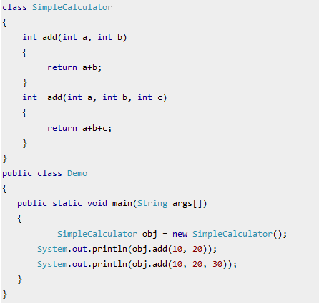
Output:
30
60

Slide 7
class Simple {
int add(int a, String b) {
System.out.println(10);
}
int add(String a, int b) {
System.out.println(“String”);
}
public class Demo {
public static void main(String args[]) {
Simple obj = new Simple ();
obj.add(10,”Hi”));
obj.add(“Hi”,10));
}
}
Output:
10
String

Slide 8
class Simple {
int add(int a) {
System.out.println(10);
}
int add(String a) {
System.out.println(“String”);
}
public class Demo {
public static void main(String args[]) {
Simple obj = new Simple ();
obj.add(10));
obj.add(“Hi”));
}
}
Output:
10
String

Slide 9
Runtime Polymorphism
It is also known as Dynamic Method Dispatch or Dynamic polymorphism
It is handle by JVM
Dynamic polymorphism is a process in which a call to an overridden method is resolved at runtime, that's why it is called runtime polymorphism.

Slide 10
Example of Runtime Polymorphism
In this example we have two classes ABC and XYZ. ABC is a parent class and XYZ is a child class.
The child class is overriding the method myMethod() of parent class.
we have child class object assigned to the parent class reference so in order to determine which method would be called, the type of the object would be determined at run-time.
It is the type of object that determines which version of the method would be called (not the type of reference).

Slide 11
class Test{
int show() {
System.out.println(“10”);
}
public class Demo extends Test {
int show() {
System.out.println(“20”);
}
public static void main(String args[]) {
Test t = new Test ();
t.show();
Demo d = new Demo();
d.show();
}
}
Output:
10
20

Slide 12
class Test{
int show(String a) {
System.out.println(“Test”);
}
public class Demo extends Test {
int show(String a) {
System.out.println(“Demo”);
}
public static void main(String args[]) {
Test t = new Test ();
t.show(“Test”);
Demo d = new Demo();
d.show(“Demo”);
}
}
Output
Test
Demo

Slide 13
class Test{
int show(String a, int b) {
System.out.println(“String and Int”);
}
public class Demo extends Test {
int show(String a, int b) {
System.out.println(“String and Int”);
}
public static void main(String args[]) {
Test t = new Test ();
t.show(“Test”,10);
Demo d = new Demo();
d.show(“Demo”,20);
}
}
Output
String and Int
String and Int

Slide 14
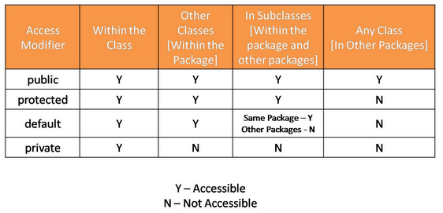
Access Controls/Modifiers in Java
As the name suggests access modifiers in Java helps to restrict the scope of a class, constructor , variable , method or data member. There are four types of access modifiers available in java:
Default – No keyword required
Private
Protected
Public

Slide 15
1. Default Modifier
When no access modifier is specified for a class , method or data member – It is said to be having the default access modifier by default.
The data members, class or methods which are not declared using any access modifiers i.e. having default access modifier are accessible only within the same package.

Slide 16
//Java program to illustrate default modifier
package p1;
//Class Geeks is having Default access modifier
class Hello {
void display() {
System.out.println("Hello World!");
}
}
//Java program to illustrate error while using class from different package with default modifier
package p2;
import p1.*;
//This class is having default access modifier
class HelloNew {
public static void main(String args[]) {
//accessing class Hello from package p1
Hello obj = new Hello();
obj.display();
}
}
Output:
Compile Time Error

Slide 17
2. Private Modifier
The private access modifier is specified using the keyword private. The methods or data members declared as private are accessible only within the class in which they are declared.
Any other class of same package will not be able to access these members.
Top level Classes or interface can not be declared as private because
private means “only visible within the enclosing class”.
protected means “only visible within the enclosing class and any subclasses”
Hence these modifiers in terms of application to classes, they apply only to nested classes and not on top level classes

Slide 18
//Java program to illustrate error while using class from different package with private modifier
package p1;
class A {
private void display() {
System.out.println(“BenchPartner");
}
}
class B {
public static void main(String args[]) {
A obj = new A();
//trying to access private method of another class
obj.display();
}
}
Output:
error: display() has private access in A obj.display();

Slide 19
3. Protected Modifier
The protected access modifier is specified using the keyword protected.
The methods or data members declared as protected are accessible within same package or sub classes in different package.
Example
we will create two packages p1 and p2. Class A in p1 is made public, to access it in p2.
The method display in class A is protected and class B is inherited from class A and this protected method is then accessed by creating an object of class B.

Slide 20
//Java program to illustrate protected modifier
package p1;
public class A {
protected void display() {
System.out.println(“BenchPartner");
}
}
//Java program to illustrate protected modifier
package p2;
import p1.*; //importing all classes in package p1
//Class B is subclass of A
class B extends A {
public static void main(String args[]) {
B obj = new B();
obj.display();
}
}
Output:
BenchPartner

Slide 21
4. Public Modifiers
The public access modifier is specified using the keyword public. The public access modifier has the widest scope among all other access modifiers.
Classes, methods or data members which are declared as public are accessible from every where in the program. There is no restriction on the scope of a public data members.

Slide 22
//Java program to illustrate public modifier
package p1;
public class A {
public void display() {
System.out.println(“BenchPartner");
}
}
package p2;
import p1.*;
class B {
public static void main(String args[]) {
A obj = new A;
obj.display();
}
}
Output:
BenchPartner

Slide 23
Nested Classes in Java
Simply put, Java allows us to define classes inside other classes.
Nested classes enable us to logically group classes that are only used in one place, write more readable and maintainable code and increase encapsulation.
types of nested classes available in the language:
Static nested classes
Non-static nested classes
Local classes
Anonymous classes

Slide 24
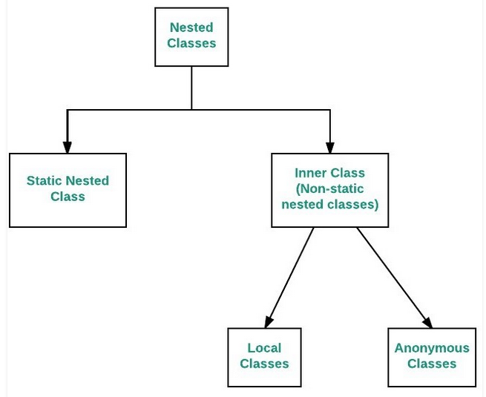
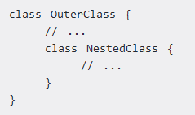
Syntax

Slide 25
Static nested classes
As with static members, these belong to their enclosing class, and not to an instance of the class
They can have all types of access modifiers in their declaration
They only have access to static members in the enclosing class
They can define both static and non-static members
They are accessed using the enclosing class name.
OuterClass.StaticNestedClass
For example, to create an object for the static nested class, use this syntax:
OuterClass.StaticNestedClass nestedObject = new OuterClass.StaticNestedClass();

Slide 26
public class Enclosing {
private static int x = 1;
public static class StaticNested {
private void run() {
// method implementation
}
}
public void test() {
Enclosing.StaticNested nested = new Enclosing.StaticNested();
nested.run();
}
}

Slide 27
Non-Static Nested Classes (Inner Class)
They are also called inner classes
They can have all types of access modifiers in their declaration
Just like instance variables and methods, inner classes are associated with an instance of the enclosing class
They have access to all members of the enclosing class, regardless of whether they are static or non-static
They can only define non-static members

Slide 28
To instantiate an inner class, we must first instantiate its enclosing class.
Let's see how we can do that:
Outer outer = new Outer();
Outer.Inner inner = outer.new Inner();

Slide 29
Local Classes
Local classes are a special type of inner classes – in which the class is defined inside a method or scope block. They cannot have access modifiers in their declaration
They have access to both static and non-static members in the enclosing context
They can only define instance members

Slide 30
public class NewEnclosing {
void run() {
class Local {
void run() {
// method implementation
}
}
Local local = new Local();
local.run();
}
public void test() {
NewEnclosing newEnclosing = new NewEnclosing();
newEnclosing.run();
}
}

Slide 31
Anonymous Classes
Anonymous classes can be used to define an implementation of an interface or an abstract class without having to create a reusable implementation.
They cannot have access modifiers in their declaration
They have access to both static and non-static members in the enclosing context
They can only define instance members
They're the only type of nested classes that cannot define constructors or extend/implement other classes or interfaces

Slide 32
// To define an anonymous class, let's first define a simple abstract class
abstract class SimpleAbstractClass {
abstract void run();
}
// how we can define an anonymous class
public class AnonymousInnerTest {
public void whenRunAnonymousClass_thenCorrect() {
SimpleAbstractClass sbc = new SimpleAbstractClass() {
void run() {
// method implementation
}
}
sbc.run();
}
}

Slide 33
Recursion in Java
Recursion in java is a process in which a method calls itself continuously. A method in java that calls itself is called recursive method.
There are two main requirements of a recursive function:
A Stop Condition – the function returns a value when a certain condition is satisfied, without a further recursive call
The Recursive Call – the function calls itself with an input which is a step closer to the stop condition
Each recursive call will add a new frame to the stack memory of the JVM. So, if we don't pay attention to how deep our recursive call can dive, an out of memory exception may occur.
Syntax:
returntype methodname(){
//code to be executed
methodname(); //calling same method
}

Slide 34
Java Recursion Example: Infinite times
public class InfiniteTimes {
static void p(){
System.out.println("hello");
p();
}
public static void main(String[] args) {
p();
}
}
Output:
hello
hello
...
java.lang.StackOverflowError

Slide 35
Java Recursion Example: Infinite times
public class InfiniteTimes {
static int count=0;
static void p(){
count++;
if(count<=5){
System.out.println(“Hello "+count);
p();
}
}
public static void main(String[] args) {
p();
}
}
Output:
Hello 1
Hello 2
Hello 3
Hello 4
Hello 5

Slide 36
Recursion Types
Recursion are of two types based on when the recursive method call is made.
Tail Recursion: A recursive method is tail recursive when recursive method call is the last statement executed inside the method (usually along with a return statement).
Head Recursion : Any recursion which is not tail recursion, can be referred as head recursion.

Slide 37
Example of Head Recursion
Example of Tail Recursion
public int sum(int n) {
if (n >= 1) {
return sum(n - 1)+n;
}
return n;
}
public int tailSum(int currentSum, int n) {
if (n <= 1) {
return currentSum + n;
}
return tailSum(currentSum + n, n - 1);
}

