Slide 1
Chapter 4
Inheritance and Packaging

Slide 2
Inheritance
Inheritance in Java is a mechanism in which one object acquires all the properties and behaviours of a parent object. It is an important part of OOPs (Object Oriented programming system).
Use to inherit attributes and methods from one class to another.
Use for Method Overriding (so runtime polymorphism can be achieved).
Use For Code Reusability.
Inheritance represents the IS-A relationship which is also known as a parent-child relationship.

Slide 3
Terms used in Inheritance
Class: A class is a group of objects which have common properties. It is a template or blueprint from which objects are created.
Sub Class/Child Class: Subclass is a class which inherits the other class. It is also called a derived class, extended class, or child class.
Super Class/Parent Class: Superclass is the class from where a subclass inherits the features. It is also called a base class or a parent class.
Reusability: As the name specifies, reusability is a mechanism which facilitates you to reuse the fields and methods of the existing class when you create a new class. You can use the same fields and methods already defined in the previous class.

Slide 4
Syntax of Java Inheritance
class Animal{
// eat() method
// sleep() method
}
class Dog extends Animal{
// bark() method
}
In Java, we use the extends keyword to inherit from a class. Here, we have inherited the Dog class from the Animal class.
The Animal is the superclass (parent class or base class), and the Dog is a subclass (child class or derived class).
The subclass inherits the fields and methods of the superclass.

Slide 5
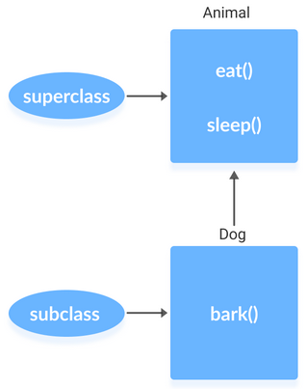
subclass (child) - the class that inherits from another class
superclass (parent) - the class being inherited from

Slide 6
is-a relationship
Inheritance is an is-a relationship. We use inheritance only if an is-a relationship is present between the two classes.
Here are some examples:
A car is a vehicle.
Orange is a fruit.
A surgeon is a doctor.
A dog is an animal.

Slide 7
Example 1: Inheritance
class Animal {
public void eat() {
System.out.println("I can eat");
}
public void sleep() {
System.out.println("I can sleep");
}
}
class Dog extends Animal {
public void bark() {
System.out.println("I can bark");
}
}
class Main {
public static void main(String[] args) {
Dog dog1 = new Dog();
dog1.eat();
dog1.sleep();
dog1.bark();
}
}
Output
I can eat
I can sleep
I can bark

Slide 8
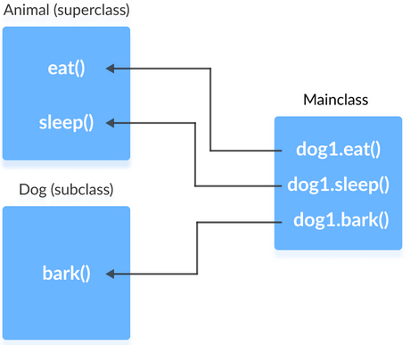
Here, we have inherited a subclass Dog from superclass Animal. The Dog class inherits the methods eat() and sleep() from the Animal class.
Hence, objects of the Dog class can access the members of both the Dog class and the Animal class.

Slide 9
The super keyword
The super keyword in Java is a reference variable which is used to refer immediate parent class object.
Usage of super Keyword
super can be used to refer immediate parent class instance variable.
super can be used to invoke immediate parent class method.
super() can be used to invoke immediate parent class constructor.

Slide 10
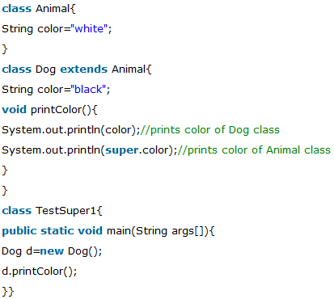
1. super can be used to refer immediate parent class instance variable.
We can use super keyword to access the data member or field of parent class. It is used if parent class and child class have same fields.
Output:
Black
white

Slide 11
In the above example, Animal and Dog both classes have a common property colour. If we print colour property, it will print the color of current class by default. To access the parent property, we need to use super keyword.

Slide 12
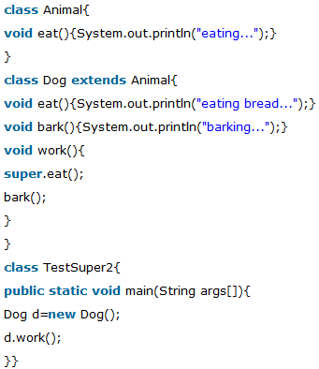
2. super can be used to invoke parent class method
The super keyword can also be used to invoke parent class method. It should be used if subclass contains the same method as parent class. In other words, it is used if method is overridden.
Output:
eating...
barking...

Slide 13
In the above example Animal and Dog both classes have eat() method if we call eat() method from Dog class, it will call the eat() method of Dog class by default because priority is given to local.
To call the parent class method, we need to use super keyword.

Slide 14
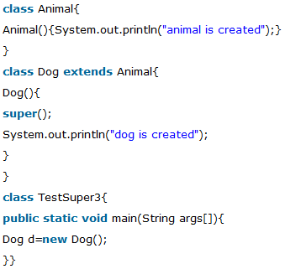
3. super is used to invoke parent class constructor.
The super keyword can also be used to invoke the parent class constructor.
Output:
animal is created
dog is created

Slide 15
super example: real use
Here, Emp class inherits Person class so all the properties of Person will be inherited to Emp by default. To initialize all the property, we are using parent class constructor from child class. In such way, we are reusing the parent class constructor.

Slide 16
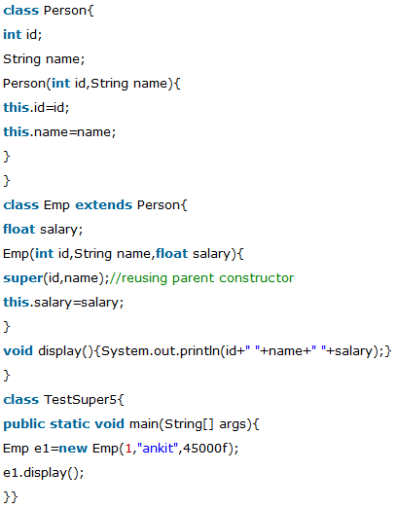
Output:
1 ankit 45000

Slide 17
Object class in Java
Object class is present in java.lang package.
Every class in Java is directly or indirectly derived from the Object class.
If a Class does not extend any other class then it is direct child class of Object and if extends other class then it is an indirectly derived.
Therefore the Object class methods are available to all Java classes.

Slide 18
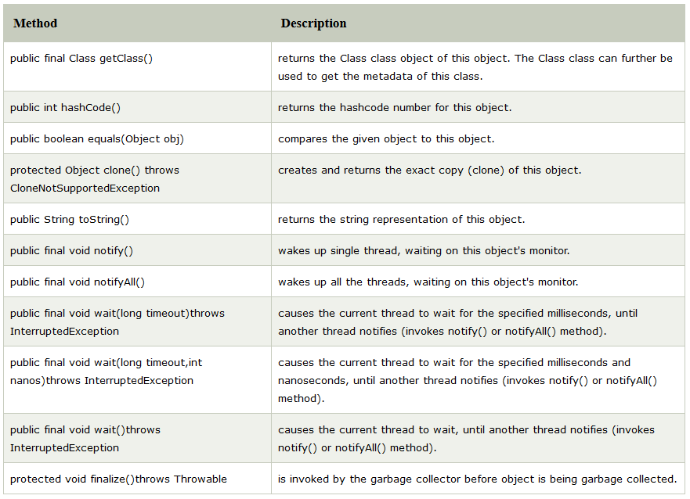
Methods of Object class

Slide 19
Abstract class in Java
A class which is declared as abstract is known as an abstract class. It can have abstract and non-abstract methods. It needs to be extended and its method implemented.
Rules for Abstract Class
An abstract class must be declared with an abstract keyword.
It can have abstract and non-abstract methods.
It cannot be instantiated.
It can have constructors and static methods also.
It can have final methods which will force the subclass not to change the body of the method.

Slide 20
Example of Abstract class
In this example, Shape is the abstract class, and its implementation is provided by the Rectangle and Circle classes.
Mostly, we don't know about the implementation class (which is hidden to the end user), and an object of the implementation class is provided by the factory method.
A factory method is a method that returns the instance of the class. We will learn about the factory method later.
In this example, if you create the instance of Rectangle class, draw() method of Rectangle class will be invoked.

Slide 21
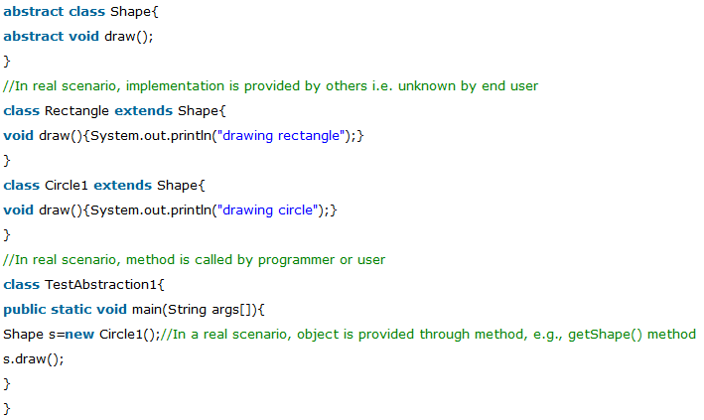
Output
Drawing circle

Slide 22
Final Classes in Java
A class declared as final cannot be extended while a method declared as final cannot be overridden in its subclasses.
A method or a class is declared to be final using the final keyword.
a final class cannot be extended, it can extend other classes.
In simpler words, a final class can be a sub class but not a super class.
You cannot extend a final class. If you try it gives you a compile time error.

Slide 23
Example of Final classes
final class Super {
private int data = 30;
}
public class Sub extends Super{
public static void main(String args[]){
}
Output:
Exception in thread "main" java.lang.Error: Unresolved compilation problem: at newJavaExamples.Sub.main(Sub.java:9)

Slide 24
Java Packages
A Package is a collection of related classes.
It helps organize your classes into a folder structure and make it easy to locate and use them.
More importantly, it helps improve re-usability.
Each package in Java has its unique name and organizes its classes and interfaces into a separate namespace, or name group.
Syntax:
package nameOfPackage;

Slide 25
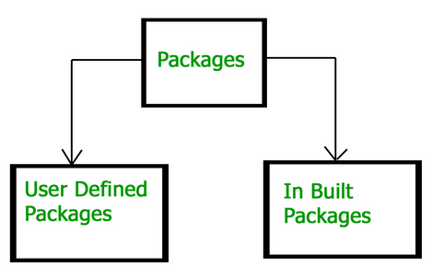
Types of Packages
There are two types of packages in Java.
Built-in packages
User-defined packages

Slide 26
1. Built-in Packages
These packages consist of a large number of classes which are a part of Java API. Some of the commonly used built-in packages are:
1) java.lang: Contains language support classes(e.g classed which defines primitive data types, math operations). This package is automatically imported.
2) java.io: Contains classed for supporting input / output operations.
3) java.util: Contains utility classes which implement data structures like Linked List, Dictionary and support ; for Date / Time operations.
4) java.applet: Contains classes for creating Applets.
5) java.awt: Contain classes for implementing the components for graphical user interfaces (like button , ;menus etc).
6) java.net: Contain classes for supporting networking operations.

Slide 27
2. User-defined packages
These are the packages that are defined by the user.
First we create a directory myPackage (name should be same as the name of the package).
Then create the MyClass inside the directory with the first statement being the package names.

Slide 28
Now we can use the MyClass class in our program
// Name of the package must be same as the directory
// under which this file is saved
package myPackage;
} public class MyClass {
public void getNames(String s) {
System.out.println(s);
}
// import 'MyClass' class from 'names' myPackage
import myPackage.MyClass;
public class PrintName {
public static void main(String args[]) {
// Initializing the String variable with a value
String name = “my name";
// Creating an instance of class MyClass in
// the package.
MyClass obj = new MyClass();
obj.getNames(name);
}
}
MyClass.java must be saved inside the myPackage directory since it is a part of the package.

Slide 29
How to access package from another package?
There are three ways to access the package from outside the package.
import package.*;
import package.classname;
fully qualified name.

Slide 30
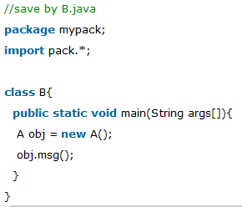
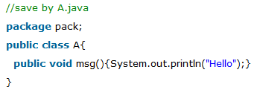
1) Using packagename.*
If you use package.* then all the classes and interfaces of this package will be accessible but not subpackages.
The import keyword is used to make the classes and interface of another package accessible to the current package.
Output
Hello

Slide 31
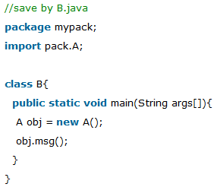
2. Using packagename.classname
If you import package.classname then only declared class of this package will be accessible.
Output
Hello

Slide 32
3. Using fully qualified name
If you use fully qualified name then only declared class of this package will be accessible.
Now there is no need to import. But you need to use fully qualified name every time when you are accessing the class or interface.
It is generally used when two packages have same class name e.g. java.util and java.sql packages contain Date class.

Slide 33
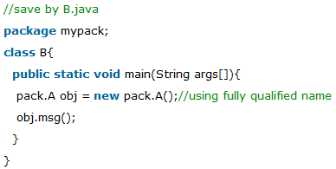
Output
Hello

Slide 34
Sub package in java
Package inside the package is called the subpackage. It should be created to categorize the package further.
Example:
package com.sub.core;
class Simple{
public static void main(String args[]){
System.out.println("Hello subpackage");
}
}
To Compile: javac -d . Simple.java
To Run: java com.sub.core.Simple
Output:
Hello subpackage

Slide 35
What is an Interface?
An interface is just like Java Class, but it only has static constants and abstract method.
Java uses Interface to implement multiple inheritance.
A Java class can implement multiple Java Interfaces.
All methods in an interface are implicitly public and abstract.
Syntax for Declaring Interface
interface {
//methods
}

Slide 36
Why use Java interface?
There are mainly three reasons to use interface. They are given below.
It is used to achieve abstraction.
By interface, we can support the functionality of multiple inheritance.
It can be used to achieve loose coupling.

Slide 37
How to declare an interface?
An interface is declared by using the interface keyword.
It provides total abstraction; means all the methods in an interface are declared with the empty body, and all the fields are public, static and final by default.
A class that implements an interface must implement all the methods declared in the interface.
interface <interface_name>{
// declare constant fields
// declare methods that abstract
// by default.
}

Slide 38
Implementing Interfaces
When a class implements an interface, you can think of the class as signing a contract, agreeing to perform the specific behaviours of the interface.
If a class does not perform all the behaviours of the interface, the class must declare itself as abstract.
A class uses the implements keyword to implement an interface.
The implements keyword appears in the class declaration following the extends portion of the declaration.

Slide 39
Example of Interfaces
public class Mammal implements Animal {
public void eat() {
System.out.println("Mammal eats");
}
public void travel() {
System.out.println("Mammal travels");
}
public int noOfLegs() {
return 0;
}
public static void main(String args[]) {
Mammal m = new Mammal();
m.eat();
m.travel();
}
}
interface Animal {
public void eat();
public void travel();
}
Output
Mammal eats
Mammal travels

Slide 40
Extending Interfaces
An interface can extend another interface in the same way that a class can extend another class.
The extends keyword is used to extend an interface, and the child interface inherits the methods of the parent interface.
The following Sports interface is extended by Hockey and Football interfaces.

Slide 41
// Filename: Sports.java
public interface Sports {
public void setHomeTeam(String name);
public void setVisitingTeam(String name);
}
// Filename: Football.java
public interface Football extends Sports {
public void homeTeamScored(int points);
public void visitingTeamScored(int points);
public void endOfQuarter(int quarter);
}
// Filename: Hockey.java
public interface Hockey extends Sports {
public void homeGoalScored();
public void visitingGoalScored();
public void endOfPeriod(int period);
public void overtimePeriod(int ot);
}
The Hockey interface has four methods, but it inherits two from Sports; thus, a class that implements Hockey needs to implement all six methods.
Similarly, a class that implements Football needs to define the three methods from Football and the two methods from Sports.

Slide 42
Difference between Class and Interface
Class | Interface
In class, you can instantiate variable and create an object. | In an interface, you can't instantiate variable and create an object.
Class can contain concrete(with implementation) methods | The interface cannot contain concrete(with implementation) methods
The access specifiers used with classes are private, protected and public. | In Interface only one specifier is used- Public.

Slide 43
Extending Multiple Interfaces
A Java class can only extend one parent class. Multiple inheritance is not allowed.
Interfaces are not classes, however, and an interface can extend more than one parent interface.
The extends keyword is used once, and the parent interfaces are declared in a comma-separated list.
For example, if the Hockey interface extended both Sports and Event, it would be declared as
public interface Hockey extends Sports, Event

