Slide 1
Chapter 5
Handling Error/Exceptions

Slide 2
What is an Exception?
An Exception is an unwanted event that interrupts the normal flow of the program.
When an exception occurs program execution gets terminated.
In such cases we get a system generated error message.
The good thing about exceptions is that they can be handled in Java.
By handling the exceptions we can provide a meaningful message to the user about the issue rather than a system generated message, which may not be understandable to a user.

Slide 3
Why an Exception Occurs?
There can be several reasons that can cause a program to throw exception.
For example:
Opening a non-existing file in your program,
Network connection problem,
bad input data provided by user etc.

Slide 4
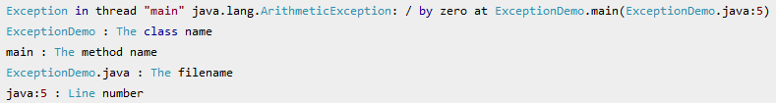
Exception Handling
If an exception occurs, which has not been handled by programmer then program execution gets terminated and a system generated error message is shown to the user.
An exception generated by the system is given below

Slide 5
This message is not user friendly so a user will not be able to understand what went wrong.
In order to let them know the reason in simple language, we handle exceptions.
We handle such conditions and then prints a user friendly warning message to user
which lets them correct the error as most of the time exception occurs due to bad data provided by user.

Slide 6
Advantage of Exception Handling
Separating Error-Handling Code from "Regular" Code
Propagating Errors Up the Call Stack
Grouping and Differentiating Error Types
Exception handling ensures that the flow of the program doesn’t break when an exception occurs.
Meaningful Error Reporting:
Propagation of Errors:
Easy Identification of Program Code and Error-Handling Code:
Provision to Complete Program Execution:

Slide 7
Difference between error and exception
Errors: An Error indicates serious problem that a reasonable application should not try to catch.
Exceptions: indicates conditions that a reasonable application might try to catch. A programmer can handle such conditions and take necessary corrective actions.
Few examples:
NullPointerException – When you try to use a reference that points to null.
ArithmeticException – When bad data is provided by user, for example, when you try to divide a number by zero this exception occurs because dividing a number by zero is undefined.
ArrayIndexOutOfBoundsException – When you try to access the elements of an array out of its bounds, for example array size is 5 (which means it has five elements) and you are trying to access the 10th element.

Slide 8
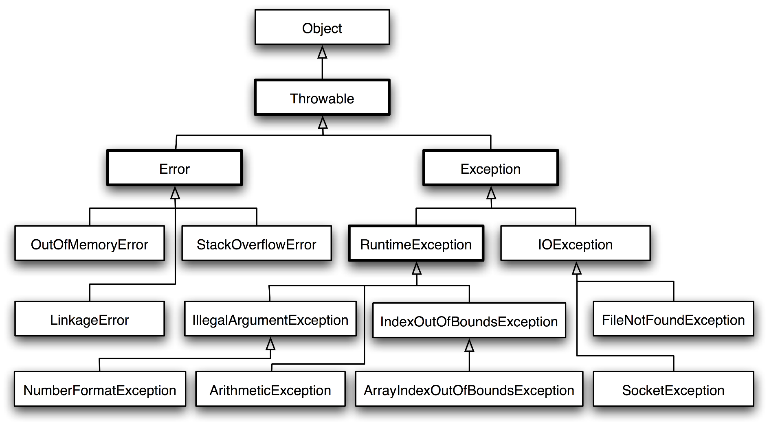
Types of Exceptions

Slide 9
There are four types of exceptions in Java:
Checked exceptions
Unchecked exceptions
User-Defined Exceptions
Error

Slide 10
1. Checked Exceptions
All exceptions other than Runtime Exceptions are known as Checked exceptions as the compiler checks them during compilation to see whether the programmer has handled them or not.
If these exceptions are not handled/declared in the program, you will get compilation error.
For example, SQLException, IOException, ClassNotFoundException etc.

Slide 11
2. Unchecked Exceptions
Runtime Exceptions are also known as Unchecked Exceptions.
These exceptions are not checked at compile-time so compiler does not check whether the programmer has handled them or not.
it’s the responsibility of the programmer to handle these exceptions and provide a safe exit.
For example, ArithmeticException, NullPointerException, ArrayIndexOutOfBoundsException etc.

Slide 12
3. User-Defined Exceptions
Sometimes, the built-in exceptions in Java are not able to describe a certain situation.
In such cases, user can also create exceptions which are called ‘user-defined Exceptions’.
Following steps are followed for the creation of user-defined Exception.

Slide 13
The user should create an exception class as a subclass of Exception class. Since all the exceptions are subclasses of Exception class, the user should also make his class a subclass of it. This is done as:
class MyException extends Exception
We can write a default constructor in his own exception class.
MyException(){}
We can also create a parameterized constructor with a string as a parameter. We can use this to store exception details. We can call super class(Exception) constructor from this and send the string there.
MyException(String str) {
super(str);
}

Slide 14
To raise exception of user-defined type, we need to create an object to his exception class and throw it using throw clause, as:
MyException me = new MyException(“Exception details”); throw me;

Slide 15
3. Error
Error is irrecoverable
For example: OutOfMemoryError, VirtualMachineError, AssertionError etc.

Slide 16
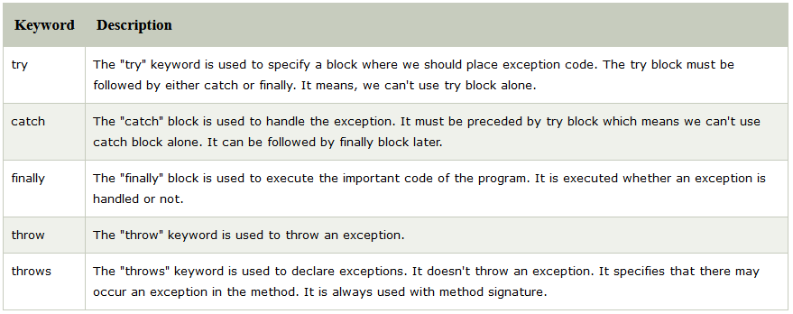
Java Exception Keywords
There are 5 keywords which are used in handling exceptions in Java

Slide 17
Catching Exception (Try and Catch)
Try Block
The try block contains set of statements where an exception can occur.
A try block is always followed by a catch block, which handles the exception that occurs in associated try block.
A try block must be followed by catch blocks or finally block or both.
Syntax of try block
try{
//statements that may cause an exception
}
While writing a program, if you think that certain statements in a program can throw a exception, enclosed them in try block and handle that exception

Slide 18
Catch Block
A catch block is where you handle the exceptions, this block must follow the try block.
A single try block can have several catch blocks associated with it.
You can catch different exceptions in different catch blocks.
When an exception occurs in try block, the corresponding catch block that handles that particular exception executes.
For example if an arithmetic exception occurs in try block then the statements enclosed in catch block for arithmetic exception executes.
Syntax of try catch
try {
//statements that may cause an exception
} catch (exception(type) e(object))‏ {
//error handling code
}

Slide 19
Example: try catch block
If an exception occurs in try block then the control of execution is passed to the corresponding catch block.
A single try block can have multiple catch blocks associated with it, you should place the catch blocks in such a way that the generic exception handler catch block is at the last(see in the example below).
The generic exception handler can handle all the exceptions but you should place is at the end, if you place it at the before all the catch blocks then it will display the generic message.
You always want to give the user a meaningful message for each type of exception rather then a generic message.

Slide 20
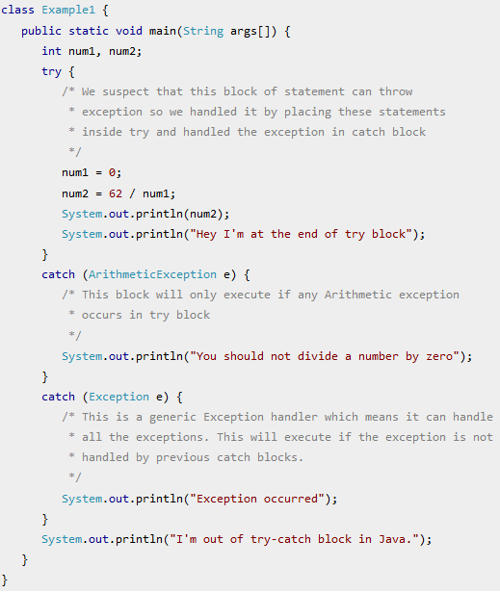
Output:
You should not divide a number by zero
I'm out of try-catch block in Java.

Slide 21
Multiple catch blocks in Java
If you are wondering why we need other catch handlers when we have a generic that can handle all.
This is because in generic exception handler you can display a message but you are not sure for which type of exception.
it may trigger so it will display the same message for all the exceptions and user may not be able to understand which exception occurred.
That's the reason you should place is at the end of all the specific exception catch blocks

Slide 22
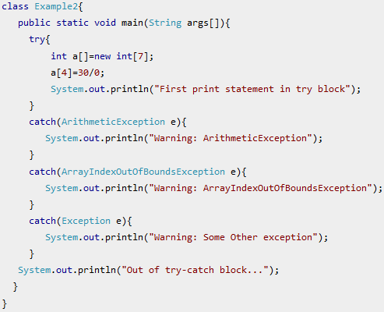
Output:
Warning: ArithmeticException Out of try-catch block...

Slide 23
Nested try block
The try block within a try block is known as nested try block in java.
Sometimes a situation may arise where a part of a block may cause one error and the entire block itself may cause another error.
In such cases, exception handlers have to be nested.

Slide 24
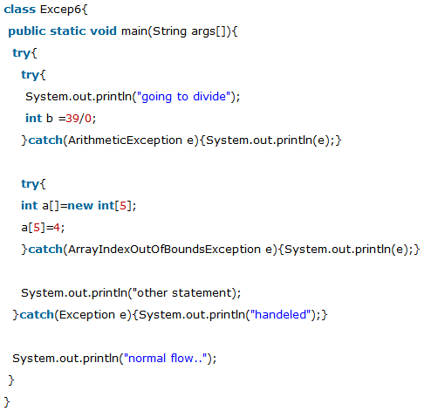
nested try example

Slide 25
How to Throw Exception
throw keyword is used to explicitly throw an exception
We can throw either checked or unchecked exception in java by throw keyword
It is mainly used to throw custom exception.
In Java we have already defined exception classes such as ArithmeticException, NullPointerException, ArrayIndexOutOfBounds exception etc.
For example when we divide a number by zero, this triggers ArithmeticException,
when we try to access the array element out of its bounds then we get ArrayIndexOutOfBoundsException.

Slide 26
define our own set of conditions or rules and throw an exception explicitly using throw keyword.
For example, we can throw ArithmeticException when we divide number by 5, or any other numbers,
what we need to do is just set the condition and throw any exception using throw keyword.
Throw keyword can also be used for throwing custom exceptions
Syntax of throw keyword:
throw new exception_class("error message");

Slide 27
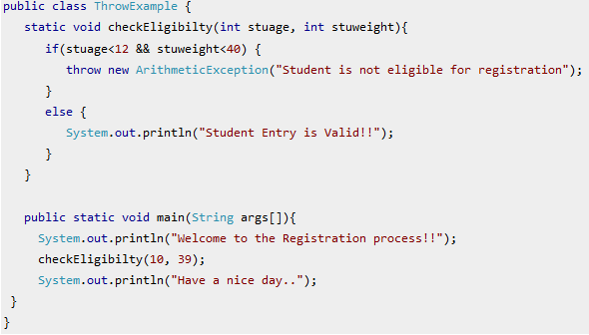
Output:
Welcome to the Registration process!!Exception in thread "main“
java.lang.ArithmeticException: Student is not eligible for registration
ThrowExample.checkEligibilty(ThrowExample.java:9)
ThrowExample.main(ThrowExample.java:18)

Slide 28

Java throws keyword
throws keyword is used to declare an exception.
It gives an information to the programmer that there may occur an exception so it is better for the programmer to provide the exception handling code so that normal flow can be maintained.
Exception Handling is mainly used to handle the checked exceptions. If there occurs any unchecked exception such as NullPointerException, it is programmers fault that he is not performing check up before the code being used.
Syntax of java throws

Slide 29
Which exception should be declared by throws
checked exception only, because:
unchecked Exception: under your control so correct your code.
error: beyond your control e.g. you are unable to do anything if there occurs VirtualMachineError or StackOverflowError.

Slide 30
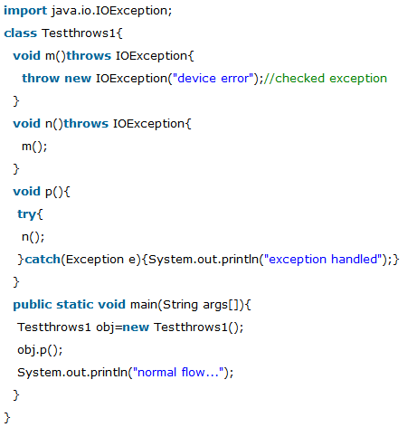
throws example
Output:
exception handled
normal flow...

Slide 31
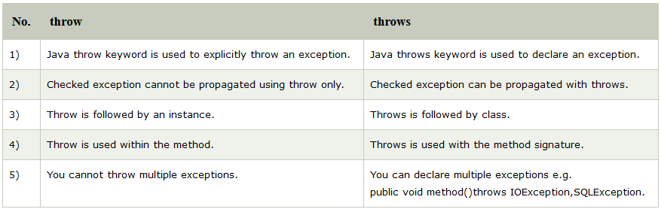
throw and throws
There are many differences between throw and throws keywords.

Slide 32



Java throw example
Java throws example
Java throw and throws example

Slide 33
Java finally block (finally keyword)
Java finally block is a block that is used to execute important code such as closing connection, stream etc.
finally block is always executed whether exception is handled or not.
It is follows try or catch block.
Finally block in java can be used to put "cleanup" code such as closing a file, closing connection etc.
If you don't handle exception, before terminating the program, JVM executes finally block(if any)

Slide 34
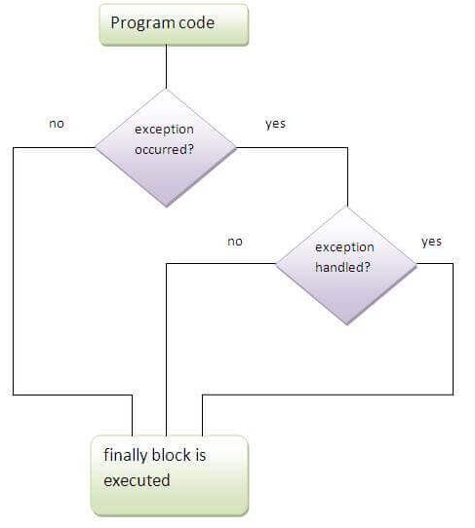
Execution of finally block

Slide 35
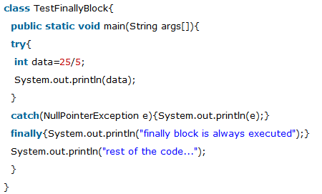
Usage of Java finally – Case 1
finally example where exception doesn't occur.
Output:
5 finally block is always executed
rest of the code...

Slide 36
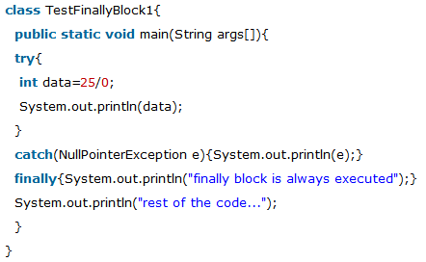
Usage of Java finally – Case 2
finally example where exception occurs and not handled.
Output:
finally block is always executed
Exception in thread main java.lang.ArithmeticException:/ by zero

Slide 37
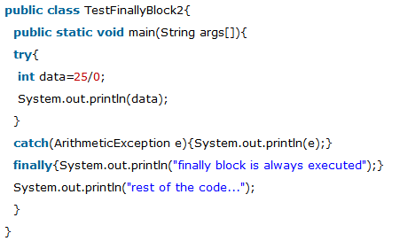
Usage of Java finally – Case 3
finally example where exception occurs and handled.
Output:
Exception in thread main java.lang.ArithmeticException:/ by zero
finally block is always executed
rest of the code...

