Slide 1
Chapter 6
Handling String

Slide 2
Strings in Java
Strings in Java are Objects that are backed internally by a char array.
It is a sequence of characters
Since arrays are immutable(cannot grow), Strings are immutable as well.
to a StWhenever a change ring is made, an entirely new String is created.
Syntax
<String_Type> <string_variable> = “<sequence_of_string>”;

Slide 3
Creating Strings
The most direct way to create a string is to write
String greeting = "Hello world!";
Whenever it encounters a string literal in your code, the compiler creates a String object with its value in this case, "Hello world!'.
As with any other object, you can create String objects by using the new keyword and a constructor.
The String class has 11 constructors that allow you to provide the initial value of the string using different sources, such as an array of characters.

Slide 4
Example: String Creation
public class StringCreate {
public static void main(String args[]) {
char[] helloArray = { 'h', 'e', 'l', 'l', 'o', '.' };
String helloString = new String(helloArray);
System.out.println( helloString );
}
}
Output
hello.
Note − When it is created a String object cannot be changed. If there is a necessity to make a lot of modifications to Strings of characters, then you should use String Buffer and String Builder Classes.

Slide 5
String Length
Methods used to obtain information about an object are known as accessor methods.
One accessor method that you can use with strings is the length() method, which returns the number of characters contained in the string object.
The following program is an example of length(), method String class.

Slide 6
Example: String Length
public class StringLength {
public static void main(String args[]) {
String str = “Tomorrow is Holiday";
int len =str.length();
System.out.println( "String Length is : " + len );
}
}
Output
String Length is : 17

Slide 7
String Concatenation
String concatenation forms a new string that is the combination of multiple strings.
There are two ways to concat string in java:
By using + operator
By using concat() method

Slide 8
1. By using + operator
Using the + operator is the most common way to concatenate two strings in Java.
You can provide either a variable, a number, or a String literal (which is always surrounded by double quotes).
To combine the strings “I’m a” and “student”, for example, write:
"I’m a" + " student"
Combining Multiple Strings
Any number of + operands can be strung together, for instance:
"I’m a" + " student" + "! And so are you."

Slide 9
Example: By using + operator
class StringConcatenation {
public static void main(String args[]){
String s="Sachin"+" Tendulkar";
System.out.println(s); //Sachin Tendulkar
}
}

Slide 10
2. By using the Concat() Method
The String class has a method concat() that performs the same operation.
This method acts on the first string and then takes the string to combine as a parameter:
The String concat() method concatenates the specified string to the end of current string
Syntax:
public String concat(String another)

Slide 11
Example: Using the Concat() Method
class StringConcatenation{
public static void main(String args[]){
String s1="Sachin ";
String s2="Tendulkar";
String s3=s1.concat(s2);
System.out.println(s3); //Sachin Tendulkar
}
}

Slide 12
Java String Compare
We can compare string in java on the basis of content and reference.
It is used in authentication (by equals() method), sorting (by compareTo() method), reference matching (by == operator) etc.
There are three ways to compare string in java:
By equals() method
By = = operator
By compareTo() method

Slide 13
1. String compare by equals() method
The String equals() method compares the original content of the string. It compares values of string for equality. String class provides two methods:
public boolean equals(Object another) compares this string to the specified object.
public boolean equalsIgnoreCase(String another) compares this String to another string, ignoring case.

Slide 14
Example: public boolean equals(Object another)
class StringComparison{
public static void main(String args[]){
String s1="Sachin";
String s2="Sachin";
String s3=new String("Sachin");
String s4="Saurav";
System.out.println(s1.equals(s2));//true
System.out.println(s1.equals(s3));//true
System.out.println(s1.equals(s4));//false
}
}

Slide 15
Example: public boolean equalsIgnoreCase(String another)
class StringComparison{
public static void main(String args[]){
String s1="Sachin";
String s2="SACHIN";
System.out.println(s1.equals(s2));//false
System.out.println(s1.equalsIgnoreCase(s2));//true
}
}

Slide 16
2. String compare by == operator
The = = operator compares references not values.
class StringComparison{
public static void main(String args[]){
String s1="Sachin";
String s2="Sachin";
String s3=new String("Sachin");
System.out.println(s1==s2);
//true (because both refer to same instance)
System.out.println(s1==s3);
//false (because s3 refers to instance created in nonpool)
}
}

Slide 17
3. String compare by compareTo() method
The String compareTo() method compares values lexicographically and returns an integer value that describes if first string is less than, equal to or greater than second string.
Suppose s1 and s2 are two string variables. If:
s1 == s2 :0
s1 > s2 :positive value
s1 < s2 :negative value

Slide 18
class StringComparison{
public static void main(String args[]){
String s1="Sachin";
String s2="Sachin";
String s3="Ratan";
System.out.println(s1.compareTo(s2));
//0
System.out.println(s1.compareTo(s3));
//1(because s1>s3)
System.out.println(s3.compareTo(s1));
//-1(because s3 < s1 )
}
}

Slide 19
Java String Changing Case
Converting your Java strings of text to upper or lower case is fairly straightforward: just use the inbuilt methods toUpperCase and toLowerCase.
Methods are:
toUpperCase()
toLowerCase()

Slide 20
1. toLowerCase() method
This Java string method converts every character of the particular string into the lower case by using the rules of the default locale.
This method is locale sensitive. Therefore it can show unexpected results if used for strings which are intended to be interpreted separately.
Syntax
public String toLowerCase()

Slide 21
public class ToLowerCase {
public static void main(String args[]) {
String S1 = new String("UPPERCASE CONVERTED TO LOWERCASE");
//Convert to LowerCase
System.out.println(S1.toLowerCase());
}
}
Output:
uppercase converted to lowercase

Slide 22
2. toUppercase () method
The toUppercase() method is used to convert all the characters in a given string to upper case.
Syntax
Public string toUpperCase()
Example:
public class ToUpperCase {
public static void main(String args[]) {
String S1 = new String("lowercase converted to uppercase"); //Convert to UpperCase
System.out.println(S1.toUpperCase());
}
}
Output: LOWERCASE CONVERTED TO UPPERCASE

Slide 23
Character Extraction
There are several ways by which characters can be extracted from String class object.
String is treated as an object in Java so we can’t directly access the characters that comprise a string.
For doing this String class provides various predefined methods.
charAt()
getChars()
getBytes()
toCharArray()

Slide 24
1. charAt()
charAt() method is used to extract a single character at an index. It has following syntax.
Syntax: char charAt(int index)
class Temp{
public static void main(String...s){
String str="Hello";
char ch=str.charAt(2);
System.out.println(ch);
}
}
Output l
In above example ch will contain character l. We must take care that the index should not be negative and should not exceed string length.

Slide 25
2. getChars()
It is used to extract more than one character. getChars() has following syntax.
Syntax: void getChars(int stringStart, int stringEnd, char arr[], int arrStart)
Here stringStart and stringEnd is the starting and ending index of the substring.
arr is the character array that will contain the substring.
It will contain the characters starting from stringStart to stringEnd-1.
arrStart is the index inside arr at which substring will be copied.
The arr array should be large enough to store the substring.

Slide 26
class Temp{
public static void main(String...s){
String str="Hello World";
char ch[]=new str.char[4];
str.getChars(1,5,ch,0);
System.out.println(ch);
}
}
Output ello

Slide 27
3. getBytes()
getBytes() extract characters from String object and then convert the characters in a byte array. It has following syntax.
Syntax: byte [] getBytes()
Example
String str="Hello";
byte b[]=str.getBytes();

Slide 28
4. toCharArray()
It is an alternative of getChars() method.
toCharArray() convert all the characters in a String object into an array of characters.
It is the best and easiest way to convert string to character array. It has following syntax.
Syntax: char [] toCharArray()

Slide 29
class Temp{
public static void main(String...s){
String str="Hello World";
char ch[]=str.toCharArray();
System.out.println(ch);
}
}
Output Hello World

Slide 30
Searching in a String
The String class provides 2 methods for searching a string. They are
indexOf(): Searches for the first occurrence of a character or substring.
lastIndexOf(): Searches for the last occurrence of a character or substring.
These methods return the starting index of character or a substring on a successful search else they return -1.

Slide 31
public class SearchStringEmp{
public static void main(String[] args) {
String strOrig = "Hello readers";
int intIndex = strOrig.indexOf("Hello");
if(intIndex == - 1) {
System.out.println("Hello not found");
}else {
System.out.println("Found Hello at index " + intIndex);
}
}
}
Output
Found Hello at index 0

Slide 32
This example shows how we can search a word within a String object
public class HelloWorld {
public static void main(String[] args) {
String text = "The cat is on the table";
System.out.print(text.contains("the"));
}
}
Output
true

Slide 33
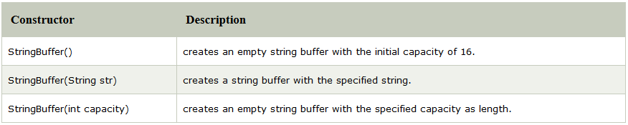
Java String Buffer / Modifying String
Java StringBuffer class is used to create mutable (modifiable) string.
The StringBuffer class in java is same as String class except it is mutable i.e. it can be changed.
Constructors of StringBuffer class

Slide 34
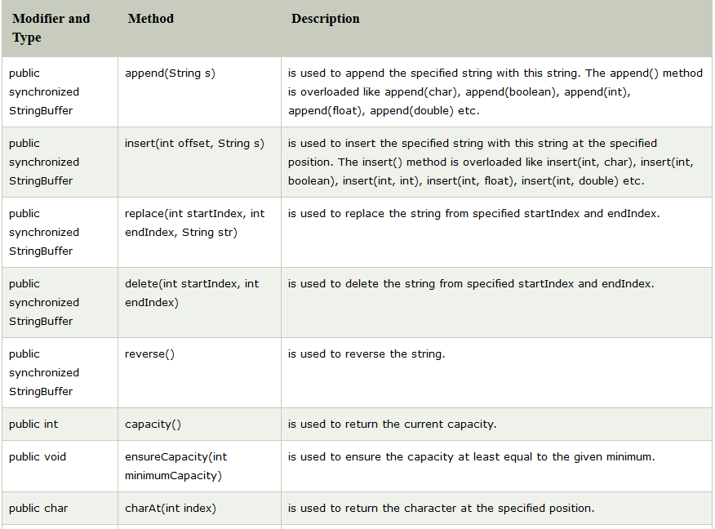
methods of StringBuffer class

Slide 35
1. StringBuffer append() method
The append() method concatenates the given argument with this string.
class StringBufferExample{
public static void main(String args[]){
StringBuffer sb=new StringBuffer("Hello ");
sb.append("Java"); //now original string is changed
System.out.println(sb); //prints Hello Java
}
}

Slide 36
2. StringBuffer insert() method
The insert() method inserts the given string with this string at the given position.
class StringBufferExample{
public static void main(String args[]){
StringBuffer sb=new StringBuffer("Hello ");
sb.insert(1,"Java"); //now original string is changed
System.out.println(sb); //prints HJavaello
}
}

Slide 37
3. StringBuffer replace() method
The replace() method replaces the given string from the specified beginIndex and endIndex.
class StringBufferExample{
public static void main(String args[]){
StringBuffer sb=new StringBuffer("Hello");
sb.replace(1,3,"Java");
System.out.println(sb); //prints HJavalo
}
}

Slide 38
4. StringBuffer delete() method
The delete() method of StringBuffer class deletes the string from the specified beginIndex to endIndex.
class StringBufferExample{
public static void main(String args[]){
StringBuffer sb=new StringBuffer("Hello");
sb.delete(1,3);
System.out.println(sb); //prints Hlo
}
}

Slide 39
5. StringBuffer reverse() method
The reverse() method of StringBuilder class reverses the current string.
class StringBufferExample{
public static void main(String args[]){
StringBuffer sb=new StringBuffer("Hello");
sb.reverse();
System.out.println(sb); //prints olleH
}
}

