Slide 1
Chapter 7
Threads

Slide 2
What is Threads?
A thread is a:
Facility to allow multiple activities within a single process
Referred as lightweight process
A thread is a series of executed statements
Each thread has its own program counter, stack and local variables
A thread is a nested sequence of method calls
Its shares memory, files and per-process state

Slide 3
What's the need of a thread or why we use Threads?
To perform asynchronous or background processing
Increases the responsiveness of GUI applications
Take advantage of multiprocessor systems
Simplify program logic when there are multiple independent entities
Thread implementation in java can be achieved in two ways:
Extending the java.lang.Thread class
Implementing the java.lang.Runnable Interface

Slide 4
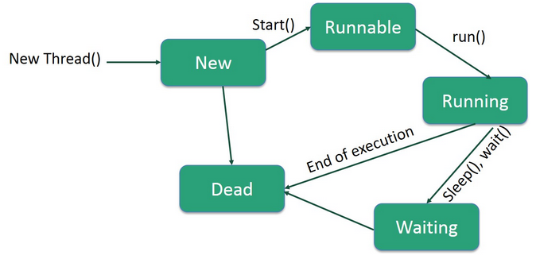
Life Cycle of a Thread
A thread goes through various stages in its life cycle. For example, a thread is born, started, runs, and then dies.
The following diagram shows the complete life cycle of a thread.

Slide 5
New − A new thread begins its life cycle in the new state. It remains in this state until the program starts the thread. It is also referred to as a born thread.
Runnable − After a newly born thread is started, the thread becomes runnable. A thread in this state is considered to be executing its task.
Waiting − Sometimes, a thread transitions to the waiting state while the thread waits for another thread to perform a task. A thread transitions back to the runnable state only when another thread signals the waiting thread to continue executing.
Timed Waiting − A runnable thread can enter the timed waiting state for a specified interval of time. A thread in this state transitions back to the runnable state when that time interval expires or when the event it is waiting for occurs.
Terminated (Dead) − A runnable thread enters the terminated state when it completes its task or otherwise terminates.

Slide 6
1. Create a Thread by Extending a Thread Class
The second way to create a thread is to create a new class that extends Thread class using the following two simple steps.
This approach provides more flexibility in handling multiple threads created using available methods in Thread class.
Step 1:
You will need to override run( ) method available in Thread class.
This method provides an entry point for the thread and you will put your complete business logic inside this method.
Following is a simple syntax of run() method
public void run( )

Slide 7
Step 2:
Once Thread object is created, you can start it by calling start() method, which executes a call to run( ) method.
Following is a simple syntax of start() method
void start( );

Slide 8
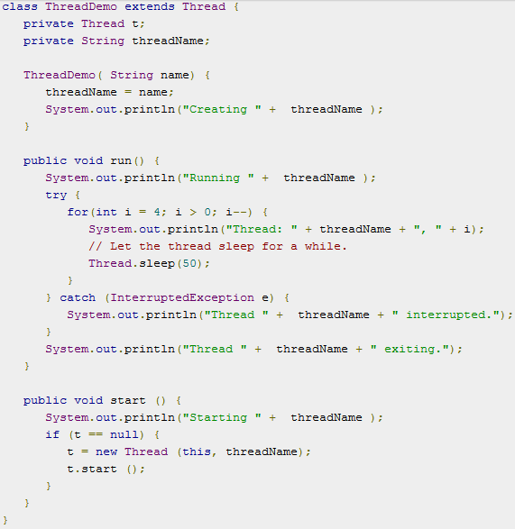
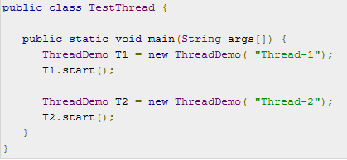
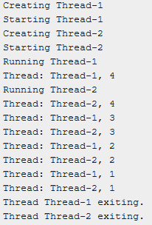
Output

Slide 9
2. Create a Thread by Implementing a Runnable Interface
If your class is intended to be executed as a thread then you can achieve this by implementing a Runnable interface.
You will need to follow three basic steps −
Step 1:
As a first step, you need to implement a run() method provided by a Runnable interface.
This method provides an entry point for the thread and you will put your complete business logic inside this method.
Following is a simple syntax of the run() method −
public void run( )

Slide 10
Step 2:
As a second step, you will instantiate a Thread object using the following constructor −
Thread(Runnable threadObj, String threadName);
Where, threadObj is an instance of a class that implements the Runnable interface and threadName is the name given to the new thread.
Step 3:
Once a Thread object is created, you can start it by calling start() method, which executes a call to run( ) method. Following is a simple syntax of start() method −
void start();

Slide 11
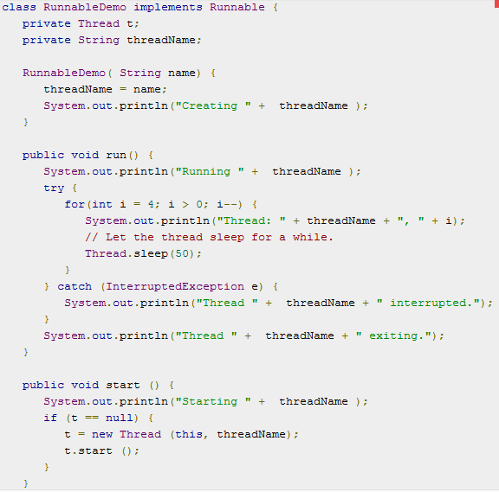
Here is an example that creates a new thread and starts running it

Slide 12
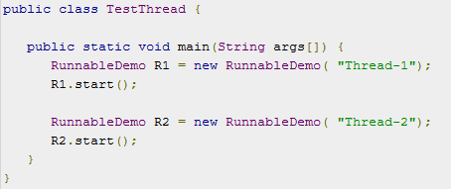
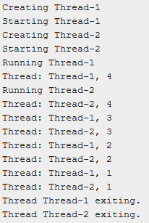
Output

Slide 13
Extends Thread class vs Implements Runnable Interface
Extending the Thread class will make your class unable to extend other classes, because of the single inheritance feature in JAVA. However, this will give you a simpler code structure. If you implement Runnable, you can gain better object-oriented design and consistency and also avoid the single inheritance problems.
If you just want to achieve basic functionality of a thread you can simply implement Runnable interface and override run() method. But if you want to do something serious with thread object as it has other methods like suspend(), resume(), ..etc which are not available in Runnable interface then you may prefer to extend the Thread class.

Slide 14
Ending Thread
A Thread ends due to the following reasons:
The thread ends when it comes when the run() method finishes its execution.
When the thread throws an Exception or Error that is not being caught in the program.
Java program completes or ends.
Another thread calls stop() methods.

Slide 15
Deadlock
Whenever there is multiple processes contending for exclusive access to multiple locks, there is the possibility of deadlock.
A set of processes or threads is said to be deadlocked when each is waiting for an action that only one of the others can perform.
In Order to avoid deadlock, one should ensure that when you acquire multiple locks, you always acquire the locks in the same order in all threads.

