Slide 1


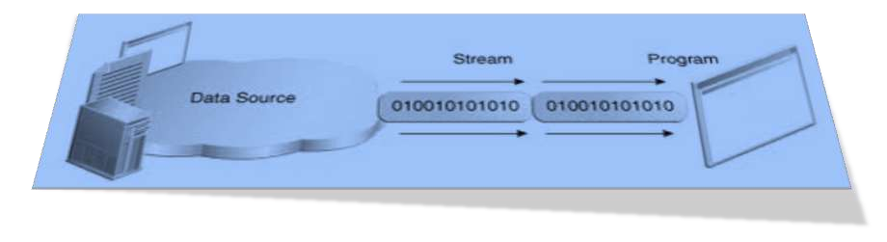

Slide 2

Storage of data in variables is temporary. When the program is done running or when computer is turned off the data is gone!
Data is stored permanently on secondary storage devices (magnetic tapes, optical disks, flash drives, hard disks) unless we erase it or when the storage device is damaged or destroyed.
We consider creation & use of files of data

Slide 3


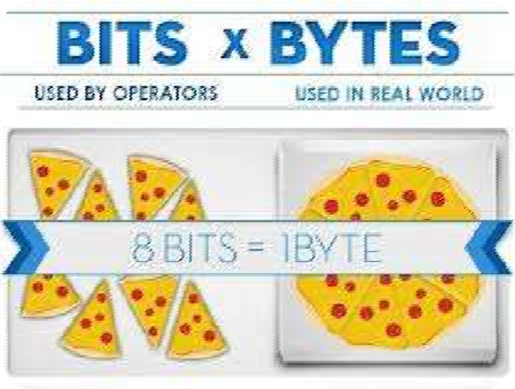

Lowest level of data storage is in binary digits (0s and 1s bits )
Bits are grouped together into bytes Bytes are grouped into characters
Characters and/or bytes are grouped together to form fields
Fields are grouped together to form records Records are grouped to form files

Slide 4



A file is a collection of data in mass storage.
A data file is not a part of a program’s source code.
The same file can be read or modified by different programs.
The program must be aware of the format of the data in the file.

Slide 5
The files are maintained by the operating system.
The system provides commands and/or GUI utilities for viewing file directories and for copying, moving, renaming, and deleting files.
The operating system also provides basic functions, callable from programs, for reading and writing directories and files.

Slide 6



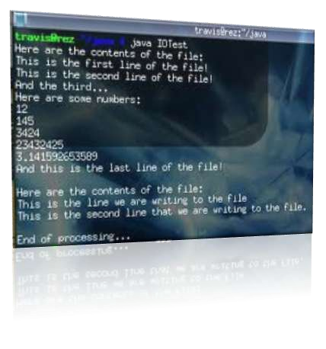
A computer user distinguishes text (“ASCII”) files and “binary” files. This distinction is based on how you treat the file.
A text file is assumed to contain lines of text.
Each line terminates with a new line character (or a combination, carriage return plus line feed).

Slide 7

Any plain-text file, example “something.txt”
Source code of programs in any language,
“Something.java”
HTML documents
Data files for certain programs, example “fish.dat”

Slide 8


A “binary” file can contain any information, any combination of bytes.
Only a programmer / designer knows how to interpret it.
Different programs may interpret the same file differently (for example, one program displays an image, another extracts an encrypted message).

Slide 9

Compiled programs, for example, “Something.class”
Image files, for example, “something.gif” Music files, for example, “something.mp3”
Any file can be treated as a binary file, even a text file.

Slide 10

I/O means Input/Output. It is input to and output from programs.
Input can be from a keyboard or a file. Output can be
to display (screen) or to a file File I/O has many advantages :
for permanent copy
output from one program can be input to another program
input can be automated rather than entered manually

Slide 11


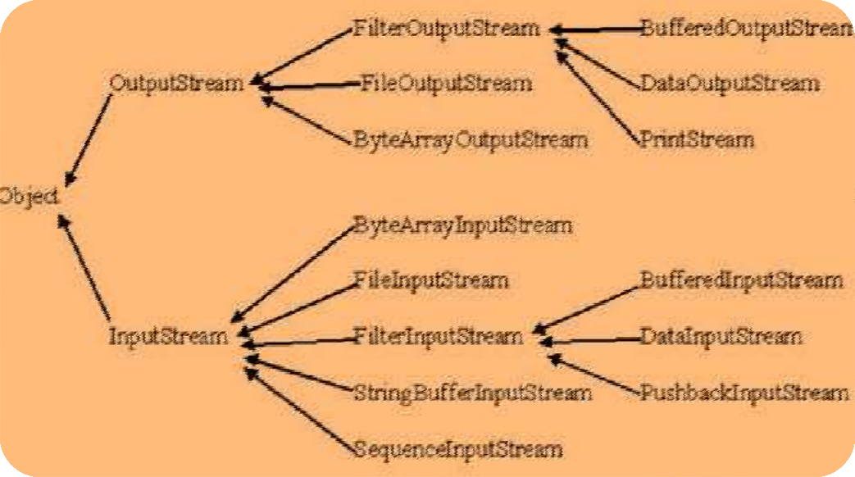

A stream is an object that either delivers data to its destination (screen, file, etc.) or that takes data from a source (keyboard, file, etc.)
It is an abstraction derived from sequential input or output devices.

Slide 12
An input stream produces a stream of characters; an output stream receives a stream of characters, “one at a time.”
Streams apply not just to files, but also to IO devices, Internet streams, and so on.
A file can be treated as an input or output
stream.

Slide 13
In reality file streams are buffered for efficiency: it is not practical to read or write one character at a time from or to mass storage.
It is common to treat text files as streams.

Slide 14

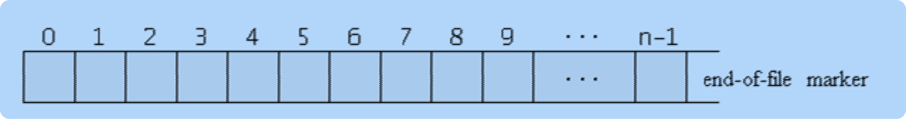
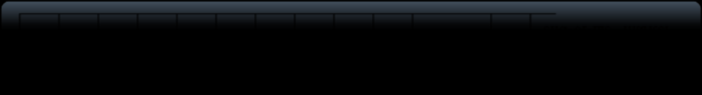
Java views a file as a stream of bytes
File ends with end-of-file marker or a specific byte number
Java file I/O involves streams. You write and read data to streams.

Slide 15
Java The purpose of the stream abstraction is to keep program code independent from physical devices.
Three stream objects are automatically created for every application:
System.in System.out, and System.err.

Slide 16

There are two types of streams :
Byte Streams
Character Streams

Slide 17


Byte streams create binary files.
A binary file essentially contains the memory image of the data. That is, it stores bits as they are in memory.
Binary files are faster to read and write because no translation need take place.
Binary files, however, cannot be read with a text editor.

Slide 18

Character streams create text files.
These are files designed to be read with a text editor.
Java automatically converts its internal unicode characters to the local machine representation (ASCII).

Slide 19

The java.io package contains nearly every class you might ever need to perform input and output (I/O) in Java.
All these streams represent an input source and an output destination.
The stream in the java.io package supports many data such as primitives, Object, localized characters etc.

Slide 20
A stream can be defined as a sequence of data. The InputStream is used to read data from a source and the OutputStream is used for writing data to a destination.
Java provides strong, flexible support for I/O as it relates to files and networks.

Slide 21

Input stream: - a stream that provides input to a program
System.in is an input stream
Output stream: a stream that accepts output from a program System.out is an output stream
A stream connects a program to an I/O object
System.out connects a program to the screen System.in connects a program to the keyboard

Slide 22

Java input console is accomplished by reading from System.in.
To obtain a character-based stream that is attached to the console, you wrap System.in in a BufferedReader object, to create a character stream.
Most common syntax to obtain BufferedReader:
BufferedReader br = new BufferedReader(new
InputStreamReader(System.in));
Once BufferedReader is obtained, we can use read( ) method to reach a character or readLine( ) method to read a string from the console.

Slide 23




To read a character from a BufferedReader, we use read( ) method whose sytax is as follows:
int read ( )
Each time that read( ) is called, it reads a character from the input stream and returns it as an integer value. It returns .1 when the end of the stream is encountered.

Slide 24
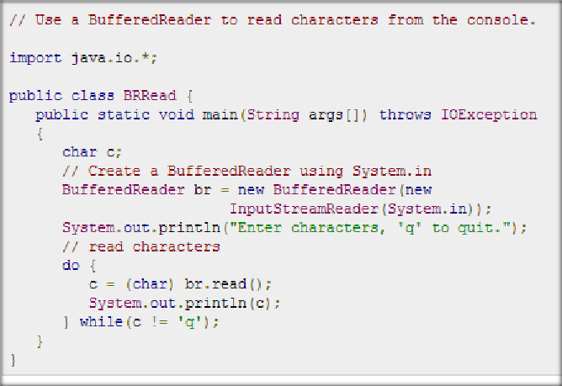
The following program demonstrates read( ) by reading
characters from the console until the user types a "q":

Slide 25
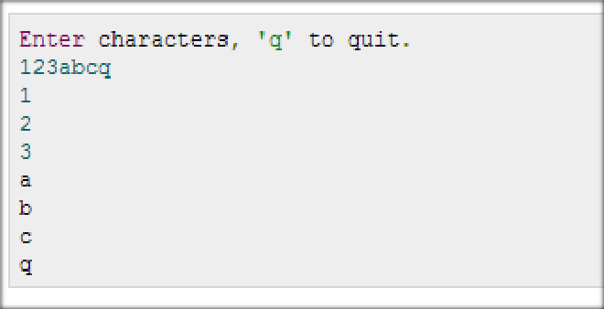
Below is a sample run of the program

Slide 26

To read a string from the keyboard we use readLine ( ) that is a member of the BufferedReader class. The syntax is shown below :
String readLine ( )

Slide 27
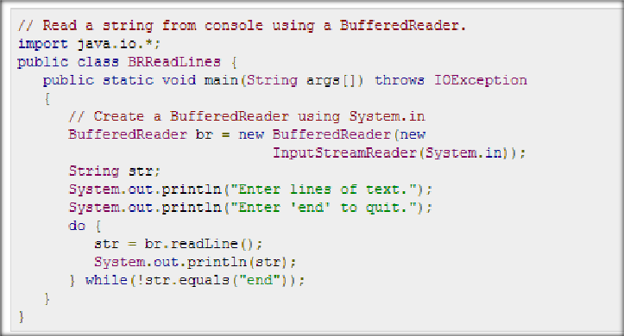
The following program BufferedReader and the readLine( ) method. The program reads and displays lines of text until you enter the word "end":

Slide 28
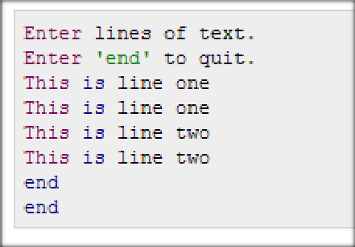
Below is a sample run of the program

Slide 29

Console output is most easily accomplished by print( ) and println( ).
These methods are defined by the class
PrintStream which is the type of the object referenced by System.out.
Because PrintStream is an output stream derived from OutputStream, it also implements the low-level method write( ). Thus, write( ) can be used to write to the console.

Slide 30


The simplest form of write( ) defined by PrintStream is shown here:
void write(int byteval)
This method writes to the stream the byte specified by byteval. Although byteval is declared as an integer, only the low-order eight bits are written.

Slide 31
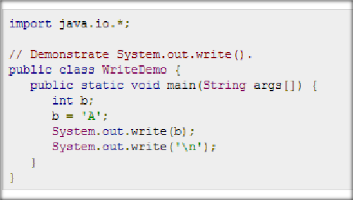
The following example uses write( ) to output the character
"A" followed by a newline to the screen
This will produce the character “A” on the output screen

Slide 32

The InputStream is used to read data from a source and the OutputStream is used for writing data to a destination.
The two important streams used are FileInputStream and FileOutputStream

Slide 33



This stream is used for reading data from the files.
Objects can be created using the keyword new and
there are several types of constructors available.
The following takes a file name as a string to create an input stream object to read the file. :
InputStream f = new FileInputStream("C:/java/hello");

Slide 34





The following takes a file object to create an input stream object to read the file. First we create a file object using File() method as follows:
File f = new File("C:/java/hello"); InputStream f = new
FileInputStream(f);

Slide 35






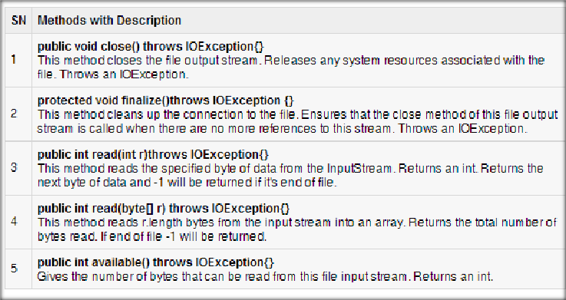
Once you have InputStream object in hand, there is a list of helper methods which can be used to read to stream or to do other operations on the stream.

Slide 36




FileOutputStream is used to create a file and write data into it.The stream would create a file, if it doesn't already exist, before opening it for output.
Following takes a file name as a string to create an input stream object to write the file.:
OutputStream f = new FileOutputStream("C:/java/hello");
Following takes a file object to create an output stream object to write the file. First we create a file object using File() method as follows:
File f = new File("C:/java/hello"); OutputStream f = new FileOutputStream(f);

Slide 37





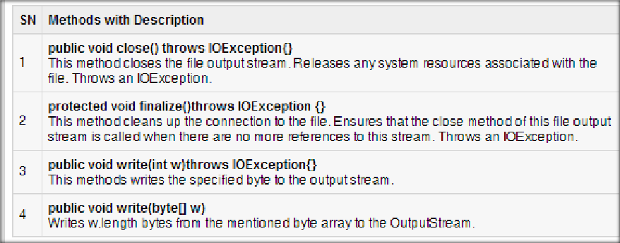
The following helper methods can be used to write to stream or to do other operations on the stream, once you have OutputStream object in hand.

Slide 38









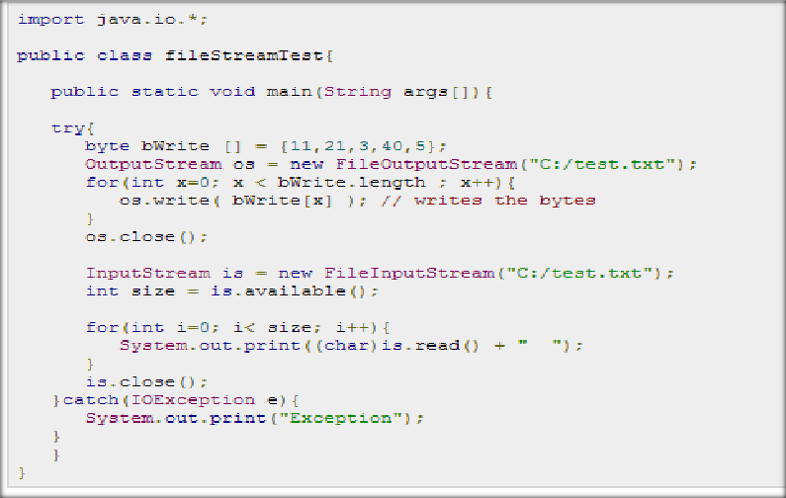
The following program would create file test.txt and would write given numbers in binary format.

Slide 39


