Slide 1
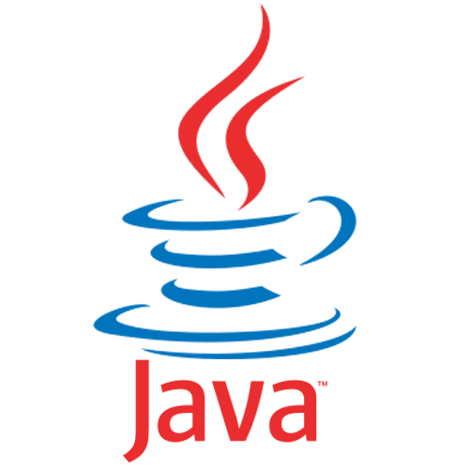
Introduction of Java
By Rajiv Bikram Shah

Slide 2
Content
What is Java ?
Where is Java used ?
History of Java
Features of Java
Disadvantage of Java
Java Development Kit (JDK)
Java Compiler
Java Virtual Machine (JVM)
Java Program-Development phase
Portability of Java
Simple Java Program
Java Development Tools
What is Object Oriented Programming

Slide 3
What is Java ?
Java is relatively high-level language, class-based and Object-oriented Programming Language.
Java was developed by James Gosling at Sun Microsystems.
Java is a first programming language which provide the concept of writing programs that can be executed using the web.

Slide 4
Where Is Java Used ?
3 Billion devices run java.
There are many devices where Java is currently used.
Java is full-featured and general-purpose programming language that is capable for developing a robust mission-critical application for:
Desktop Applications - Media player, Antiviruses etc.
Servers
Mobile Devices
Web Applications
Enterprise Application – Banking Application, Business Application
Embedded System
Games
Robotics
Java running on the desktop is called Application
Java running on the Internet is called Applets
Java running on the server-side is called Servlet

Slide 5

James Gosling
James Gosling is generally credited as the inventor of the Java programming language
He was the first designer of Java and implemented its original compiler and virtual machine
He is also known as the Father of Java.

Slide 6
Brief History of Java
In 1990, Sun Microsystems began an internal project known as the Green Project to work on a new technology.
In 1992, the Green Project was spun off and its interest directed toward building highly interactive devices for the cable TV industry.
In 1994, the focus of the original team was re-targeted, this time to the use of Internet technology. A small web browser called HotJava was written.
Oak was renamed to Java after learning that Oak had already been trademarked.

Slide 7
In 1995, Java was first publicly released.
In 1996, Java Development Kit (JDK) 1.0 was released.
In 2002, JDK 1.4 (codename Merlin) was released, the most widely used version.
In 2004, JDK 5.0 (codename Tiger) was released, the latest version.
There are the JDK version list and its release date.

Slide 8
Version Name | Code Name | Release Date
JDK 1.0 | Oak | January 1996
JDK 1.1 | (none) | February 1997
J2SE 1.2 | Playground | December 1998
J2SE 1.3 | Kestrel | May 2000
J2SE 1.4 | Merlin | February 2002
J2SE 5.0 | Tiger | September 2004
JDK 6 | Mustang | December 2006
JDK 7 | Dolphin | July 2011
JDK 8 |  | March 2014
JDK 9 |  | September, 21st 2017
JDK 10 |  | March, 20th 2018
JDK 11 |  | September, 25th 2018
JDK 12 |  | March, 19th 2019
JDK 13 |  | September, 10th 2019

Slide 9
Features of Java
Java is Simple.
Java is Object Oriented
Java is Distributed
Java is Architecture Neutral
Java is Robust
Java is Interpreted and Compiled
Java is Secure
Java is Portable
Java is Multi-Threaded
Java Is Dynamic

Slide 10
Features of Java
Java is Simple
Java is Object Oriented
Java is Distributed
Java is Architecture Neutral
Java is Robust
Java is Interpreted
Java is Secure
Java is Portable
Java is Multi-Threaded
Java Is Dynamic
Java is partially modeled on C++, but greatly simplified and improved. Some people refer to Java as "C++--" because it is like C++ but with more functionality and fewer negative aspects.

Slide 11
Features of Java
Java is Simple
Java is Object Oriented
Java is Distributed
Java is Architecture Neutral
Java is Robust
Java is Interpreted
Java is Secure
Java is Portable
Java is Multi-Threaded
Java Is Dynamic
Java was designed from the start to be object-oriented. Object- oriented programming (OOP) is a popular programming approach that is replacing traditional procedural programming techniques.
Object-oriented programming provides great flexibility, modularity, clarity, and reusability through encapsulation, inheritance, and polymorphism.

Slide 12
Features of Java
Java is Simple
Java is Object Oriented
Java is Distributed
Java is Architecture Neutral
Java is Robust
Java is Interpreted
Java is Secure
Java is Portable
Java is Multi-Threaded
Java Is Dynamic
Distributed computing involves several computers working together on a network.
Java is designed to make distributed computing easy. Since networking capability is inherently integrated into Java, writing network programs is like sending and receiving data to and from a file.

Slide 13
Features of Java
Java is Simple
Java is Object Oriented
Java is Distributed
Java is Architecture Neutral
Java is Robust
Java is Interpreted
Java is Secure
Java is Portable
Java is Multi-Threaded
Java Is Dynamic
Write once, run anywhere With a Java Virtual Machine (JVM), you can write one program that will run on any platform.

Slide 14
Features of Java
Java is Simple
Java is Object Oriented
Java is Distributed
Java is Architecture Neutral
Java is Robust
Java is Interpreted
Java is Secure
Java is Portable
Java is Multi-Threaded
Java Is Dynamic
Java compilers can detect many problems that would first show up at execution time in other languages.
Java has a runtime exception-handling feature to provide programming support for robustness.

Slide 15
Features of Java
Java is Simple
Java is Object Oriented
Java is Distributed
Java is Architecture Neutral
Java is Robust
Java is Interpreted
Java is Secure
Java is Portable
Java is Multi-Threaded
Java Is Dynamic
You need an interpreter to run Java programs. The programs are compiled into the Java Virtual Machine code called bytecode.
The bytecode is machine-independent and can run on any machine that has a Java interpreter, which is part of the Java Virtual Machine (JVM).

Slide 16
Features of Java
Java is Simple
Java is Object Oriented
Java is Distributed
Java is Architecture Neutral
Java is Robust
Java is Interpreted
Java is Secure
Java is Portable
Java is Multi-Threaded
Java Is Dynamic
Java implements several security mechanisms to protect your system against harm caused by stray programs.

Slide 17
Features of Java
Java is Simple
Java is Object Oriented
Java is Distributed
Java is Architecture Neutral
Java is Robust
Java is Interpreted
Java is Secure
Java is Portable
Java is Multi-Threaded
Java Is Dynamic
Because Java is architecture neutral, Java programs are portable.
They can be run on any platform without being recompiled.

Slide 18
Features of Java
Java is Simple
Java is Object Oriented
Java is Distributed
Java is Architecture Neutral
Java is Robust
Java is Interpreted
Java is Secure
Java is Portable
Java is Multi-Threaded
Java Is Dynamic
Multithread programming is smoothly integrated in Java, where as in other languages you have to call procedures specific to the operating system to enable multithreading.

Slide 19
Features of Java
Java is Simple
Java is Object Oriented
Java is Distributed
Java is Architecture Neutral
Java is Robust
Java is Interpreted
Java is Secure
Java is Portable
Java is Multi-Threaded
Java Is Dynamic
Java was designed to adapt to an evolving environment. New code can be loaded on the fly without recompilation.
There is no need for developers to create, and for users to install, major new software versions.
New features can be incorporated transparently as needed.

Slide 20
Disadvantages of Java
Slower than compiled language such as C
an experiment in 1999 showed that Java was 3 or 4 times slower than C or C++
Since Java Programs run on top of JVM, it consumes more memory.

Slide 21
Java Platform Edition
A Java Platform is the set of APIs, class libraries, and other programs used in developing Java programs for specific applications.
There are 3 Java Platform Editions
Java 2 Platform, Standard Edition (J2SE)
Core Java Platform targeting applications running on workstations
Java 2 Platform, Enterprise Edition (J2EE)
Component-based approach to developing distributed, multi-tier enterprise applications
Java 2 Platform, Micro Edition (J2ME)
Targeted at small, stand-alone or connectable consumer and embedded devices

Slide 22
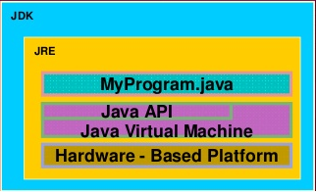
Java Development Kit (JDK)
Java Development Kit (JDK)
Is a set of Java tools for developing Java programs
Consists of Java API, Java Compiler, and JVM
Java Application Programming Interface (API)
Is prewritten code, organized into packages of similar topics
Java Virtual Machine (JVM) is an execution engine that runs compiled Java byte code.

Slide 23
Java Compiler (Byte Code)
The Java compiler translates Java programs into byte‐code.
Byte-code creates and store on disk as .class file
Byte-code verifier verify the validation and check whether it violate java’s security or not.
Once compiled to byte‐code, a Java program can be used on any computer, making it very portable machine.

Slide 24
Java Virtual Machine (JVM)
Java Virtual Machine is the like usual computer which translate high level language into machine language.
Just like that Java virtual machine also translate Bytecode into machine language.
JVM are available for many hardware and software Platform.

Slide 25
Java Program Development Phase
Java programs normally undergo four phases
Edit
Programmer writes program (and stores program on disk)
Compile
Compiler creates byte-codes from program (.class)
Load
Class loader stores byte-codes in memory
Execute
Interpreter: translates byte-codes into machine language

Slide 26
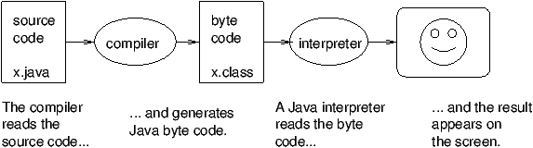
Cont…

Slide 27
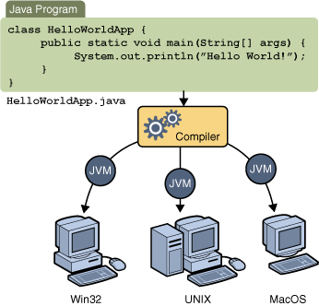
Portability of Java
Portable means that a program may be written on one type of computer and then run on a wide variety of computers, with little or no modification.
Java byte code runs on the JVM and not on any particular CPU; therefore, compiled programs are highly portable.
JVMs exist on many platforms:
Windows
Mac
Linux

Slide 28
A Simple Java Program
//This program prints Welcome to Java!
class Welcome {
public static void main(String[] args) {
System.out.println("Welcome to Java!");
}
}

Slide 29
Class definition: This line uses the keyword class to declare that a new class is being defined.
Class Welcome
Main Method: In Java programming language, every application must contain a main method whose signature is:
public static void main(String[] args)
public: So that JVM can execute the method from anywhere.
static: Main method is to be called without object. The modifiers public and static can be written in either order.
void: The main method doesn't return anything.
main(): Name configured in the JVM.
String[]: The main method accepts a single argument: an array of elements of type String.
The next line of code is shown here. Notice that it occurs inside main( )
System.out.println("Hello, World");
Output is actually accomplished by the built-in println( ) method. System is a predefined class that provides access to the system, and out is the variable of type output stream that is connected to the console.
Comments: They can either be multi-line or single line comments.
/* This is multiline comment*/
// This single line comment

Slide 30
Java Development Tools
A software that provides an integrated development environment (IDE) for rapidly developing Java programs.
Java development tools on the market:
NetBeans by Sun (open source)
IntelliJ IDEA by Jetbrains
Eclipse by IBM (open source)
Other useful tools:
TextPad Editor
Visual Studio Code
Jedit

Slide 31
What is Object Oriented Programming?
A language in which everything represent in the form of Object is called Object Oriented Programming Language.
It not only makes the program less complex but also makes the software reuse feasible and possible.
All object-oriented programming languages provide mechanisms that help you implement the object- oriented model.
Principles of OOP:
Encapsulation
Inheritance
Polymorphism
Abstraction

Slide 32
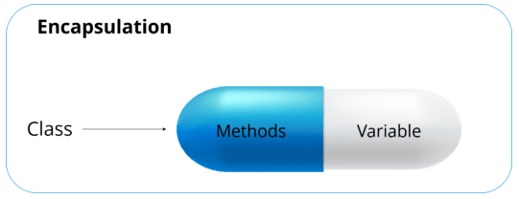
Encapsulation
Encapsulation is a mechanism where you bind your data and code together as a single unit. It also means to hide your data in order to make it safe from any modification and misuse.
The best way to understand encapsulation is to look at the example of a medical capsule, where the drug is always safe inside the capsule. Similarly, through encapsulation the methods and variables of a class are well hidden and safe.
Advantages of Encapsulation
Protection
Consistency
Allows change

Slide 33
We can achieve encapsulation in Java by:
Declaring the variables of a class as private.
Providing public setter and getter methods to modify and view the variables values.
Let us look at the code below to get a better understanding of encapsulation:
public class Employee {
private String name;
public String getName() {
return name;
}
public void setName(String name) {
this.name = name;
}
public static void main(String[] args) {
}
}

Slide 34
Inheritance
Inheritance is one such concept where the properties of one class can be inherited by the other.
It helps to reuse the code and establish a relationship between different classes.
A class that is derived from another class is called a sub-class (also a derived class, extended class, or child class).
The class from which the subclass is derived is called a super-class (also a base class or a parent class).
A class which is a subtype of a more general class is said to be inherited from it.
The sub-class inherits the base class’ data members and member functions.
A sub-class has all data members of its base-class plus its own.
A sub-class has all member functions of its base class (with changes) plus its own.

Slide 35
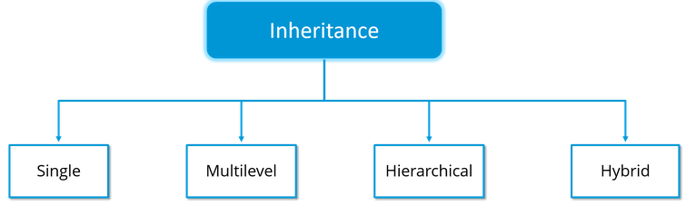
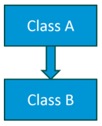
Inheritance is further classified into 4 types:
Single Inheritance: In single inheritance, one class inherits the properties of another. It enables a derived class to inherit the properties and behaviour from a single parent class.
Class A
{
---
}
Class B extends A {
---
}
Here, Class A is your parent class and Class B is your child class which inherits the properties and behaviour of the parent class.

Slide 36
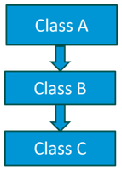
Multilevel Inheritance: When a class is derived from a class which is also derived from another class, i.e. a class having more than one parent class but at different levels, such type of inheritance is called Multilevel Inheritance.
Class A{
---
}
Class B extends A{
---
}
Class C extends B{
---
}
Here A is the parent class for B and class B is the parent class for C. So in this case class C implicitly inherits the properties and methods of class A along with Class B.

Slide 37
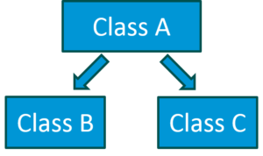
Hierarchical Inheritance: When a class has more than one child classes (sub classes) or in other words, more than one child classes have the same parent class, then such kind of inheritance is known as hierarchical.
Class A{
---
}
Class B extends A{
---
}
Class C extends A{
---
}
Class B and C are the child classes which are inheriting from the parent class i.e Class A.

Slide 38
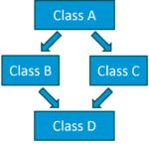
Hybrid Inheritance: Hybrid inheritance is a combination of multiple inheritance and multilevel inheritance.
Since multiple inheritance is not supported in Java as it leads to ambiguity, so this type of inheritance can only be achieved through the use of the interfaces.
Class A is a parent class for class B and C, whereas Class B and C are the parent class of D which is the only child class of B and C.

Slide 39
Polymorphism
Polymorphism refers to a programming language's ability to process objects differently depending on their data type or class.
Generally, the ability to appear in many forms.
More specifically, it is the ability to redefine methods for derived classes.
For example, given a base class shape, polymorphism enables the programmer to define different area methods for any number of derived classes, such as circles, rectangles and triangles. No matter what shape an object is, applying the area method to it will return the correct results.

Slide 40
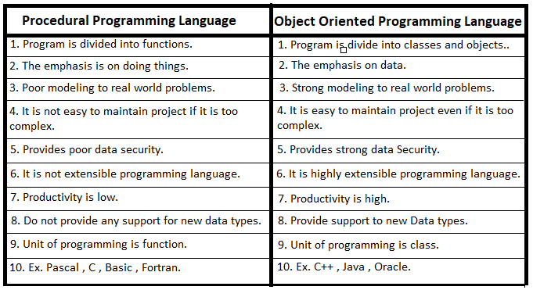
Procedure Oriented Vs Object Oriented

Slide 41
Abstraction
Abstraction is the concept of hiding the internal details and describing things in simple terms.
It’s used to create a boundary between the application and the client programs.
For example phone call, we don't know the internal processing.
A Java program is also a great example of abstraction. Here java takes care of converting simple statements to machine language and hides the inner implementation details from the outer world.

Slide 42
Abstraction in Real Life
Abstraction is present in almost all the real life machines.
Your car is a great example of abstraction. You can start a car by turning the key or pressing the start button. You don’t need to know how the engine is getting started, what all components your car has. The car internal implementation and complex logic is completely hidden from the user.
We can heat our food in Microwave. We press some buttons to set the timer and type of food. Finally, we get a hot and delicious meal. The microwave internal details are hidden from us. We have been given access to the functionality in a very simple manner.

Slide 43
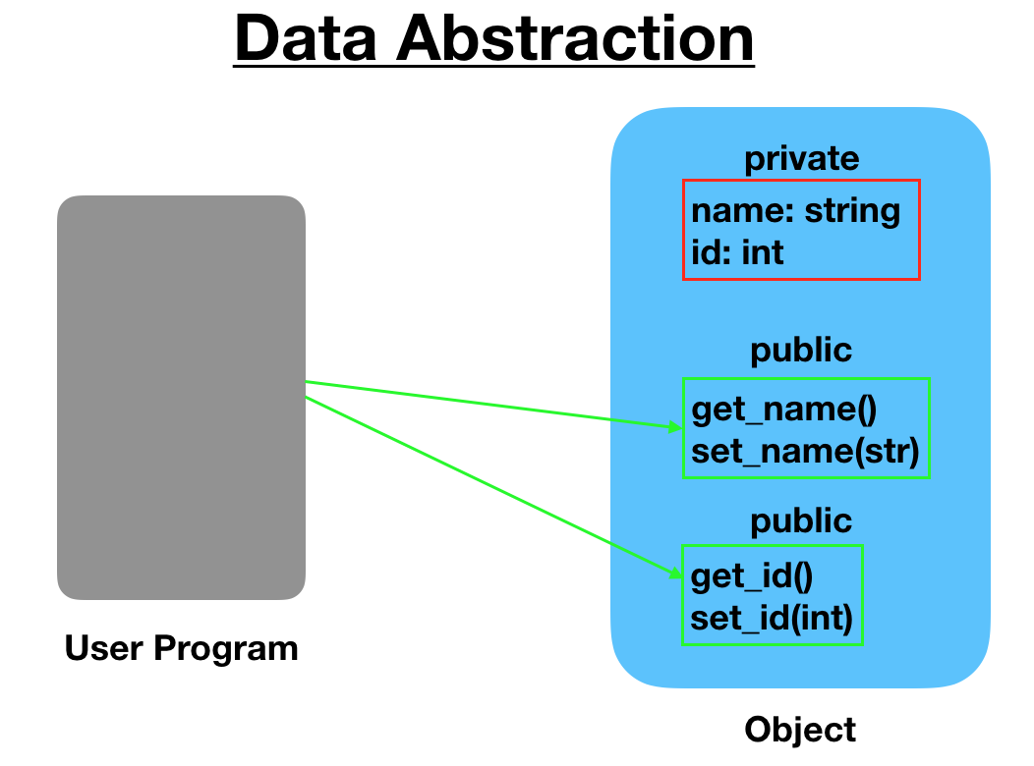
What are the different types of abstraction?
Data Abstraction
Process Abstraction
Data Abstraction
When the object data is not visible to the outer world, it creates data abstraction. If needed, access to the Objects’ data is provided through some methods.

Slide 44
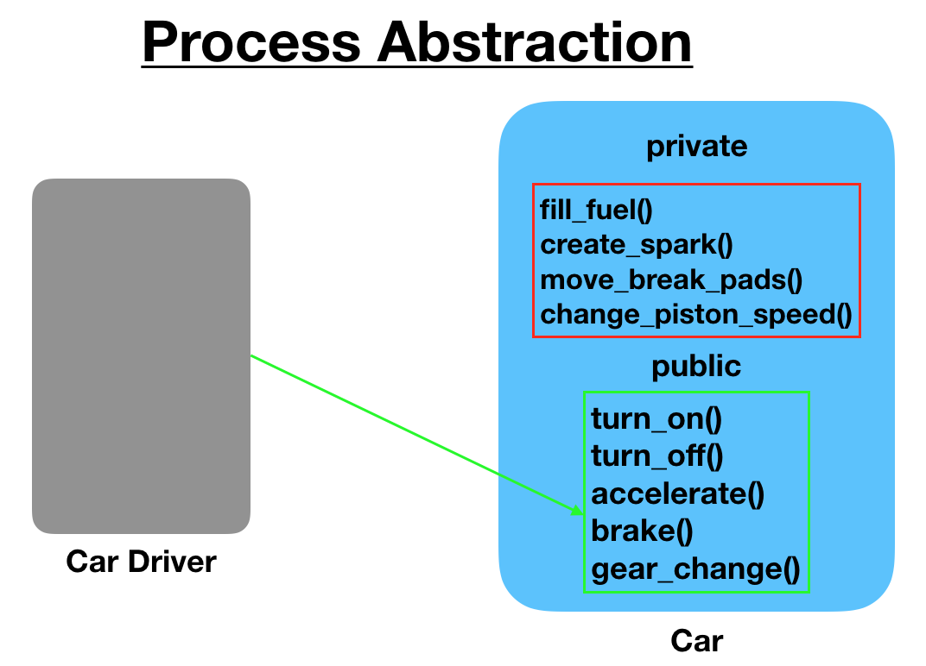
Process Abstraction
We don’t need to provide details about all the functions of an object. When we hide the internal implementation of the different functions involved in a user operation, it creates process abstraction.

Slide 45
Abstraction in Java is implemented through interfaces and abstract classes. They are used to create a base implementation or contract for the actual implementation classes.
public interface Car {
void turnOnCar();
void turnOffCar();
String getCarType();
}

Slide 46
Assignment
What is object oriented programming? Define features/principles of object oriented programming with a small block of code for each.
Next Class
What are the Data Types in Java?

