Slide 1
Java Layout Manager

Slide 2
Layout Managers
The LayoutManagers are used to arrange components in a particular manner.
Layout Manager is an interface that is implemented by all the classes of layout managers.
A layout manager is an object that controls the size and the position of components in a container. Every Container object has a LayoutManager object that controls its layout.

Slide 3
There are following classes that represents the layout managers:
java.awt.BorderLayout java.awt.FlowLayout java.awt.GridLayout java.awt.CardLayout java.awt.GridBagLayout javax.swing.BoxLayout javax.swing.GroupLayout javax.swing.ScrollPaneLayout javax.swing.SpringLayout etc.

Slide 4
Border Layout:
The BorderLayout is used to arrange the components in five regions: north, south, east, west and center.
Each region (area) may contain one component only. It is the default layout of frame or window.
The BorderLayout provides five constants for each region:
public static final int NORTH public static final int SOUTH public static final int EAST
public static final int WEST public static final int CENTER

Slide 5
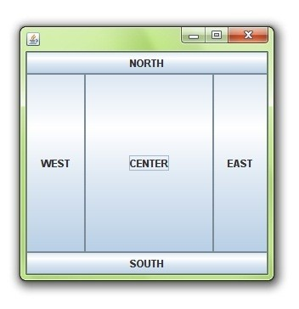
Example of Border Layout class:
Constructors of BorderLayout class:
BorderLayout(): creates a border layout but with no gaps between the components.
BorderLayout(int hgap, int vgap): creates a border layout with the given horizontal and vertical gaps between the components.

Slide 6
Grid Layout
The GridLayout is used to arrange the components in rectangular grid. One component is displayed in each rectangle.
Constructors of GridLayout class:
GridLayout(): creates a grid layout with one column per component in a row.
GridLayout(int rows, int columns): creates a grid layout with the given rows and columns but no gaps between the components.
GridLayout(int rows, int columns, int hgap, int vgap): creates a grid layout with the given rows and columns alongwith given horizontal and vertical gaps.

Slide 7
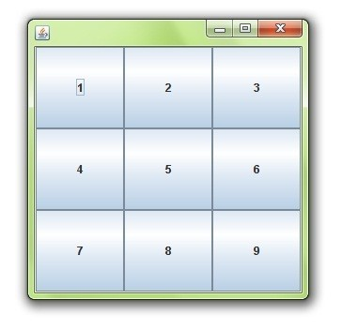
GridLayout

Slide 8
FlowLayout
The FlowLayout is used to arrange the components in a line, one after another (in a flow). It is the default layout of applet or panel.
Fields of FlowLayout class:
1.public static final int LEFT
2.public static final int RIGHT
3.public static final int CENTER 4.public static final int LEADING 5.public static final int TRAILING

Slide 9
Constructors of FlowLayout class:
FlowLayout(): creates a flow layout with centered alignment and a default 5 unit horizontal and vertical gap.
FlowLayout(int align): creates a flow layout with the given alignment and a default 5 unit horizontal and vertical gap.
FlowLayout(int align, int hgap, int vgap):
creates a flow layout with the given alignment and the given horizontal and vertical gap.

Slide 10
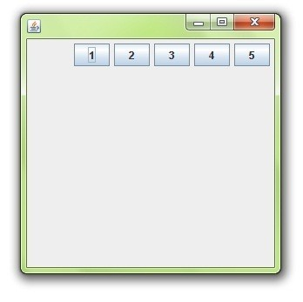
FlowLayout

Slide 11
Card Layout
The CardLayout class manages the components in such a manner that only one component is visible at a time. It treats each component as a card that is why it is known as CardLayout.
Constructors
CardLayout(): creates a card layout with zero horizontal and vertical gap.
CardLayout(int hgap, int vgap): creates a card layout with the given horizontal and vertical gap.

Slide 12
Methods
public void next(Container parent): is used to flip to the next card of the given container.
public void previous(Container parent): is used to flip to the previous card of the given container.
public void first(Container parent): is used to flip to the first card of the given container.
public void last(Container parent): is used to flip to the last card of the given container.
public void show(Container parent, String name): is used to flip to the specified card with the given name.

Slide 13
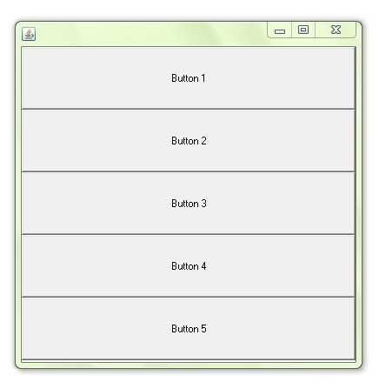
Box Layout
Fields of BoxLayout class:
public static final int X_AXIS public static final int Y_AXIS public static final int LINE_AXIS public static final int PAGE_AXIS
Constructor of BoxLayout class:
BoxLayout(Container c, int axis):
creates a box layout that arranges the components with the given axis.

Slide 14
The End

