Slide 1
Event Handling

Slide 2
Event handling
It's now time to see how to get GUIs to respond to user actions like clicking on a button, typing text or dragging the mouse.
These things are called events, and responding to them is called event handling.

Slide 3
Events Types
User Interface
No User Interface
Pressing a button
Entering a charcter by
keyboard
Selecting an item from list
Timer Expires
Counter Exceed value
Software or hardware failure
Operation is completed

Slide 4
Delegation Model
Event Sources
Events Listener
Event Classes

Slide 5
Event Sources
An object that generate an event
A source must register listener in order to receive notification about specific type of event

Slide 6
Add Listener
Syntax:
public void add<Type>Listener(TypeListener obj)
Keyboard: addKeyListener()
Mouse :addMouseMotionListener()

Slide 7
Remove Listener
Syntax:
public void removeTypeListener(TypeListener el)
removeKeyListener( ).

Slide 8
Event Listeners
In Java, event handling is based on listeners.
A listener is an object with a method which contains the code we want to run when an event happens

Slide 9
Major Requirements
Registered to receive notifications about specific types of events.
implement methods to receive and process these notifications.

Slide 10


Generate An Event
Source
Multicasting
Unicasting
Receive Copy
Receive Copy
Listener
Listeners
Process the event & return
Process the event & return

Slide 11
Event Classes
SuperClass
Available In
EventObject Class
Java.util
Subclass
SuperClass
Available In
AWTEvent Class
Java.awt
Subclass
All AwtEvents

Slide 12
The recipe for event handling
Write class MyListener which implements ActionListener (or whatever).
Set up a GUI as before.
Create a MyListener object.
Associate the MyListener object with the component we want to respond to, using addActionListener

Slide 13
Event Class
ActionListener
Interfaces
Sources
User
Button is Pressed
ListItem is DoubleClicked
Menu item is Selected
Button
List
Menu Item
ActionEvent Class
Method
void actionPerformed(ActionEvent ae)

Slide 14
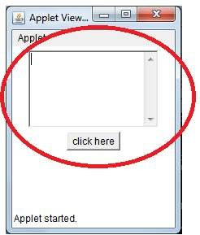
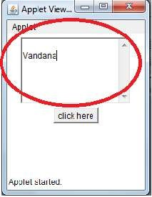
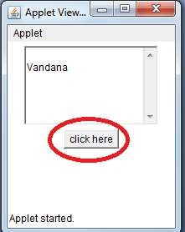
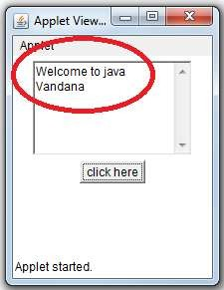
Textarea

Slide 15
import java.applet.Applet;
import java.awt.*;
import java.awt.event.*;
/*
<Applet code=Textarea.class width="200" height="200"></Applet>
<*/
public class Textarea extends Applet implements ActionListener
{
TextArea t1;
Button b1;
•

Slide 16
public void init()
{
t1=new TextArea(" ",5,20); add(t1);
b1=new Button("click here");
add(b1);
b1.addActionListener(this);
}
public void actionPerformed(ActionEvent e)
{
String msg="Welcome to java"; if(e.getSource()==b1)
{
t1.insert(msg,0);
}
}

Slide 17
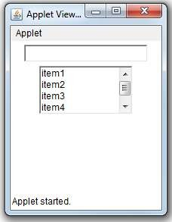
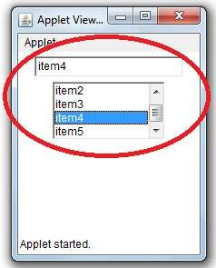
List Box

Slide 18
List Box
import java.applet.Applet;
import java.awt.*;
import java.awt.event.*;
/*
<Applet code=list.class width="200" height="200">
</Applet>
*/
public class list extends Applet implements ActionListener
{
List list1;
TextField t1;
•

Slide 19
ListBox….
public void init()
{
t1=new TextField(20);
add(t1);
public void actionPerformed(ActionEvent e)
{
if(e.getSource()==list1)
t1.setText(((List)e.getSource()).getSelectedItem());
}
list1=new List(4);
list1.add("item1");
list1.add("item2");
list1.add("item3");
list1.add("item4");
list1.add("item5");
add(list1);
list1.addActionListener(this);
}

Slide 20
Event Class
ItemListener
Interfaces
Sources
User
CheckBox is clicked
List item is clicked
Choice Selection is made
Checkable menu item
is selected or deselected.
CheckBox
List
Chioce
ItemEvent Class
Method
void itemStateChanged(ItemEvent ie)

Slide 21
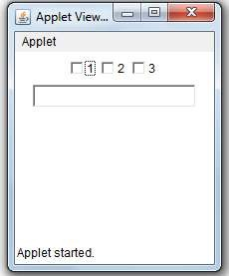
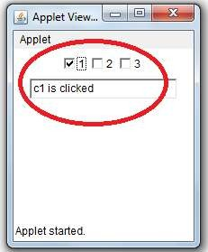
Checkbox

Slide 22
CheckBox
import java.applet.Applet;
import java.awt.*;
import java.awt.Checkbox.*;
import java.awt.event.*;
/*
<Applet code=checkboxs.class height="200" width="200"></Applet>
*/
public class checkboxs extends Applet implements ItemListener
{
Checkbox c1,c2,c3;
TextField t1;

Slide 23
public void init()
{
c1 = new Checkbox("1"); add(c1); c1.addItemListener(this);
public void itemStateChanged(ItemEvent e)
{
if(e.getItemSelectable() == c1) t1.setText("c1 is clicked");
c2=new Checkbox("2"); add(c2); c2.addItemListener(this);
if(e.getItemSelectable() == c2)
t1.setText("c2 is clicked");
if(e.getItemSelectable() == c3) t1.setText("c3 is clicked");
c3=new Checkbox("3"); add(c3); c3.addItemListener(this);
}
t1=new TextField(20); add(t1);
}

Slide 24
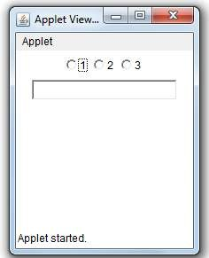
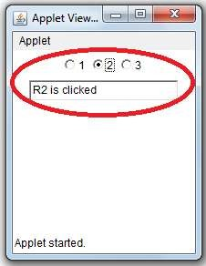
Radio Buttons
Add CheckGroupBox()

Slide 25
import java.applet.Applet;
import java.awt.*;
import java.awt.Checkbox;
import java.awt.event.*;
/*
<Applet code=Radios.class width="200" height="200"></Applet>
*/
public class Radios extends Applet implements ItemListener
{
CheckboxGroup c;
Checkbox c1,c2,c3;
TextField t1;

Slide 26
public void init()
{
c=new CheckboxGroup();
public void itemStateChanged(ItemEvent e)
{
if(e.getItemSelectable() == c1) t1.setText("R1 is clicked");
c1=new Checkbox("1",false,c); add(c1); c1.addItemListener(this);
if(e.getItemSelectable() == c2) t1.setText("R2 is clicked");
c2=new Checkbox("2",false,c); add(c2); c2.addItemListener(this);
if(e.getItemSelectable() == c3) t1.setText("R3 is clicked");
}
c3=new Checkbox("3",false,c); add(c3); c3.addItemListener(this);
t1=new TextField(20);
add(t1);
}

Slide 27
Adapter Class
import java.applet.*;
import java.awt.*;
import java.awt.event.*;
public class MouseAdapterDemo extends Applet {
public void init() {
setBackground(Color.green);
addMouseListener(new MyMouseAdapter(this));
}
}
class MyMouseAdapter extends MouseAdapter {
MouseAdapterDemo mad;
public MyMouseAdapter(MouseAdapterDemo mad) {
this.mad = mad;
}

Slide 28
Adapter Class
public void mousePressed(MouseEvent me) {
mad.setBackground(Color.red);
mad.repaint();
}
public void mouseReleased(MouseEvent me) {
mad.setBackground(Color.green);
mad.repaint();
}
}

Slide 29
Inner Classes
inner class is a class defined within other class, or even within an expression.

Slide 30
Inner Class
import java.applet.*;
import java.awt.*;
import java.awt.event.*;
/*
<applet code="MouseInnerDemo" width=100 height=100>
</applet>
*/
public class MouseInnerDemo extends Applet {
public void init() {
setBackground(Color.green);
addMouseListener(new MyMouseAdapter());
}

Slide 31
Inner Class
class MyMouseAdapter extends MouseAdapter {
public void mousePressed(MouseEvent me) {
setBackground(Color.red);
repaint();
}
public void mouseReleased(MouseEvent me) {
setBackground(Color.green);
repaint();
}
}
}

Slide 32
Anonymous inner class
An anonymous inner class is one that is not assigned a name

Slide 33
Anonymous Inner Classes
// Anonymous inner class demo.
import java.applet.*;
import java.awt.event.*;
/*
<applet code="AnonymousInnerClassDemo" width=200 height=100>
</applet>
*/
public class AnonymousInnerClassDemo extends Applet {
public void init() {
addMouseListener(new MouseAdapter() {
public void mousePressed(MouseEvent me) {
showStatus("Mouse Pressed");
}
});
}
}

Slide 34


