Slide 1
How Hierarchical Control Self-organizes in Artificial Adaptive Systems
Rainer W. Paine, Jun Tani

Slide 2
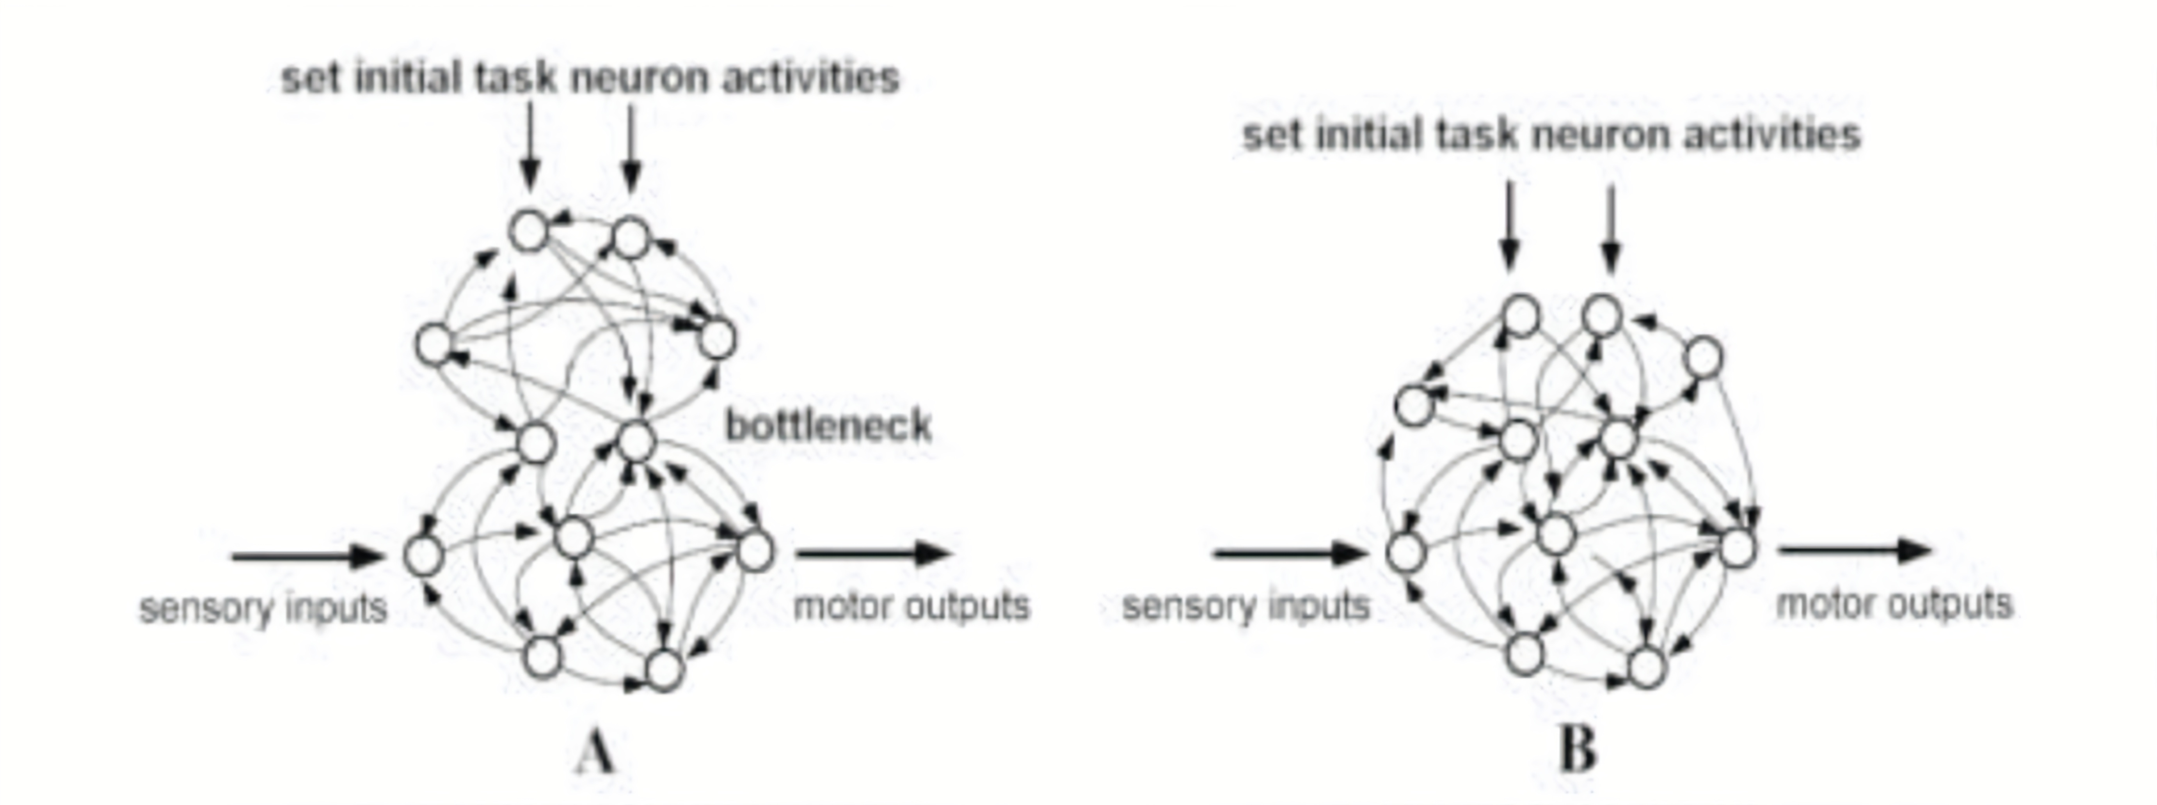
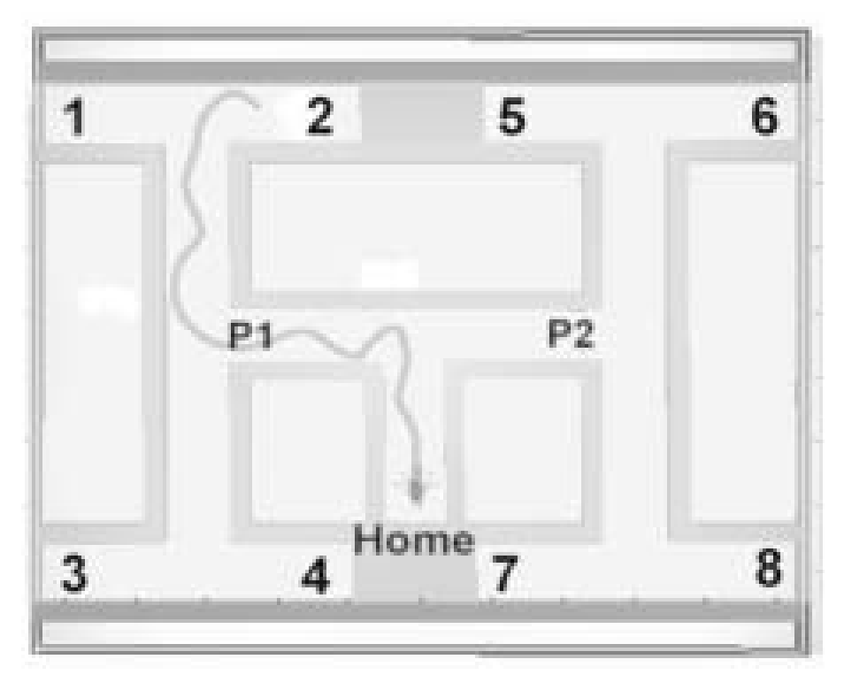
 | N1 | N2 | N3 | N4 | N5 | N6 | N7 | N8 | N9
N1
N2
N3
N4
N5
N6
N7
N8
N9
12 sessions per generation
(each with a different 𝛾 – goal pair)
2 trials within each session (to see if the robot can get to the (same) goal consistently)
Population of 80 robots per generation
200 generations (x 20 evolutionary runs to obtain means and variances need for a t-test)
Trial ends on collision, reaching a goal or at t=2000
The fittest 25% of the population advance to the next generation
Probability of mutation is 0.02
Parameters are encoded by 5 bits

Slide 3
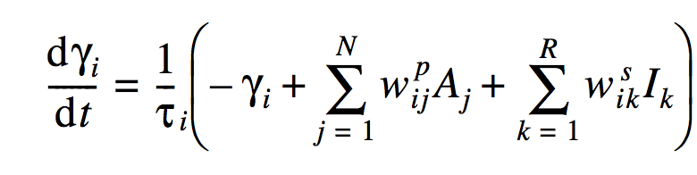
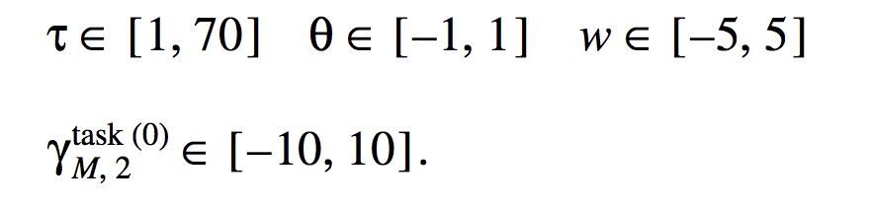
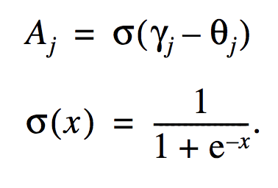
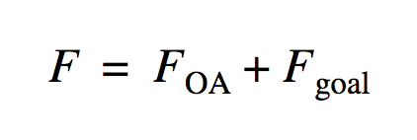
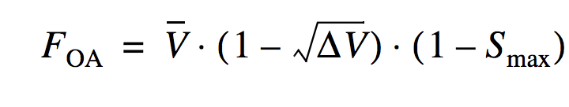
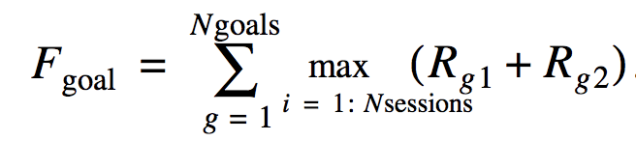




CTRNN optimized using a GA

Slide 4
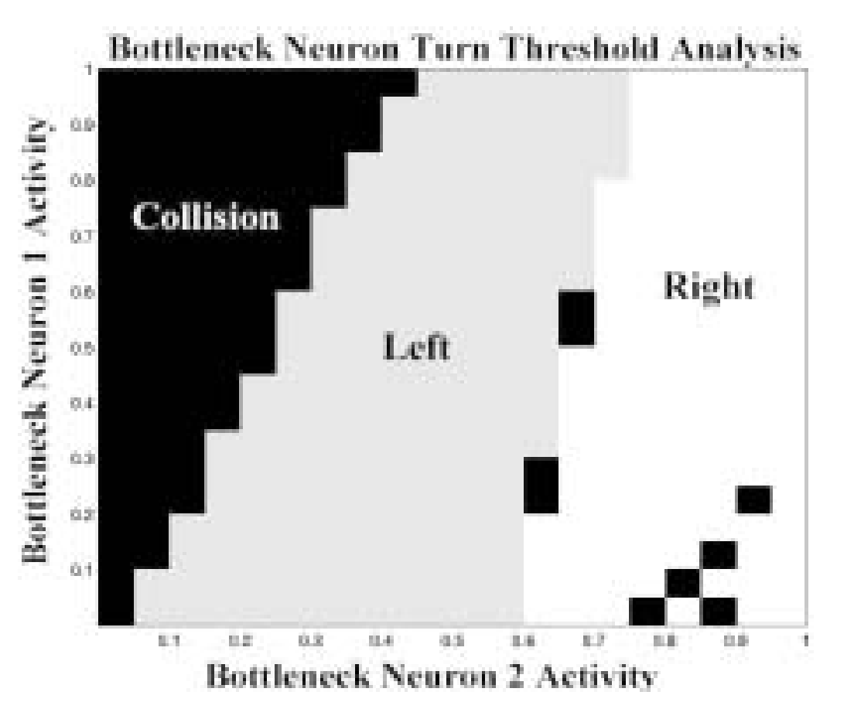
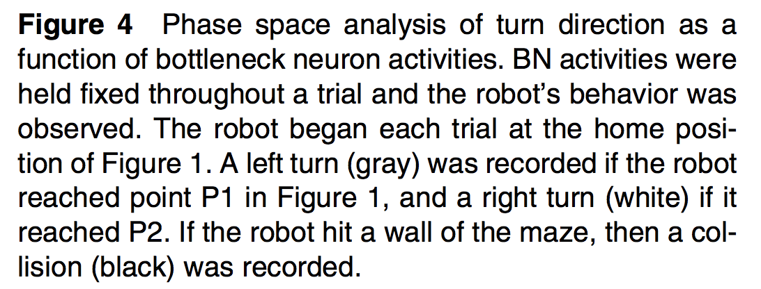

Slide 5
Lower network ‘learns’ motor primitives that can be evoked by directly setting BN activity

Slide 6
