Slide 1
Graph Neural Networks driven Recommender Systems
Vertiefungsprojekt I (HS22), Master of Eng. In Data Science
Student: Roman Loop
Academic Supervisor: Shao Jü Woo
Project duration: 10. October 2022 to 15. January 2023

Slide 2
Agenda
Motivation
Recommender Systems (5 min.)
Graph Theorie: Bipartite Graph
Content based filtering vs. Collaberative filtering
Graph Neural Networks (GNN)
Dataset
Solution Design (15 min.)
Take-aways / Schlussfolgerung (5 min.)
Diskussion

Slide 3




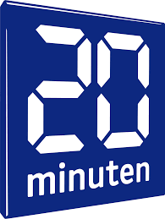




Motivation
We live in a world in which recommendations are so common that we tend to forget the apparent ease with which these systems designed to optimize our consumer choices have been incorporated into practically any device and platform. We’re used to constantly receiving recommendations, but the way in which they have settled in our daily life is a long and interesting history […]¹
¹Source: medium.com, Commons, 2017-08-01, https://medium.com/@Commons/the-importance-of-recommender-systems-36f86f92181

Slide 4
Motivation
People are very bad decistion makers…. Find source

Slide 5
Graph Theory
Nodes
Edges
Homogenious vs. Heterogenious graphs
Weighted vs. Unweigthed graphs
Special graph types
Bipartide graphs
Interaction vs. Adjecency matrix
Property Graph

Slide 6
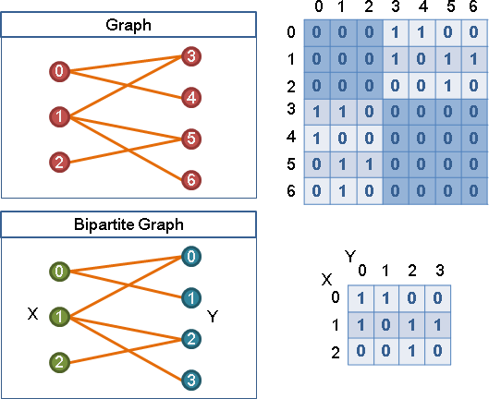
The Bipartite Graph
Heterogener Graph mit (genau) zwei Typen von Nodes
Geeignet Struktur um Empfehlungssysteme mit zu modellieren
Interaction Matrix vs. Adjacency Matrix
Bipartite graph and interaction matrix. Source : https://web.ntnu.edu.tw

Slide 7
Recommender Systems
Content-based: fokussiert auf das Produkt. Bei dieser Methode geht es um Produkte Clustering um einem Benutzer ähnliche Produkte vorgeschlagen.

Slide 8
Recommender System
Ziel: möglichst genaue Vorhersage, was ein Benutzer interessiert
Entwicklung:
1. Gen: «Content-based» fokussiert auf das Produkt. Bei dieser Methode geht es um Produkte Clustering um einem Benutzer ähnliche Produkte vorgeschlagen.
2. Gen: «Collaborative-Filtering» fokussiert auf das Nutzerverhalten. Diese Methode sucht nach möglichst ähnlichen Benutzern und macht Vorschläge Nutzer werden und sucht nach
3. Gen: Graph Neural Networks (GNN)

Slide 9
Message Passing

Slide 10
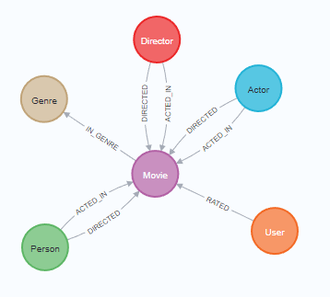
Dataset: MovieLens100K

Slide 11
Dataset: MovieLens100K
Type | Label | # Instances | Relevant properties
Node | User | 671 | Name
Node | Movie | 9’125 | Title, Budget, IMDB-Rating, plot, runtime, revenue, year
Node | Genre | 20 | Name
Node | Actor | 15’443 | Bio, birthdate
Node | Director | 4’091 | Bio, birthdate
Node | Person | 19’047 | Bio, birthdate
Relationship | RATED | 100’004 | Rating, rating-timestamp
Relationship | ACTED_IN | 35’910 | Role
Relationship | DIRECTED | 10’007 | -
Relationship | IN_GENRE | 20’340 | -

Slide 12
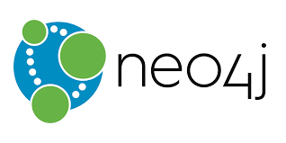




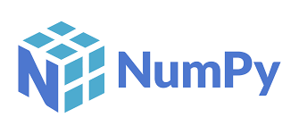
Solution Design
Data pre-processing / Feature Engineering
Find embeddings (user and movie plots)
PyG HeteroData Class
GNN models
Hyperparameter tuning

Slide 13
Data pre-processing / Feature Engineering
Neo4j
Type-casting
One-hot encoding for genres
Calculating actor & director popularity

Slide 14
Data pre-processing / Feature Engineering
Neo4J
Type-casting
One-hot encoding for genres
Calculating actor & director popularity
Python / Pandas
Convert object-types to numerical types
Handle missing values
Embeddings (next slide)

Slide 15
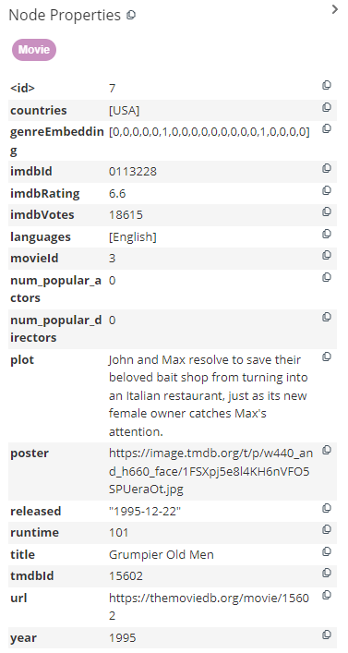




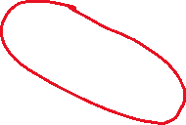

Data pre-processing / Feature Engineering
Neo4J
Type-casting
One-hot encoding for genres
Calculating actor & director popularity

Slide 16
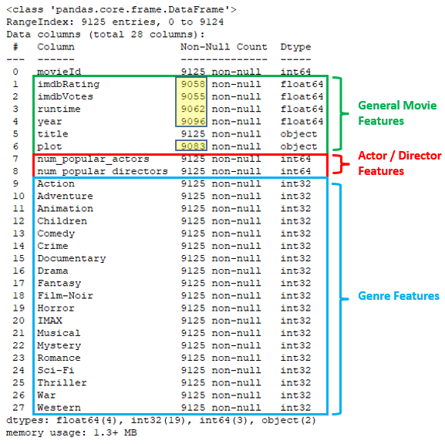
Data pre-processing / Feature Engineering
Python / Pandas
Convert object-types to numerical types
Genres
Handle missing values -> fill with mean value
imdbRating: 67 (0.73%)
imdbVotes: 70 (0.77%)
runtime: 63 (0.69%)
year: 29 (0.32%)
plot: 42 (0.46%)
Embeddings (next slide)

Slide 17
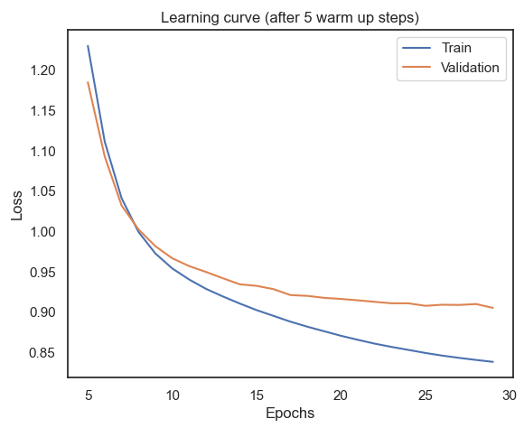
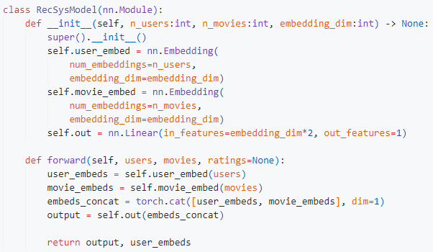
User embeddings
Problem: No user features
Solution: Train a NN with no features and extract the the user-embeddings.

Slide 18
Plot embeddings
Problem: Movie titles and plots are String objects
Solution: Use a pre-trained NLP Model from huggingface to embed title and plot
Next Problem: 384 dimensions!
Next Solution: Use dimensionality reductions methods

