Slide 1
Graph Neural Networks driven Recommender Systems
Vertiefungsprojekt I (HS22), Master of Eng. in Data Science
Student: Roman Loop
Academic Supervisor: Shao Jü Woo
Project duration: 10. October 2022 to 31. January 2023

Slide 2
Agenda
Project goals
The Dataset
Theory & Concepts:
The Bipartite Graph
Types of Recommender Systems
Message Passing Layer (Graph Convolution)
Solution Design
Pre-processing & Feature engineering
PyG processing
Build and train a GNN
Evaluation & Conclusion
Questions & Discussion

Slide 3
Project goals
Study basic theory on graph neural networks
Literature review of papers dealing explictly with recommender systems
Building the graph neural network based recommender system
More specific: Build a recommendation system to predict how a user would rate a certain movie.

Slide 4
Theory & Concepts
The Bipartite Graph
Recommender Systems
Message Passing Layer (Graph Convolution)

Slide 5
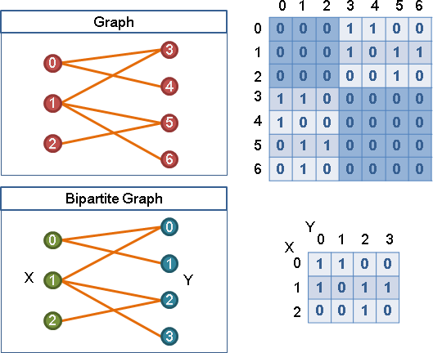
The Bipartite Graph
Heterogeneous graph with exactely two different types of nodes
Natural structur to model recommender systems
Keep in mind: Interaction matrix ≠ adjacency matrix
Bipartite graph and interaction matrix. Source : https://web.ntnu.edu.tw

Slide 6
Types of Recommender Systems
Goal: A recommender system is a system that tries to predict the value a user would grant to a certain item.
Types:
Content-based: elaborate a specific profile for each item and then calculate some similarity-based metric. Basically, it is about clustering similar items.
Collaborative-filtering: Focus on user behaviour. Assumption is, that users with a similar oberservation history tend to be interested in the same items.
GNN based: State-of-the-art for modern recommender systems. Learn suitable representations of graph data. Use message passing layers.

Slide 7
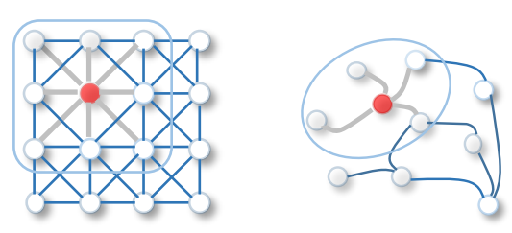
Message Passing Layer
Message passing layers or MPL build the core of every GNN
Similar to image convolutions
Process:
Gather information about the neighbourhood of a node
Aggregate this information
Update the current node embedding with the new information
Source: Wu et al., 2019, A comprehensive Survey on Graph Neural Networks, https://arxiv.org/pdf/1901.00596.pdf

Slide 8
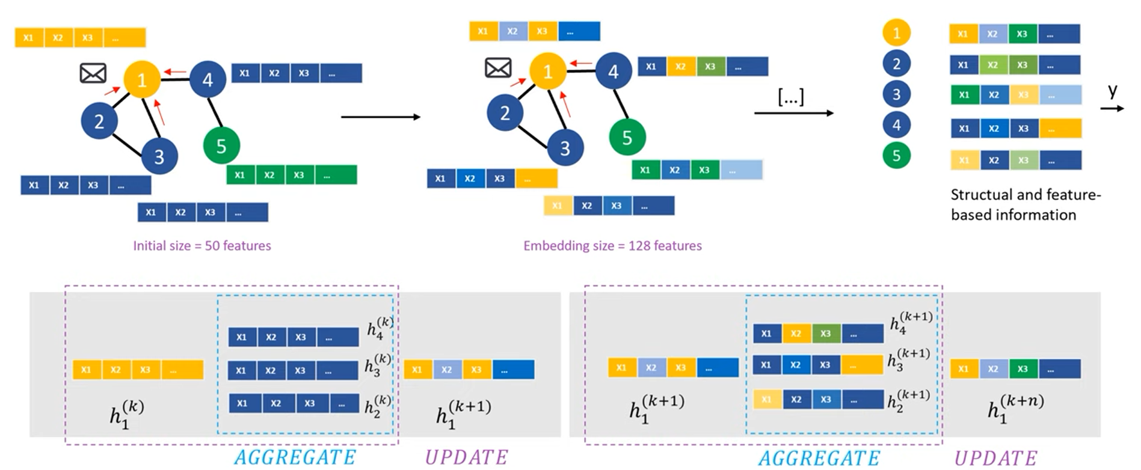
Message Passing Layer
Source: DeepFinr, Understanding Graph Neural Networks | Part 2/3, Youtube

Slide 9
The Dataset

Slide 10
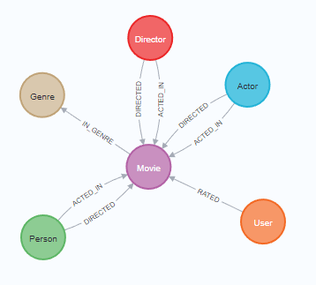
MovieLens100K
Type | Label | # Instances | Relevant properties
Node | User | 671 | Name
Node | Movie | 9’125 | Title, Budget, IMDB-Rating, plot, runtime, revenue, year
Node | Genre | 20 | Name
Node | Actor | 15’443 | Bio, birthdate
Node | Director | 4’091 | Bio, birthdate
Node | Person | 19’047 | Bio, birthdate
Relationship | RATED | 100’004 | Rating, rating-timestamp
Relationship | ACTED_IN | 35’910 | Role
Relationship | DIRECTED | 10’007 | -
Relationship | IN_GENRE | 20’340 | -

Slide 11




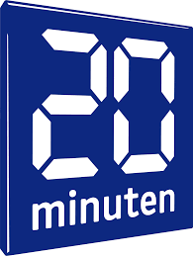




Motivation
If you’ve ever had a social media account, purchased something online, or consumed content from a streaming platform, there’s a good chance that you’ve been influenced by a recommender system. ¹
We live in a world in which recommendations are so common that we tend to forget the apparent ease with which these systems designed to optimize our consumer choices have been incorporated into practically any device and platform. We’re used to constantly receiving recommendations, but the way in which they have settled in our daily life is a long and interesting history […]²
¹Source: medium.com, Commons, 2017-08-01, https://medium.com/@Commons/the-importance-of-recommender-systems-36f86f92181
²Source: medium.com, Commons, 2019-08-06, https://medium.com/@topspinj/recommender-systems-101-bcbdfbe1e6e7#:~:text=Recommender%20systems%20are%20fuelled%20by,%2C%20and%202)%20implicit%20feedback%20.

Slide 12







Solution Design
Data pre-processing / Feature Engineering
Find embeddings (user and movie plots)
PyG HeteroData Class
GNN models
Hyperparameter tuning

Slide 13
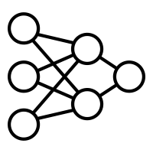


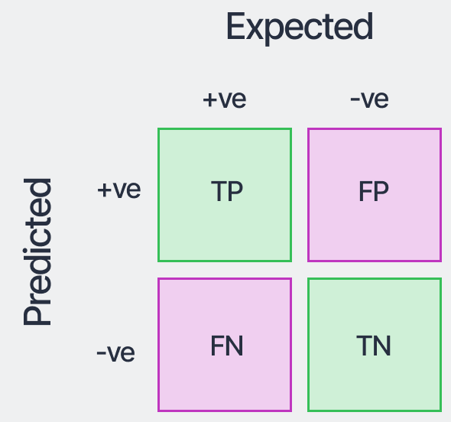

Big Picture

Slide 14
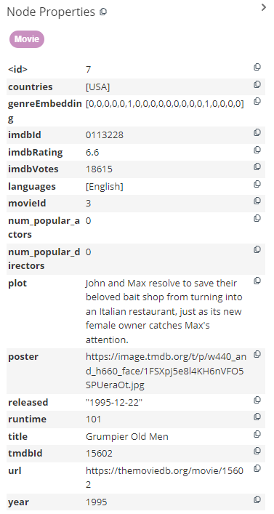
Pre-processing / Feature Engineering
Neo4J
Type-casting
One-hot encoding for genres
Calculating actor & director popularity

Slide 15
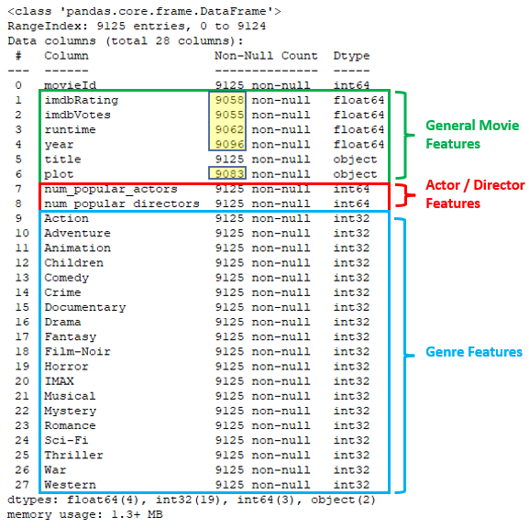
Pre-processing / Feature Engineering
Python / Pandas
Convert object-types to numerical types
Handle missing values -> fill with mean value
imdbRating: 67 (0.73%)
imdbVotes: 70 (0.77%)
runtime: 63 (0.69%)
year: 29 (0.32%)
plot: 42 (0.46%)
Embeddings (next slide)

Slide 16
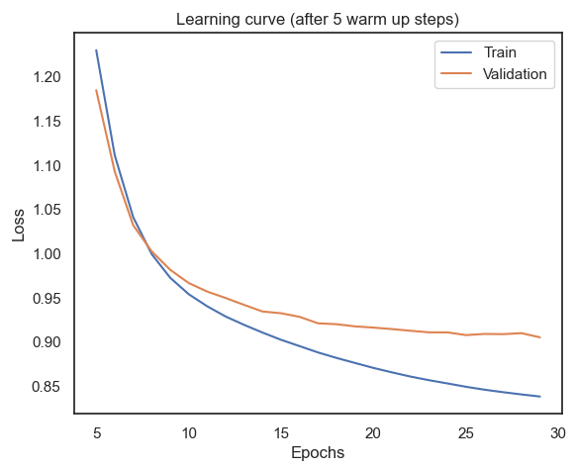
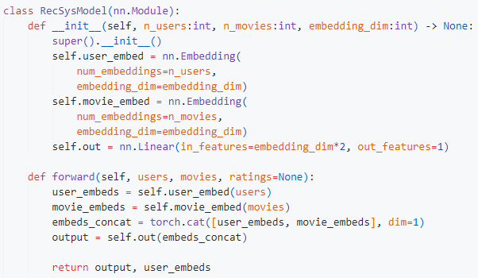
User embeddings
Problem: No user features
Solution: Train a NN with no features and extract the the user-embeddings.

Slide 17
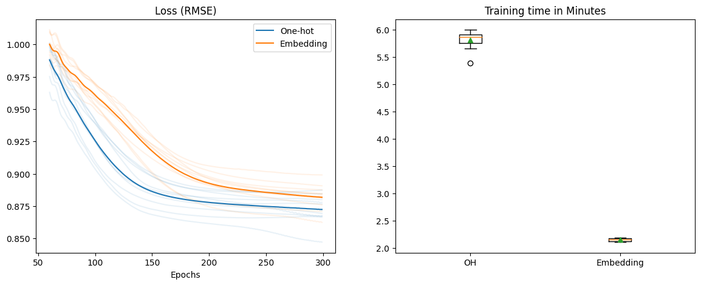
One-hot encoding vs. Pre-trained embeddings

Slide 18
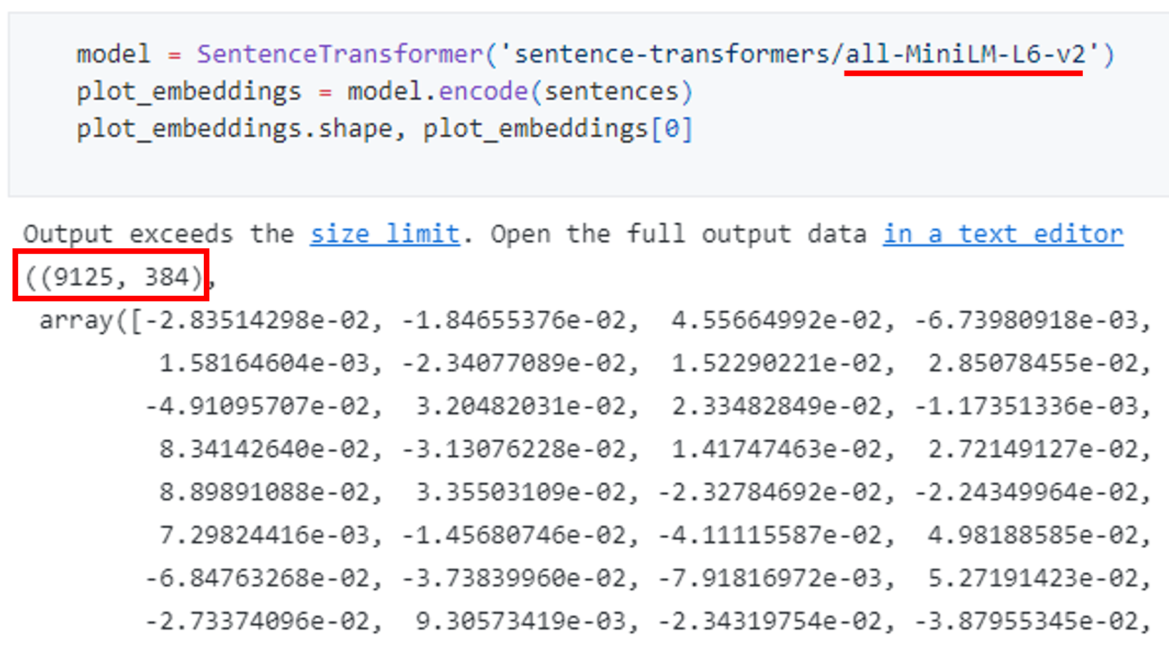
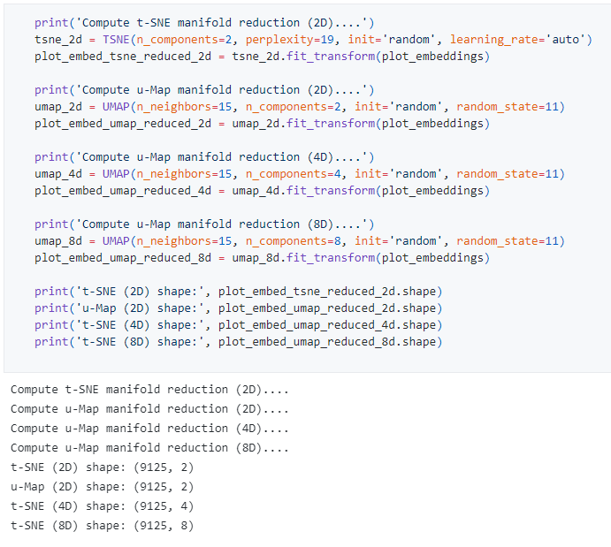
Plot embeddings
Problem: Movie titles and plots are string objects
Solution: Use a pre-trained NLP Model from huggingface to embed title and plot
Next Problem: 384 dimensions!
Next Solution: Use dimensionality reduction methods

Slide 19
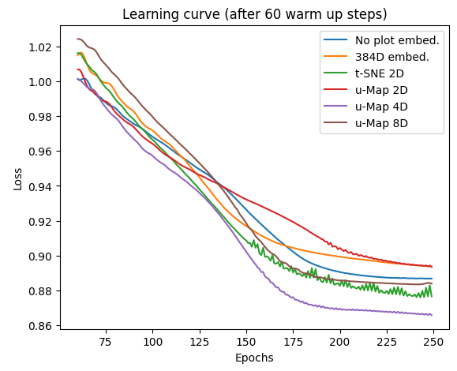
Plot embeddings

Slide 20
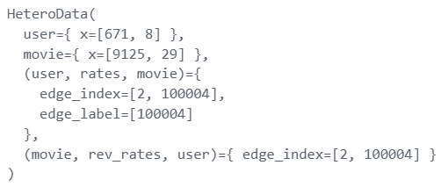
PyG pre-processing
Movie features: Genres, famous actors/directors, budget, revenue, title and plot embeddings
Rating score (1-5)
Create HeteroData Class
RandomLinkSplit (Train / Test Split) I used a 80/10/10 Split
Pre-trained embeddings
M₁
rates
U₁
rev_rates
M₂
U₂
rates
rev_rates
rates
rev_rates
M₉₁₂₄
U₆₇₁
rates
rev_rates
rates
rev_rates
M₉₁₂₅

Slide 21
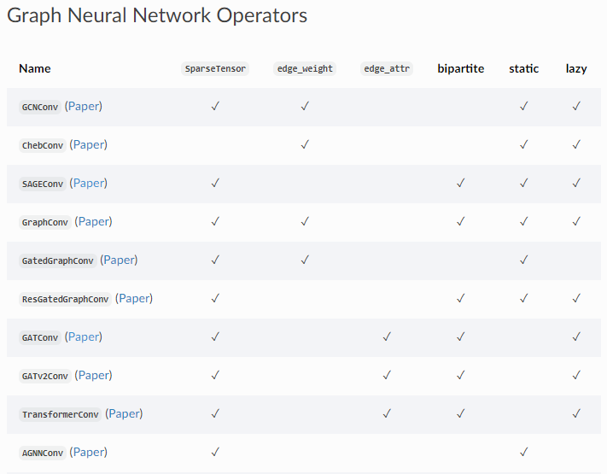



Build and Train a GNN model
Problem: Plenty of GNN models, which fits best?
Solution: Try and Error ☺
GraphGPS (Rampasek et al.)
Knowledge Embedding Based Graph Convolutional Network (Donghan Ye et al.)
PyG Graph Operators:
SAGEConv
GATConv
…

Slide 22
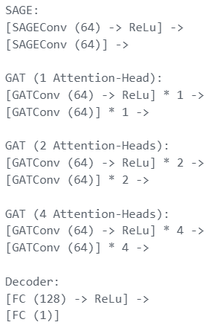
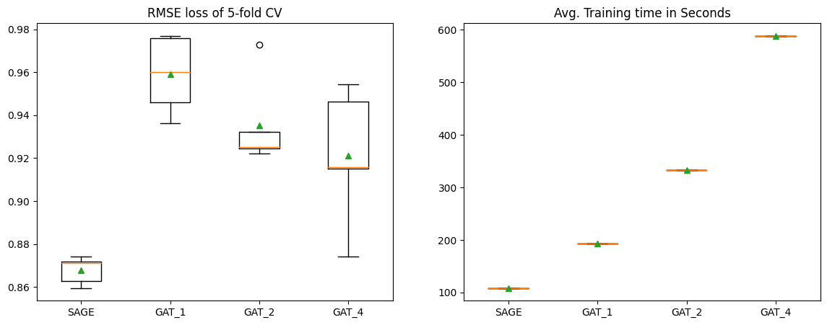

Compare different PyG GNN Operators
Conclusion: SAGE-Model has the lowest loss and fastes trainig times. It is 2x as fast as the GAT-Model with 1 Attention-head and 6x faster than GAT with 4 Attention-heads).

Slide 23
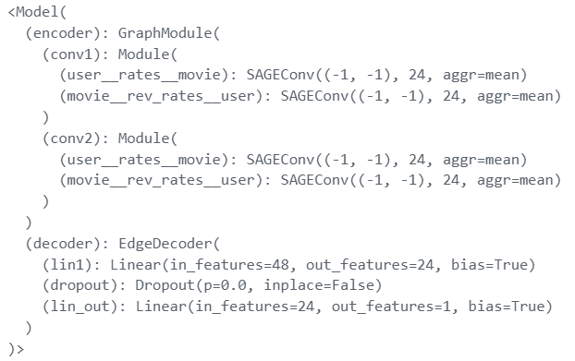
Hyperparameter tuning
Parameters
Number of epochs
Model size and architecture
Aggregation type
Activation function
Regularization methods (dropout)
Conclusion: Reducing the model capacity led to better results because the model could not overfit after a few epochs. With a smaller model I was able to train for 600 epochs without suffering from overfitting.

Slide 24
Evaluation

Slide 25
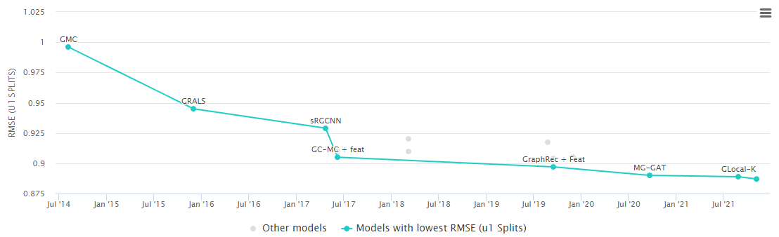
Benchmarks
Note: Datasets used consist only of user-ID’s, movie-ID’s and rating scores (no additional features).
Benchmark for MovieLens100K dataset
Best performing models on RMSE
Glocal-K: 0.889 (see paper)
GHRS: 0.887 (see paper)

Slide 26
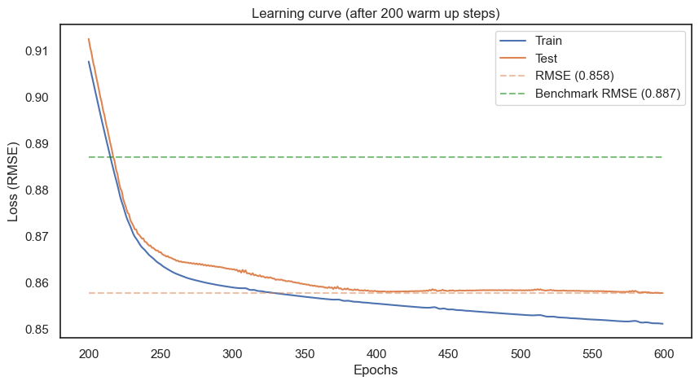
Model evaluation

Slide 27
Precision@k / Recall@k
Precision@k is the proportion of recommended items in the top-k set that are relevant. Suppose that my precision@10 is 80%. This means that 80% of the recommendation I make are relevant to the user.
Recall@k is the proportion of relevant items found in the top-k recommendations. Suppose that we computed recall@10 and found it is 40%. This means that 40% of the total number of the relevant items appear in the top-k results.
 | Threshold=3.5 | Threshold=4.0
Precision@20 | 0.7238 | 0.3782
Recall@20 | 0.6644 | 0.3486

Slide 28
Write Recommendations back to Neo4J

Slide 29
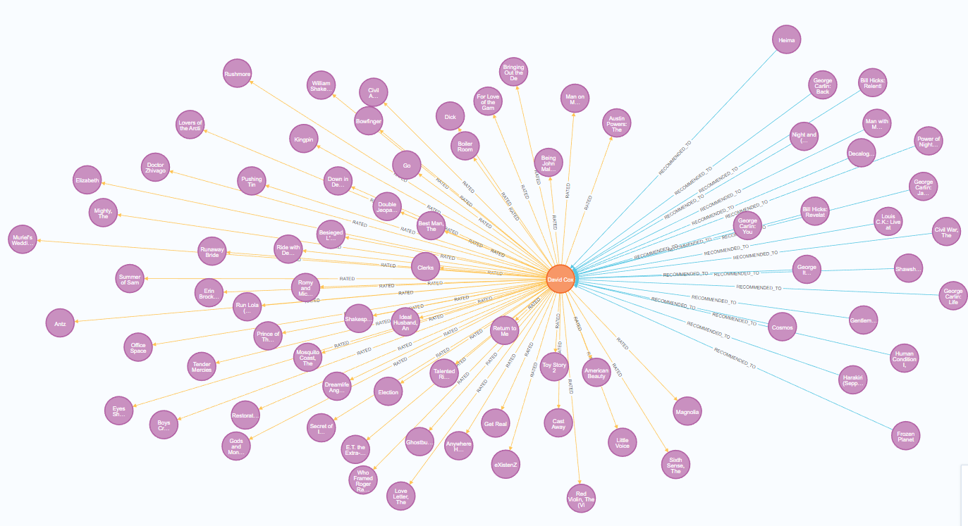
New Relation –[:RECOMMENDED_TO]->
Notes:
match (u:User)
where u.userId = 190
return *;

Slide 30
Conclusion

Slide 31
Wrap-up
Overall very good results. Main reason for better loss than benchmark models is propably the fact, that I used an enriched dataset with features. However, the project showed GNNs work very well on recommendation tasks.
Unstable model training. Sometimes the training got stock at RMSE of 0.93. The next training run than performed well again. Tweaking the learning rate might help (learning schedule).
Try binarizing approch for better precision@k and recall@k. Different loss function

Slide 32
Questions?

