Slide 1
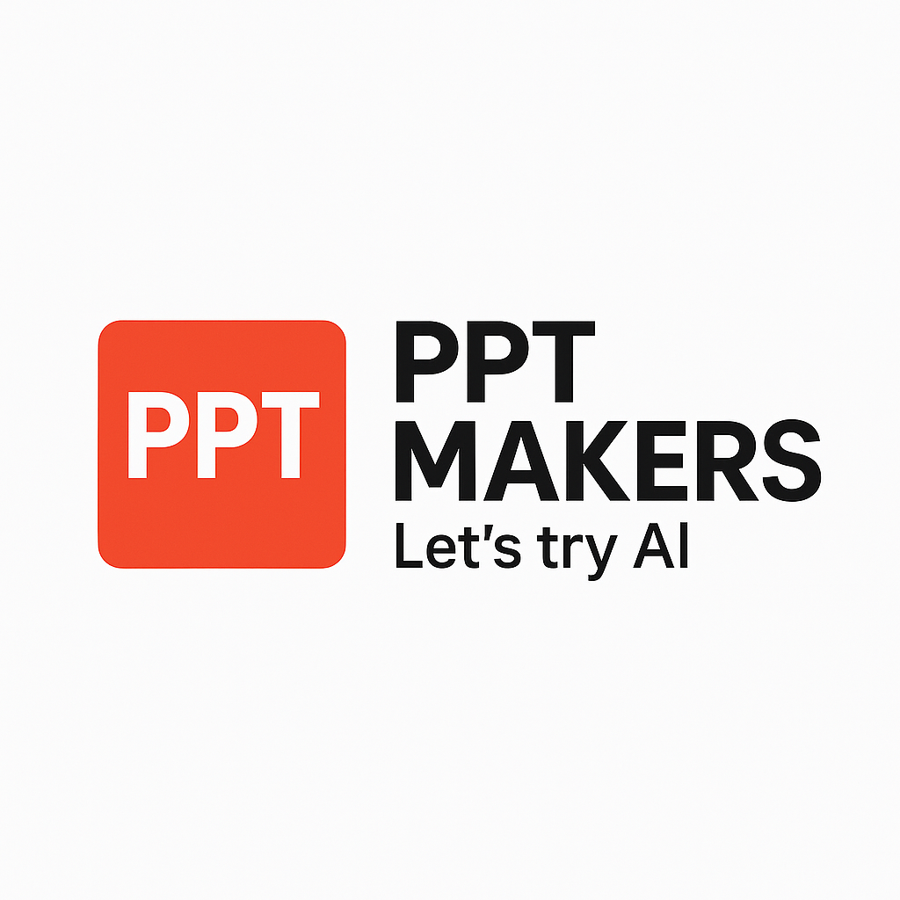
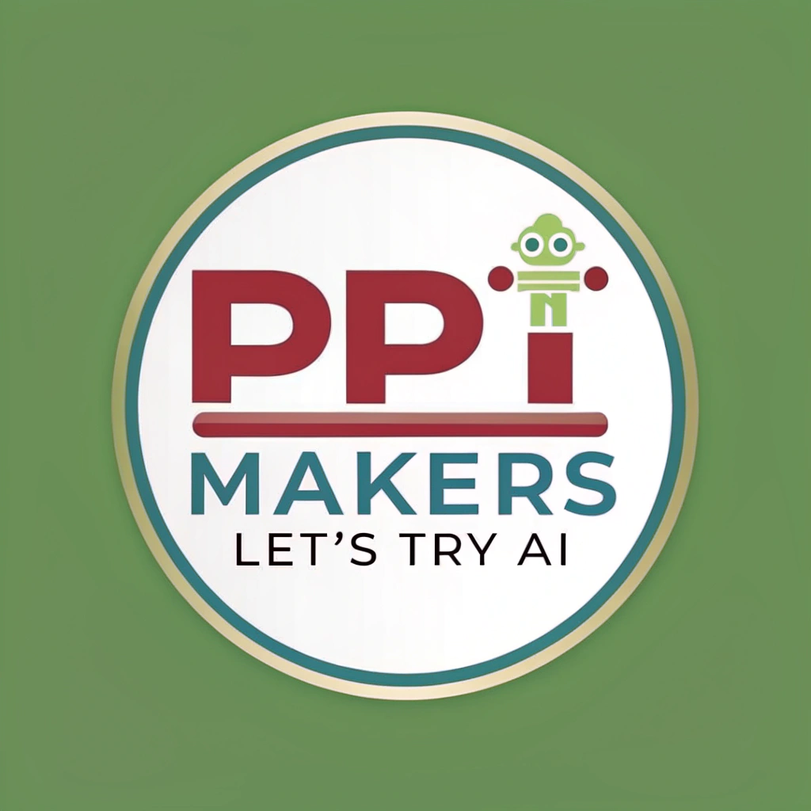
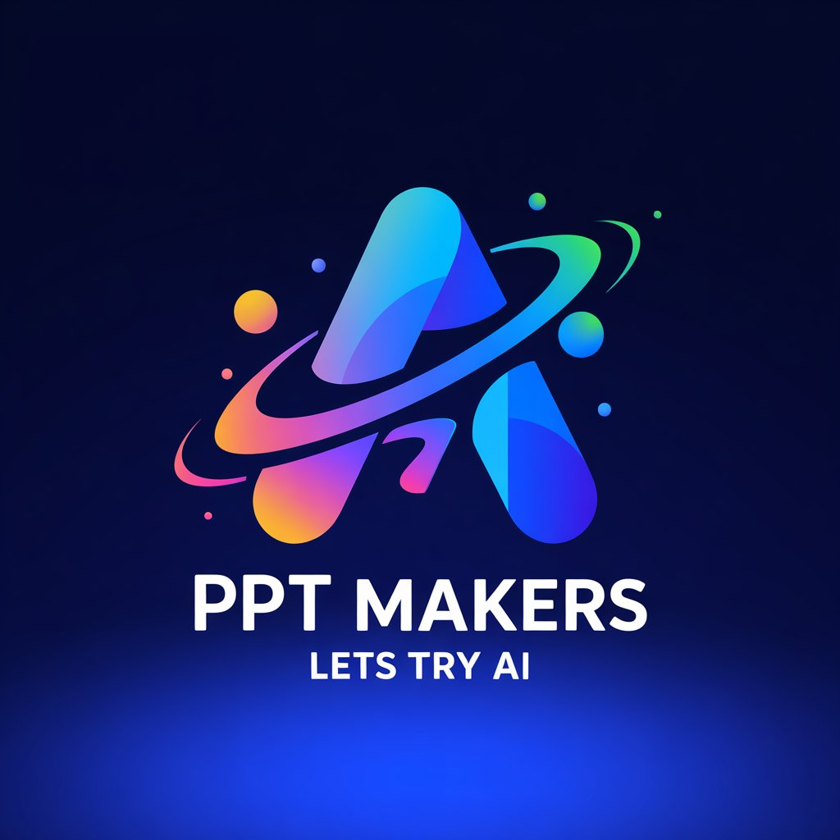
Application of Artificial Intelligence in Education
Here is a short introductory sentence: "The integration of Artificial Intelligence (AI) in education has revolutionized the way students learn and teachers teach, offering a multitude of benefits and opportunities to enhance the overall learning experience."

Slide 2
AI for content generation
Here is a brief introduction to the topic "AI for Content Generation": The rapid advancement of Artificial Intelligence (AI) has revolutionized the way we create and consume content. AI-powered tools have enabled the generation of high-quality content at unprecedented speeds and scales, transforming the way businesses, organizations, and individuals produce and disseminate information. AI for content generation refers to the use of machine learning algorithms and natural language processing techniques to automatically create, edit, and refine content such as text, images, videos, and audio files. This technology has the potential to transform industries such as marketing, journalism, education, and entertainment, and is poised to change the way we interact with information and each other. In this topic, we will explore the applications, benefits, and challenges of AI-powered content generation, and examine the implications for the future of content creation.

Slide 3
Advantages
Here are the key advantages of using AI for content generation in education: • **Personalization**: AI-generated content can be tailored to individual students' learning styles, abilities, and needs, improving engagement and understanding. • **Efficiency**: AI can quickly generate large volumes of high-quality content, reducing the workload and time spent by educators on content creation. • **Customization**: AI can create customized content for specific courses, topics, or learning objectives, ensuring that students receive relevant and accurate information. • **Scalability**: AI-generated content can be easily scaled up or down to accommodate changing curriculum requirements or student enrollment. • **Consistency**: AI can ensure consistency in content quality, tone, and language, reducing errors and improving overall educational experience.

Slide 4
Practical Examples
Here are some practical examples of applying AI for content generation in education in English: 1. **Automated Quiz Generation**: AI-powered platforms can generate quizzes based on educational content, such as textbooks, online courses, or educational standards. This helps teachers save time and creates a more personalized learning experience for students. Example: Quizzify, a platform that uses AI to generate quizzes based on educational content, has been used by teachers to create quizzes for their students. 2. **AI-Generated Learning Paths**: AI algorithms can analyze a student's learning behavior, strengths, and weaknesses to create customized learning paths. This helps students focus on areas where they need improvement and accelerates their learning process. Example: DreamBox, a math education platform, uses AI to create personalized learning paths for students, adapting to their learning style and pace. 3. **Content Summarization**: AI-powered tools can summarize lengthy educational content, such as articles, videos, or podcasts, into concise and easily digestible summaries, helping students quickly grasp key concepts. Example: Summarize.ai, a platform that uses AI to summarize educational content, has been used by students and teachers to quickly grasp complex topics. 4. **AI-Generated Flashcards**: AI algorithms can generate flashcards based on educational content, helping students memorize key terms, concepts, and formulas. Example: Anki, a popular flashcard app, uses AI to generate flashcards based on user input, helping students memorize large amounts of information. 5. **AI-Assisted Essay Writing**: AI-powered tools can assist students in writing essays by providing suggestions for structure, grammar, and sentence structure, helping to improve the overall quality of their writing. Example: Grammarly, a writing tool, uses AI to suggest grammar corrections, sentence structure improvements, and even provides suggestions for essay structure and content. 6. **AI-Generated Virtual Field Trips**: AI-powered platforms can create immersive virtual field trips, allowing students to explore historical sites, museums, or other educational destinations remotely. Example: Discovr, a platform that uses AI to create virtual field trips, has been used by teachers to take their students on virtual tours of historical sites and museums. These are just a few examples of how AI is being applied in education to generate content and improve the learning experience. As AI technology continues to evolve, we can expect to see even more innovative applications in the future!

Slide 5
Development Prospects
The future potential of AI for content generation in English is vast and promising, with significant development prospects in the coming years. As AI technology continues to advance, we can expect to see more sophisticated language models capable of generating high-quality, human-like content at scale. This could revolutionize industries such as publishing, marketing, and education, where AI-generated content could supplement or even replace human writers. Additionally, AI-powered content generation could enable the creation of customized content for individual users, tailoring messages to specific audiences and improving engagement. Furthermore, AI-generated content could also help to reduce the content creation burden on human writers, freeing them up to focus on higher-level creative tasks. As AI technology continues to evolve, we can expect to see even more innovative applications of AI-generated content, such as the creation of interactive stories, personalized news feeds, and immersive educational experiences.

Slide 6
AI for curriculum development
Here is a brief introduction for the topic "AI for Curriculum Development": The rapid advancement of Artificial Intelligence (AI) has transformed various aspects of education, including curriculum development. As the demand for personalized and effective learning experiences continues to grow, AI is being increasingly utilized to support the creation of curricula that are tailored to individual students' needs, abilities, and learning styles. AI-powered tools can analyze vast amounts of educational data, identify knowledge gaps, and generate customized lesson plans that cater to diverse learners. Moreover, AI can facilitate the development of adaptive assessments, provide real-time feedback, and even help teachers create engaging multimedia content. As AI continues to evolve, its potential to revolutionize the curriculum development process is vast, offering a new paradigm for educators to design and deliver high-quality educational experiences that prepare students for success in the 21st century.

Slide 7
Advantages
Here are the key advantages of using AI for curriculum development in education: • **Personalization**: AI can help create customized learning paths for individual students, taking into account their learning style, pace, and abilities. • **Efficiency**: AI can automate the process of curriculum development, freeing up educators' time to focus on more important tasks, such as teaching and mentoring. • **Scalability**: AI can quickly and easily create and update curriculum content, making it easier to scale educational programs to large numbers of students. • **Data-driven insights**: AI can analyze vast amounts of educational data to identify trends, patterns, and areas for improvement, helping educators to refine their curriculum and teaching methods. • **Cost-effective**: AI can reduce the costs associated with curriculum development, such as printing and distributing physical materials, and help make high-quality educational content more accessible to a wider range of students.

Slide 8
Practical Examples
Here are some practical examples of applying AI for curriculum development in education in English: 1. **Personalized Learning Paths**: AI-powered adaptive learning systems create customized learning paths for students based on their strengths, weaknesses, and learning style, ensuring that they receive targeted instruction and support. 2. **Intelligent Tutoring Systems**: AI-powered chatbots and virtual assistants provide one-on-one support to students, offering real-time feedback, guidance, and assessments to help them master specific skills or concepts. 3. **Curriculum Mapping and Alignment**: AI algorithms analyze educational standards, benchmarks, and learning objectives to create detailed maps of curricula, ensuring that they are aligned, coherent, and easy to implement. 4. **Automated Content Generation**: AI-powered tools generate high-quality, engaging educational content, such as videos, simulations, and interactive activities, reducing the time and effort required for content creation. 5. **Assessment and Feedback**: AI-driven assessment tools provide instant feedback to students, teachers, and parents, offering insights into student performance, strengths, and areas for improvement. 6. **Natural Language Processing (NLP)**: AI-powered NLP tools analyze student responses to open-ended questions, providing insights into their thinking, understanding, and communication skills. 7. **Data-Driven Instruction**: AI-powered data analytics tools help teachers identify trends, patterns, and correlations in student data, enabling them to make data-driven decisions about instruction and curriculum development. 8. **Game-Based Learning**: AI-powered game design tools create engaging, interactive learning experiences that adapt to students' skills and knowledge levels, promoting active learning and fun. 9. **Virtual Field Trips**: AI-powered virtual reality tools simulate real-world experiences, allowing students to explore new environments, cultures, and historical events in a safe and controlled setting. 10. **Teacher Support and Professional Development**: AI-powered tools provide teachers with personalized support, resources, and professional development opportunities, helping them stay updated on best practices and curriculum developments. These examples illustrate how AI can enhance the curriculum development process, making it more efficient, effective, and student-centered.

Slide 9
Development Prospects
The future potential and development prospects of AI for curriculum development in English are vast and exciting. AI-powered tools can revolutionize the way curricula are designed, developed, and delivered, enabling personalized learning experiences tailored to individual students' needs and abilities. With AI-driven natural language processing and machine learning algorithms, curricula can be generated more efficiently and effectively, incorporating real-time feedback and assessment data to inform instruction. AI can also help identify knowledge gaps and learning patterns, allowing educators to refine their teaching strategies and improve student outcomes. Moreover, AI can facilitate collaboration and knowledge sharing among educators, enabling the development of more comprehensive and inclusive curricula. As AI continues to evolve, it is likely to play an increasingly prominent role in shaping the future of English language education, enhancing the quality and effectiveness of curriculum development, and ultimately, improving student learning outcomes.

Slide 10
AI for personalized learning
Here is a brief introduction to the topic "AI for personalized learning": In recent years, the education sector has witnessed a significant shift towards personalized learning, where students' individual needs, abilities, and learning styles are taken into account to tailor the learning experience. Artificial Intelligence (AI) has emerged as a powerful tool to facilitate this transformation, enabling educators to create customized learning paths for each student. By leveraging AI's capabilities in data analysis, natural language processing, and machine learning, educators can now create highly effective and engaging learning experiences that cater to each student's unique strengths, weaknesses, and learning preferences. This innovative approach has the potential to revolutionize the way we learn, making education more efficient, effective, and enjoyable for students of all ages and backgrounds.

Slide 11
Advantages
Here are the key advantages of using AI for personalized learning in education: • **Tailored instruction**: AI can analyze individual students' strengths, weaknesses, and learning styles to provide customized lesson plans and adaptive assessments, ensuring each student receives relevant and effective instruction. • **Efficient grading and feedback**: AI-powered tools can automate grading and provide immediate feedback, freeing up instructors to focus on teaching and mentoring, and reducing the workload associated with grading. • **Real-time monitoring and adaptation**: AI can continuously monitor students' progress and adjust instruction in real-time, allowing for precise targeting of areas where students need additional support or enrichment. • **Scalability and accessibility**: AI-powered personalized learning platforms can reach a large number of students, making high-quality education more accessible and equitable, particularly for students in remote or underserved areas. • **Data-driven insights**: AI can analyze vast amounts of educational data to identify trends, patterns, and correlations, providing educators with valuable insights to inform instructional decisions and improve student outcomes.

Slide 12
Practical Examples
Here are some practical examples of applying AI for personalized learning in education: 1. **Adaptive Assessments**: AI-powered adaptive assessments adjust their difficulty level and content based on a student's performance, providing a more accurate measure of their knowledge and skills. Example: DreamBox Learning's math program uses AI to adjust the difficulty level of math problems based on a student's performance, ensuring they're always challenged but not overwhelmed. 2. **Intelligent Tutoring Systems**: AI-powered chatbots or virtual assistants provide one-on-one support to students, offering real-time feedback and guidance on complex topics. Example: Carnegie Learning's Cognitive Tutor system uses AI to provide personalized math and science instruction to students, adapting to their learning style and pace. 3. **Content Recommendations**: AI algorithms analyze a student's learning history and preferences to recommend personalized learning content, such as videos, articles, or simulations. Example: McGraw-Hill's ALEKS system uses AI to recommend personalized learning content to students, based on their strengths, weaknesses, and learning goals. 4. **Automated Grading**: AI-powered grading systems quickly and accurately assess student assignments, freeing up instructors to focus on teaching and feedback. Example: Gradescope's AI-powered grading system uses machine learning algorithms to automatically grade student assignments, reducing grading time by up to 90%. 5. **Learning Analytics**: AI-powered analytics platforms provide insights into student learning behavior, helping educators identify areas of improvement and develop targeted interventions. Example: BrightBytes' Clarity system uses AI to analyze student learning data, providing educators with actionable insights to improve student outcomes and achievement. 6. **Virtual Learning Environments**: AI-powered virtual learning environments simulate real-world scenarios, allowing students to engage in interactive and immersive learning experiences. Example: zSpace's virtual reality platform uses AI to create interactive, 3D learning experiences for students, enhancing engagement and understanding of complex concepts. These are just a few examples of how AI is being applied to personalize learning in education. By leveraging AI, educators can create more effective, efficient, and engaging learning experiences for students.

Slide 13
Development Prospects
The future potential of AI for personalized learning in English is vast and promising, with significant development prospects on the horizon. As AI technology advances, it is expected to revolutionize the way students learn English by providing tailored instruction, real-time feedback, and adaptive assessments. AI-powered learning platforms will be able to analyze individual student data, learning styles, and abilities to create customized lesson plans, making learning more efficient and effective. Additionally, AI-driven chatbots and virtual assistants will enable students to practice conversational skills, receive instant feedback, and engage in interactive discussions. Furthermore, AI-powered adaptive assessments will help teachers identify knowledge gaps and adjust instruction accordingly, ensuring that students are well-prepared for standardized tests and future academic success. As AI continues to evolve, it is likely to play a crucial role in shaping the future of English language learning, enabling students to achieve their full potential and become confident communicators in the global community.

Slide 14
SUMMARY
In conclusion, the application of Artificial Intelligence (AI) in education has transformative potential to revolutionize the way we learn and teach. By leveraging AI's capabilities in personalized learning, adaptive assessment, and intelligent tutoring systems, educators can create more effective and efficient learning experiences that cater to individual students' needs and abilities. Additionally, AI-powered tools can help reduce teacher workload, improve student engagement, and enhance the overall quality of education. As AI continues to evolve and become more accessible, it is crucial that educators, policymakers, and industry leaders work together to develop and implement AI-based solutions that prioritize equity, inclusivity, and human values, ultimately leading to a more intelligent and empathetic education system that benefits students and society as a whole.

