Slide 1
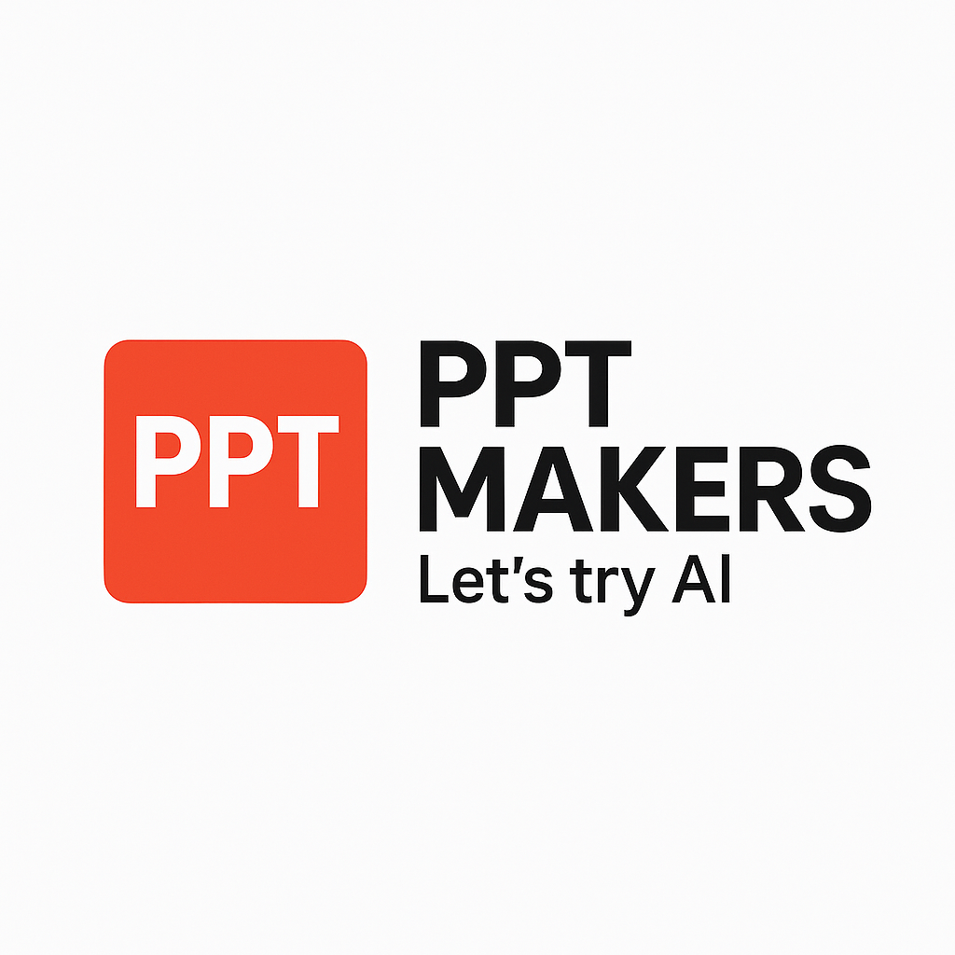
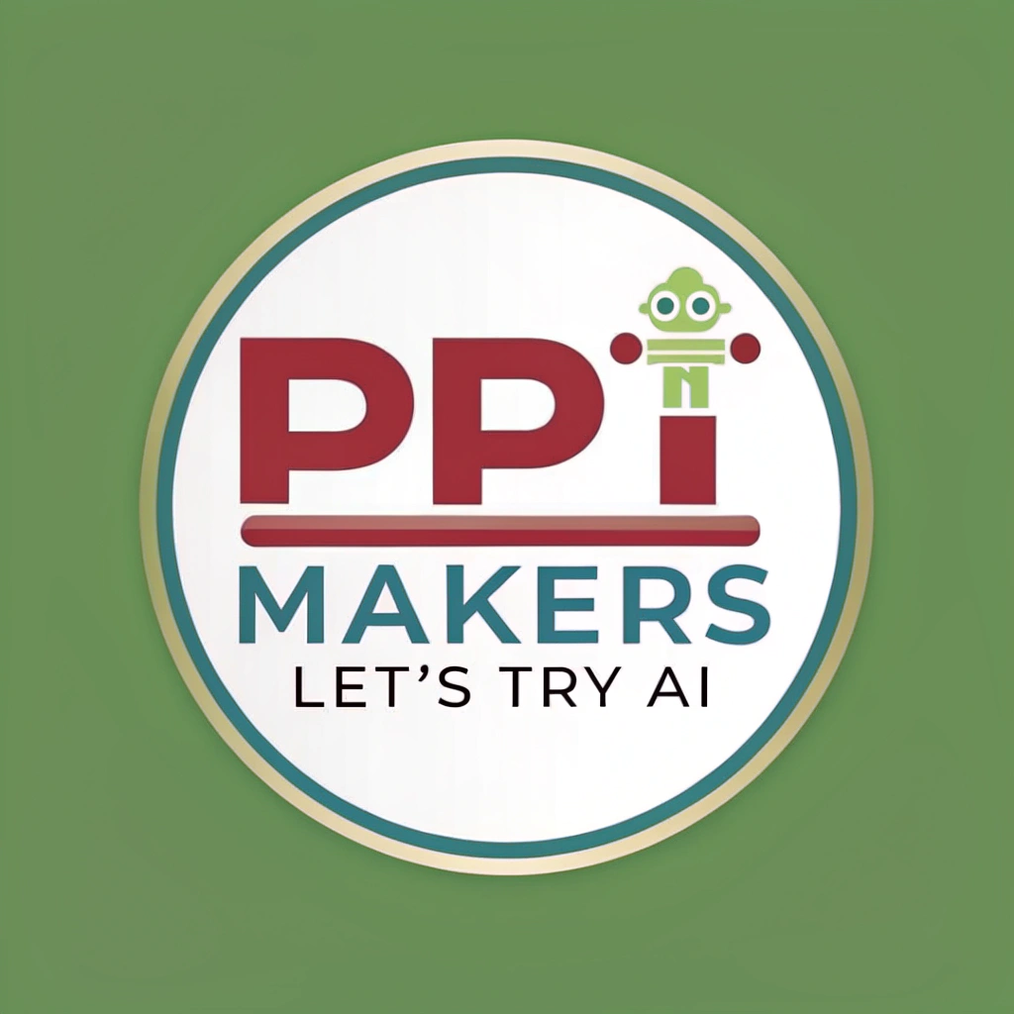
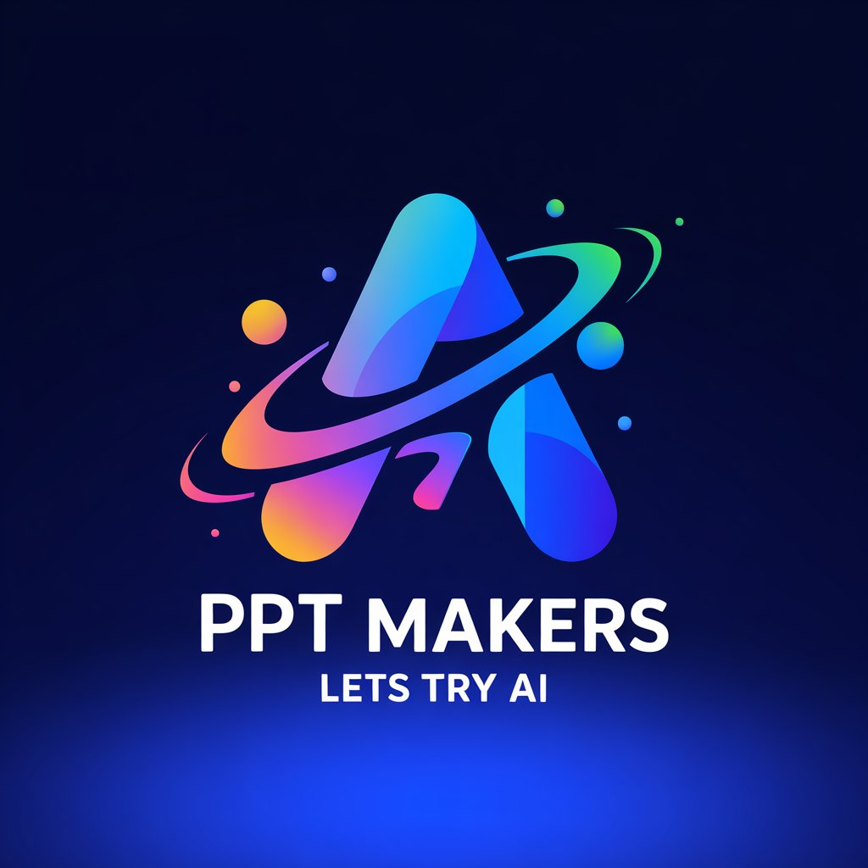
Application of Artificial Intelligence in Education
Artificial intelligence (AI) is transforming the education sector by providing personalized learning experiences, automating administrative tasks, and improving student outcomes.

Slide 2
AI for content generation
Artificial intelligence has revolutionized the way we create and consume content. AI-powered tools can generate high-quality content quickly and efficiently, from blog posts and social media updates to entire books and scripts. These tools use natural language processing and machine learning algorithms to analyze vast amounts of data and produce human-like content that is engaging, informative, and relevant. With the increasing demand for content and the need for businesses to stay competitive, AI for content generation is becoming an essential tool for marketers, writers, and communicators.

Slide 3
Advantages
• Personalized learning experiences for students with tailored content and recommendations. • Increased efficiency and reduced workload for instructors with automated grading and feedback. • Enhanced accessibility and inclusivity with AI-generated content in multiple languages and formats. • Improved student engagement with interactive and immersive learning experiences. • Scalability and flexibility with AI-generated content that can be easily updated and revised.

Slide 4
Practical Examples
AI-powered chatbots can assist students with homework and project-related queries, providing instant answers and guidance. For instance, a chatbot can help a student with a math problem, explaining the solution step-by-step. AI-generated quizzes and assessments can be used to evaluate student understanding and provide personalized feedback. AI can also analyze student performance data to identify knowledge gaps and suggest targeted interventions. AI-driven virtual teaching assistants can facilitate remote learning by providing real-time support and engagement. For instance, an AI-powered virtual teaching assistant can lead a virtual classroom discussion, ask questions, and provide feedback to students. AI-powered content creation tools can help educators generate customized learning materials, such as interactive lessons, games, and simulations. For instance, an AI-powered tool can create a customized lesson plan based on a student's learning style and pace. AI-driven adaptive learning systems can adjust the difficulty level of course materials based on a student's performance. For instance, an AI-driven adaptive learning system can reduce the difficulty level of a math problem if a student is struggling, and increase it if they are performing well. AI-powered language translation tools can help educators communicate with students who speak different languages, facilitating global learning and collaboration. For instance, an AI-powered translation tool can translate a teacher's lecture into multiple languages in real-time.

Slide 5
Development Prospects
AI for content generation has the potential to revolutionize the way we create and consume written content, enabling the production of high-quality, engaging, and personalized content at scale. As AI technology advances, we can expect to see significant improvements in natural language processing, allowing AI-powered content generators to better understand context, tone, and style. This could lead to the development of AI-driven content creation tools that can produce high-quality content faster and more efficiently than human writers, freeing up human creatives to focus on more strategic and high-level tasks. Additionally, AI-generated content could be used to augment human content, providing a new level of personalization and customization, and potentially opening up new revenue streams for content creators and publishers.

Slide 6
AI for curriculum development
Artificial Intelligence (AI) has revolutionized various aspects of education, and curriculum development is no exception. Traditional methods of curriculum development often rely on human expertise, which can be time-consuming, labor-intensive, and prone to biases. AI-powered tools can help streamline the process, leveraging data analytics and machine learning algorithms to identify trends, patterns, and correlations. This enables the creation of more personalized, effective, and adaptive curricula that cater to diverse learning needs.

Slide 7
Advantages
• Personalized learning: AI can create customized learning paths for students based on their individual needs, abilities, and learning styles. • Scalability: AI can develop and update curriculum materials at a much faster rate and larger scale than human teachers, making it ideal for large classrooms or online courses. • Adaptability: AI can adjust curriculum content and difficulty level in real-time based on student performance and feedback, ensuring that students are always challenged and engaged. • Enhanced accessibility: AI can provide real-time translation, text-to-speech, and speech-to-text functionality, making learning materials more accessible to students with disabilities. • Data-driven decision making: AI can analyze student performance data and provide insights to educators, helping them identify areas of improvement and make data-driven decisions about curriculum development.

Slide 8
Practical Examples
AI can be used to analyze large datasets of educational content, identifying patterns and trends to inform curriculum development. For example: * AI-powered content analysis can help identify gaps in existing curricula, ensuring that new curriculum is comprehensive and relevant. * AI-driven adaptive learning systems can provide personalized learning pathways for students, allowing for more effective use of teaching resources. * AI-assisted curriculum design can help educators create more engaging and interactive lesson plans, incorporating multimedia and gamification elements. * AI-powered analytics can track student progress and identify areas where students may need additional support, enabling targeted interventions and improved student outcomes. * AI-driven natural language processing can help analyze and generate educational content, such as textbooks and assessments, more efficiently and accurately. * AI-assisted teacher training can provide personalized coaching and feedback to teachers, helping them develop more effective teaching strategies and improve student outcomes.

Slide 9
Development Prospects
AI has the potential to revolutionize curriculum development in English by generating personalized learning pathways, adapting to individual students' learning styles and needs, and providing real-time feedback. Advanced natural language processing and machine learning algorithms can analyze vast amounts of educational data to identify effective teaching methods, optimize lesson plans, and create engaging multimedia content. AI-powered chatbots and virtual assistants can also facilitate one-on-one tutoring, enabling students to receive targeted support and guidance. Furthermore, AI can help teachers to identify knowledge gaps, track student progress, and develop data-driven assessments, ultimately leading to improved student outcomes and more effective instruction.

Slide 10
AI for personalized learning
Artificial intelligence has transformed the way we learn by enabling personalized education tailored to individual students' needs, abilities, and learning styles. With AI-powered adaptive learning systems, educators can create customized lesson plans, track student progress, and provide real-time feedback, leading to improved academic outcomes and increased student engagement.

Slide 11
Advantages
• Provides tailored learning experiences based on individual students' needs, abilities, and learning styles • Offers real-time feedback and assessment, enabling teachers to track student progress and adjust instruction accordingly • Enhances student engagement through interactive and gamified learning experiences • Supports differentiated instruction, catering to diverse learning needs and abilities • Automates administrative tasks, freeing up instructors to focus on teaching and mentoring

Slide 12
Practical Examples
AI-powered adaptive learning systems use student data and algorithms to adjust the difficulty level and content of educational materials in real-time. Examples include: * Khan Academy's adaptive math platform, which adjusts the difficulty of math problems based on a student's performance and learning pace. * DreamBox's math software, which uses AI to identify areas where students need extra support and provides personalized lessons and exercises. * Coursera's adaptive learning platform, which uses machine learning to adjust the difficulty level of online courses based on a student's performance and learning style. * Duolingo's language-learning app, which uses AI to adjust the difficulty level of language lessons and provide personalized feedback and encouragement. * Knewton's adaptive learning platform, which uses AI to adjust the difficulty level of educational content and provide personalized feedback and recommendations to students.

Slide 13
Development Prospects
As AI technology continues to advance, its potential for personalized learning in English is vast and exciting. AI-powered adaptive learning systems can analyze individual students' learning styles, strengths, and weaknesses to create customized lesson plans and exercises, tailoring the learning experience to each student's needs. AI-driven chatbots and virtual teaching assistants can provide real-time feedback, guidance, and support, freeing up human teachers to focus on more complex and creative tasks. Additionally, AI can help identify knowledge gaps and skill deficiencies, allowing educators to target specific areas for improvement. With AI, students can learn at their own pace, accelerating their progress and achieving better outcomes. As AI continues to evolve, it is likely to transform the way we learn English, making it more efficient, effective, and enjoyable for students of all ages and abilities.

Slide 14
SUMMARY
Artificial intelligence has the potential to revolutionize the education sector by enhancing the learning experience, improving student outcomes, and increasing efficiency. By leveraging AI-powered tools, educators can personalize learning paths, provide real-time feedback, and identify knowledge gaps, leading to better academic performance and increased student engagement. Additionally, AI can help automate administrative tasks, freeing up instructors to focus on teaching and mentoring. As AI continues to evolve, its applications in education will only continue to grow, enabling a more effective, efficient, and student-centered learning environment.

