Slide 1
RAG — Retrieval-Augmented Generation. Instead of asking an LLM to reason from memory alone, you pre-process and store structured knowledge (the scores, summaries, topics) in a database, then retrieve the relevant rows at query time to ground the LLM's recommendations in real data.
The combination of the two is increasingly referred to as an AI data pipeline or more specifically a structured RAG pipeline — the key distinction from classic RAG (which retrieves raw text chunks) being that your retrieval layer returns structured numeric scores, which are far more reliable for a reasoning agent than unprocessed text.

Slide 2
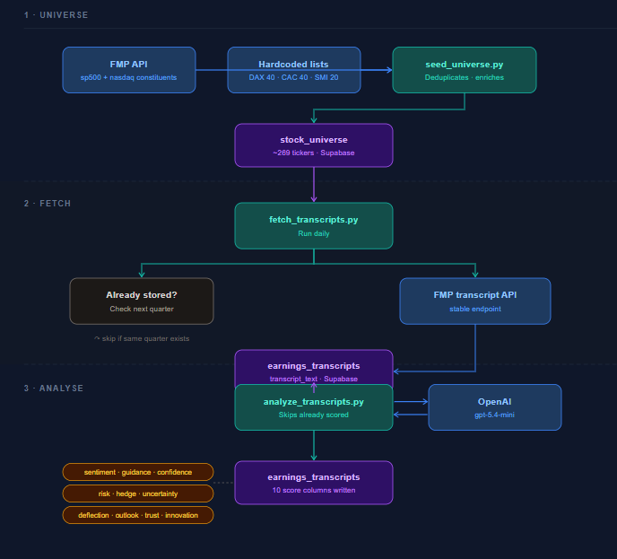
Data Pipeline Process
1 · Universe
FMP API — pulls S&P 500 and Nasdaq 100 constituents via the stable endpoint, returning ticker, name, sector and exchange for each company
Hardcoded lists — DAX 40, CAC 40 and SMI 20 tickers are statically defined since FMP has no constituent endpoint for European indices
seed_universe.py — merges all sources, deduplicates overlapping tickers (e.g. AAPL appears in both S&P 100 and NDX 100), enriches each ticker with a bulk profile call, and upserts ~269 rows
stock_universe table — single source of truth for the investment universe; includes ticker, name, exchange, sector, industry, country and an active flag to pause any ticker without deleting it

Slide 3
Data Pipeline Process
2 · Fetch
fetch_transcripts.py — runs daily, reads all active tickers from stock_universe, and fetches the latest earnings call transcript from FMP for each
Already stored? — for each ticker, checks if the next expected quarter already exists in the database; if yes, skips the FMP call entirely to preserve history and avoid unnecessary API usage
FMP transcript API — calls the stable earning-call-transcript endpoint with symbol, year and quarter; steps back up to 6 quarters to find the most recent available transcript
earnings_transcripts table — stores the full transcript text alongside ticker, year, quarter and earnings date; one row per company per quarter, with a unique constraint to prevent duplicates
3 . Analyse
analyze_transcripts.py — reads all rows where sentiment_score is null (i.e. not yet scored), sends each transcript to OpenAI, and writes the results back as dedicated columns
OpenAI gpt-5.4-mini — receives a structured prompt with the full transcript text and returns a JSON object of 10 integer scores on a 0–10 scale; temperature set to 0.1 for consistent output
10 score columns — sentiment, guidance, confidence, uncertainty, hedge, analyst trust, deflection, forward outlook, risk and innovation; each stored as a smallint column with a 0–10 check constraint directly in the table

Slide 4
Scores
sentiment_score — Measures the overall emotional tone of the transcript. A high score signals management is upbeat about results and the business; a low score flags concern, disappointment or defensiveness.
guidance_score — Captures whether management raised, maintained or lowered its forward outlook. The single most market-moving signal in any earnings call.
confidence_score — Reflects how assertive and specific management sounds in prepared remarks. High confidence typically correlates with strong visibility into the business; low confidence suggests uncertainty about the path ahead.
uncertainty_score — Counts how often management uses vague, qualified or non-committal language. A rising uncertainty score quarter-over-quarter is an early warning signal even when headline numbers look fine.
hedge_score — Tracks the density of legal and linguistic hedging ("subject to", "assuming conditions remain", "may", "could"). Heavy hedging often means management is less confident than the prepared script implies.
analyst_trust_score — Infers how satisfied the analyst community is based on Q&A dynamics. When analysts ask short, constructive questions the trust is high; when they probe, repeat themselves or challenge figures, it drops.
deflection_score — Measures how often management avoids, redirects or gives non-answers in the Q&A. A high deflection score on a specific topic — margins, a product line, a market — is a red flag worth investigating.
forward_outlook_score — Scores the strength and positivity of all forward-looking statements combined. Distinct from guidance_score in that it captures the broader narrative about demand, pipeline and strategy, not just numerical targets.
risk_score — Counts new or escalating risk factors mentioned during the call. A sudden spike in risk_score — tariffs, a key customer, a regulatory issue — often precedes a guidance cut in the following quarter.
innovation_score — Measures the emphasis placed on AI, new products, R&D and strategic investment. High scores indicate a company investing in future growth; low scores may signal a mature or cost-cutting mode business.

Slide 5
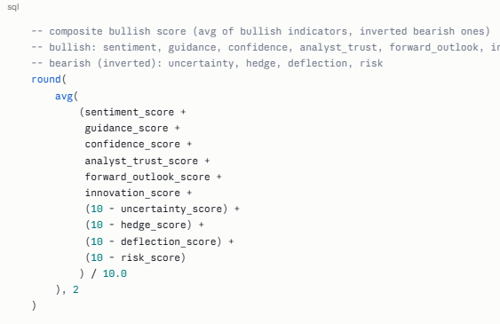
Composite Scores
The composite_score is the most useful single number — it combines all 10 scores into one 0–10 metric by averaging the bullish indicators directly and inverting the bearish ones (uncertainty, hedge, deflection, risk). A sector with a composite of 8+ is broadly constructive; below 4 is a red flag.

Slide 6
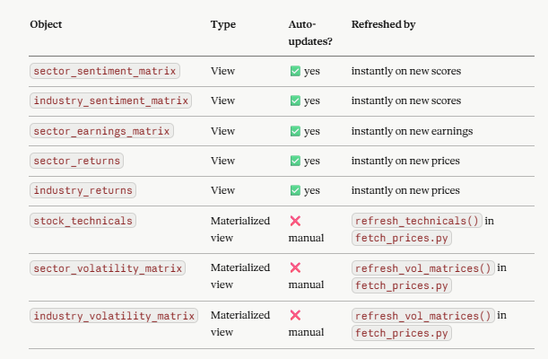
Updates

