Slide 1




Group Messaging Platform
Md. Roman Nihal 211902003
Md. Shadikur Rahman Sheam 211902020

Slide 2


Contents
Introduction
Objectives
GUI
System Architecture
Result
Future Scope

Slide 3


Introduction
Our project "Group Messaging Platform" tailored for real-time communication among numerous users within a specified group
Features:
Text
Emoji
Image
Notes:
When conducting research, it is easy to go to one source: Wikipedia. However, you need to include a variety of sources in your research. Consider the following sources:
Who can I interview to get more information on the topic?
Is the topic current and will it be relevant to my audience?
What articles, blogs, and magazines may have something related to my topic?
Is there a YouTube video on the topic? If so, what is it about?
What images can I find related to the topic?

Slide 4
Objectives
Real-Time Multimedia Communication
Scalable and Modular Architecture
User-Friendly Multimedia Interface
Message Persistence for Multimedia
Notes:
When conducting research, it is easy to go to one source: Wikipedia. However, you need to include a variety of sources in your research. Consider the following sources:
Who can I interview to get more information on the topic?
Is the topic current and will it be relevant to my audience?
What articles, blogs, and magazines may have something related to my topic?
Is there a YouTube video on the topic? If so, what is it about?
What images can I find related to the topic?

Slide 5
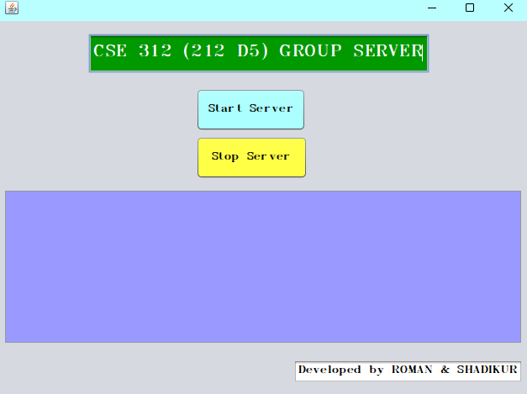
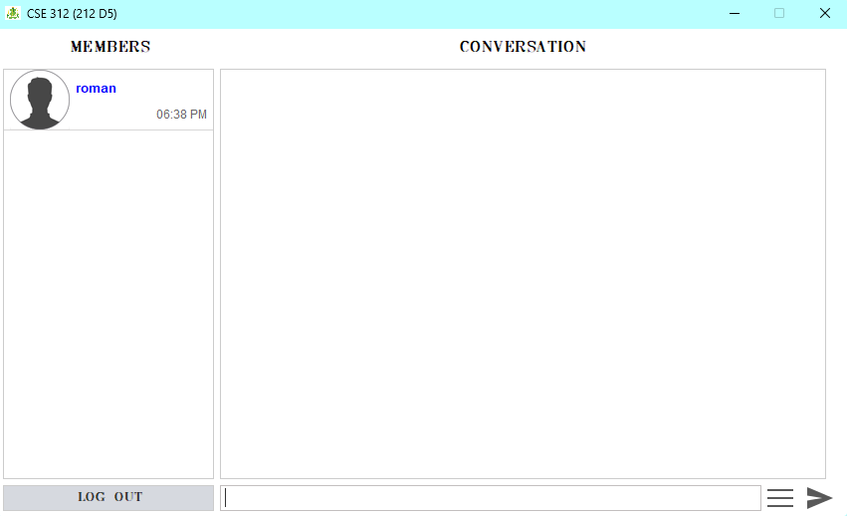
GUI
Server
Users
Notes:
When conducting research, it is easy to go to one source: Wikipedia. However, you need to include a variety of sources in your research. Consider the following sources:
Who can I interview to get more information on the topic?
Is the topic current and will it be relevant to my audience?
What articles, blogs, and magazines may have something related to my topic?
Is there a YouTube video on the topic? If so, what is it about?
What images can I find related to the topic?

Slide 6
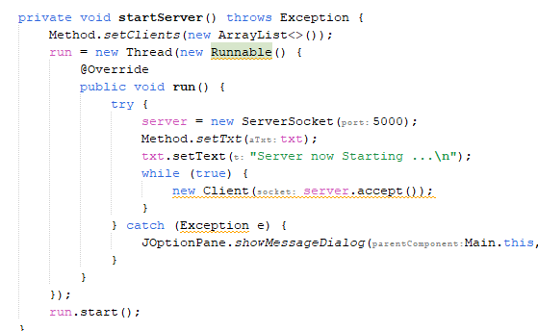
System Architecture
SocketServer’s port : 5000 ss.accept()
Server
Notes:
Now, that you have narrowed your topic, you will want to organize your research in a structure that works. There are some common organizational patterns based on the kind of research you are doing.
Organizational Structures:
Cause and Effect- this kind of structure is great for explaining the causes and effects of a topic
Compare and Contrast- in this pattern you highlight the similarities and differences of the topic
Explain process- this structure is great for outlining a series of steps to follow;
Definition- if you want to make sure your audience understands what something is using illustrations, meanings, clarifying misconceptions, you may want to use this structure
Classification- a common organizational structure is grouping like topics or facts from the research together. For instance, in the internet safety about social media apps, you may organize the research where you look at each social media app one at a time

Slide 7
System Architecture
Socket(localhost,5000)
Client(Name, Time, Image)
Client
SocketServer’s port : 5000 ss.accept()
Server
Notes:
Now, that you have narrowed your topic, you will want to organize your research in a structure that works. There are some common organizational patterns based on the kind of research you are doing.
Organizational Structures:
Cause and Effect- this kind of structure is great for explaining the causes and effects of a topic
Compare and Contrast- in this pattern you highlight the similarities and differences of the topic
Explain process- this structure is great for outlining a series of steps to follow;
Definition- if you want to make sure your audience understands what something is using illustrations, meanings, clarifying misconceptions, you may want to use this structure
Classification- a common organizational structure is grouping like topics or facts from the research together. For instance, in the internet safety about social media apps, you may organize the research where you look at each social media app one at a time

Slide 8
System Architecture
Socket(localhost,5000)
Client(Name, Time, Image)
Client
SocketServer’s port : 5000 ss.accept()
For (Client client : getClients() ) client.ouptutStream()
Update members list
Server
Group
Notes:
Now, that you have narrowed your topic, you will want to organize your research in a structure that works. There are some common organizational patterns based on the kind of research you are doing.
Organizational Structures:
Cause and Effect- this kind of structure is great for explaining the causes and effects of a topic
Compare and Contrast- in this pattern you highlight the similarities and differences of the topic
Explain process- this structure is great for outlining a series of steps to follow;
Definition- if you want to make sure your audience understands what something is using illustrations, meanings, clarifying misconceptions, you may want to use this structure
Classification- a common organizational structure is grouping like topics or facts from the research together. For instance, in the internet safety about social media apps, you may organize the research where you look at each social media app one at a time

Slide 9
System Architecture
Socket(localhost,5000)
Client(Name, Time, Image)
Client
SocketServer’s port : 5000 ss.accept()
For (Client client : getClients() ) client.ouptutStream()
Update members list
Server
Send any messages or images or emojis
Group
Notes:
Now, that you have narrowed your topic, you will want to organize your research in a structure that works. There are some common organizational patterns based on the kind of research you are doing.
Organizational Structures:
Cause and Effect- this kind of structure is great for explaining the causes and effects of a topic
Compare and Contrast- in this pattern you highlight the similarities and differences of the topic
Explain process- this structure is great for outlining a series of steps to follow;
Definition- if you want to make sure your audience understands what something is using illustrations, meanings, clarifying misconceptions, you may want to use this structure
Classification- a common organizational structure is grouping like topics or facts from the research together. For instance, in the internet safety about social media apps, you may organize the research where you look at each social media app one at a time

Slide 10
System Architecture
Socket(localhost,5000)
Client(Name, Time, Image)
Client
SocketServer’s port : 5000 ss.accept()
For (Client client : getClients() ) client.ouptutStream()
Update members list
Server
Send any messages or images or emojis
Group
Update conversation
Notes:
Now, that you have narrowed your topic, you will want to organize your research in a structure that works. There are some common organizational patterns based on the kind of research you are doing.
Organizational Structures:
Cause and Effect- this kind of structure is great for explaining the causes and effects of a topic
Compare and Contrast- in this pattern you highlight the similarities and differences of the topic
Explain process- this structure is great for outlining a series of steps to follow;
Definition- if you want to make sure your audience understands what something is using illustrations, meanings, clarifying misconceptions, you may want to use this structure
Classification- a common organizational structure is grouping like topics or facts from the research together. For instance, in the internet safety about social media apps, you may organize the research where you look at each social media app one at a time

Slide 11

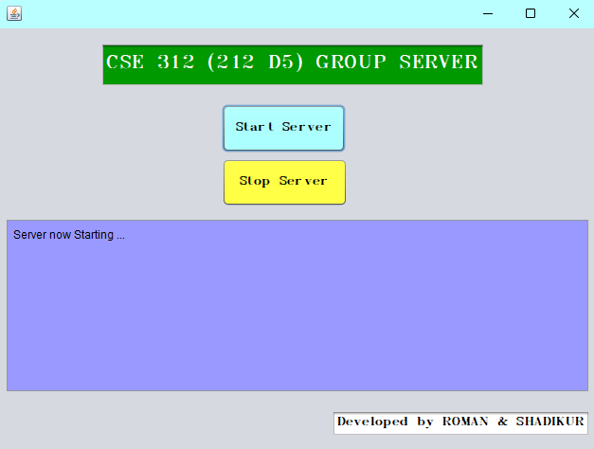
Result
Notes:
Once you find your sources, you will want to evaluate your sources using the following questions:
Author:
Who is the author?
Why should I believe what he or she has to say on the topic?
Is the author seen as an expert on the topic? How do you know?
Current:
How current is the information in the source?
When was the source published?
Is the information out-of-date?
Accuracy:
Is the content accurate?
Is the information presented objectively? Do they share the pros and cons?

Slide 12
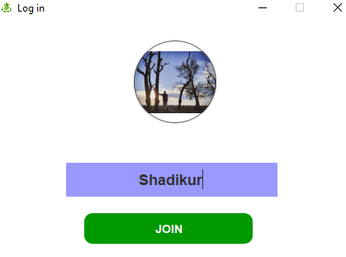
Result
Notes:
Once you find your sources, you will want to evaluate your sources using the following questions:
Author:
Who is the author?
Why should I believe what he or she has to say on the topic?
Is the author seen as an expert on the topic? How do you know?
Current:
How current is the information in the source?
When was the source published?
Is the information out-of-date?
Accuracy:
Is the content accurate?
Is the information presented objectively? Do they share the pros and cons?

Slide 13
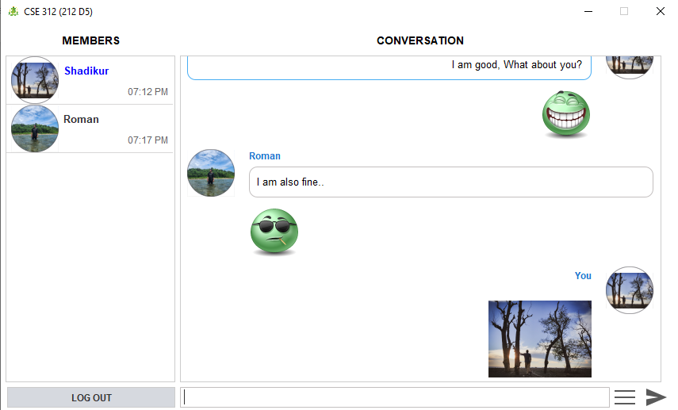
Result
Notes:
Once you find your sources, you will want to evaluate your sources using the following questions:
Author:
Who is the author?
Why should I believe what he or she has to say on the topic?
Is the author seen as an expert on the topic? How do you know?
Current:
How current is the information in the source?
When was the source published?
Is the information out-of-date?
Accuracy:
Is the content accurate?
Is the information presented objectively? Do they share the pros and cons?

Slide 14
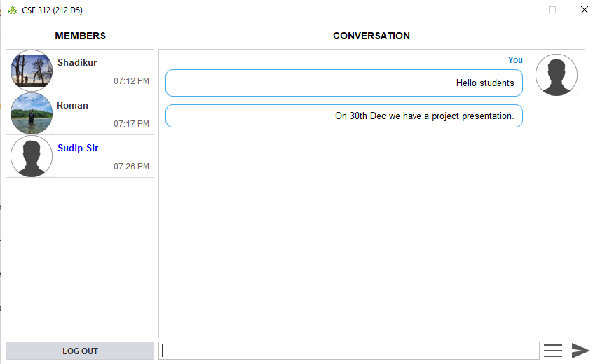
Result
Notes:
Once you find your sources, you will want to evaluate your sources using the following questions:
Author:
Who is the author?
Why should I believe what he or she has to say on the topic?
Is the author seen as an expert on the topic? How do you know?
Current:
How current is the information in the source?
When was the source published?
Is the information out-of-date?
Accuracy:
Is the content accurate?
Is the information presented objectively? Do they share the pros and cons?

Slide 15
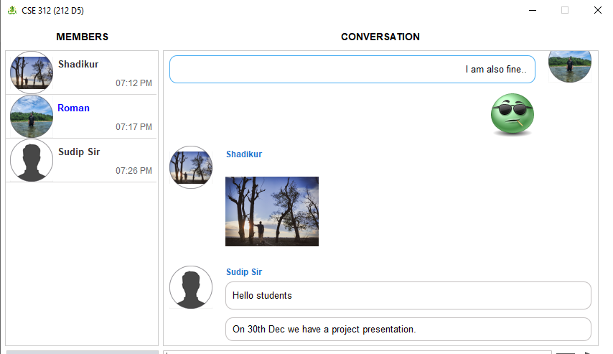
Result
Notes:
Once you find your sources, you will want to evaluate your sources using the following questions:
Author:
Who is the author?
Why should I believe what he or she has to say on the topic?
Is the author seen as an expert on the topic? How do you know?
Current:
How current is the information in the source?
When was the source published?
Is the information out-of-date?
Accuracy:
Is the content accurate?
Is the information presented objectively? Do they share the pros and cons?

Slide 16
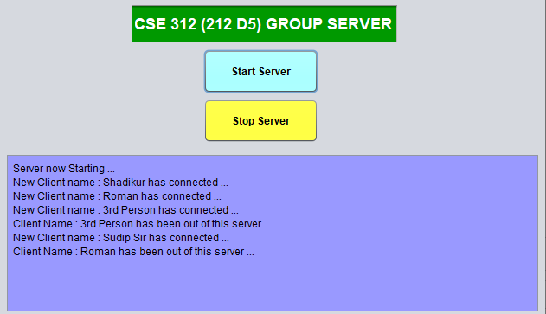
Result
Notes:
Once you find your sources, you will want to evaluate your sources using the following questions:
Author:
Who is the author?
Why should I believe what he or she has to say on the topic?
Is the author seen as an expert on the topic? How do you know?
Current:
How current is the information in the source?
When was the source published?
Is the information out-of-date?
Accuracy:
Is the content accurate?
Is the information presented objectively? Do they share the pros and cons?

Slide 17
Future Scope
Advanced Multimedia Features
Enhanced Security Measures
Integration with External Services
Multiple groups according to users
Cross-Platform Compatibility

Slide 18
Thanks
Notes:
You can use this slide as your opening or closing slide. Should you choose to use it as a closing, make sure you review the main points of your presentation. One creative way to do that is by adding animations to the various graphics on a slide. This slide has 4 different graphics, and, when you view the slideshow, you will see that you can click to reveal the next graphic. Similarly, as you review the main topics in your presentation, you may want each point to show up when you are addressing that topic.
Add animation to images and graphics:
Select your image or graphic.
Click on the Animations tab.
Choose from the options. The animation for this slide is “Split”. The drop-down menu in the Animation section gives even more animations you can use.
If you have multiple graphics or images, you will see a number appear next to it that notes the order of the animations.
Note: You will want to choose the animations carefully. You do not want to make your audience dizzy from your presentation.

