Slide 1
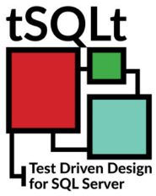

Introduction to tSQLt Framework
Roman Pijáček

Slide 2

Why shoud we write Unit Tests?
The cost of fixing a defect detected during Unit Testing is lower
Immediate feedback to developers (CI pipeline failed after commit?)
Can define logic/behavior when used with TDD
Increases confidence in maintaining/refactoring code
1
2
3
4

Slide 3

What is the tSQLt framework?
Open Source Database Unit Testing framework for MS SQL Server
Compatible with SQL Server 2005 SP2 onwards
tSQLt frameworks written in T-SQL and C#
Test Classes, Unit Tests, Asserts written in T-SQL
Tests categorized into TestClasses, executed within transactions
Ideal World: Every developer covers his code with tSQLt tests

Slide 4


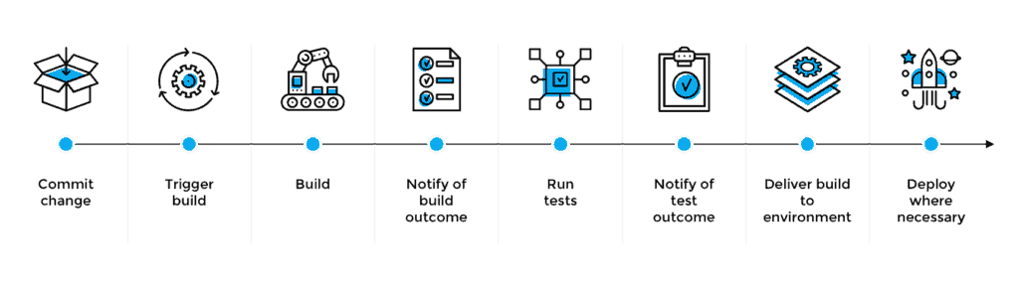
Where and When to use tSQLt?
CI/CD Pipeline, Personal/Local DB, DEV Environment
Upper environments: (PROD/UAT/etc.)

Slide 5

How does tSQLt work? Example of Test Execution
1
3
Original DB Objects
Original DB Objects
usp_MyProcedure
dbo.Table_A
dbo.View_B
dbo.Table_C
usp_MyProcedure
dbo.Table_A
dbo.View_B
dbo.Table_C
BEGIN TRAN
ROLLBACK TRAN
2
Cloned DB Objects
usp_MyProcedure
dbo.Table_A
dbo.View_B
dbo.Table_C
Execute tSQLt Tests

Slide 6
Structure of tSQLt Tests
Database
Test Class A
Setup
Test 1
Test n
Test Class B
Setup
Test 1
Test n
Test Class n
Setup
Test 1
Test n
schemas
procedures

Slide 7

tSQLt Examples

Slide 8

Sources
tSQLt.org
SQL Unit Testing with the tSQLt Framework for beginners
Unit Testing in SQL Server with tSQLt (RedGate video)
Azure SQL unit testing with tSQLt using Azure DevOps
The source code and other materials available in my GitHub repository:
github.com/RomanPijacek/tSQLt

Slide 9



Thank you ☺
pijacek.roman[at]gmail.com
linkedin.com/in/pijacek
@Roman_Pijacek
github.com/RomanPijacek

