Slide 1
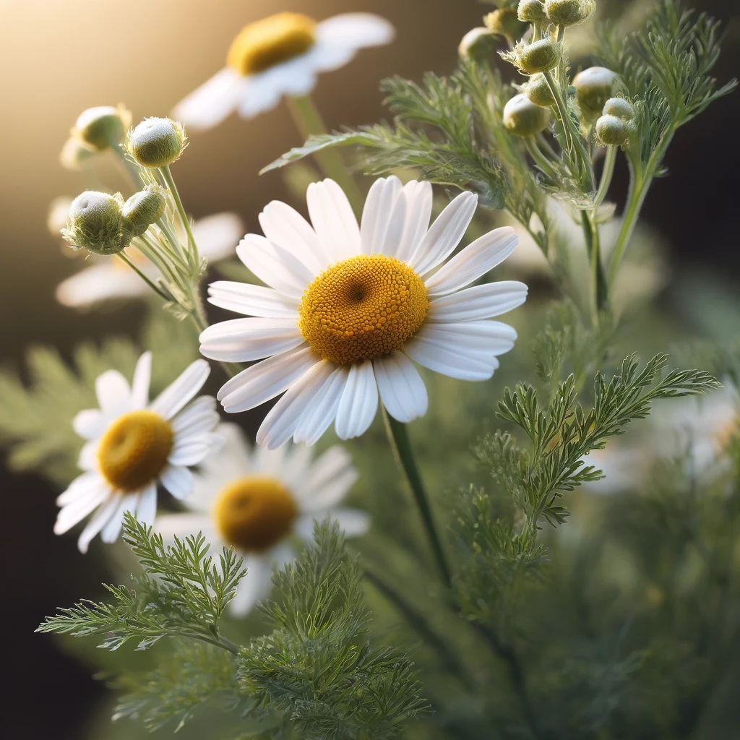
Scented Mayweed
An Overview of Its Characteristics and Uses
Your Name and Date
Notes:
Hi! This is a presentation about the mayweed.

Slide 2
Introduction to Scented Mayweed
• Scented Mayweed (Matricaria chamomilla) is a flowering plant in the Asteraceae family.
• Commonly known as German Chamomile or Wild Chamomile.
• Native to Europe and Western Asia, now found worldwide.
Notes:
Scented Mayweed, also known as Matricaria chamomilla, is a flowering plant in the Asteraceae family. It is commonly referred to as German Chamomile or Wild Chamomile. Originally native to Europe and Western Asia, it is now found all over the world.

Slide 3
Characteristics of Scented Mayweed
• Grows up to 60 cm tall.
• Feathery leaves and daisy-like white flowers with yellow centers.
• Blooms from May to October.
• Has a distinct apple-like scent.
Notes:
Scented Mayweed grows up to 60 cm tall, featuring feathery leaves and daisy-like white flowers with yellow centers. It blooms from May to October and is known for its distinct apple-like scent.

