Slide 1
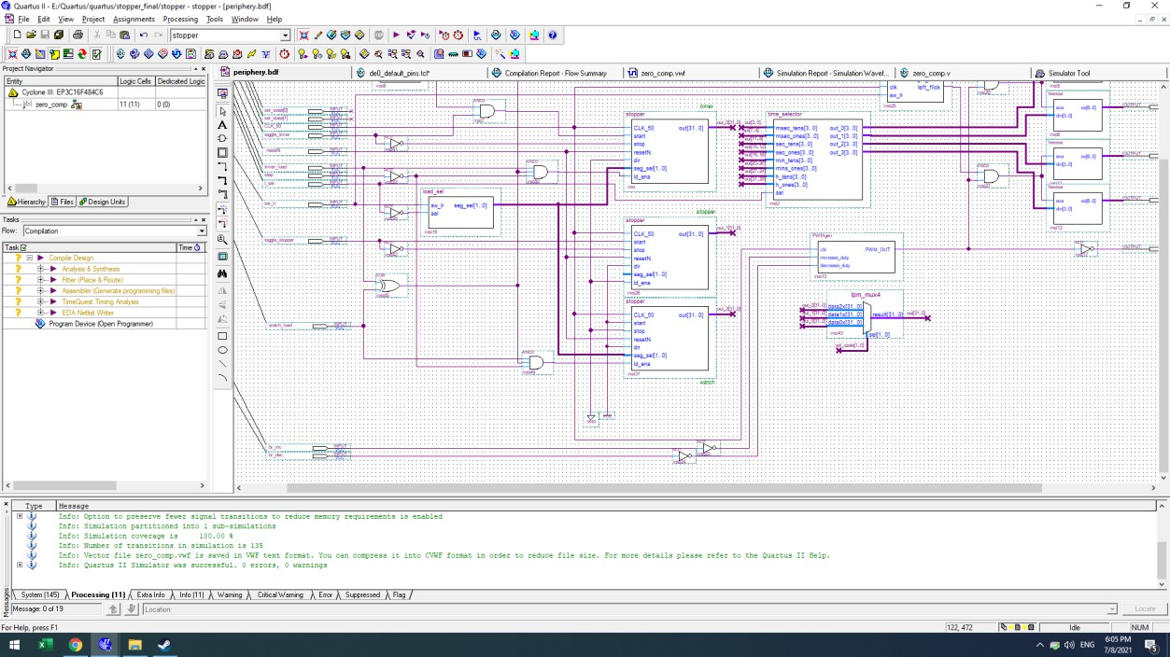
Main Block:
3 BCDs with tick rate equals to 1 millisecond. The top one is timer; mid one is stopper and the bot one is watch.
Each BCD (except stopper) has load option, which being performed via button2(right) and has several conditions that are has to be met. Verification of the conditions performed via AND3 gate with input:
XOR with timer_load and watch_load inputs.
timer_load/watch_load is ‘1’, respectively.
Step is pressed.
Each BCD has and output of 32-bit, which is current result of every counter in BCD. Then there
is a block called time_selector, which controls current display group of numbers. There are 2 options controlled with switch t_sel:
milliseconds and seconds
minutes and hours.
Flicker is Verilog-written block, which make current load segments to flick: once every half a second.
PWMgen is Verilog-written block, which is responsible for brightness control with button0(left) to decrease and button1(middle) to increase.
3-to-1 VecMux to choose the display block: timer, stopper, watch. 4 hexsse to convert binary to hex.
load_sel block to chose which counter in BCD is being loaded. Not used in watch, but could be.

Slide 2
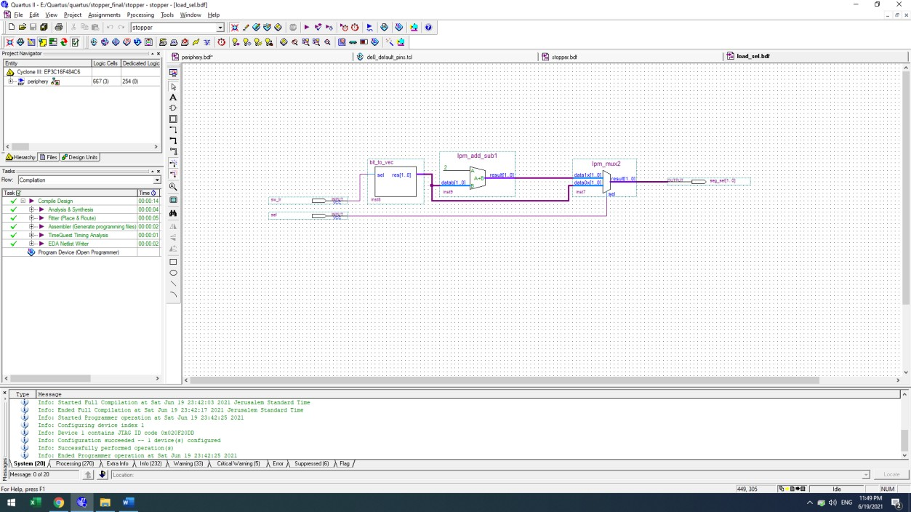
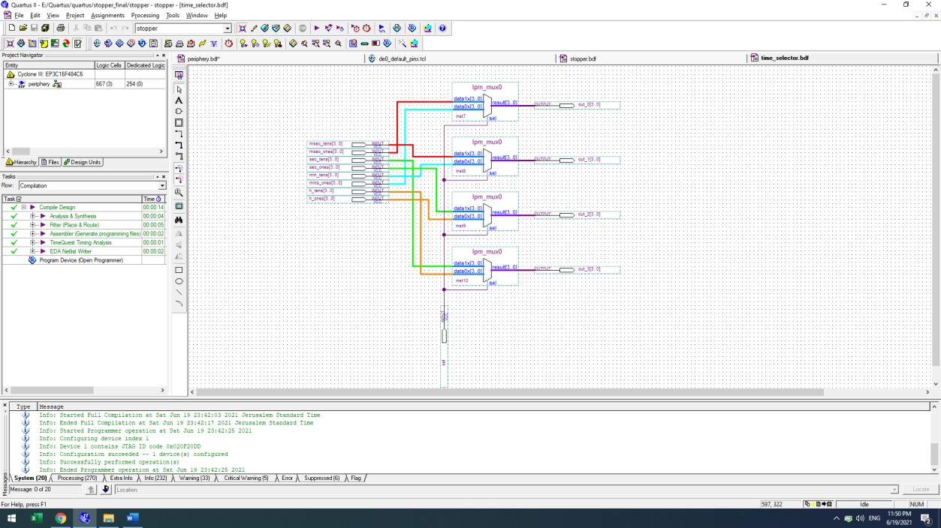
load_sel
time_selector

Slide 3
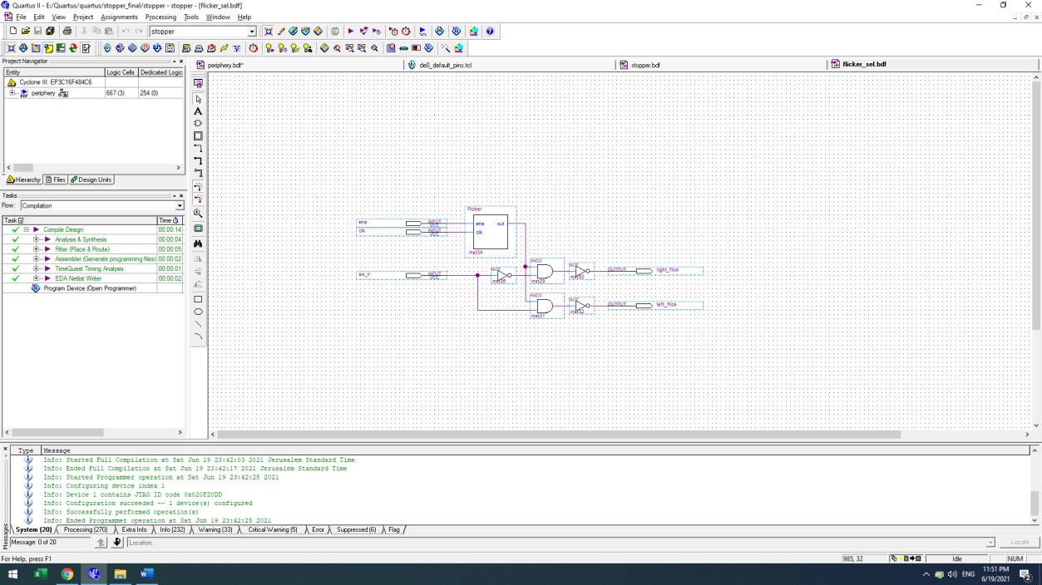
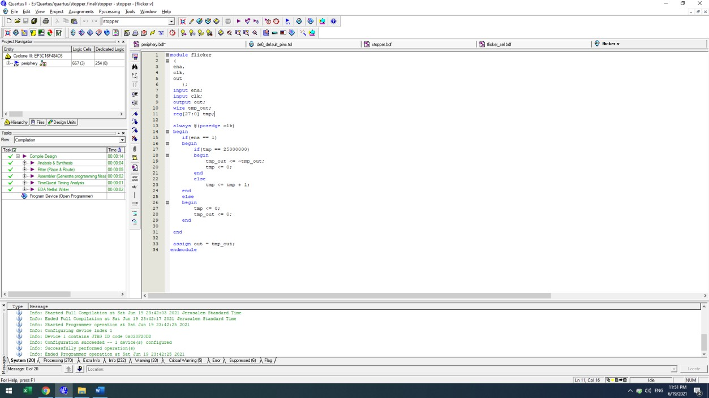
flicker_sel
flicker

Slide 4
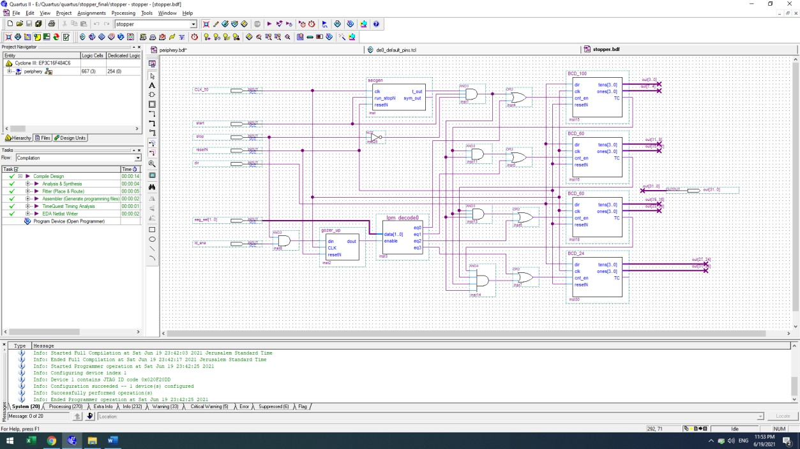
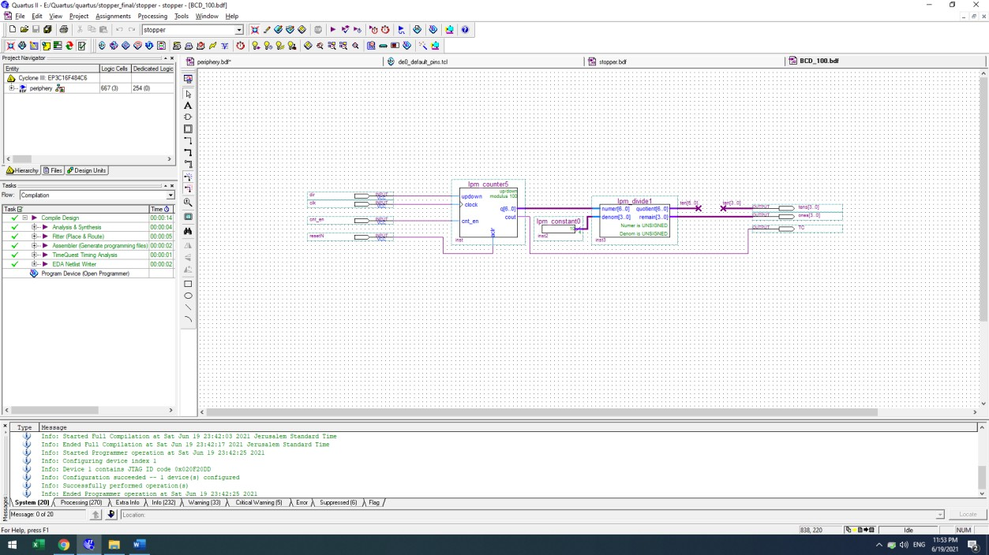
stopper
BCD_24/60/100

Slide 5
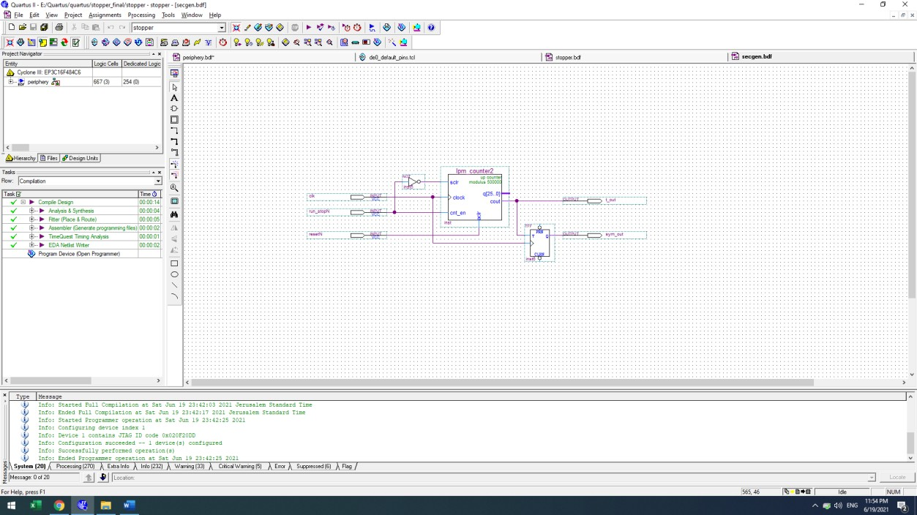
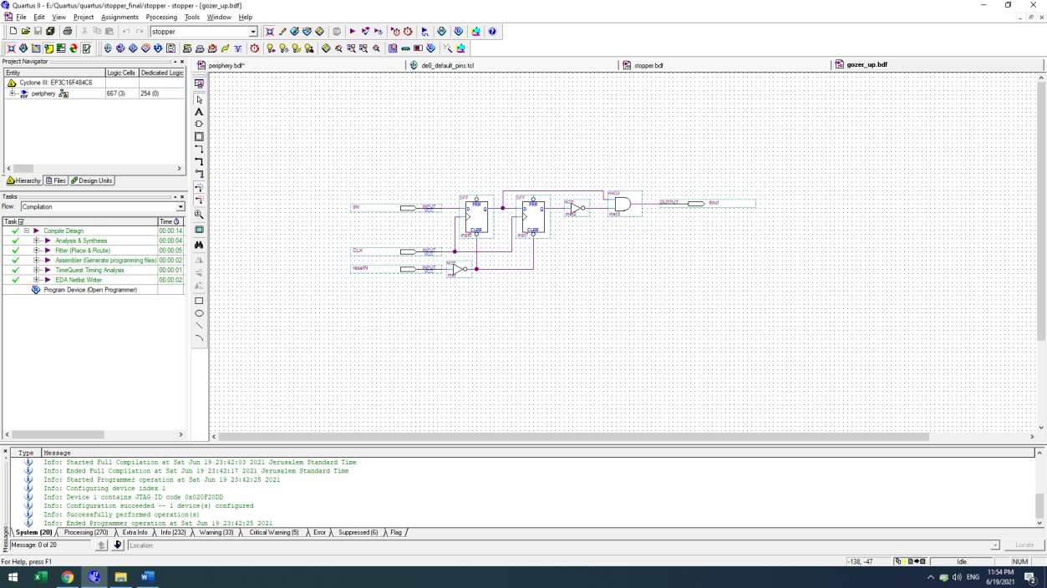
secgen (centgen actually)
gozer_up (sync rise detector)

Slide 6
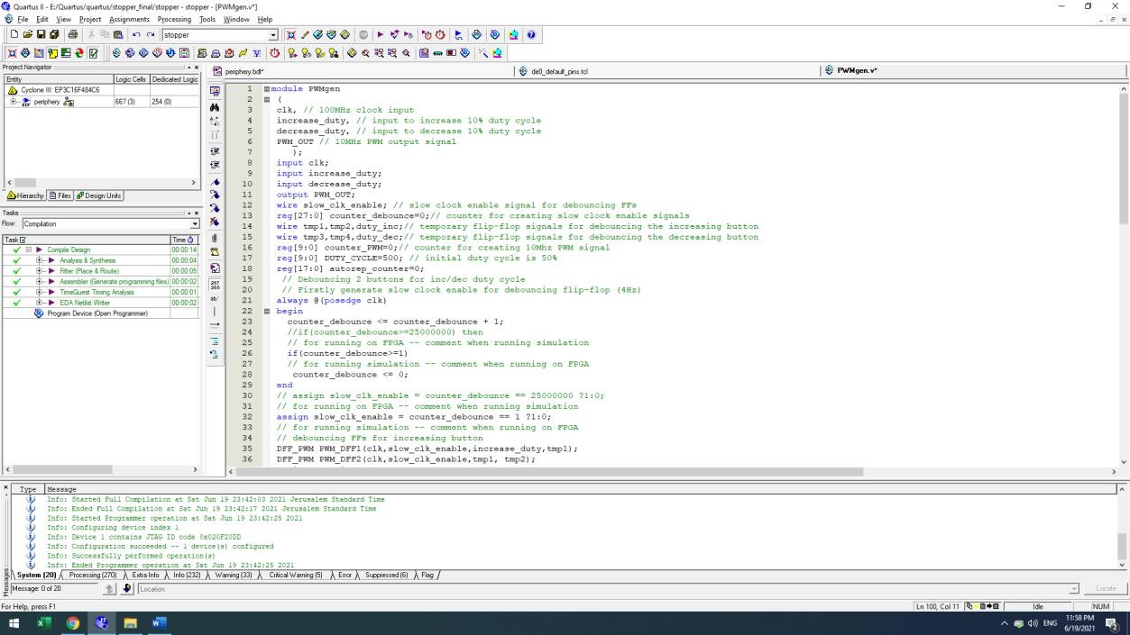
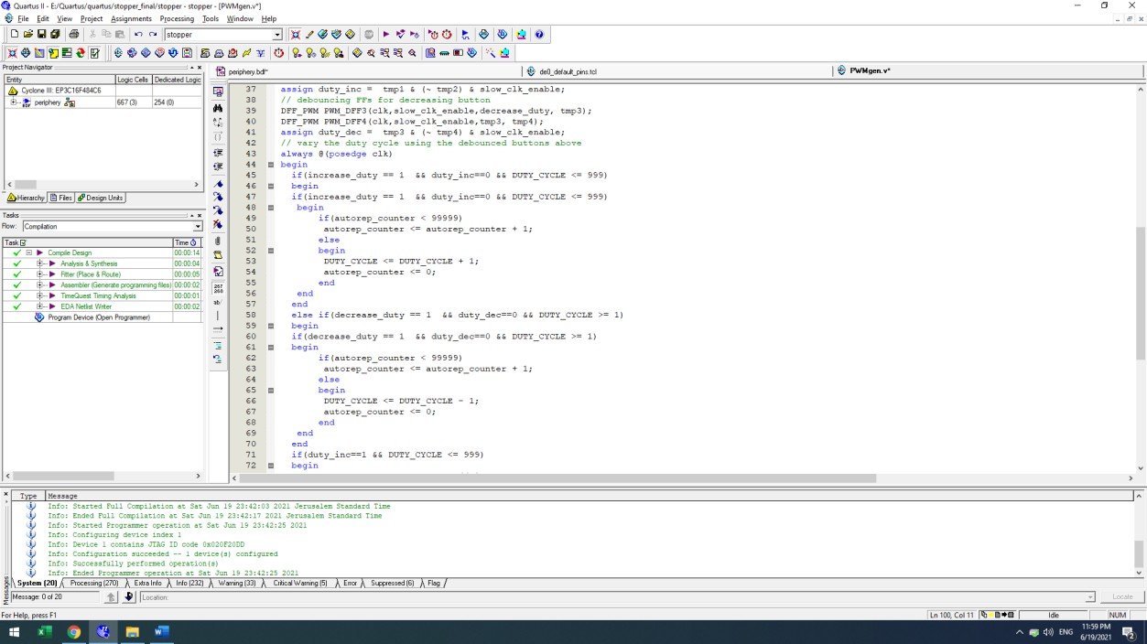
PWMgen

Slide 7
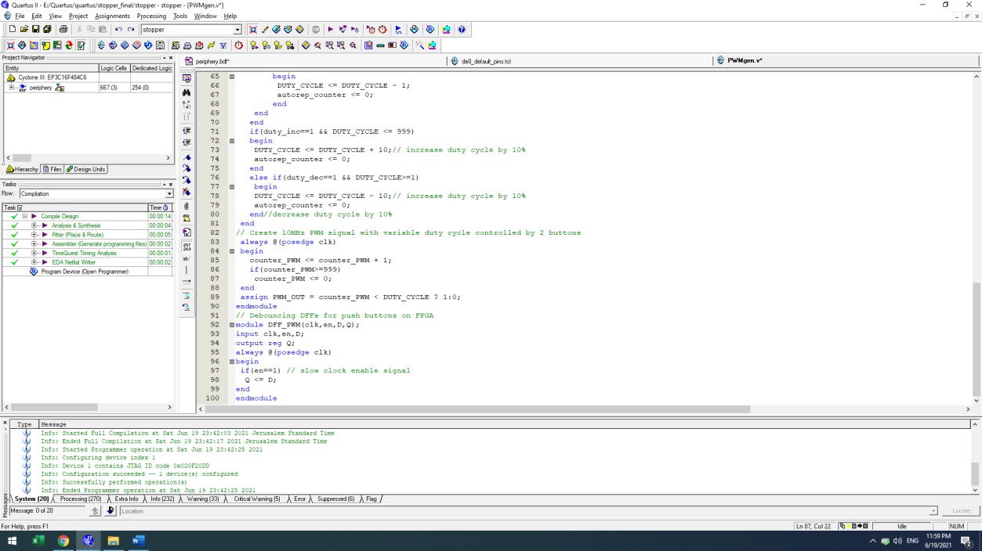
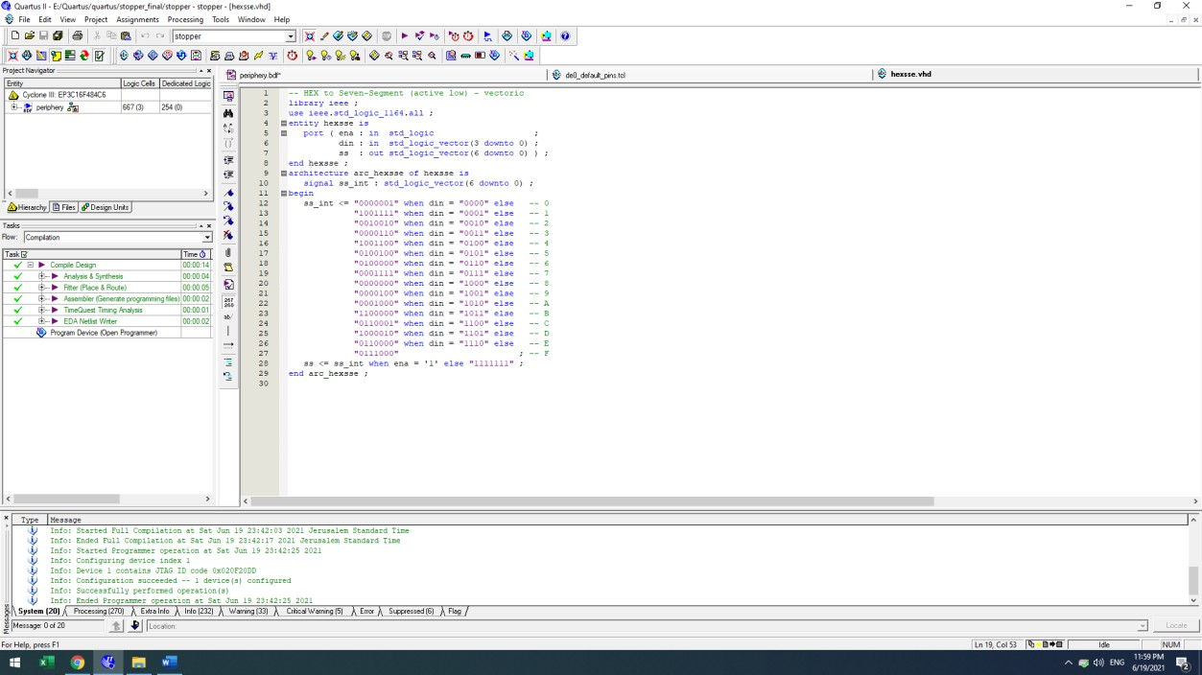
hexsse

Slide 8
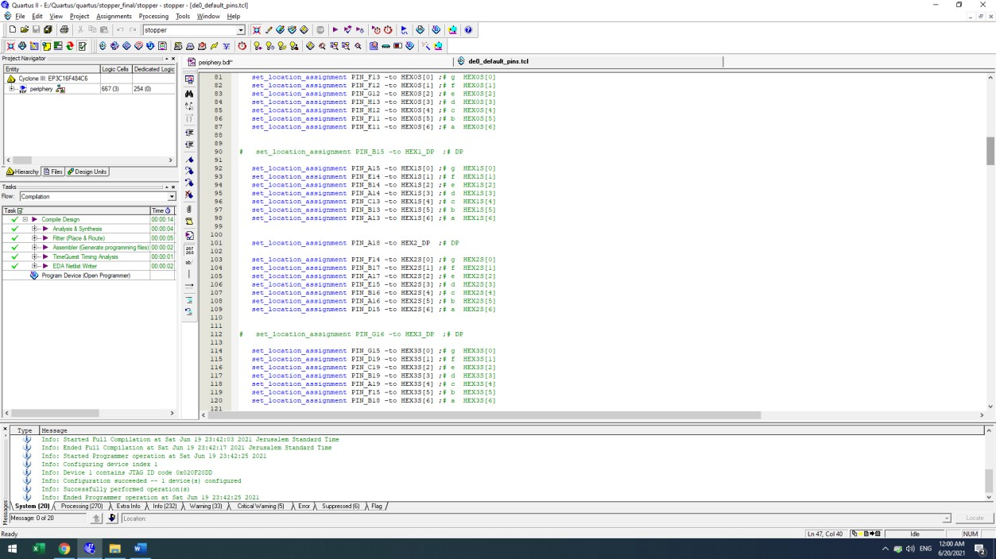
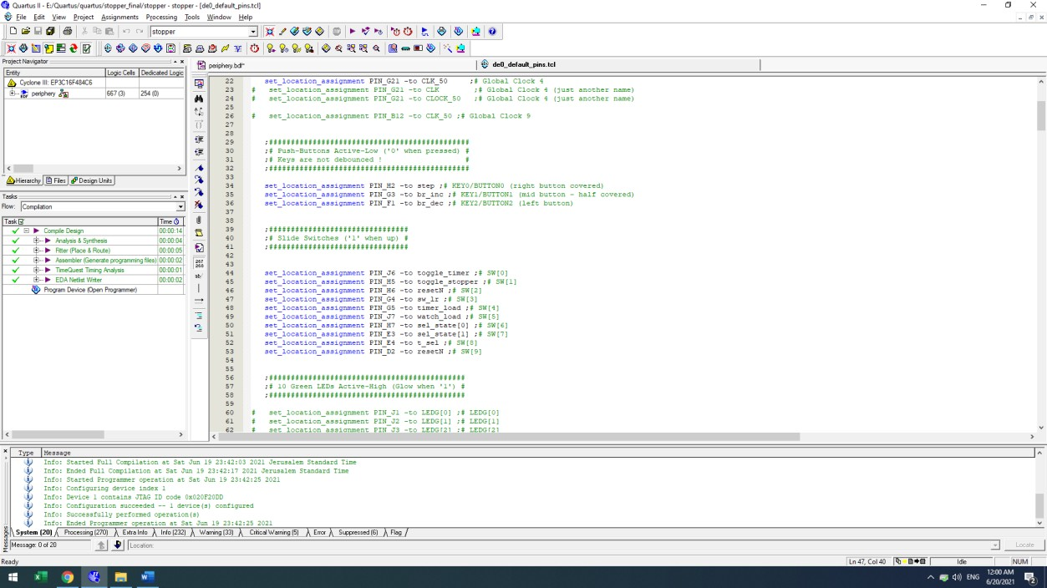
pins

Slide 9
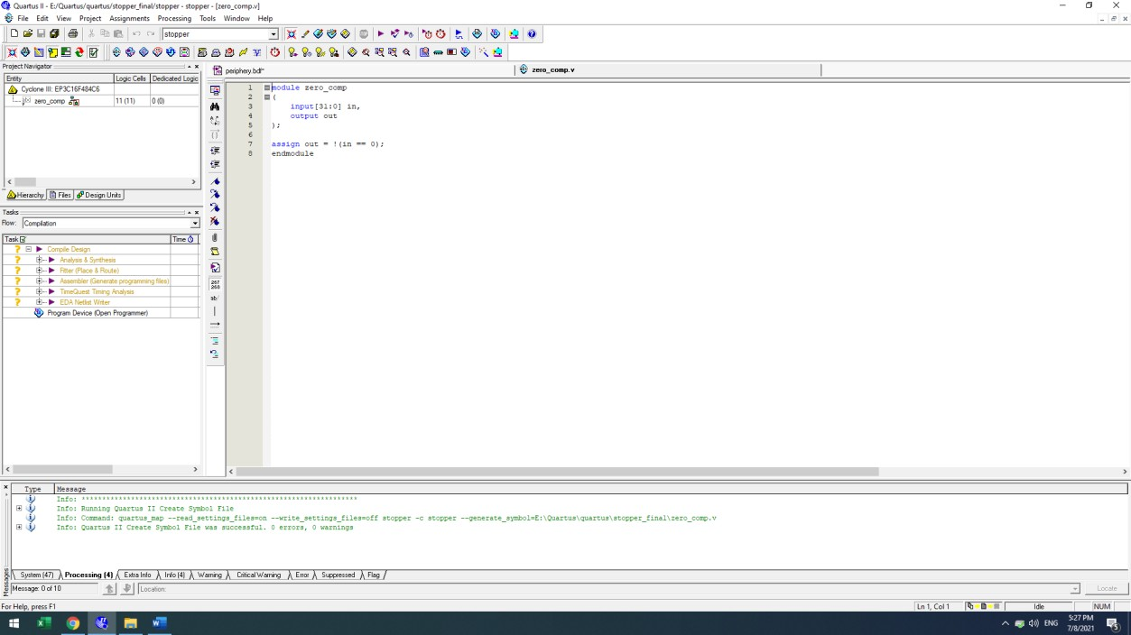
zero_comp
Output is inverted to stop timer count on 00:00:00:000.

