Slide 1
UNIT 7
TREE

Slide 2
Binary Tree
A binary tree is a nonlinear data structure (also called tree data structure) in which each node has at most (maximum) two child nodes (or children) – called Left Child Node and Right Child Node. Each child node in a binary tree has a parent node.

Slide 3
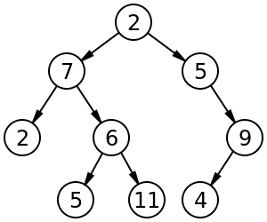
Binary Tree
Diagram of a Binary Tree:

Slide 4
Types of Binary Tree
Rooted Binary Tree
A rooted binary tree is a tree with a root node in which every node has at most (maximum) two child nodes (also called children).
Full Binary Tree (also called Proper Binary Tree or 2-tree or Strictly Binary Tree)
A full binary tree is a tree in which every node other than the leaf nodes (also called leaves) has two child nodes (also called children).

Slide 5
Types of Binary Tree
Perfect Binary Tree
A perfect binary tree is a full binary tree in which every node other than the leaf nodes (also called leaves) has two child nodes (also called children), and all leaf nodes (also called leaves) are at the same depth or same level.
Complete Binary Tree (same as Full Binary Tree)
A complete binary tree is a binary tree in which every level (except the last level) is completely filled with nodes (it means every node other than the leaf nodes has two child nodes).

Slide 6
Implementation or Representation of Binary Tree
Binary tree can be implemented or represented (performed or created) using one of the following two methods:
Using array, called sequential or linear representation of binary tree.
Using linked list, called linked representation of binary tree.

Slide 7
Traversals of Binary Tree Traversing Binary Tree
Tree traversal is the process of visiting (displaying) each node in a tree in some particular order. There are three different types of traversals of a binary tree, as shown below:
Pre-order Traversal
In-order Traversal
Post-order Traversal

Slide 8
Traversals of Binary Tree Traversing Binary Tree
Pre-order Traversal
Visit the root node (it means perform some process on the root node, generally print a value of this node).
Traverse the left subtree of the root in pre-order (means parent node, left child node, right child node).
Traverse the right subree of the root in pre-order (means parent node, left child node, right child node).

Slide 9
Traversals of Binary Tree Traversing Binary Tree
In-order Traversal
Traverse the left subtree of the root in in-order (means left child node, parent node, right child node).
Visit the root node (it means perform some process on the root node, generally print a value of this node).
Traverse the right subree of the root in in-order (means left child node, parent node, right child node).

Slide 10
Traversals of Binary Tree Traversing Binary Tree
Post-order Traversal
Traverse the left subtree of the root in post-order (means left child node, right child node, parent node).
Traverse the right subree of the root in post-order (means left child node, right child node, parent node).
Visit the root node (it means perform some process on the root node, generally print a value of this node).

Slide 11
Traversals of Binary Tree Traversing Binary Tree
Write any one example of each traversal of binary tree:
Draw a Tree.
Write a list of values in Pre-Order, In-Order, and Post-Order Traversals of the tree (that is drawn below).

Slide 12
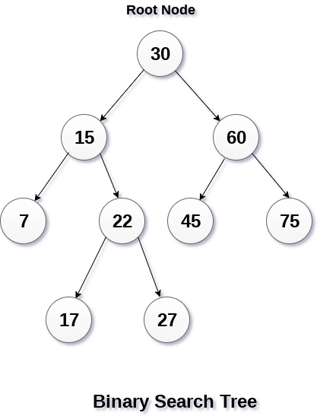
Binary Search Tree

Slide 13
Binary Search Tree
A binary search tree (BST) is a binary tree data structure which has the following properties:
The left subtree of a node contains only nodes with keys (values) less than the node's key (value).
The right subtree of a node contains only nodes with keys (values) greater than the node's key (value).
There must be no duplicate nodes in the tree. The tree does not contain nodes with the same values (duplicate values). The tree does not allow duplicate values (allows only unique means non-duplicate values).
Binary search tree is also called a sorted (or ordered) binary tree.

Slide 14
Binary Search Tree
A binary search tree (BST) can be a strict binary search tree or a non-strict binary search tree. The definition of a binary search tree given above is the definition of a strict binary search tree which does not allow duplicate values in a tree. If a binary search tree allows duplicate values in a tree, then this type of binary search tree is called a non-strict binary search tree. The definition of a non-strict binary search tree is as given below:

Slide 15
Binary Search Tree
A non-strict binary search tree (BST) is a binary tree data structure which has the following properties:
The left subtree of a node contains only nodes with keys (values) less than the node's key (value).
The right subtree of a node contains only nodes with keys (values) greater than or equal to the node's key (value).
There must be duplicate nodes in the tree. The tree can contain nodes with the same values (duplicate values). The tree allows duplicate values.

Slide 16
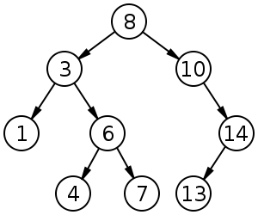
Binary Search Tree
Diagram of a Binary Search Tree (BST):

Slide 17
Binary Search Tree
Advantages of Binary Search Tree over Other Data Structures:
Searching of any value is very fast, easy, and efficient. Searching in a strict binary search tree is faster than the searching in a non-strict binary search tree.
Sorting of values is also very fast, easy, and efficient. In-order traversal gives a sorted list of values in ascending order.

Slide 18
Implementation or Representation of Binary Search Tree
Binary search tree can be implemented or represented (performed or created) using one of the following two methods:
Using array, called sequential or linear representation of binary search tree.
Using linked list, called linked representation of binary search tree.

Slide 19
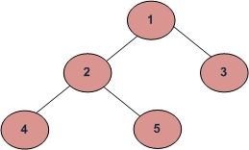
Traversals of Binary Search Tree Traversing Binary Search Tree

Slide 20
Traversals of Binary Search Tree Traversing Binary Search Tree
(a) Inorder (Left, Root, Right) : 4 2 5 1 3
(b) Preorder (Root, Left, Right) : 1 2 4 5 3
(c) Postorder (Left, Right, Root) : 4 5 2 3 1

Slide 21
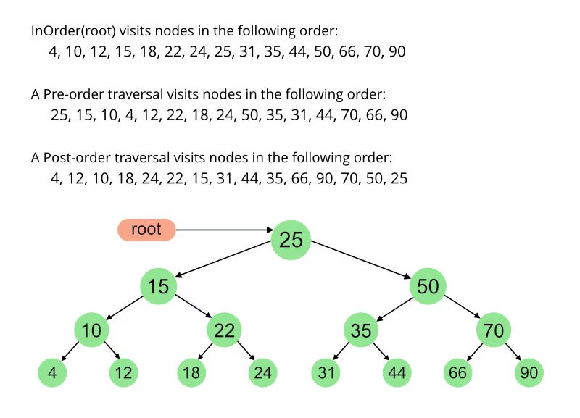
Traversals of Binary Search Tree Traversing Binary Search Tree

Slide 22
Terminologies of Tree (Different Terms or Words used in Tree)
Root or Root Node of Tree
The root node (or root) is the top node (starting node) of a tree. The root node is always at the top of a tree, therefore it is called the topmost node of the tree. The root node is the ancestor (also called parent node or father or predecessor or superior) of all nodes in the tree. The root node does not have any parent node. The root node has no parent node. The root node has 0 or more child nodes (also called children). All operations (which are performed) on the tree begin (start) from the root node of the tree. A tree has only one root node.

Slide 23
Terminologies of Tree (Different Terms or Words used in Tree)
Parent Node (also called Father or Predecessor or Ancestor)
A node that has a child is called the child’s parent node. A parent node is a node which has child nodes (also called children). Every node in a tree has at most (maximum) one parent node (except the root node). A parent node has 0 or more child nodes (also called children). A parent node is also called a father or predecessor or ancestor of its child nodes (also called children).

Slide 24
Terminologies of Tree (Different Terms or Words used in Tree)
Child Node (plural is Children) (also called Son or Successor or Descendant)
Each node in a binary tree has at most (maximum) two child nodes (children) – called Left Child Node and Right Child Node. A child node is also called a son or successor or descendant of its parent node. Left child node is called a left son or left successor or left descendant. Right child node is called a right son or right successor or right descendant.

Slide 25
Terminologies of Tree (Different Terms or Words used in Tree)
Leaf Node (plural is Leaves) (also called Terminal Nodes)
A leaf node is a node which has no child nodes (also called children). The leaf node is the bottom node (end node) of a tree. The leaf node is always at the bottom of a tree, therefore it is called the bottommost node of the tree. The leaf node is also called the terminal node. A tree can have 1 or more leaf nodes (also called leaves).

Slide 26
Terminologies of Tree (Different Terms or Words used in Tree)
Internal Node (also called Inner Node or Branch Node)
An internal node is any node of a tree (except the leaf nodes and the root node) which has child nodes (also called children). The leaf nodes and the root node are not internal nodes. An internal node is also called an inner node, branch node, non-leaf node, or non-root node.

Slide 27
Terminologies of Tree (Different Terms or Words used in Tree)
Siblings (also called Brothers or Sisters)
Two child nodes of the same parent node are called siblings. Siblings are nodes that share the same parent node. Siblings are also called brothers or sisters.

Slide 28
Terminologies of Tree (Different Terms or Words used in Tree)
Degree (in-degree and out-degree)
In-degree of a node is the number of edges arriving at that node. Out-degree of a node is the number of edges leaving that node.
The root node is the only node in the tree with In-degree = 0.
All the leaf nodes have Out-degree = 0.
Out-degree of every node in a binary tree is maximum 2.

Slide 29
Terminologies of Tree (Different Terms or Words used in Tree)
Edge, Path, and Branch
In a tree, a line drawn from a one node to another node is called an edge. Normally, the edge (line) is drawn from a root or parent node to its child nodes (also called children).
A sequence of consecutive (one after another) edges is called a path. In a tree, there is one and only one path from any node to any other node.
A path starting from the root node and ending to a leaf node is called a branch.

Slide 30
Terminologies of Tree (Different Terms or Words used in Tree)
Null Tree or Empty Tree
A tree which does not have any node other than the root node is called a null tree or empty tree. In other words, if the root node of a tree does have any child node, then the tree is called a null tree or empty tree.

Slide 31
Terminologies of Tree (Different Terms or Words used in Tree)
Level Number or Level
Each node in a tree is assigned a level number, as follows:
The root node of the tree is assigned a level number 0.
Every other nodes of the tree is assigned a level number which is 1 more than the level number of its parent node.
Nodes of the same level number are called the nodes of the same generation.

Slide 32
Terminologies of Tree (Different Terms or Words used in Tree)
Depth (also called Height)
The depth or height of a tree is the maximum number of nodes in a branch of the tree. The depth or height of a tree is the length of the path from the root node to a leaf node of the tree. The depth or height of a tree is 1 more than the largest level number of the tree. The depth or height of a tree is the number of levels of the tree.

Slide 33
Terminologies of Tree (Different Terms or Words used in Tree)
Subtree of Tree
A subtree of a tree is a tree containing all the child nodes (descendants) of any node of the tree. A subtree of a tree is a part of the main tree. The subtree of the root node is a tree containing all the child nodes (descendants) of the root node of the tree. The subtree at the left side of a node is called the Left Subtree of the node, and the subtree at the right side of a node is called the Right Subtree of the node.

Slide 34
Terminologies of Tree (Different Terms or Words used in Tree)
For example, binary tree shown above (slide 3) – Left Subtree of the Root Node is – 7, 2, 6, 5, 11, and Right Subtree of the Root Node is – 5, 9, 4. Similarly, binary search tree shown above (slide 16) – Left Subtree of the Root Node is – 3, 1, 6, 4, 7, and Right Subtree of the Root Node is – 10, 14, 13.

Slide 35
B-Tree
A B-tree is a tree data structure in which a node can have more than two child nodes (also called children).
In a B-tree, internal nodes (non-leaf nodes) can have a variable (not fixed) number of child nodes (also called children) within some pre-defined range (range decided in advance).

Slide 36
B-Tree
In a binary tree or binary search tree, the lower bound (minimum number of child nodes or children) and upper bound (maximum number of child nodes or children) are normally fixed, that is 0 and 2. But, in a B-tree, the lower bound (also called lower limit) and upper bound (also called upper limit) are normally not fixed.

Slide 37
B-Tree
However, we can specify the range of lower bound and upper bound for a B-tree. For example, if we specify the range of lower bound 2 and the range of upper bound 3 for a B-tree, then this B-tree is called a 2-3 B-tree or a 2-3 tree, in which each internal node can have only 2 or 3 child nodes (also called children) – that is minimum 2 children and maximum 3 children.

Slide 38
B-Tree
A B-tree is a generalization of a binary tree or binary search tree in which each node has at most (maximum) two child nodes (or children) – called Left Child Node and Right Child Node, but in a b-tree a node can have more than two child nodes (or children).

Slide 39
B-Tree
In a B-tree, each internal node can contain more than one keys (values). If an internal node has N child nodes (also called children), then it must have N – 1 keys (values). It means the number of keys (values) of an internal node is always 1 less than the number of its child nodes (also called children). For example, if an internal node has 3 child nodes (also called children), then it must have 2 keys (values).

Slide 40
B-Tree
If an internal node of a B-tree has 3 child nodes (also called children) and 2 keys (values), then the left subtree of the internal node contains only nodes with keys (values) less than the internal node's first key (value), the middle subtree of the internal node contains only nodes with keys (values) between the internal node's first and second keys (values), and the

Slide 41
B-Tree
right subtree of the internal node contains only nodes with keys (values) greater than the internal node's second key (value).
Each internal node's keys (values) act as separation values (also called separator values) which separate or divide its child nodes (also called children) into three parts the left subtree, middle subtree, and right subtree..

Slide 42
B-Tree
For example, if an internal node of a B-tree has 3 child nodes (also called children) and 2 keys (values) 15 and 18, then the left subtree of the internal node contains only nodes with keys (values) less than the internal node's first key (value) 15, the middle subtree of the internal node contains only nodes with keys (values) between the internal node's first and

Slide 43
B-Tree
second keys (values) 15 and 18, and the right subtree of the internal node contains only nodes with keys (values) greater than the internal node's second key (value) 18.
Here, the internal node's keys (values) 15 and 18 act as separation values (also called separator values) which separate or divide its child nodes (also called children) into three parts the left subtree, middle subtree, and right subtree.

Slide 44
B-Tree
According to Donald Knuth's (a computer scientist) definition, a B-tree is a tree which satisfies the following properties:
Every node (the root node and internal nodes) has at most (maximum) m child nodes (also called children). The value of m may be any number for example 3. Here, m means the maximum number of children of a node.

Slide 45
B-Tree
Every non-leaf or internal node (except the root node) has at least (minimum) m⁄2 child nodes (also called children). If the value of m is 3, then the value of m/2 is 1. Here, m/2 means the minimum number of children of a node.
The root node has at least (minimum) two child nodes (also called children).

Slide 46
B-Tree
If a non-leaf or internal node has N child nodes (also called children), then it must have N – 1 keys (values). For example, if a non-leaf or internal node has 3 child nodes (also called children), then it must have 2 keys (values).
All leaf nodes (also called leaves) are at the same level or depth. This type of B-tree is called balanced B-tree.

Slide 47
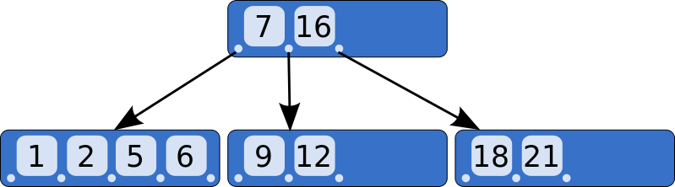
B-Tree - Example
Diagram of a B-Tree:

Slide 48
B-Tree
B-tree is a tree data structure that is used to store, read, and write large blocks of data (large amount or volume of data), because a B-tree has more nodes than a binary tree or binary search tree.
But a B-tree wastes more space in memory than a binary tree or binary search tree, because of the large number of child nodes than a binary tree or binary search tree.

Slide 49
Implementation or Representation of B-Tree
B-tree can be implemented or represented (performed or created) using one of the following two methods:
Using array, called sequential or linear representation of B-tree.
Using linked list, called linked representation of B-tree.

Slide 50
Different Operations Performed on Tree
There are different operations that can be performed on Binary Tree, Binary Search Tree (BST), and B-Tree, as shown below:
Insert (Add or Create)
Delete
Traverse (Display)
Search
Sort

Slide 51
Hierarchical Data Structure - Tree
A tree is normally used to store and represent value (data) in some hierarchical order (drawn from top to bottom or up to down).
The values are stored in the nodes of the tree.
Each node of the tree contains a value.

Slide 52
Hierarchical Data Structure - Tree
Each node in a tree has zero or more child nodes (also called children).
Every child nodes (also called children) is always one level lower than its parent node in the tree hierarchy.

