Slide 1
Design, Fabrication, and Control of a Low-Cost Quadruped Robot with Integrated Computer Vision
Bachelor Thesis Defense
Univerzitet Singidunum
Roman Sannikov

Slide 2
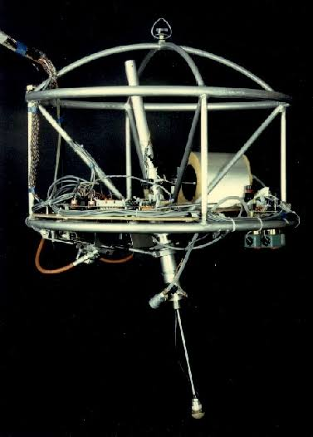
Introduction
1968 Mathematical Biosciences article “On the stability properties of quadruped creeping gaits”
1984 article “Experiments in Balance with a 3D One-Legged Hopping Machine”
2008 article “BigDog, the rough-terrain quadruped robot”
2016 article “You Only Look Once architecture”

Slide 3
Problems and solutions
High cost | Low cost
Close sourced | Open source
Hard to modify | DIY

Slide 4
Model design

Slide 5
Hardware

Slide 6
Software

Slide 7
Results

Slide 8
Future work

Slide 9
Presentation rules
Final thesis is defended publicly in front of the mentor, committee member and the audience. For the act of public defense, it is necessary to prepare a short PowerPoint presentation and oral presentation of the most important parts of the final thesis work.
The presentation should meet the following technical standards:
1) must have a neutral a background, adapted to the academic institution (name and logo of the institution);
2) should contain a minimum of 7 and a maximum of 10 slides, with a maximum of five to seven lines of text (this does not apply to any tables or charts);
3) The text should be aligned in margins and clearly visible (Times New Roman), size 26 pts);
Having in mind that the mentor and the member of the commission read your work in detail, at the presentation you will need to show only the key parts of the final thesis work (the topic you dealt with, analysis of possible solutions and specific recommendations and conclusions you have reached).

