Slide 1

Members Romana Parvin Kanta Amirul Islam Jobaida Gulsanara Jarin Tanvir Faravy
ICare
Diet Manager

Slide 2
Objective
User Profile Creation
Add diet chart
Set Reminder

Slide 3

Start Screen

Slide 4
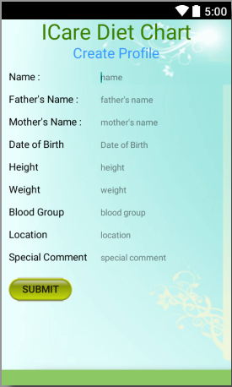
Create Profile

Slide 5
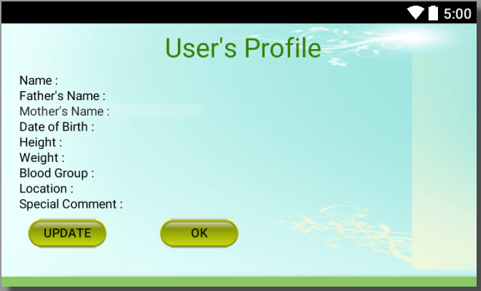
Profile Update

Slide 6
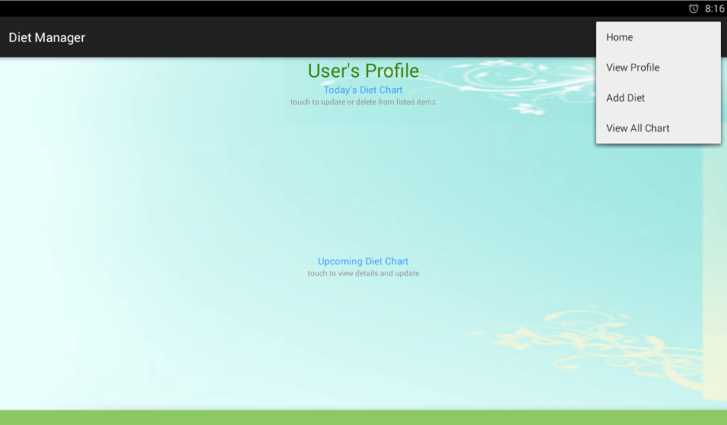
Home Screen

Slide 7
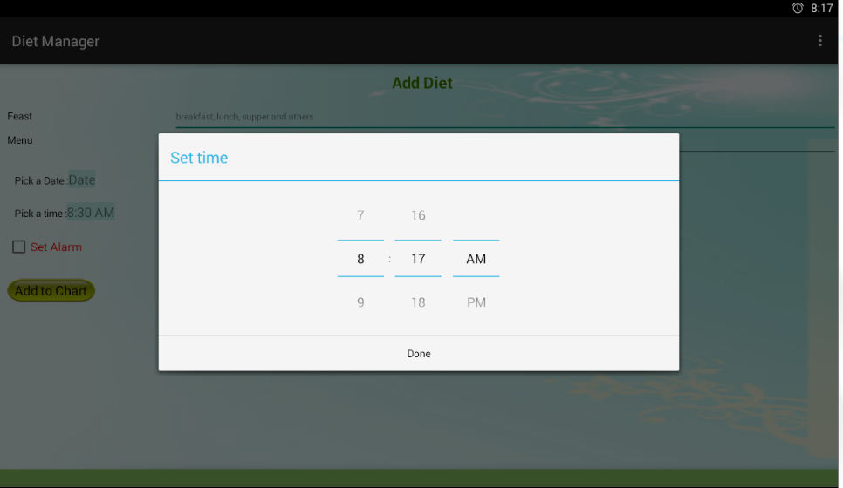
Add Diet Screen

Slide 8
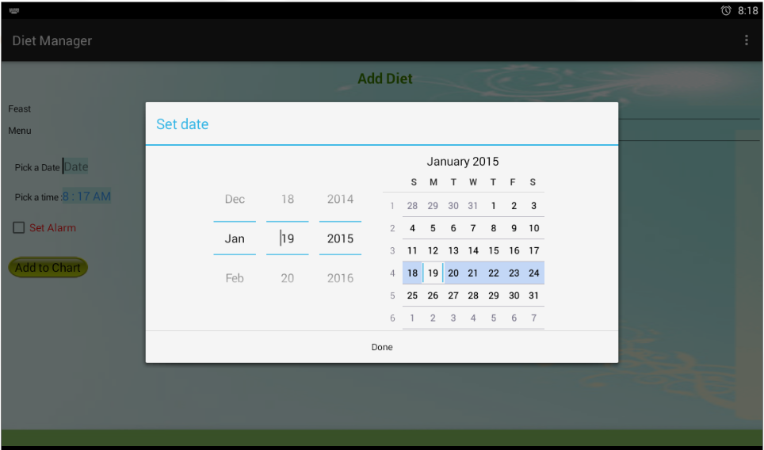
Add Diet Screen

Slide 9
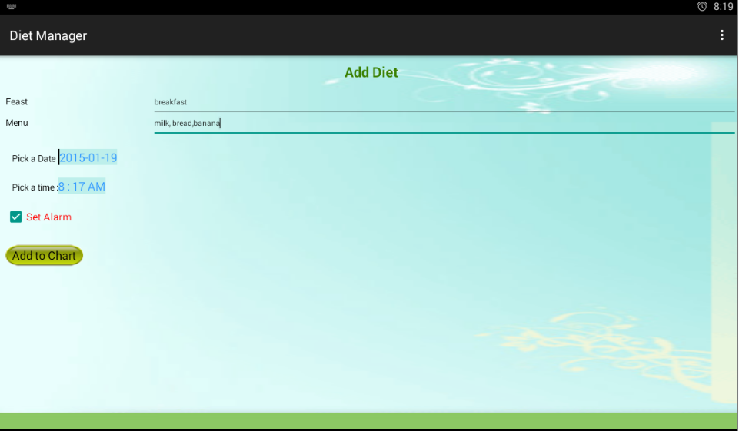
Add Diet Screen

Slide 10
How We Did
Splitting Task
Distributing Task
Integrate task
Make Presentation

Slide 11
Future Plan
Continuing……
Improve UI
Quality Assurance

Slide 12

Any Question

