Slide 1

SUMMATIVE ASSESSMENT 2
Time Series Analysis and Modeling
Romand Lansangan, Zion Ramilo, Jinghua Yang
December 2025

Slide 2
Overview
DATASET A
DATASET B
DATASET C
GARCH Volatility
ARIMAX Transfer Function
SARIMAX Intervention
SPY Daily Returns (2015-2025), GARCH(1,1) with Student-t distribution
Sales and Advertising, Prewhitening and CCF Analysis
Spanish Electricity Demand, Policy Impact Analysis

Slide 3
DATASET A
DATA SOURCE
Yahoo Finance
GARCH Volatility Modeling
TIME PERIOD
2015 - 2025
OBSERVATIONS
~2,750 daily returns
S&P 500 ETF (SPY) Daily Returns

Slide 4
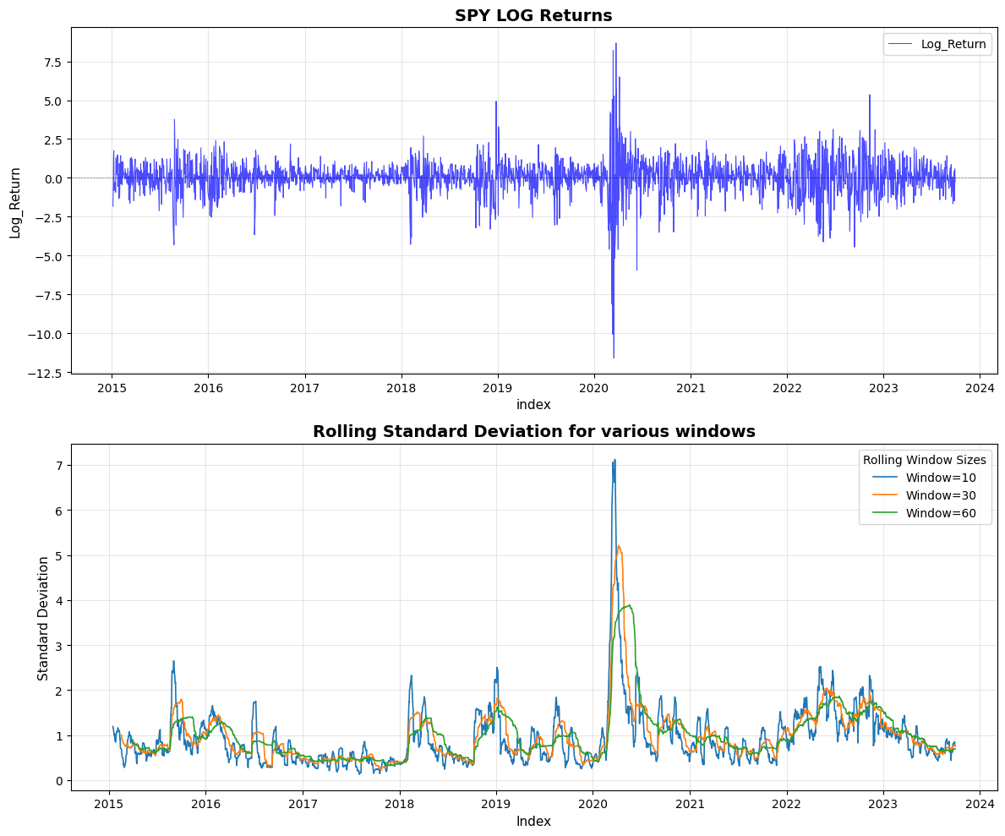
Exploratory Data Analysis
Key Observations
Clear volatility clustering. COVID crash shows -12% drop with +8% rebound. Classic GARCH behavior.
Rolling Volatility
Spikes during COVID (~7%). Elevated in Aug 2015, late 2018, and 2022.
SPY LOG Returns Plot

Slide 5
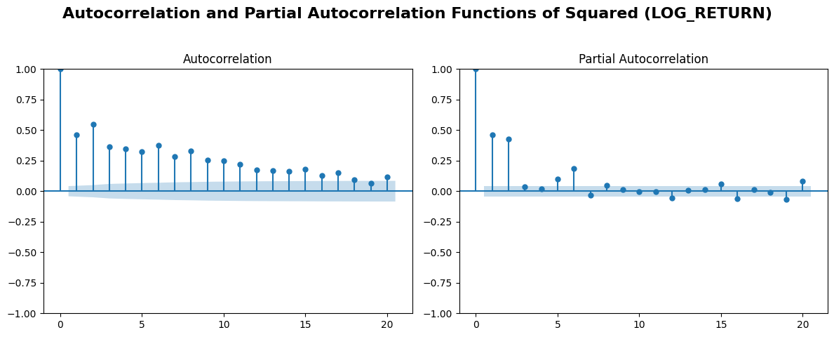
ACF/PACF of Squared Returns
ACF Analysis
PACF Analysis
Slow decay from ~0.47 at lag 1 through lag 20. GARCH term needed.
Sharp cutoff after lags 1-2. ARCH(1) sufficient.
Recommendation
Start with GARCH(1,1) - parsimonious specification

Slide 6
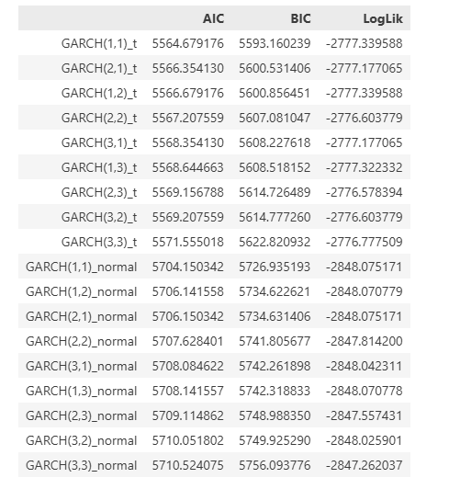
Model Selection: Grid Search
Grid search: p,q in {1,2,3}, distributions: Normal, Student-t
Best Model: GARCH(1,1)_t
Lowest BIC, parsimonious. Student-t handles fat tails.
Key Findings
Student-t models outperform Normal by ~140 BIC. Higher-order models offer minimal improvement.

Slide 7
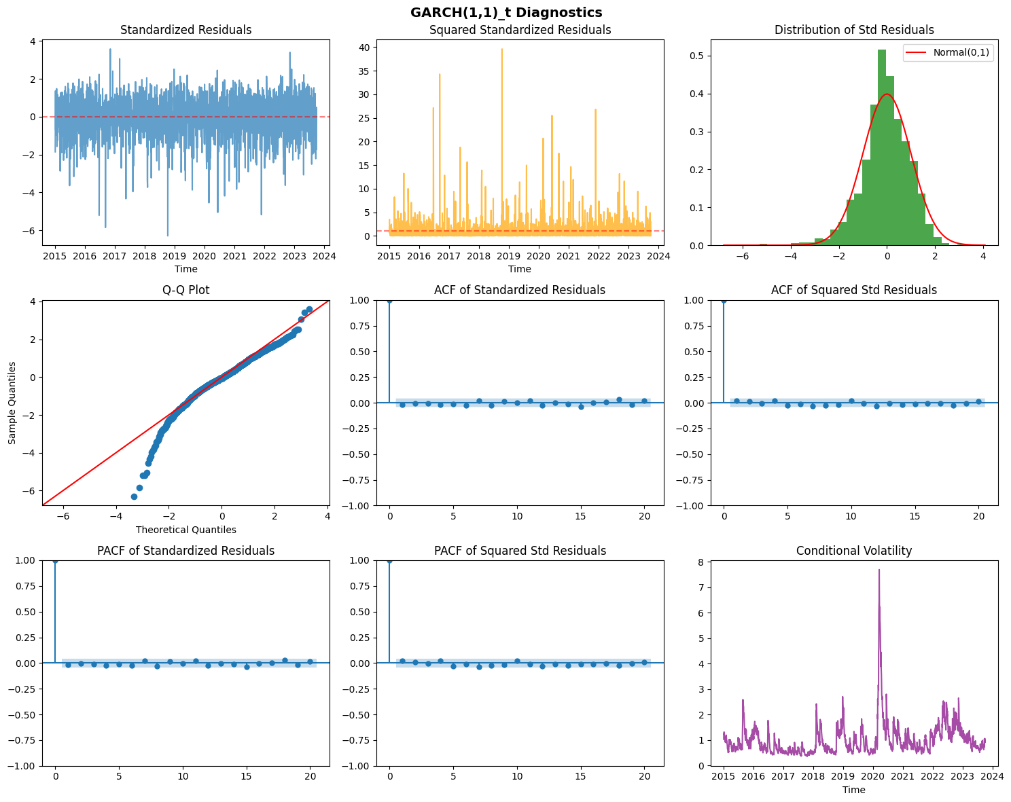
Model Diagnostics
Ljung-Box (Residuals): p > 0.67 - No serial correlation
Ljung-Box (Squared): p > 0.37 - No ARCH effects
ARCH-LM: p = 0.55 - Volatility captured
Normality: JB p = 0 - Non-normal (expected with t-dist)
Conclusion
GARCH(1,1)_t well-specified. Suitable for forecasting.

Slide 8
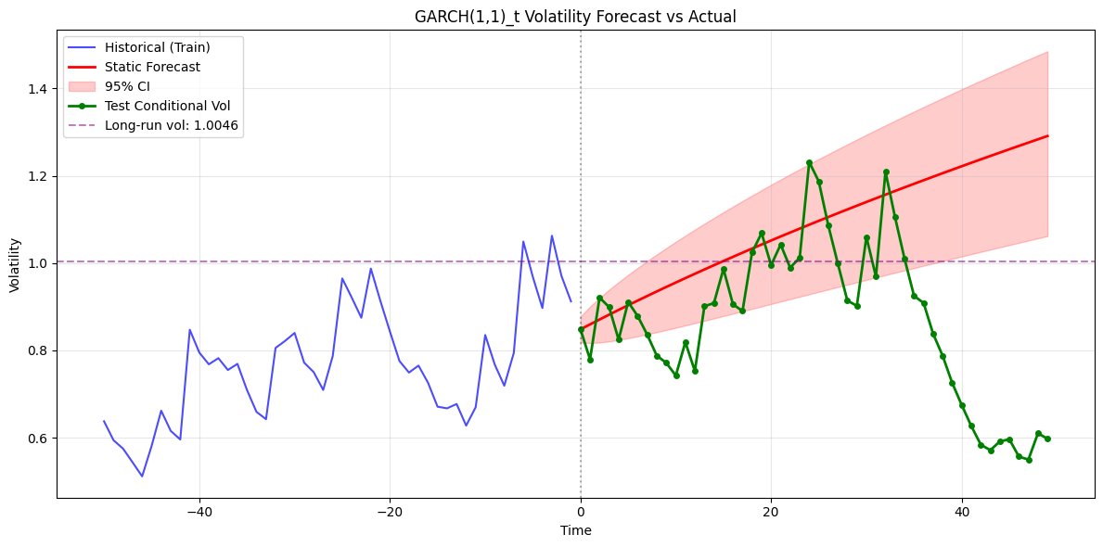
Volatility Forecasting
Limitation
Static forecasts converge to unconditional mean. Use rolling re-estimation for better performance.
Long-run Volatility
1.0046
Forecast Accuracy
MSE: 0.1109, MAE: 0.2339
95% CI Coverage: 48.0%

Slide 9
DATASET B
METHODOLOGY
Prewhitening, CCF, Transfer Function
ARIMAX Transfer Function
FREQUENCY
Weekly (52 periods/year)
VARIABLES
Sales and Advertising Analysis
Sales (output), Advertising (input)

Slide 10
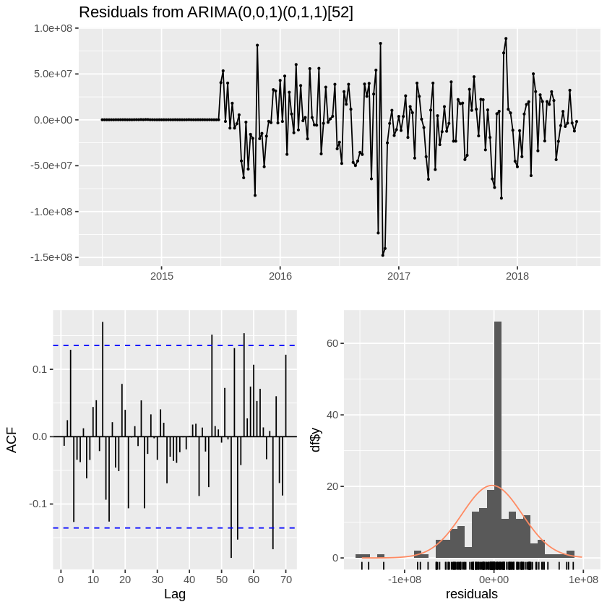
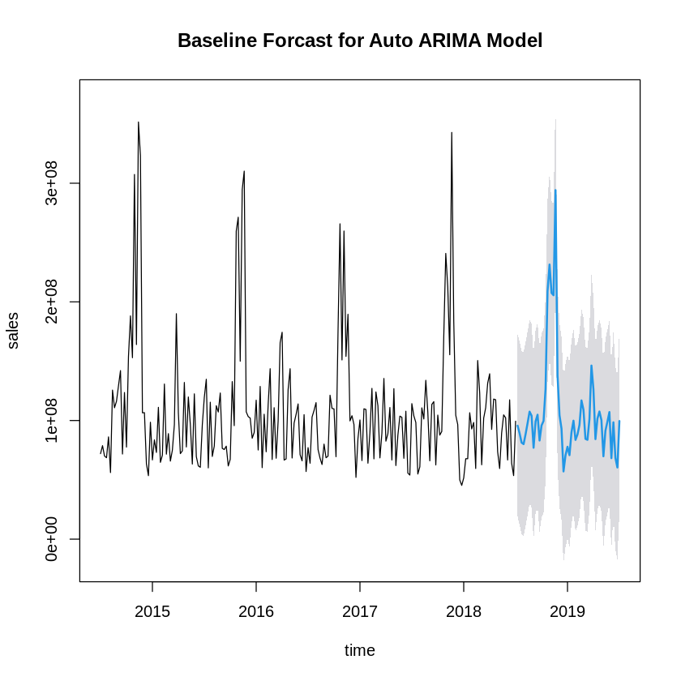
Baseline: Auto ARIMA
Stationarity
ADF Test p < 0.01 - Series is stationary
Auto ARIMA Selection
ARIMA(0,0,1)(0,1,1)[52]
Model Fit
AIC: 5958.77, BIC: 5967.94, MAPE: 22.07%
Ljung-Box: p = 0.69 - Residuals uncorrelated

Slide 11
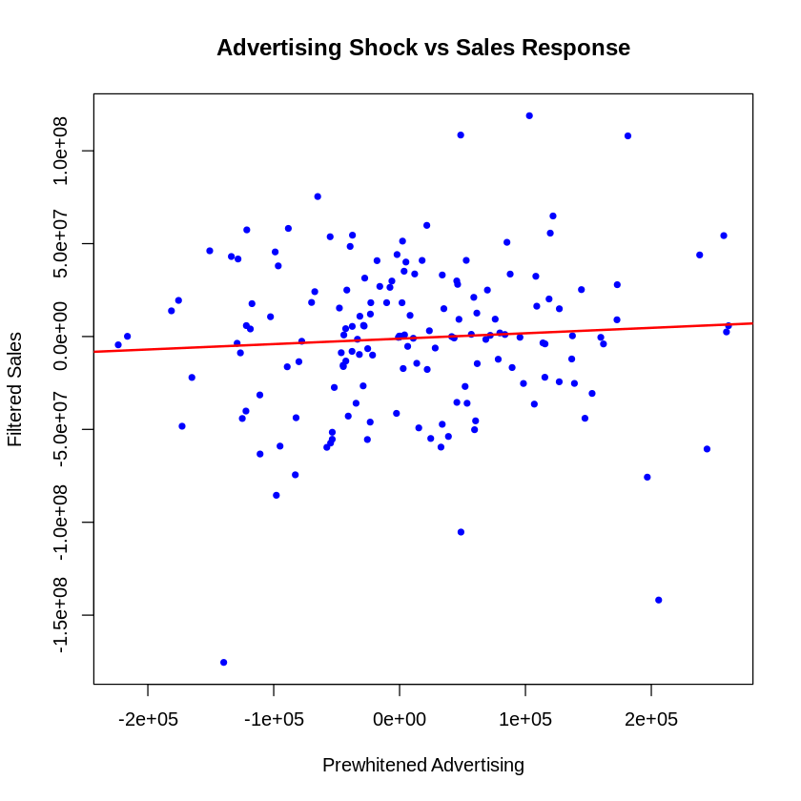
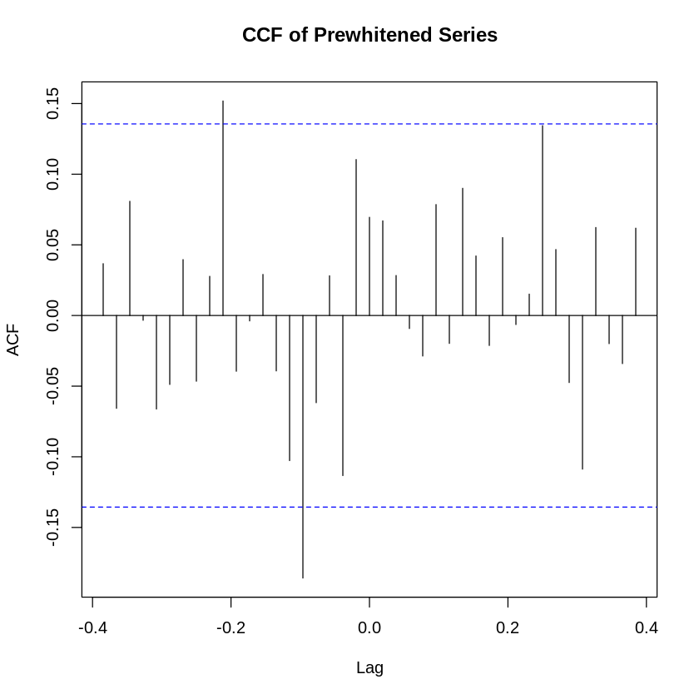
Prewhitening and CCF Analysis
Prewhitening
CCF Findings
ARIMA(0,1,2)(1,1,0)[52] filter applied to both series
Only 2 significant lags (10 and 16). Weak relationship overall.

Slide 12
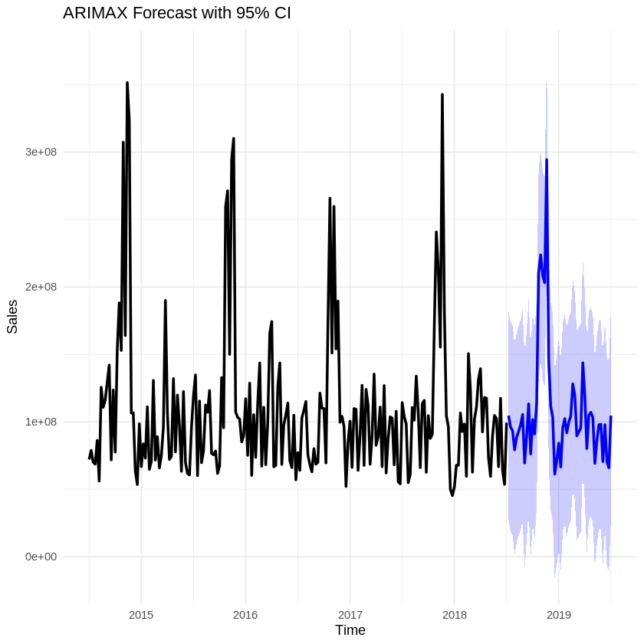
ARIMAX Transfer Function Model
Model
ARIMA(0,0,1)(0,1,1)[52] + lags
Advertising lags NOT significant. Sales driven by own history.
AIC: 325.32 (much lower than baseline)

Slide 13
DATASET C
DATA SOURCE
Kaggle Energy Dataset
SARIMAX Intervention
TIME PERIOD
2015 - 2019 (Daily)
INTERVENTION
January 1, 2017
Spanish Electricity Demand

Slide 14
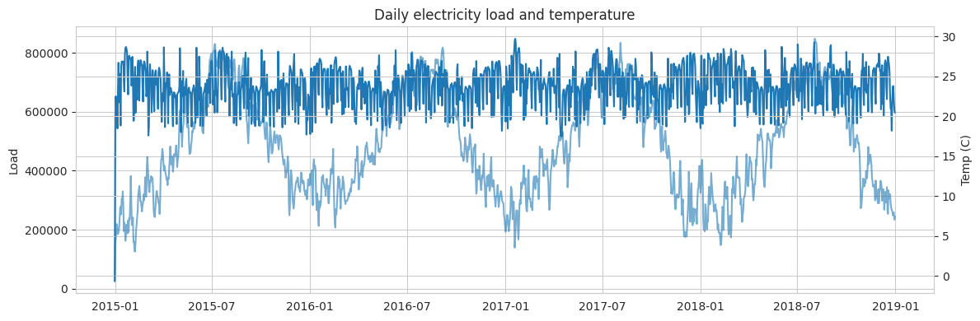
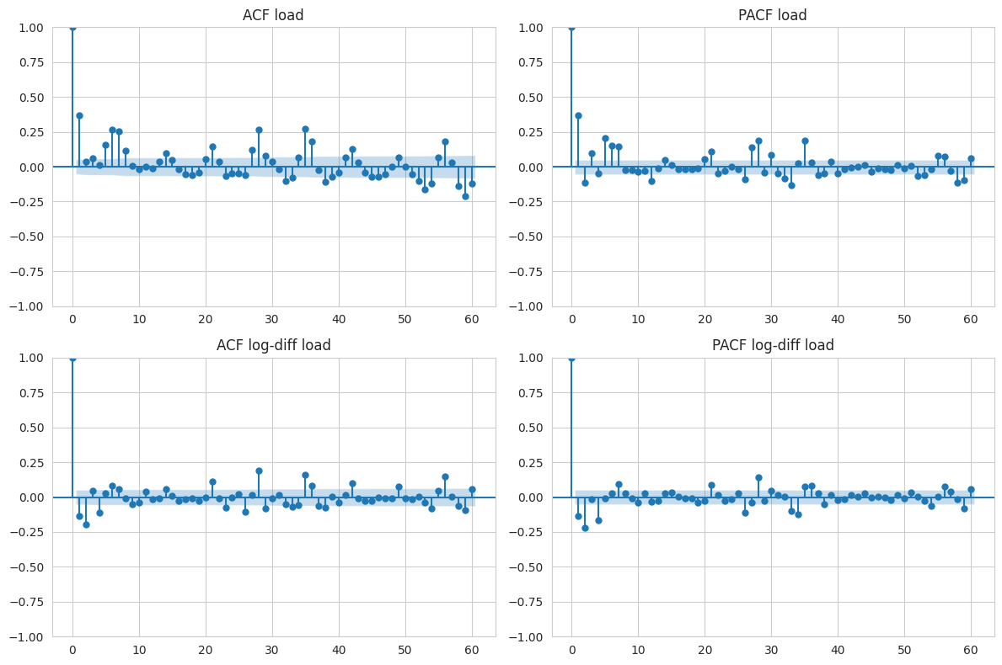
Exploratory Data Analysis
Data Characteristics
1,462 daily observations. Mean load: 688,288 MWh. Temperature: 5-30C.
Stationarity Tests
ADF (levels): p < 0.001. ADF (log-diff): p < 0.001.
Transformation
Log-transform stabilizes variance. ARIMA with d=1.

Slide 15
Intervention Model Design
Intervention Variables
Model Selection
PULSE DUMMY
= 1 on intervention day only (Jan 1, 2017)
Grid search over p,q and P,Q
STEP DUMMY
Best AIC: -2610.88
= 1 from intervention day onwards
Train/Test Split
Best Model (AIC Selection)
Train: Dec 2014 - Jun 2018
SARIMAX(0,1,1)x(1,0,1)7
Test: Jul 2018 - Dec 2018

Slide 16
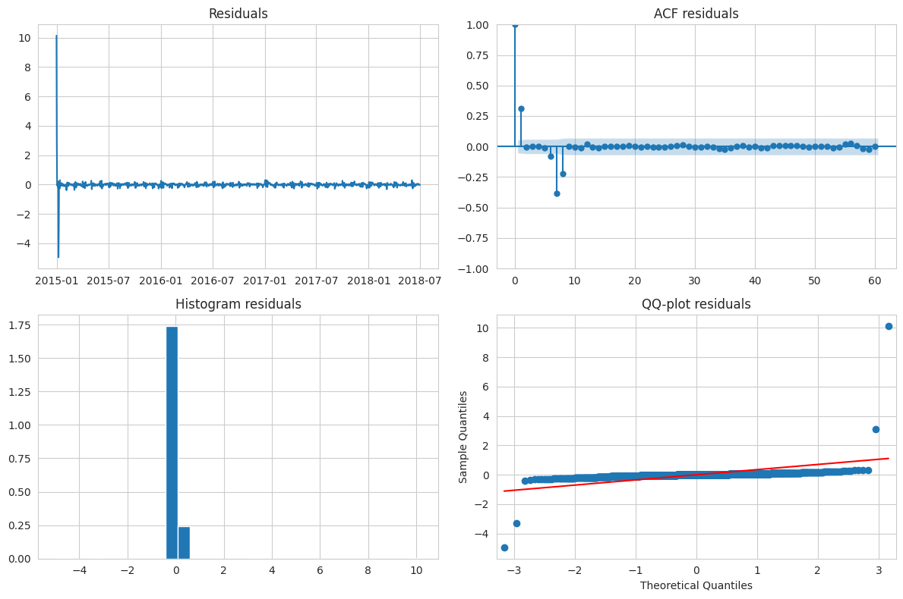
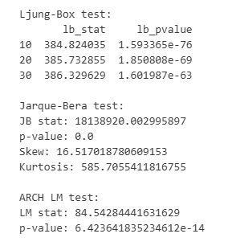
Intervention Effects
Interpretation (Original Scale)
Step: -19.1% permanent reduction
Pulse: +5.7% one-day spike (not significant)

Slide 17
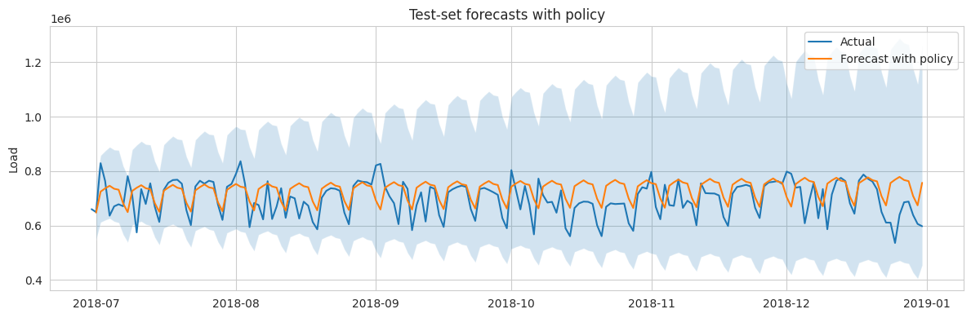

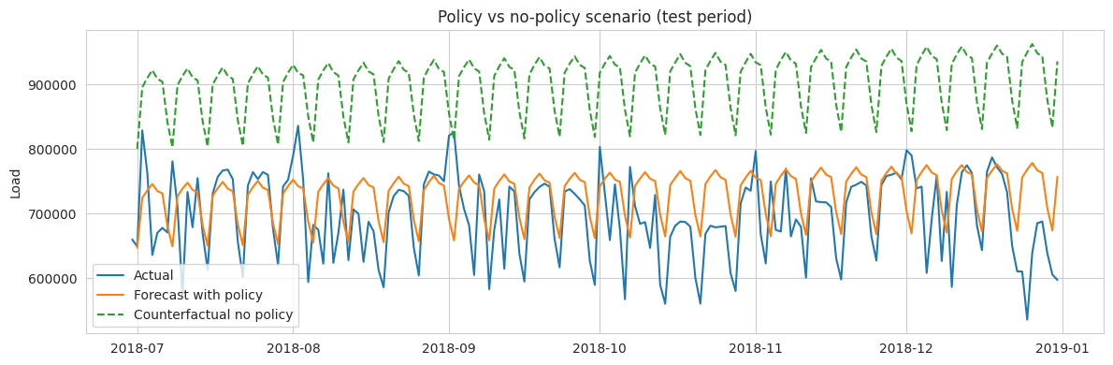
Policy Impact Analysis
Forecast Accuracy
RMSE: 76,067 MWh
MAPE: 8.7%
Counterfactual Comparison
With Policy: 730,418 MWh/day
Without Policy: 903,172 MWh/day
Estimated Reduction
19.1%
Significant demand reduction from policy intervention

Slide 18
Key Takeaways
Summative Assessment 2 Findings
DATASET A
DATASET B
DATASET C
GARCH(1,1) with Student-t
ARIMAX Transfer Function
SARIMAX Intervention
Captures volatility clustering in SPY returns. Persistence near 1.0. No residual ARCH effects.
Advertising has limited delayed impact on sales. Seasonal component essential.
Policy intervention reduced demand by 19%. Step effect dominates long-run impact.
Lansangan | Ramilo | Yang

