Slide 1
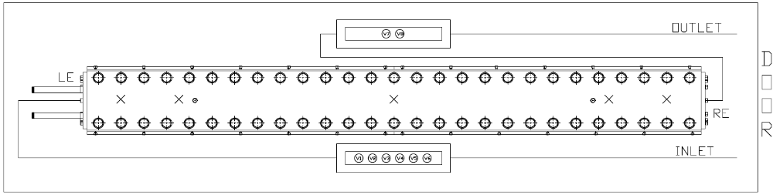
Instrumentation layout
tc8
INLET
tc10
tc1
tc2
tc3
tc4
tc9
OUTLET
List of vamas and RRR samples (box before after coil):
V1 – HOC0181AF14V.001
V2 – HOC0181AF11V.001
V3 – HOC0181AF11E.001
List of vamas and RRR samples (box after before coil):
V7 – HOC0181AF10V.001
V8 – HOC0181AF10E.001

