Slide 1
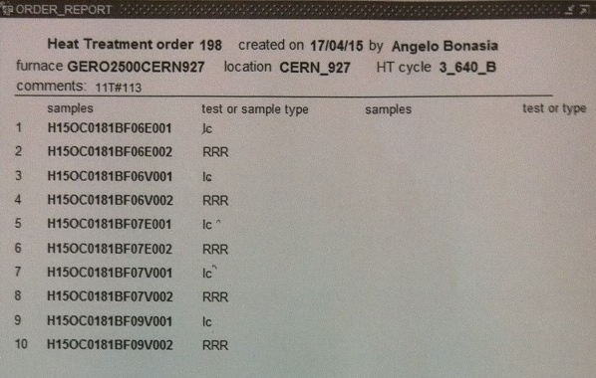
Instrumentation layout
tc8
tc10
tc1
tc2
tc3
tc4
tc9
List of vamas and RRR samples (box before coil):
V1 – H15OC0181BF06E.001
V2 – H15OC0181BF06V.001
V3 – H15OC0181BF07E.001
V4 – H15OC0181BF07V.001
5 RRR samples (3 virgin + 2 extracted)
List of vamas and RRR samples (box after coil):
V7 – H15OC0181BF09V.001

