Slide 1
Reaction RMC-101
N.Bourcey

Slide 2
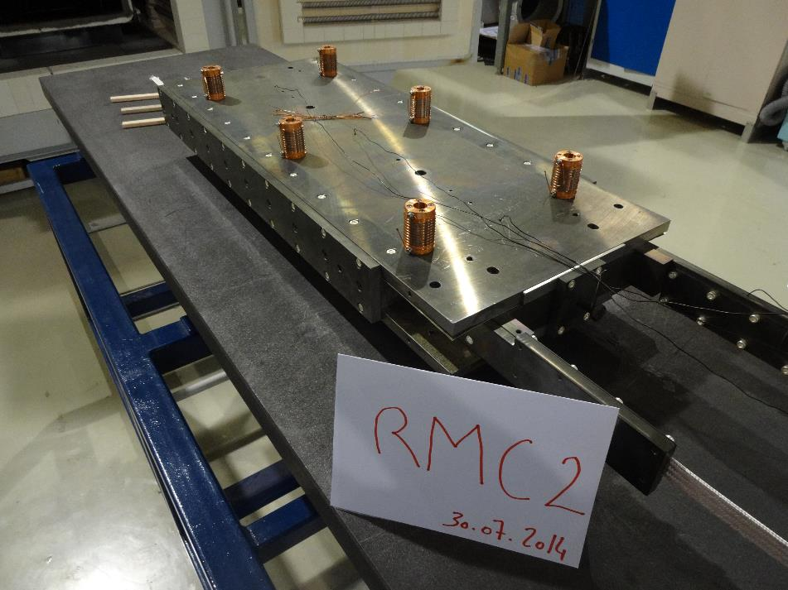
Instrumentation layout and heat cycle
tc19
tc16
tc20
tc13

Slide 3
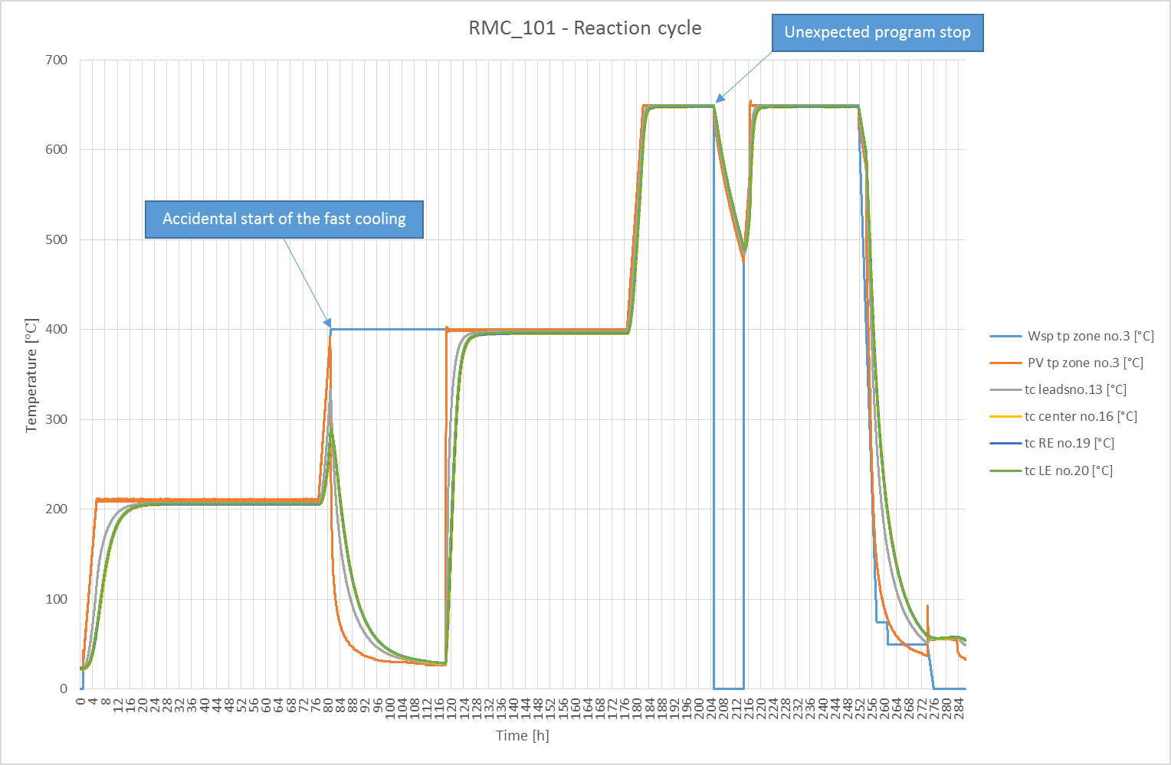

Slide 4
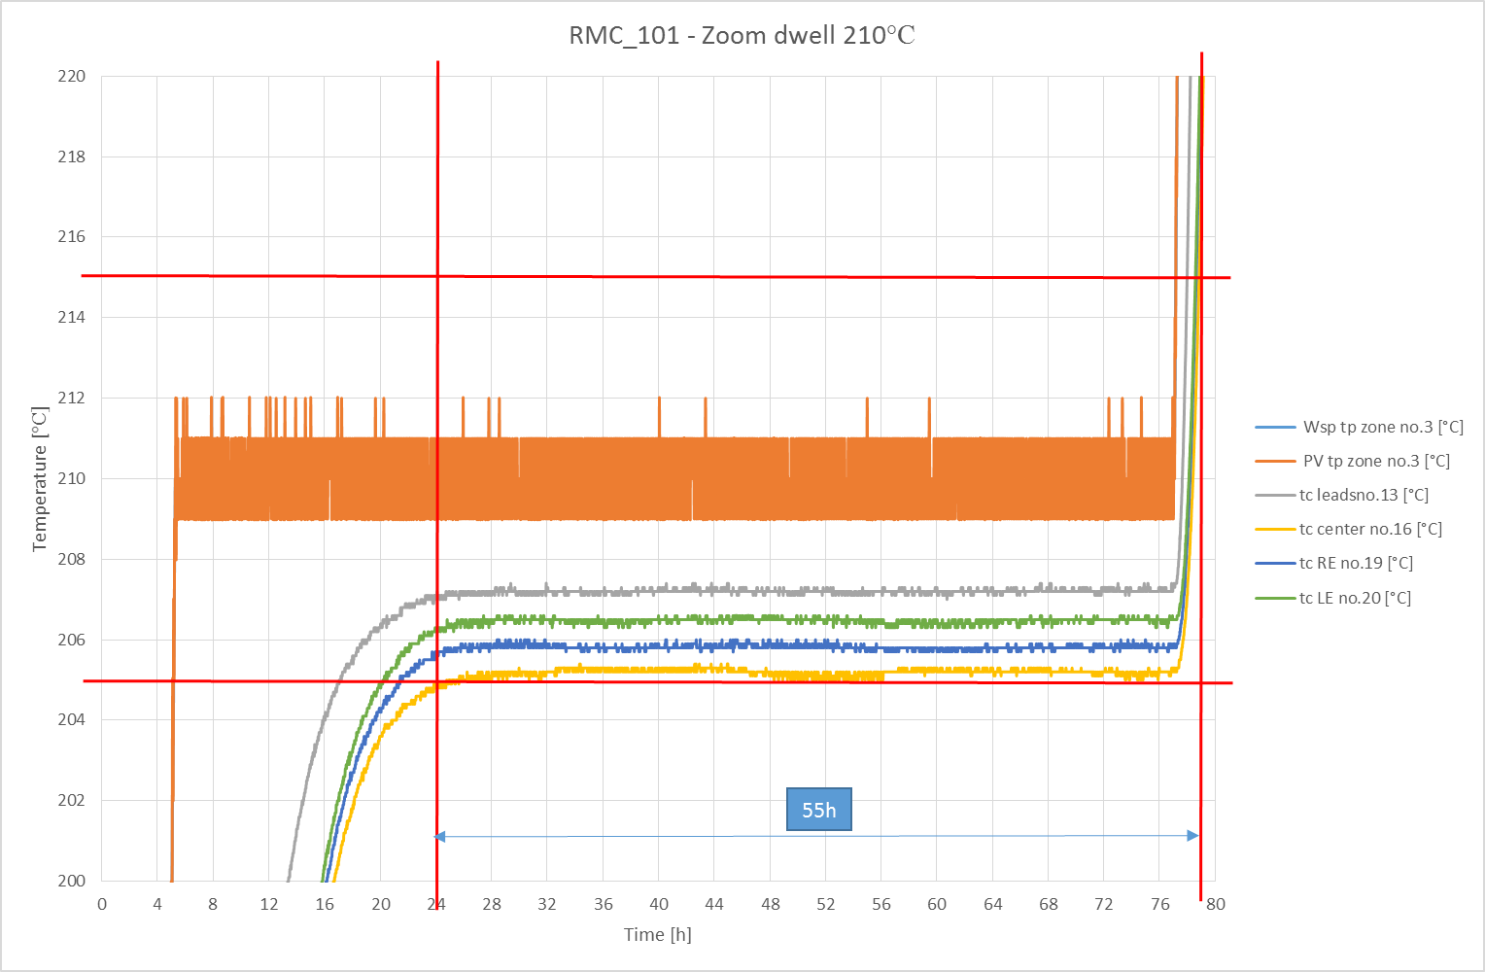

Slide 5
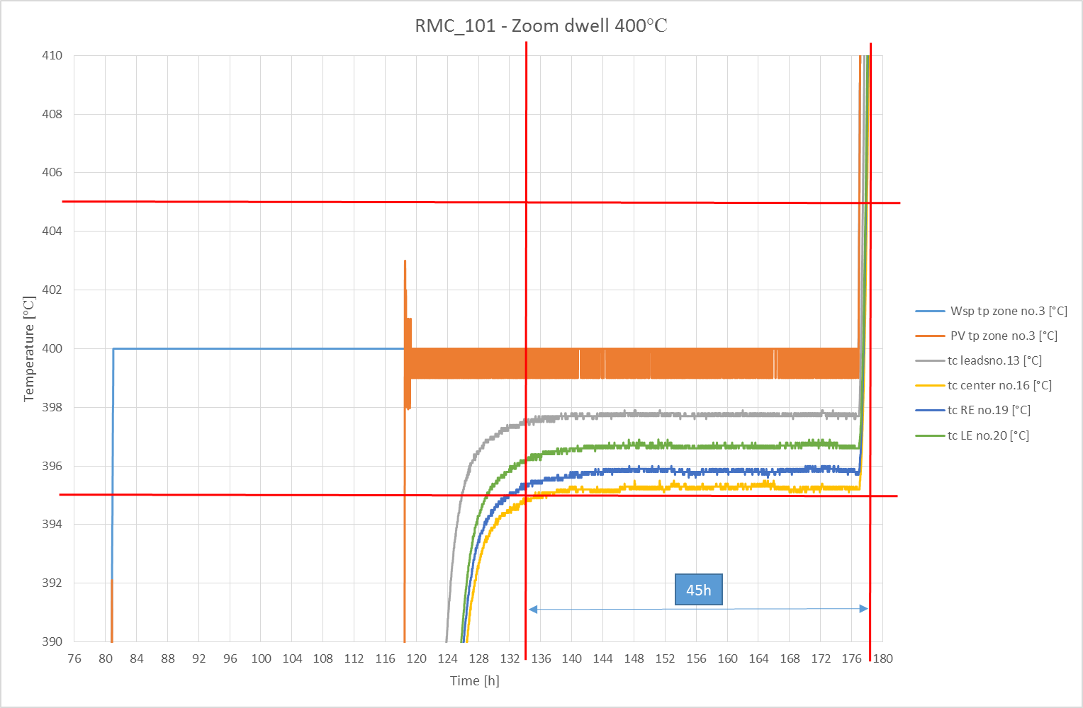

Slide 6
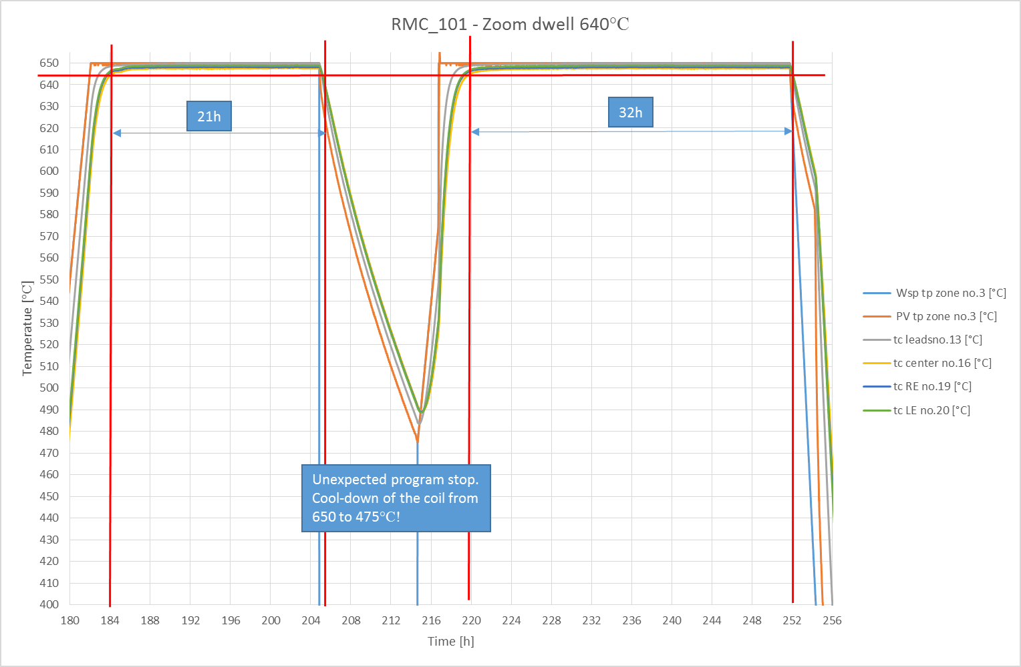

Slide 7
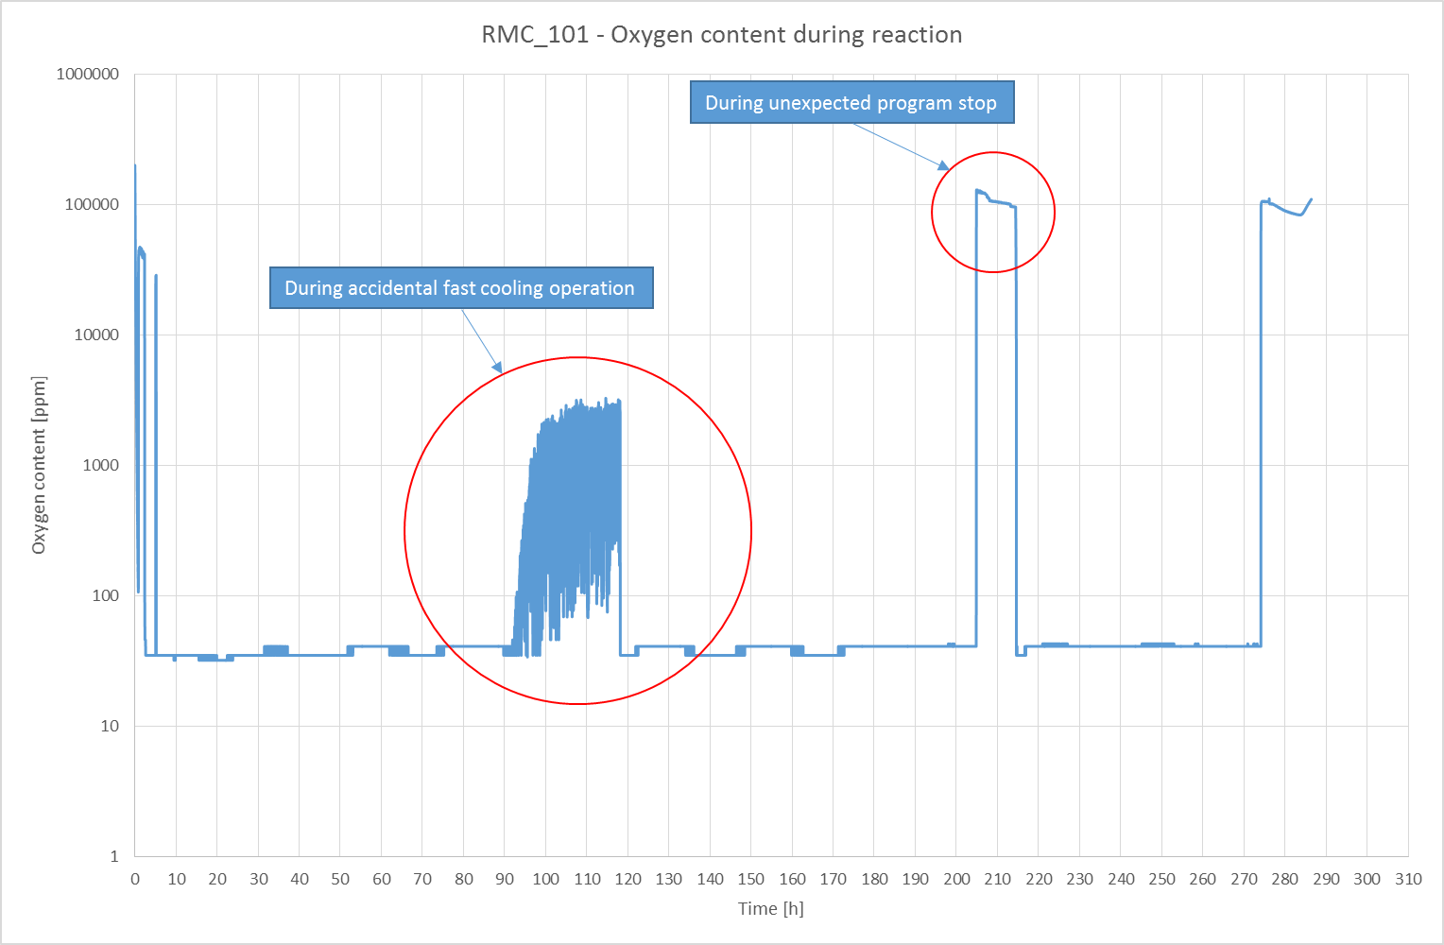

Slide 8
Conclusion
Problems occurs during the reaction of coil RMC_101;
During ramp to 400°C, the fast cooling starts accidentally leading to the cool-down of the coil from 300°C to 50°C in 38h. The coil was heated again up to 400°C and the dwell started.
During dwell at 650°C, the furnace stops the program without any reason leading to a cool-down of the coil to 475°C in 10h. The coil was heated again up to 650°C and the dwell was restarted from where it stopped.
Duration of the plateau was 55h at 210°C (expected 48h), 45h at 400°C (expected 48h) and 53h at 650°C (expected 50h)
Oxygen content in the retort increase during the furnace operation problems.

