Slide 1
TE-MSC-MDT

Slide 2
SMC11T#4_202
Reaction report
N. Bourcey
08/05/2015

Slide 3
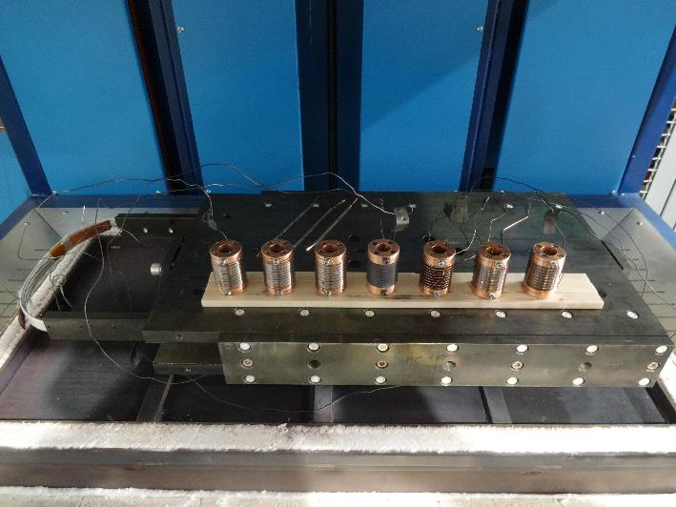
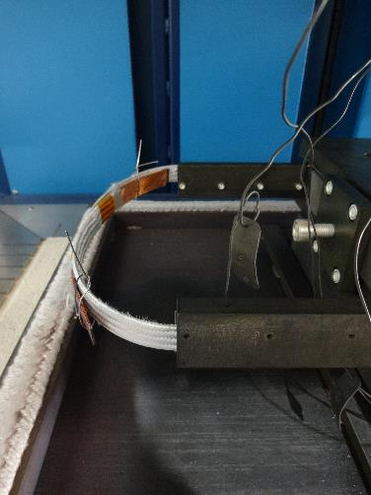
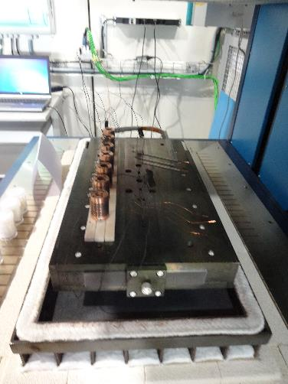
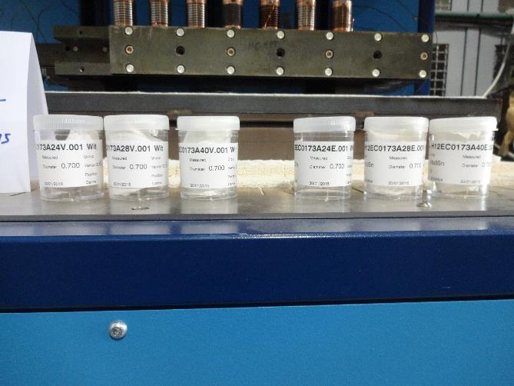
Preparation
Start date: 06/03/2015
End date: 24/03/2015
Heat cycle :
Ramp up 50°C/h, hold 100h/600°C
Ramp up 50°C/h, hold 240h/620°C

Slide 4
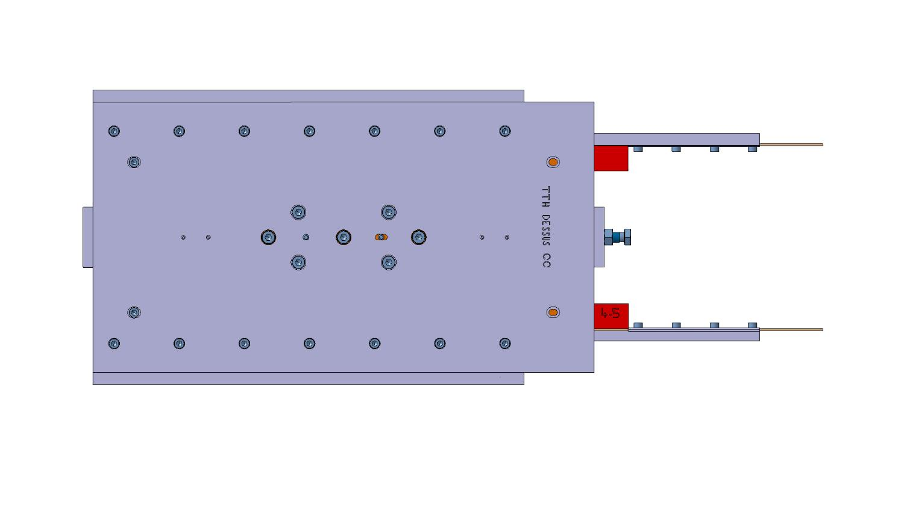
Instrumentation layout
tc8
tc10
tc1
Vamas 1
Vamas 2
Vamas 3
DummyVamas
Vamas 4
Vamas 5
Vamas 6
tc6
tc9

Slide 5
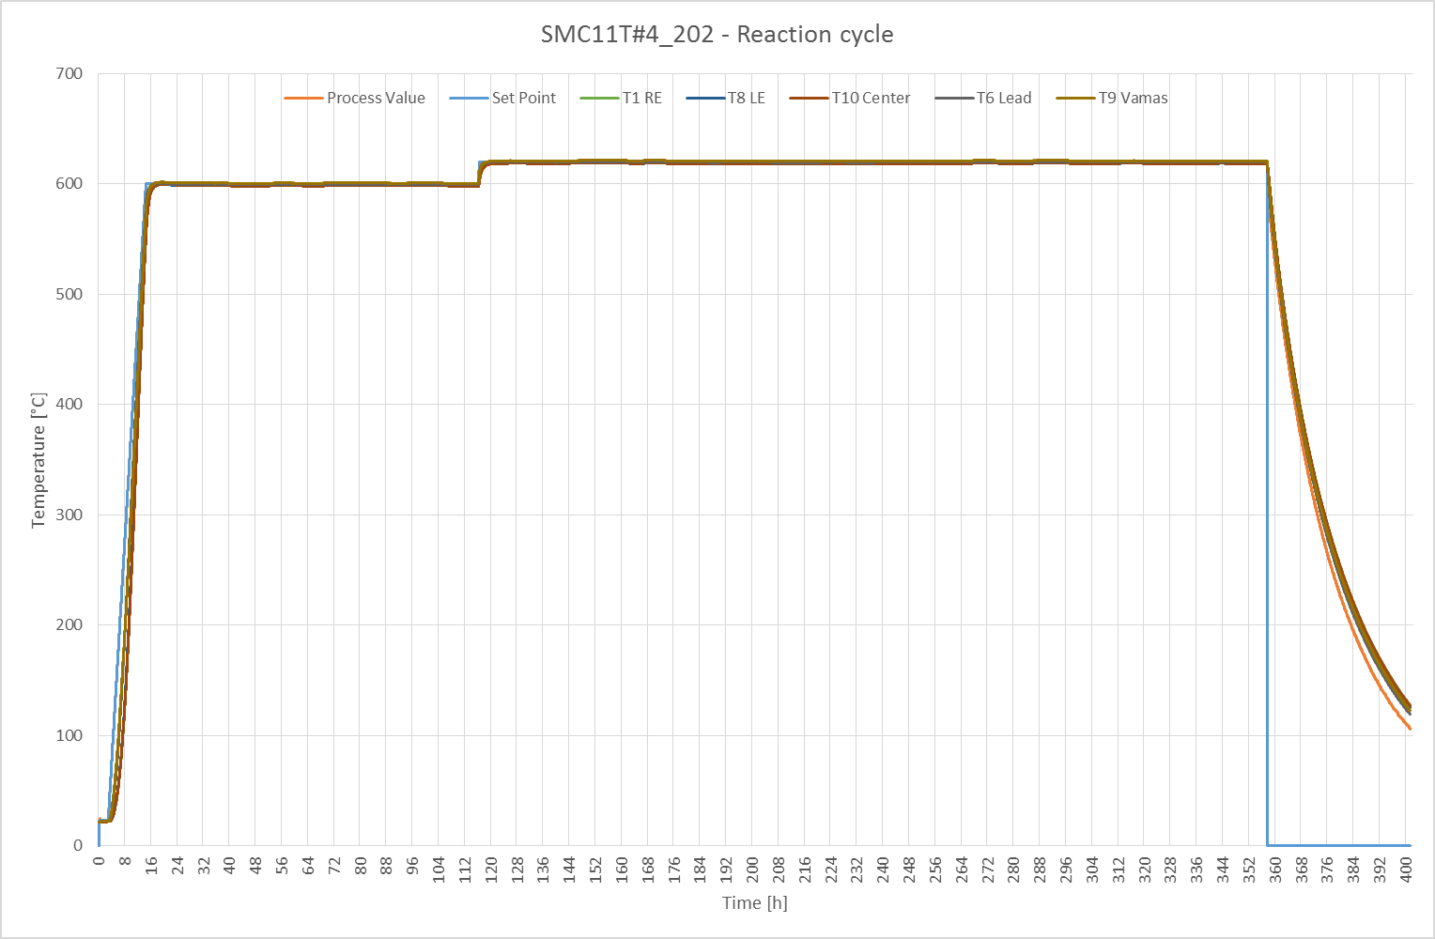

Slide 6
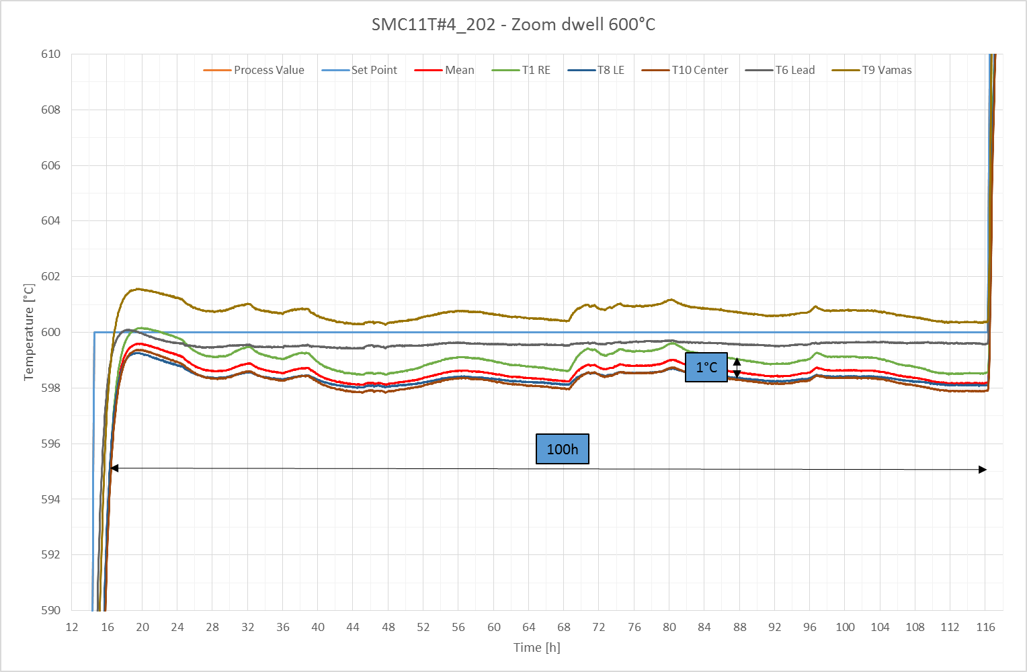

Slide 7
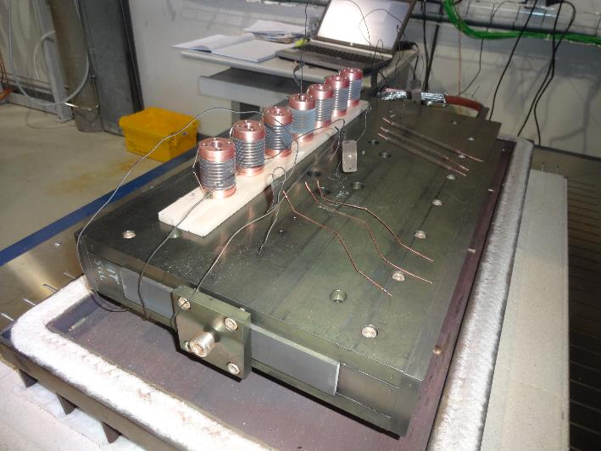
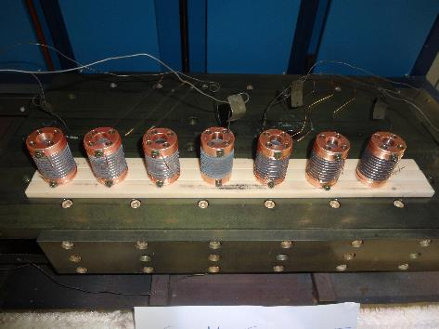
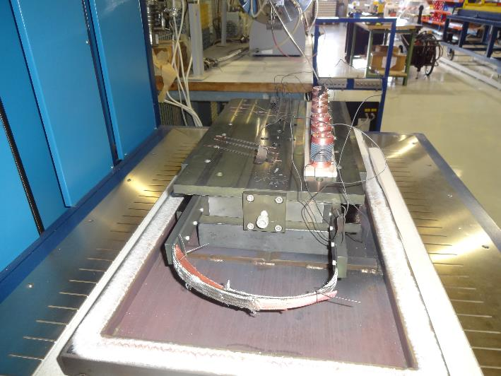
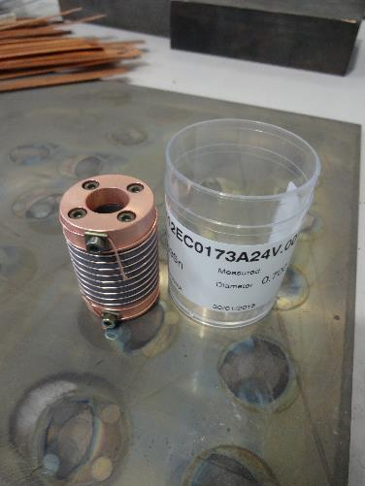
After reaction

Slide 8
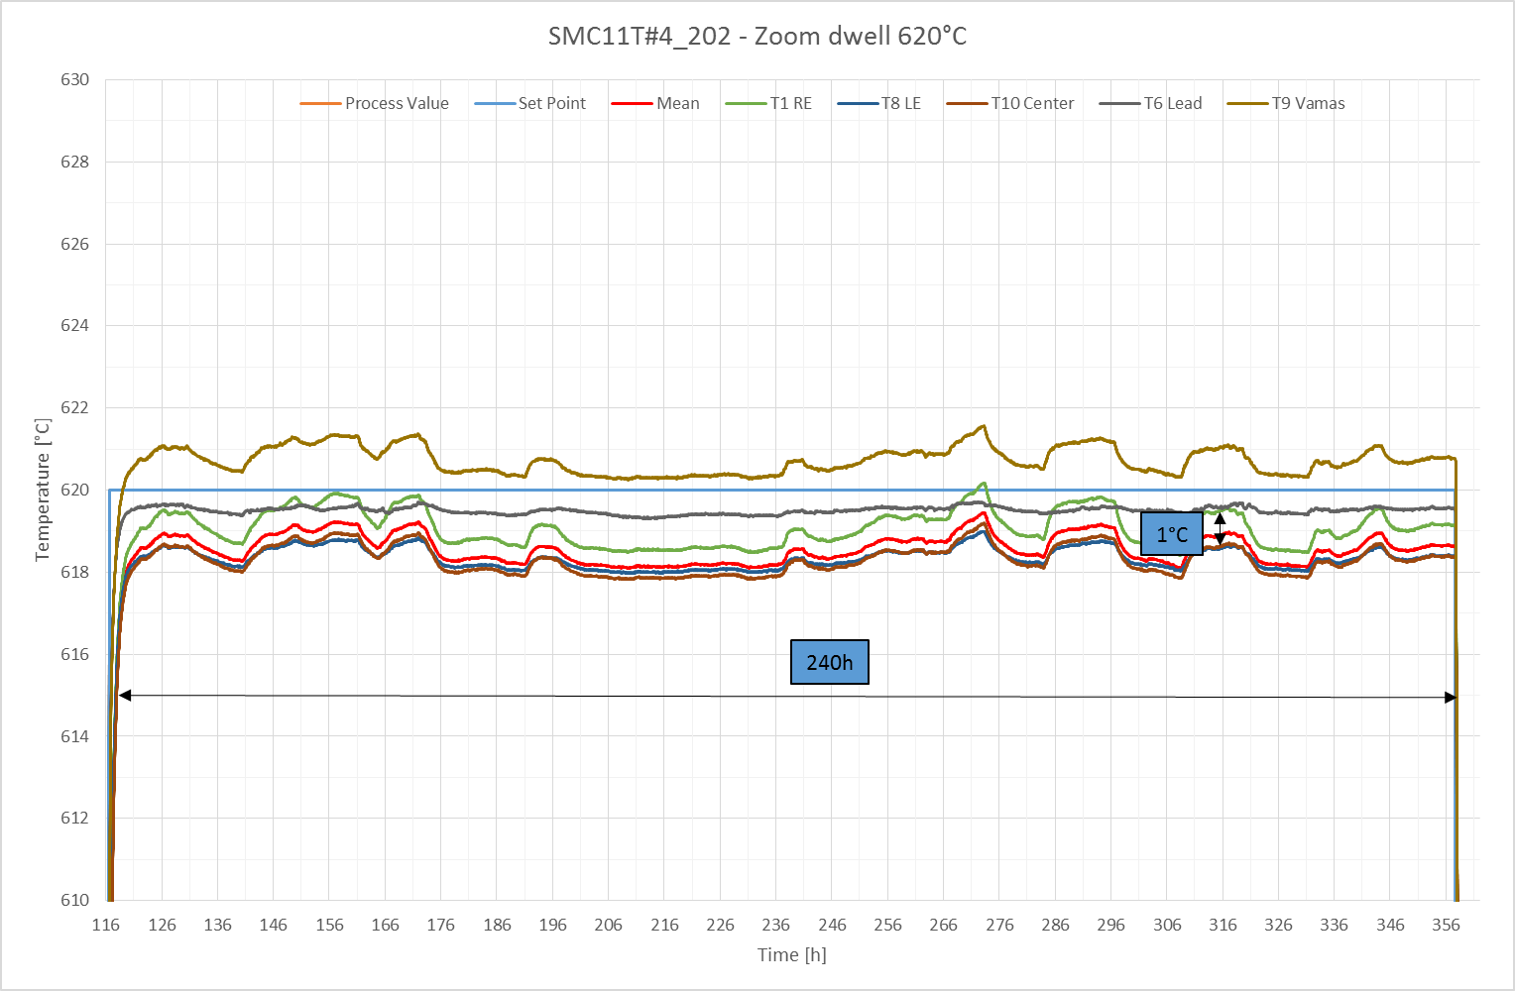

Slide 9
TE-MSC-MDT

