Slide 1
TE-MSC-MDT

Slide 2
SMC11T#4_201
Reaction report
N. Bourcey
08/04/2015

Slide 3
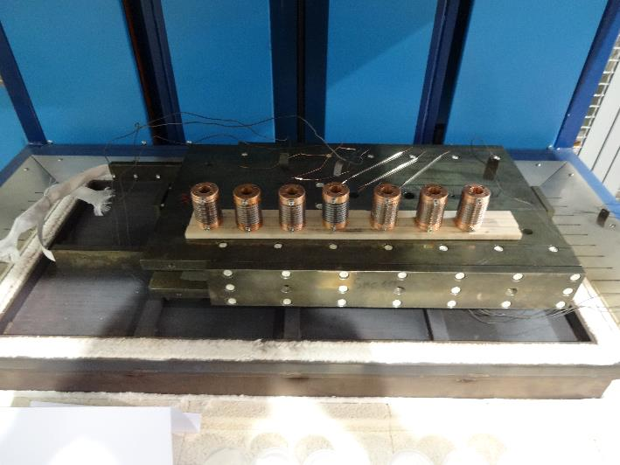
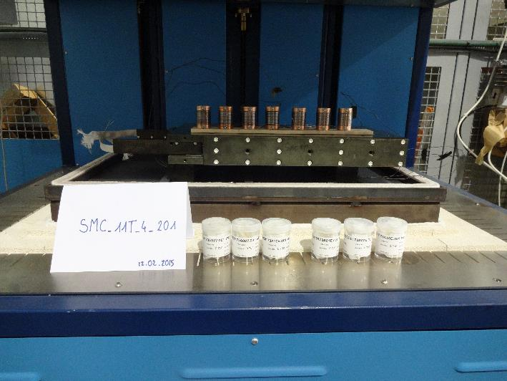
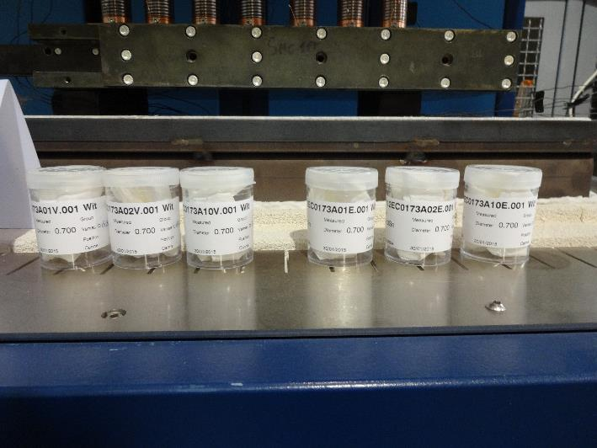
Preparation
Start date: 12/02/2015
End date: 02/03/2015
Heat cycle :
Ramp up 50°C/h, hold 100h/600°C
Ramp up 50°C/h, hold 240h/620°C

Slide 4
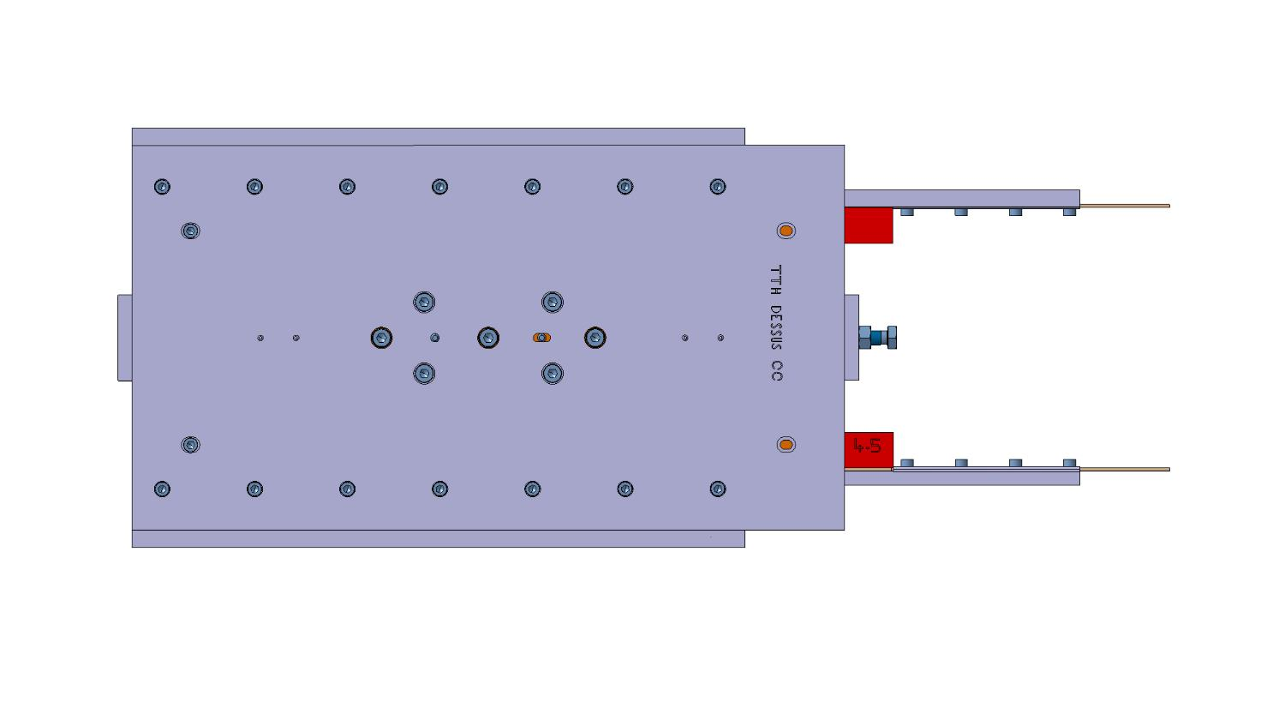
Instrumentation layout
tc8
tc10
tc1
Vamas 1
Vamas 2
Vamas 3
DummyVamas
Vamas 4
Vamas 5
Vamas 6
tc9

Slide 5
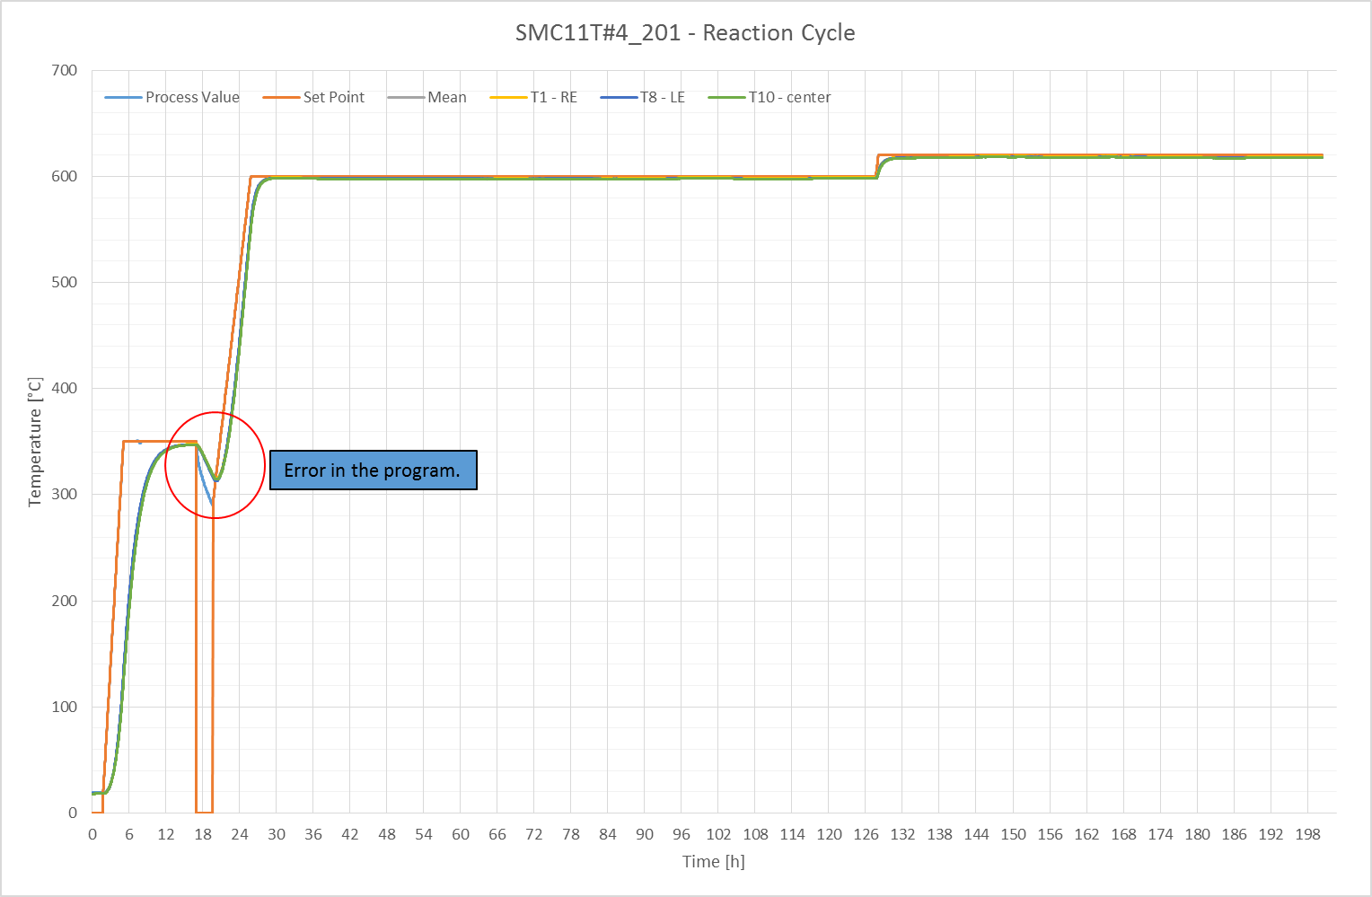

Slide 6
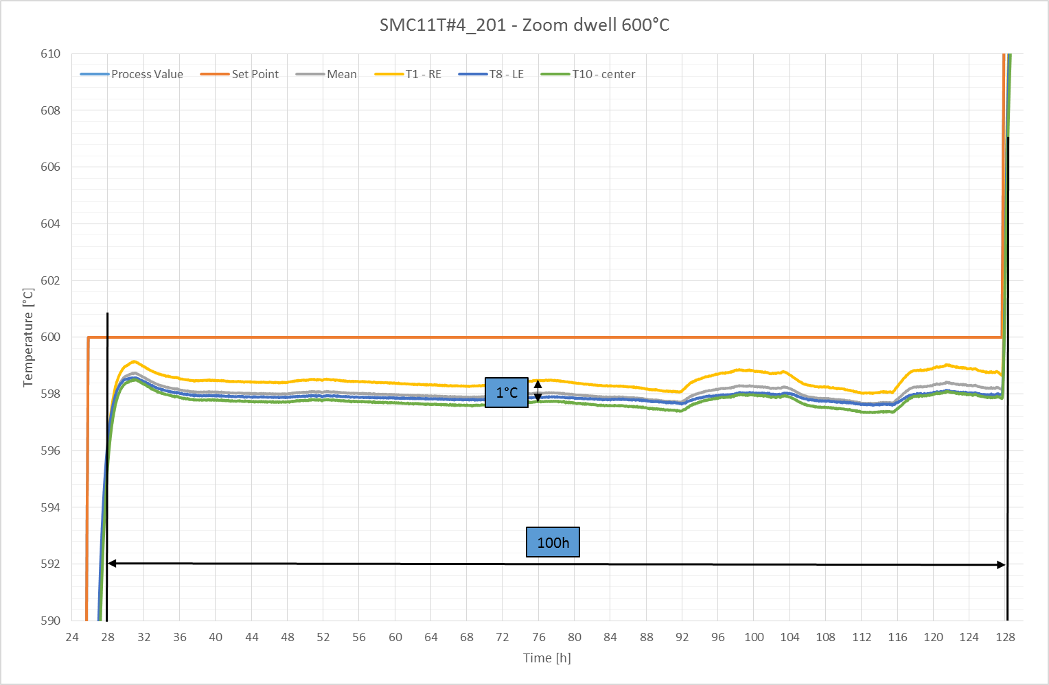

Slide 7
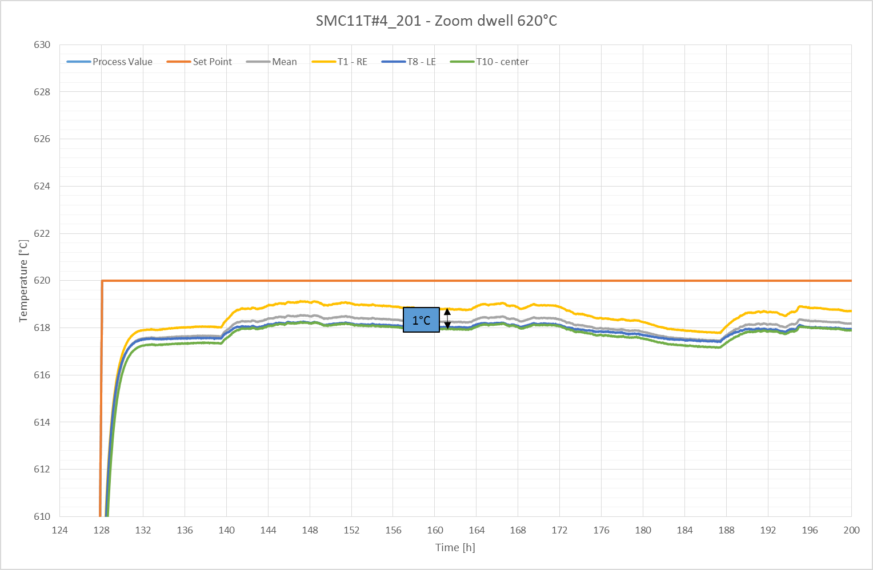

Slide 8
Summary
Problem during ramp to first plateau: at 350°C, the program stops and the coil starts to cool-down. The average temperature of the coil decrease to 300°C in 2 hours before to restart the program.
The acquisition stopped after 100h on the second plateau but the duration of the plateau has been confirmed manually.

Slide 9
TE-MSC-MDT

