Slide 1
TE-MSC-MDT

Slide 2
MQXFS_104
Reaction report
N. Bourcey
07/05/2015

Slide 3
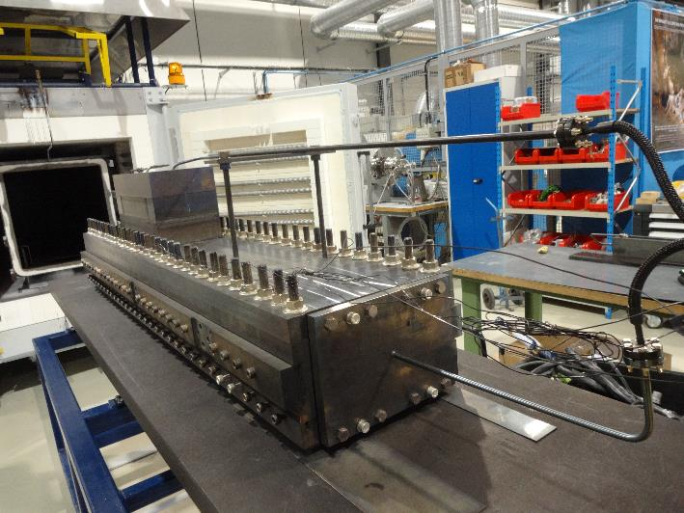
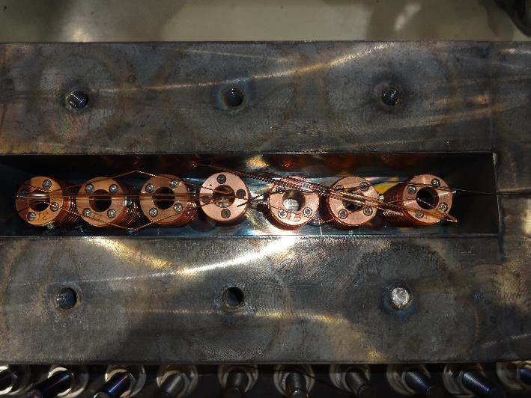
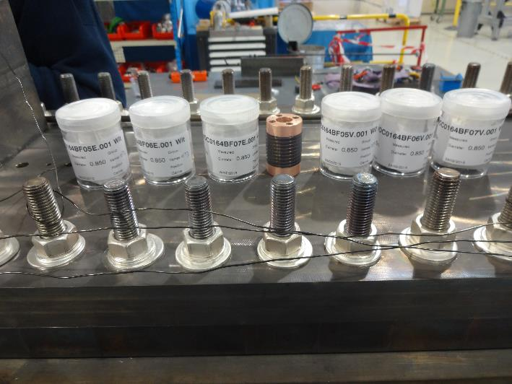
Preparation
Start date: 16/03/2015
End date: 26/03/2015
Heat cycle :
Ramp 25°C/h, hold 48h/210°C
Ramp 50°C/h, hold 48h/400°C
Ramp 50°C/h, hold 50h/640°C

Slide 4
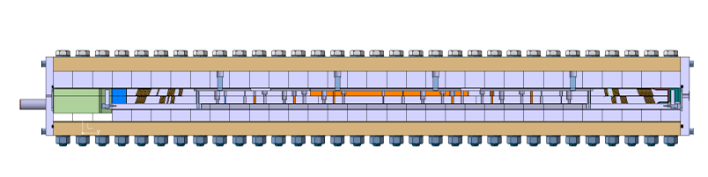
Instrumentation layout
RRR samples
tc13
Argon
Vamas 1
Vamas 2
Vamas 3
DummyVamas
Vamas 4
Vamas 5
Vamas 6
tc18
tc14
tc11

Slide 5
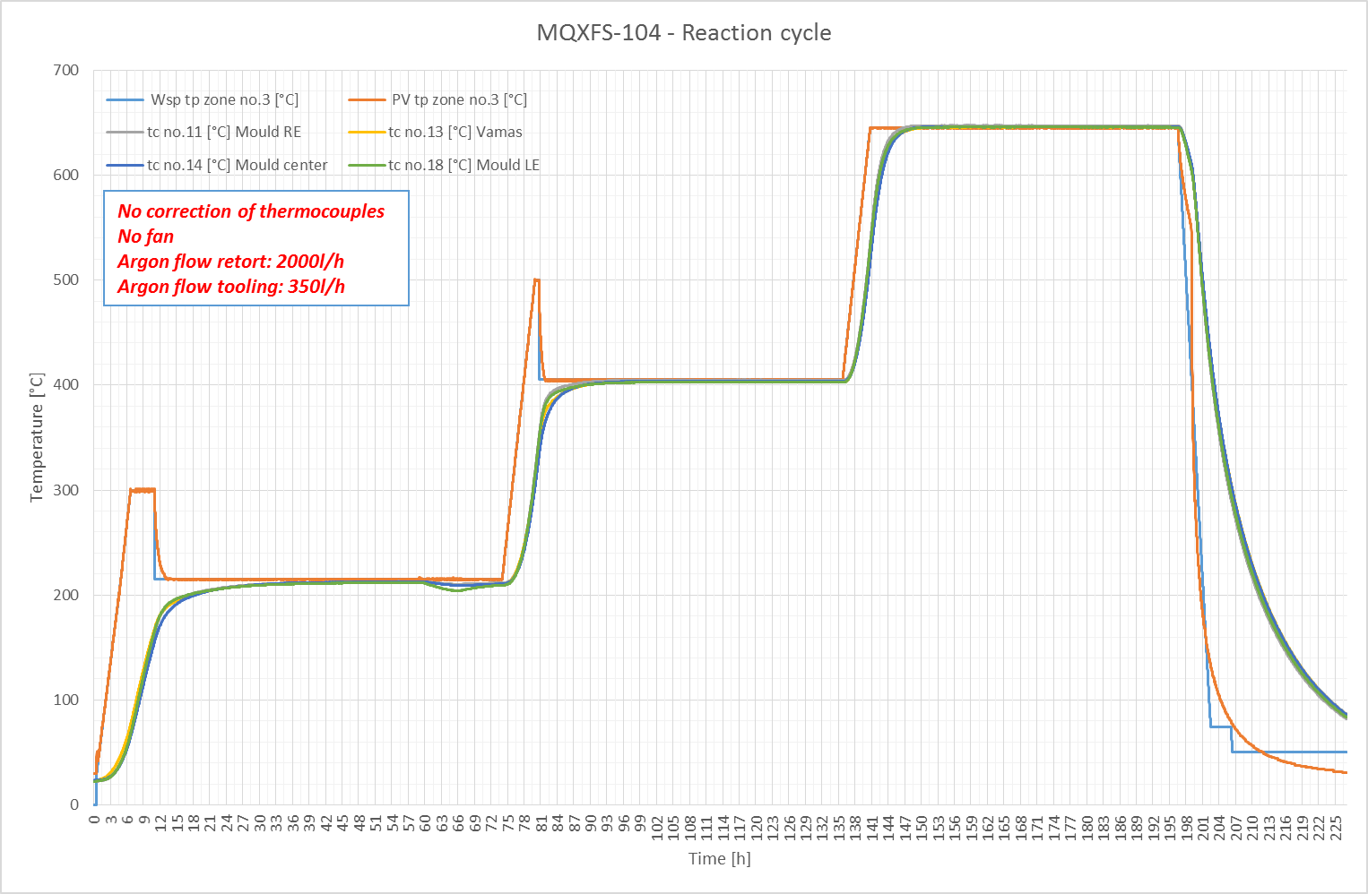

Slide 6
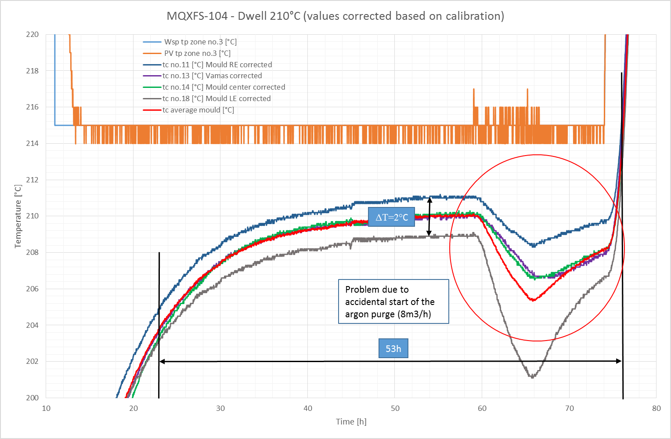

Slide 7
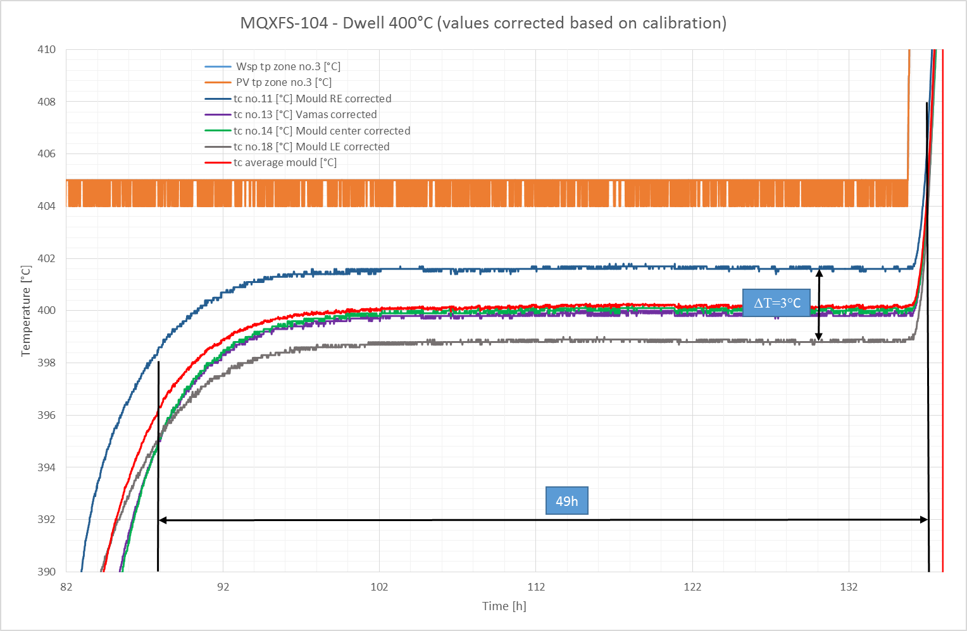

Slide 8
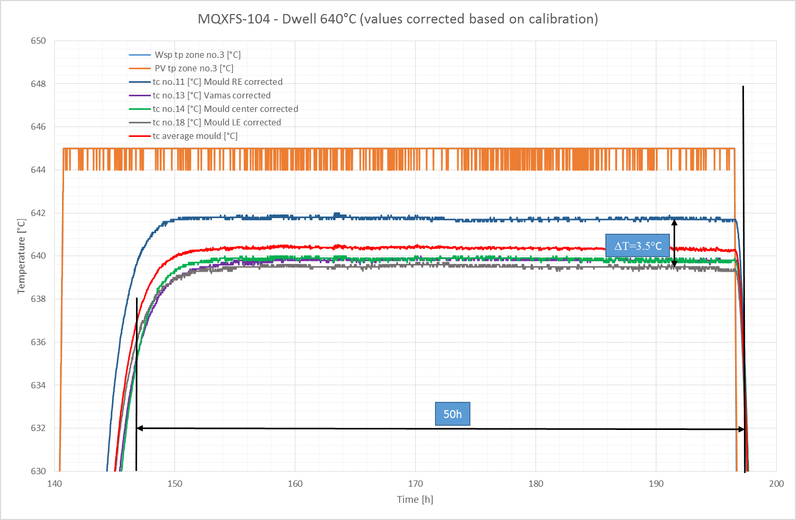

Slide 9
TE-MSC-MDT

