Slide 1
TE-MSC-MDT

Slide 2
11T_112
Reaction report
N. Bourcey
22/07/2015

Slide 3
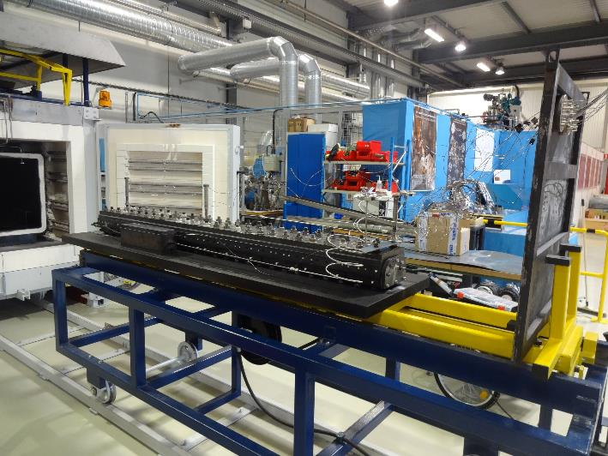
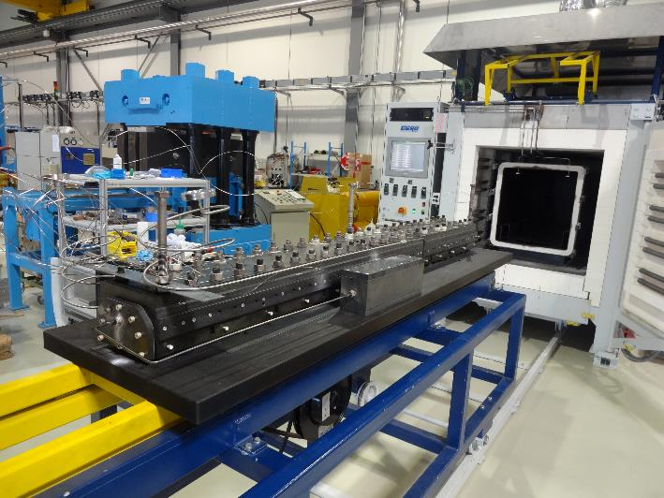
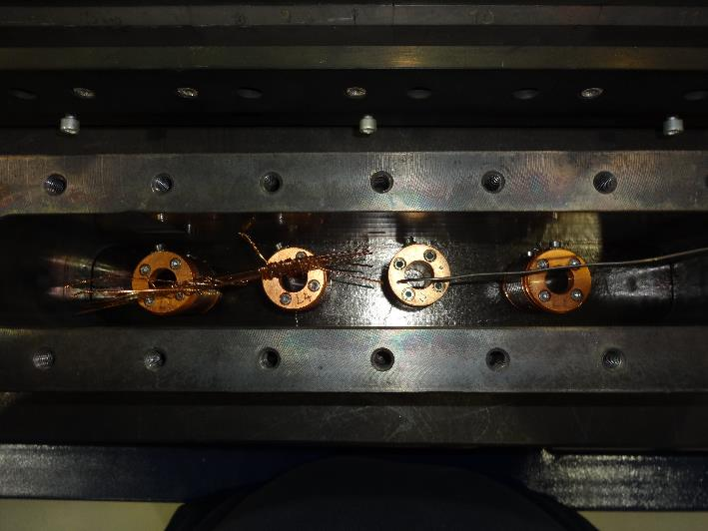
Preparation
Start date: 18/06/2015
End date: 27/06/2015
Heat cycle :
Ramp 25°C/h, hold 48h/210°C
Ramp 50°C/h, hold 48h/400°C
Ramp 50°C/h, hold 50h/640°C

Slide 4
Instrumentation layout
tc8
INLET
tc10
tc1
tc2
tc3
tc4
tc9
OUTLET
List of vamas and RRR samples (box before after coil):
V1 – HOC0181AF14V.001
V2 – HOC0181AF11V.001
V3 – HOC0181AF11E.001
5 RRR samples (virgin, extracted)
List of vamas and RRR samples (box after before coil):
V7 – HOC0181AF10V.001
V8 – HOC0181AF10E.001

Slide 5
Furnace program
Online change: +120min
Online change: -60min

Slide 6
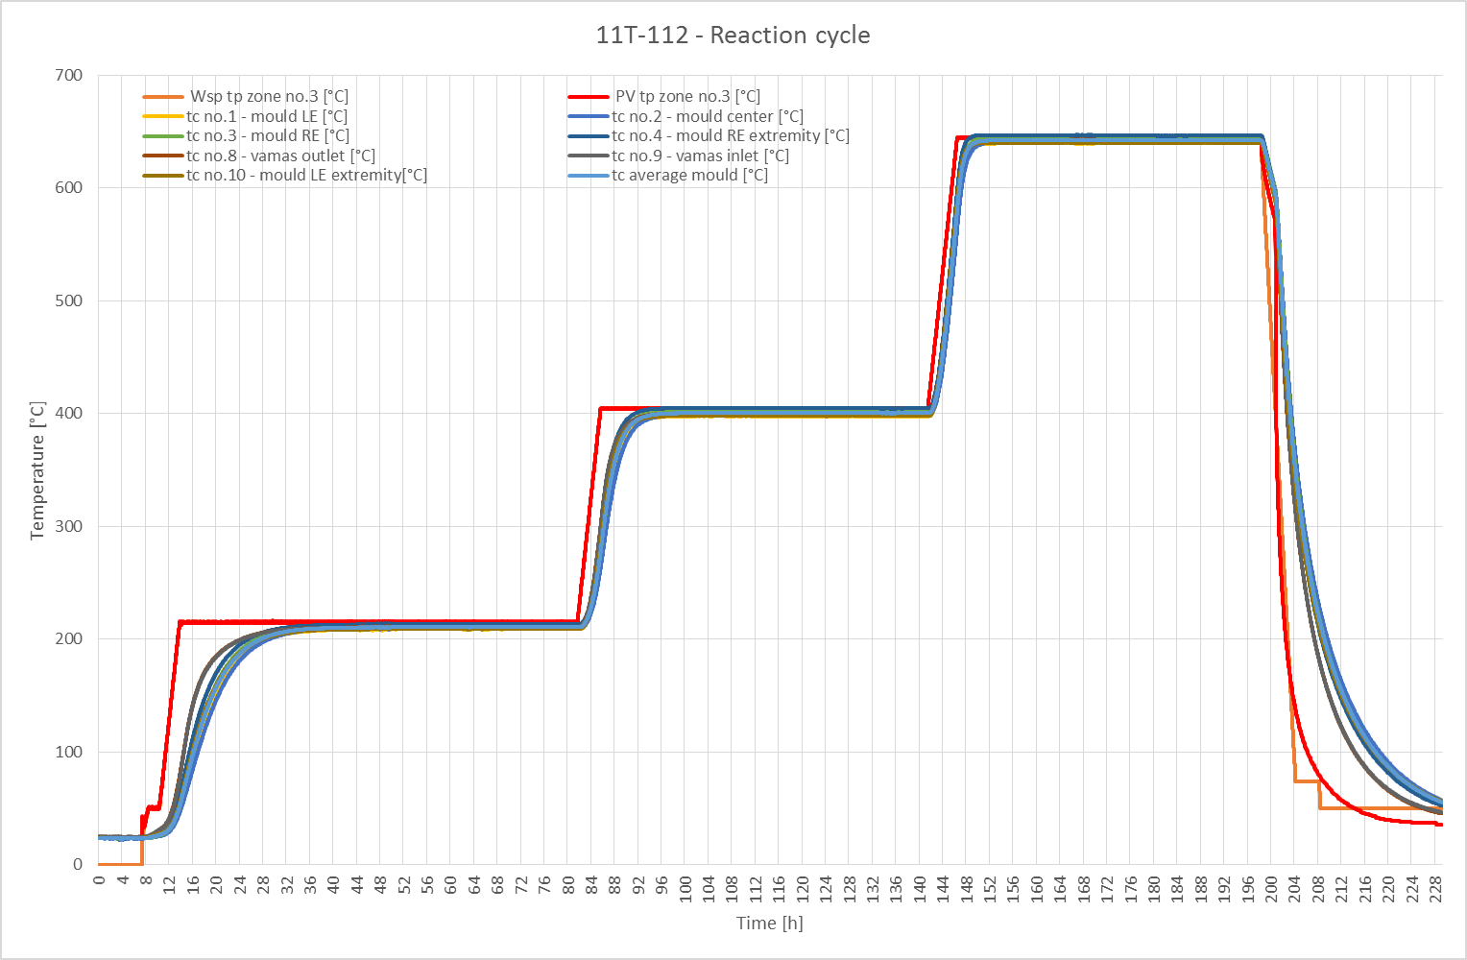

Slide 7
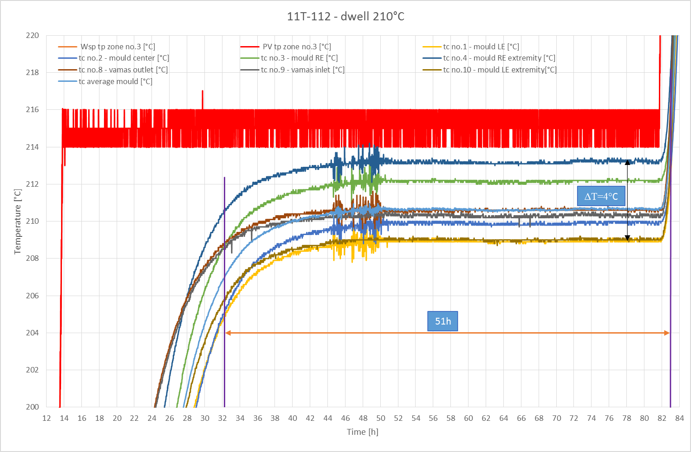

Slide 8
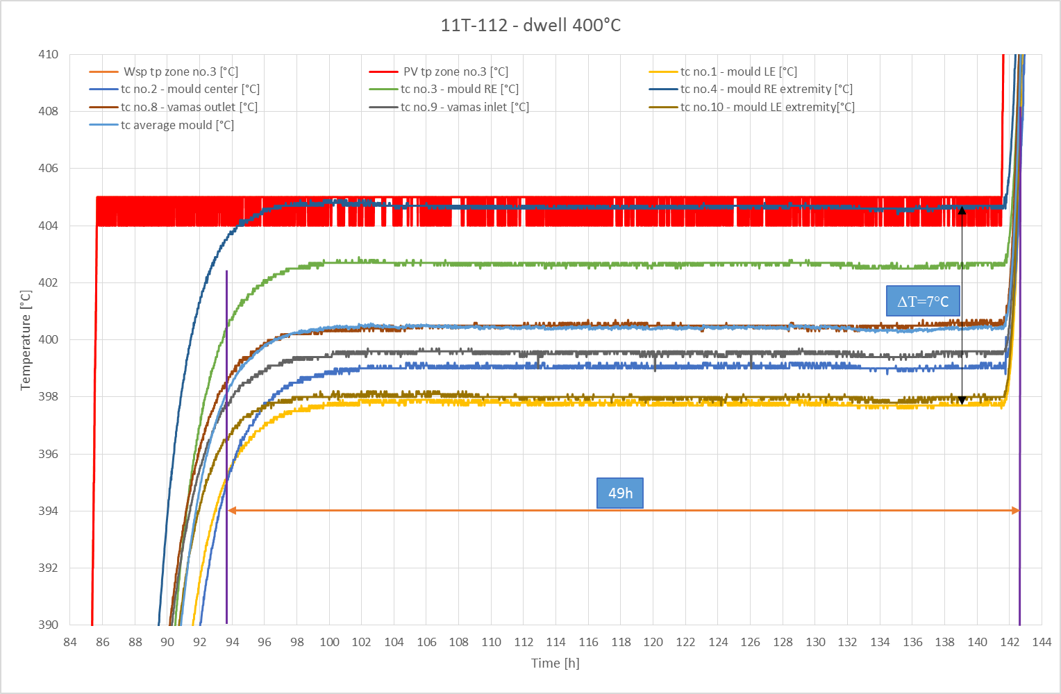

Slide 9
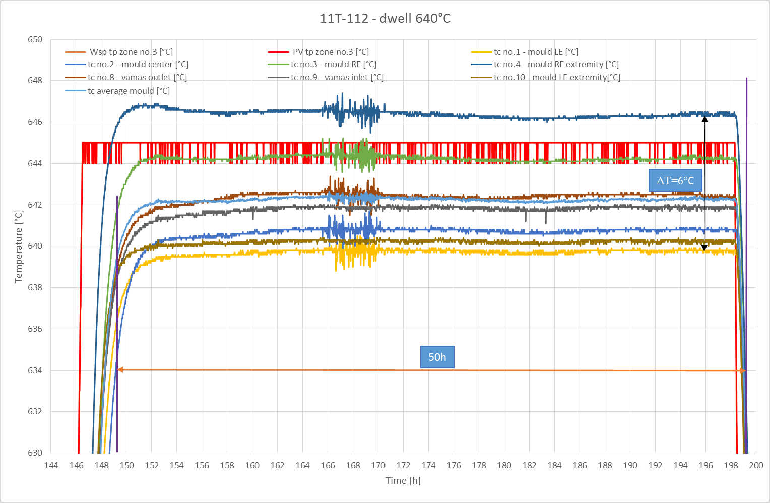

Slide 10
Remarks
No fan
New type N thermocouple calibrated
Error in the gas connection: inlet through the RE side of the coil instead of LE.

Slide 11
TE-MSC-MDT

