Slide 1
Reaction SMC#4_202 11/11/2014
N.Bourcey 01/12/2014

Slide 2
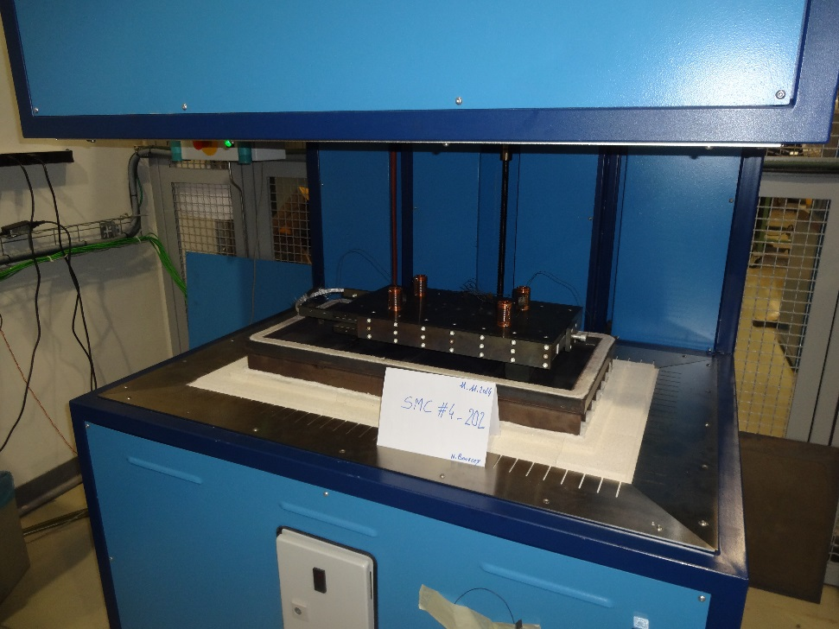
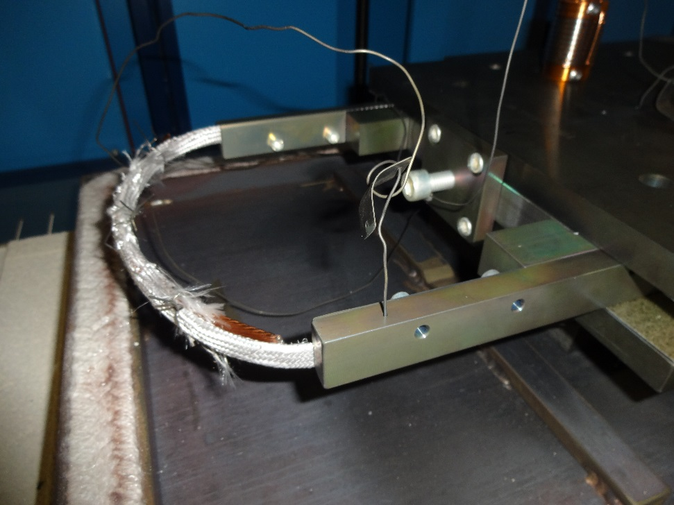
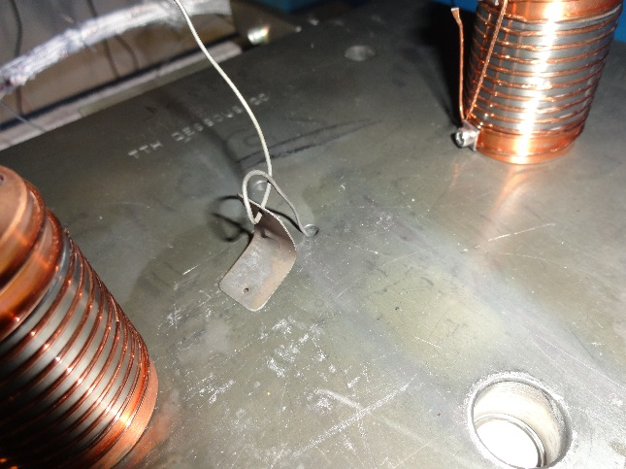
Preparation
Heat cycle :
Ramp up 50°C/h, hold 100h/620°C
Ramp up 50°C/h, hold 200h/640°C

Slide 3
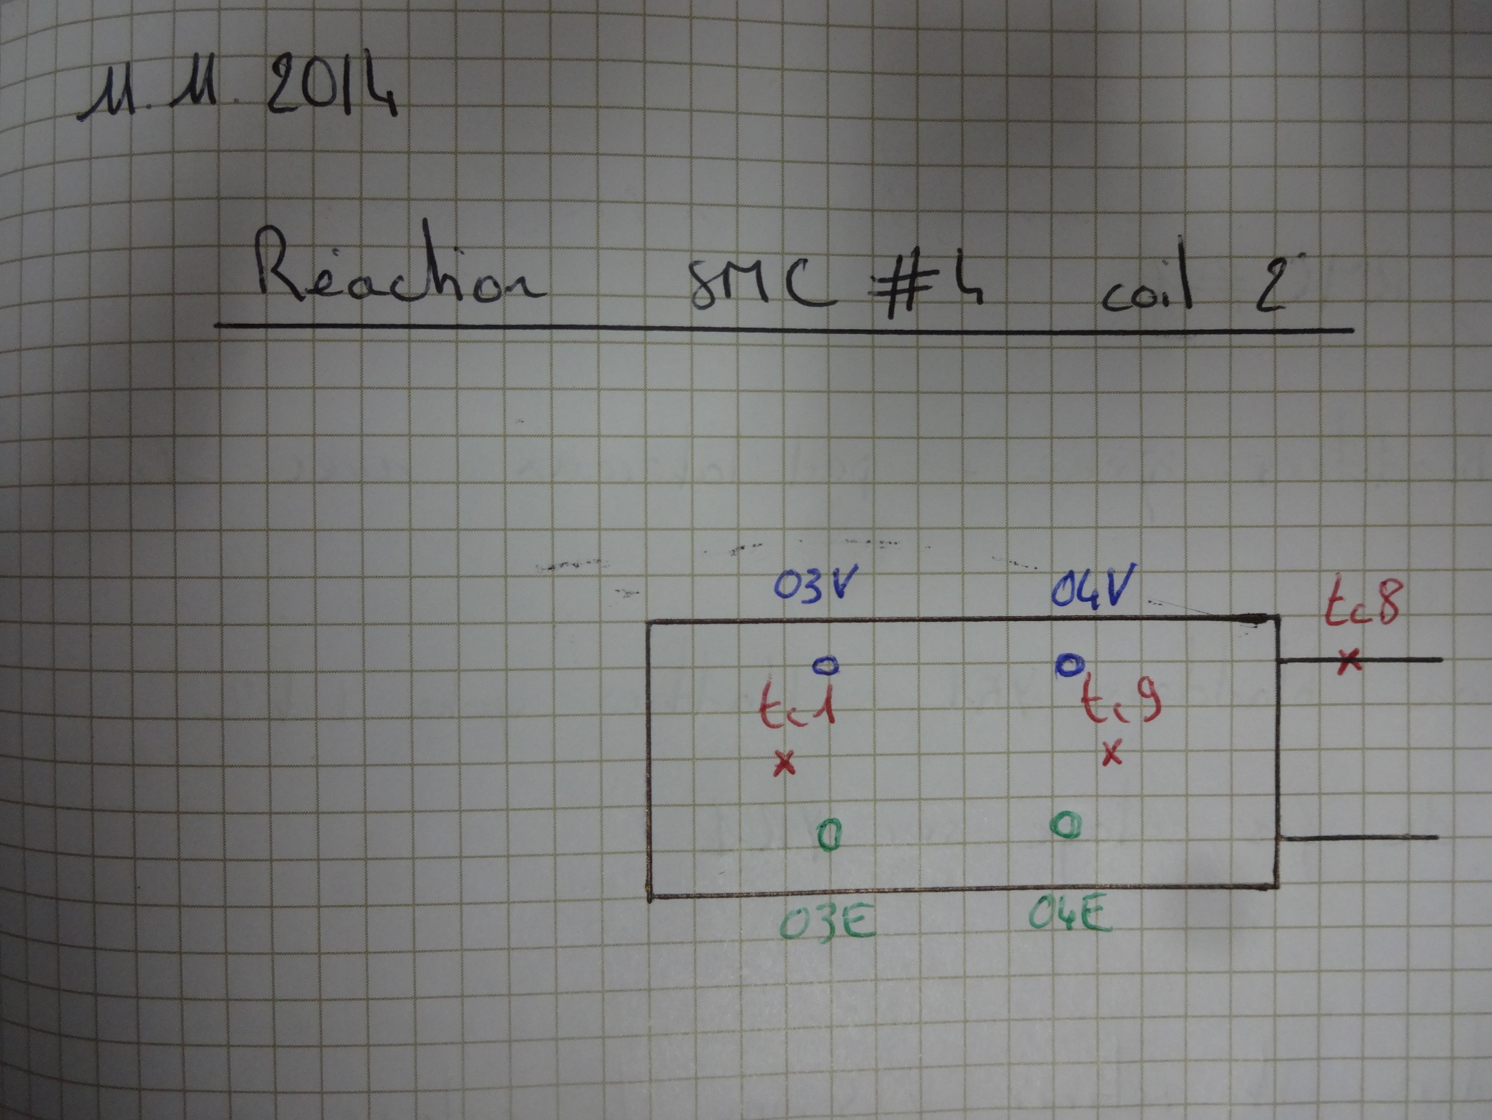

Slide 4
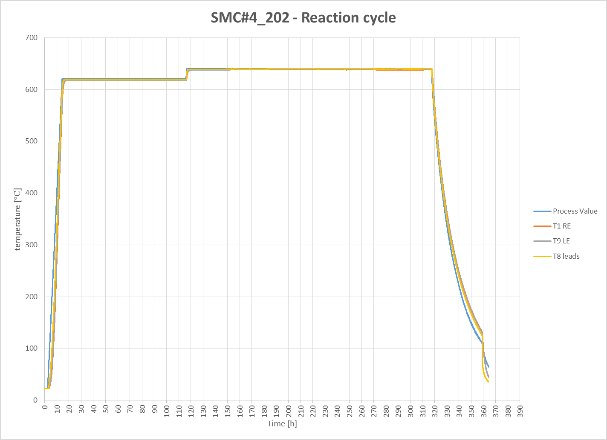

Slide 5
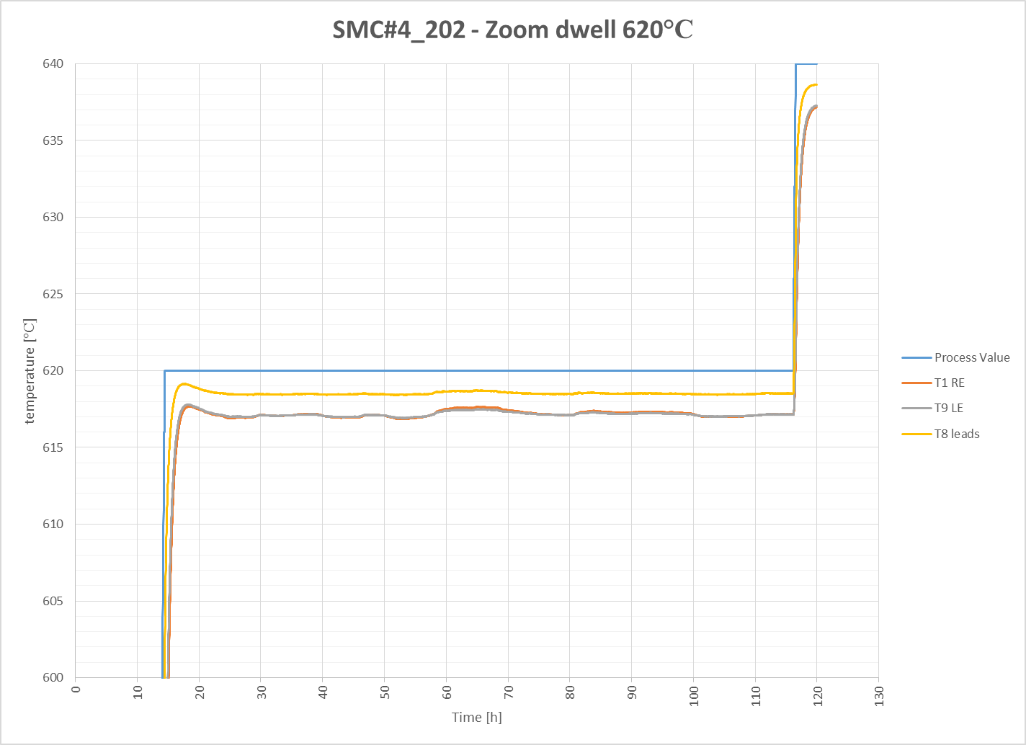

Slide 6
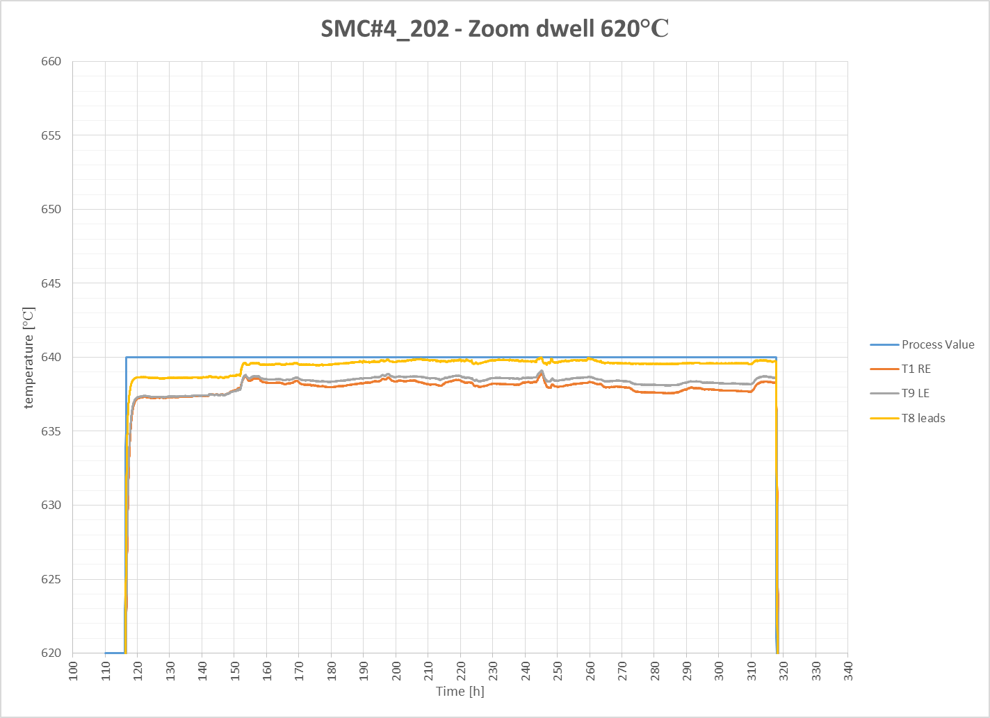

Slide 7
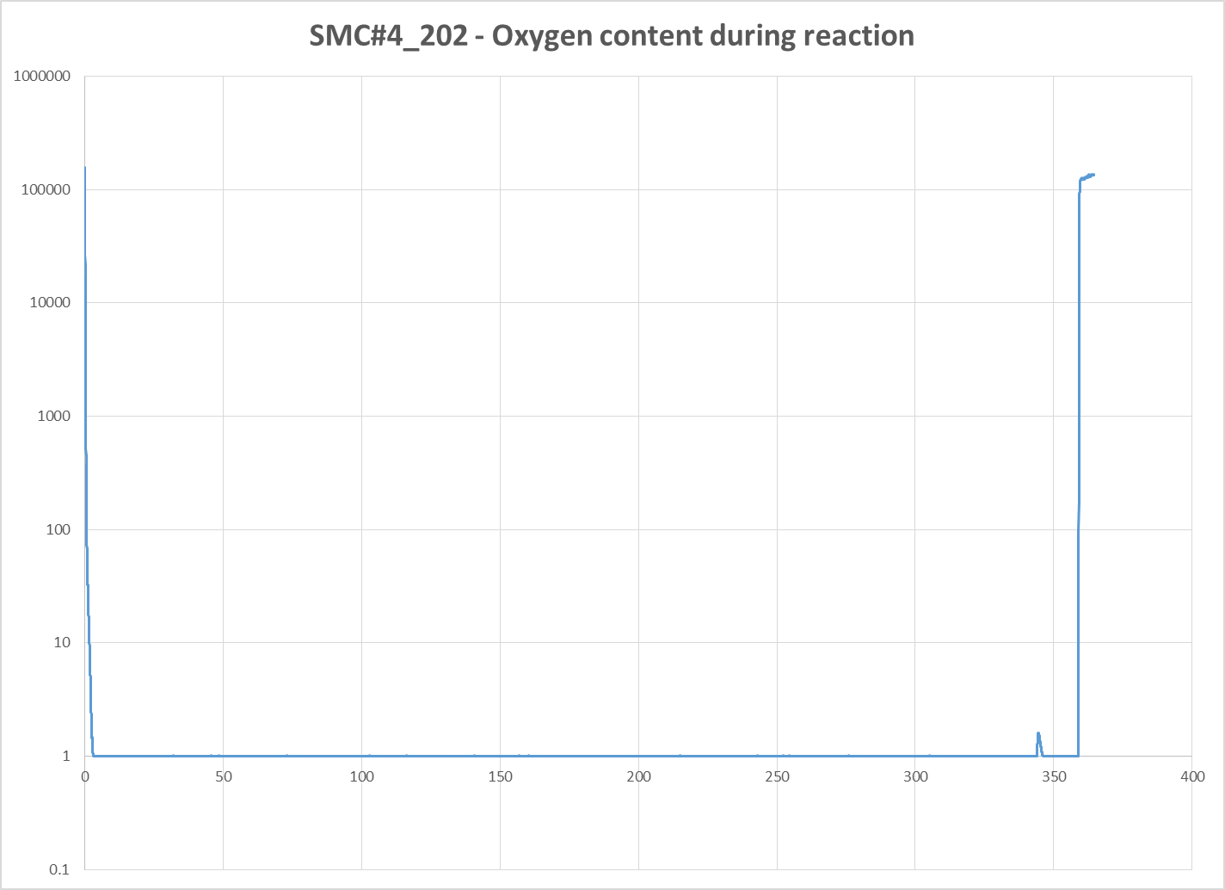

Slide 8
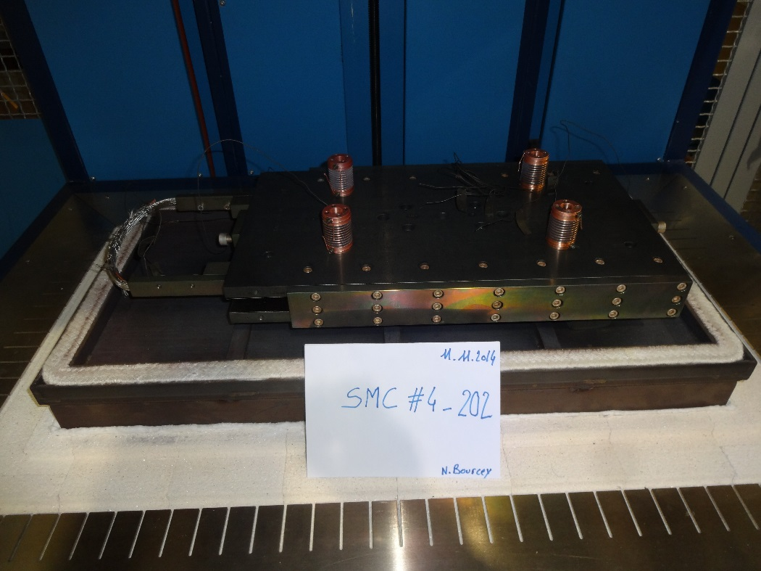
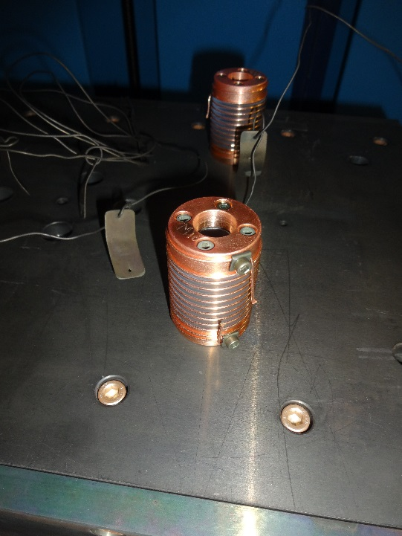
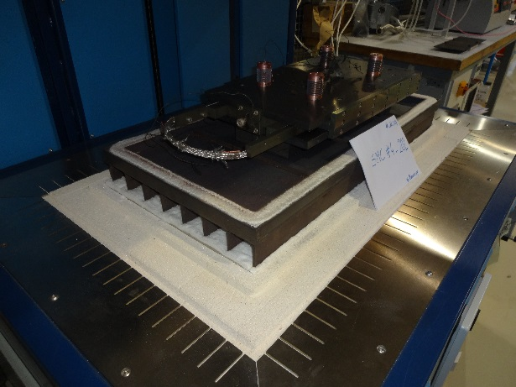
Conclusion
No problem occurs during reaction
Good homogeneity during dwell: ± 1°C

