Slide 1
TE-MSC-MDT

Slide 2
11T_113
Reaction report
N. Bourcey
21/09/2015

Slide 3
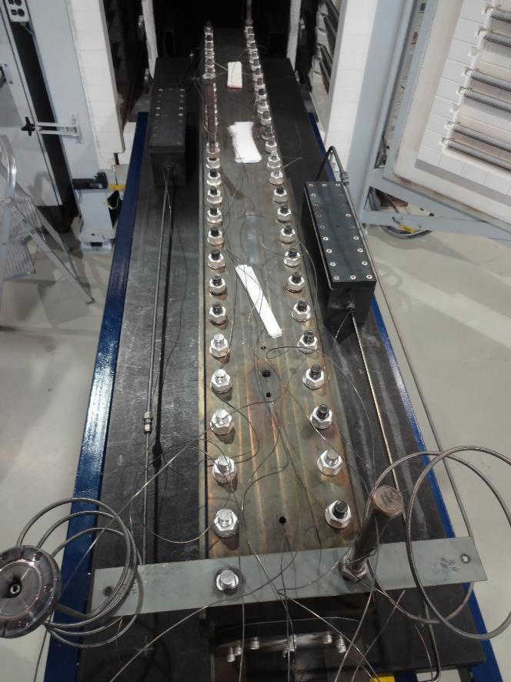
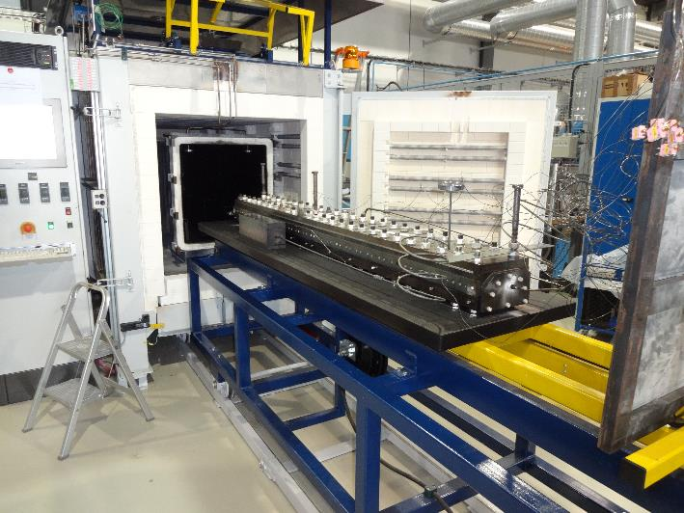
Preparation
Start date: 30/06/2015
End date: 10/07/2015
Cable ref: H15OC0181BF
Heat cycle :
Ramp 25°C/h, hold 48h/210°C
Ramp 50°C/h, hold 48h/400°C
Ramp 50°C/h, hold 50h/640°C

Slide 4
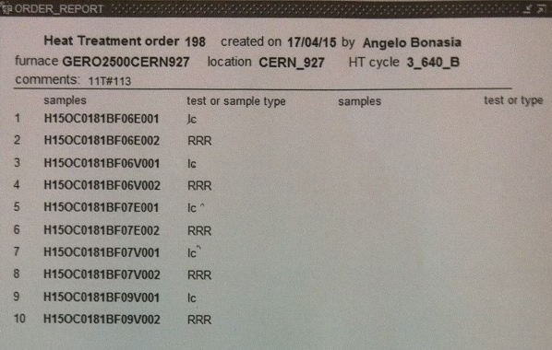
Instrumentation layout
tc8
tc10
tc1
tc2
tc3
tc4
tc9
List of vamas and RRR samples (box before coil):
V1 – H15OC0181BF06E.001
V2 – H15OC0181BF06V.001
V3 – H15OC0181BF07E.001
V4 – H15OC0181BF07V.001
5 RRR samples (3 virgin + 2 extracted)
List of vamas and RRR samples (box after coil):
V7 – H15OC0181BF09V.001

Slide 5
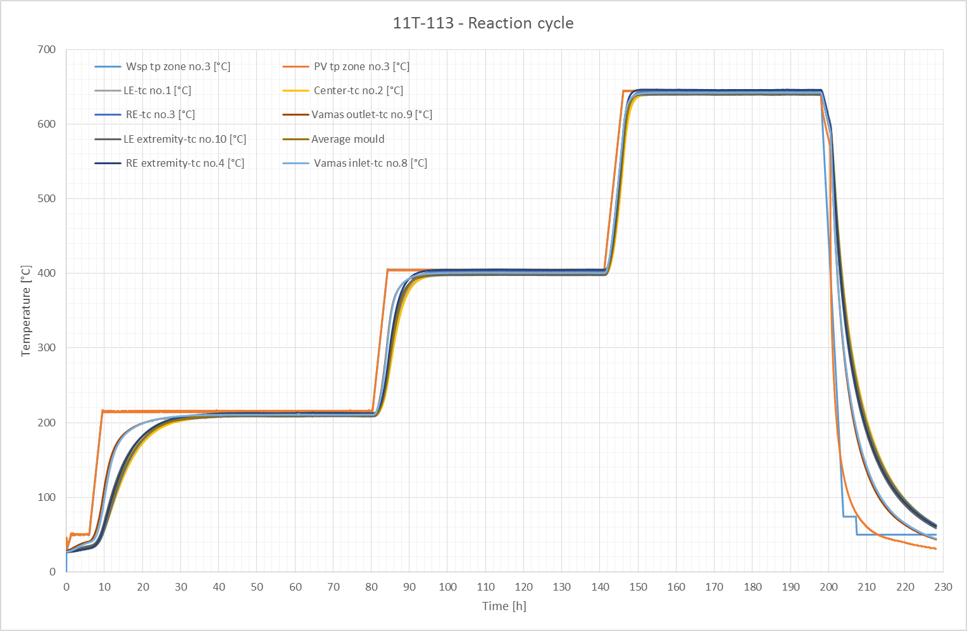

Slide 6
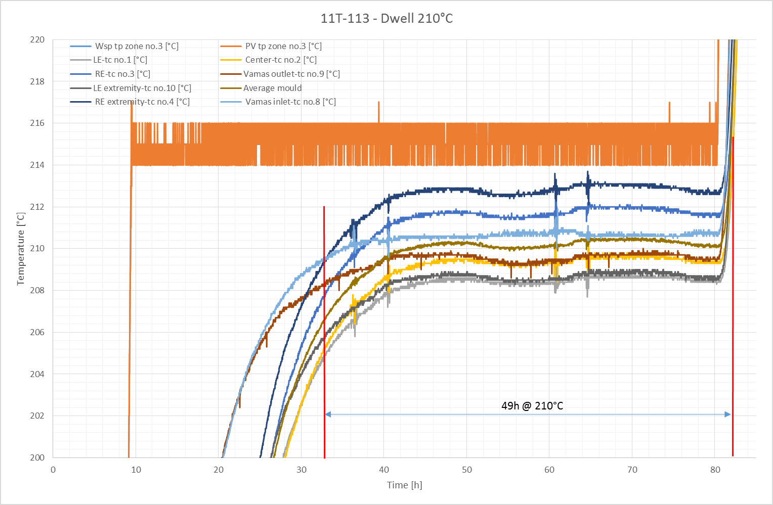

Slide 7
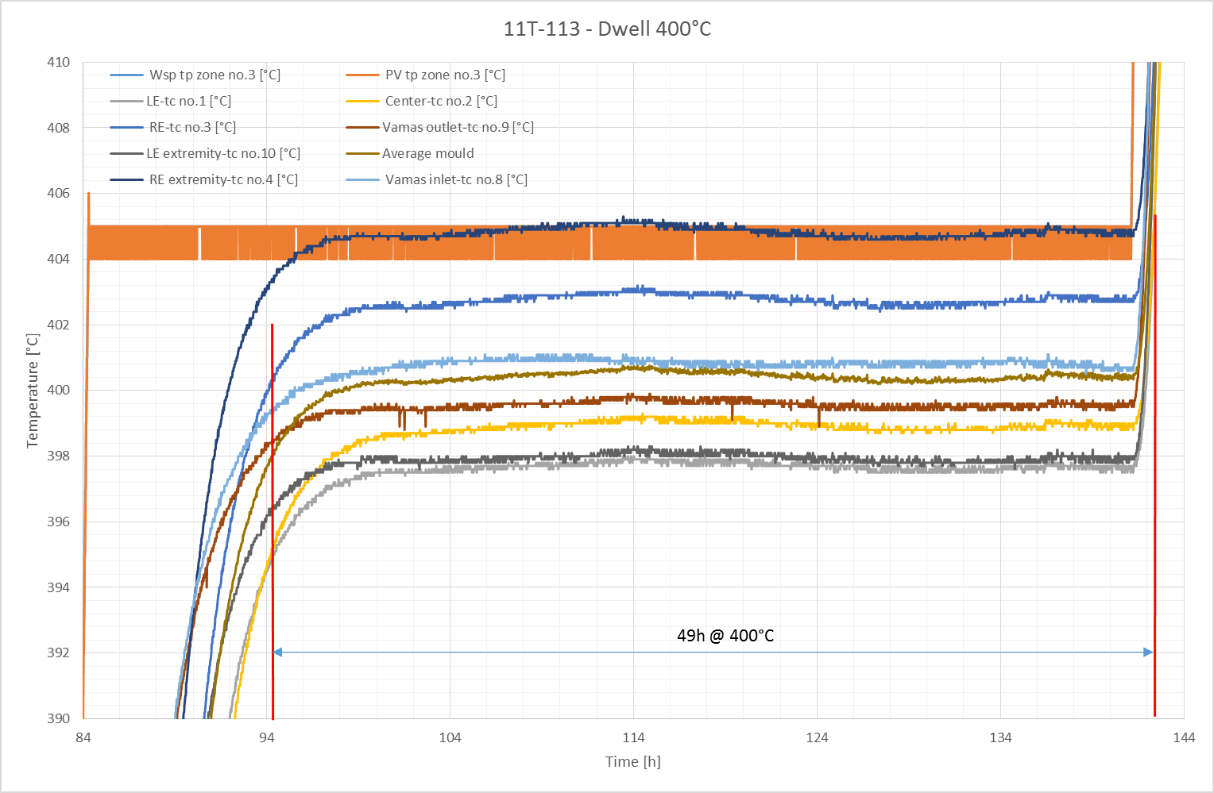

Slide 8
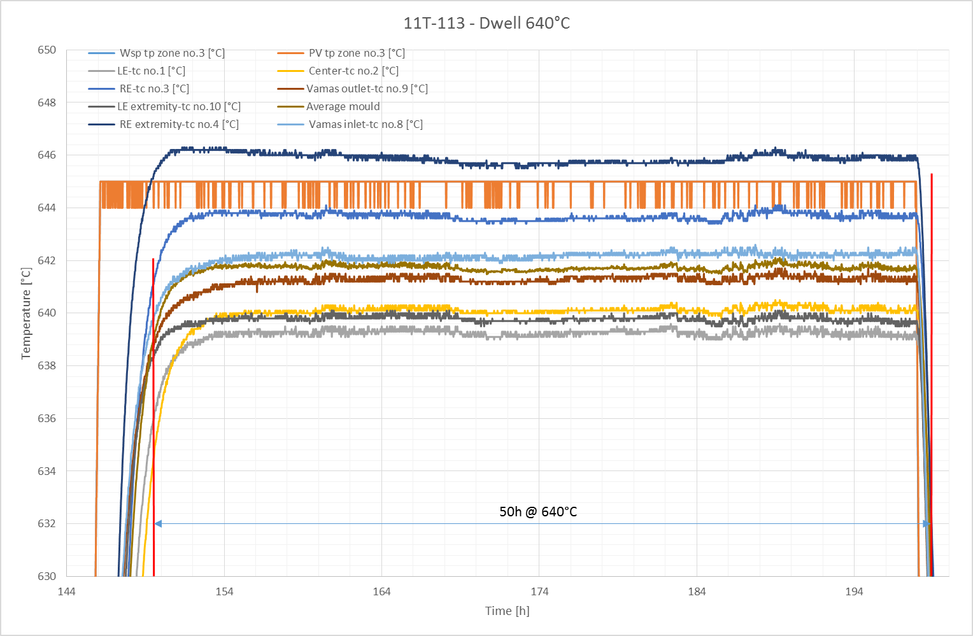

Slide 9
Remarks
No fan
New type N thermocouple calibrated
No O2 content measurement
Average temperature of the last plateau is slightly more than expected, 642°C instead of 640°C.

Slide 10
TE-MSC-MDT

