Slide 1
TE-MSC-MDT

Slide 2
11T_114
Reaction report
N. Bourcey
18/09/2015

Slide 3
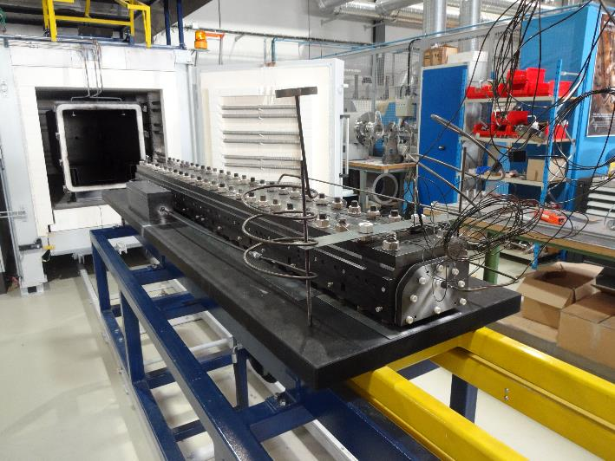
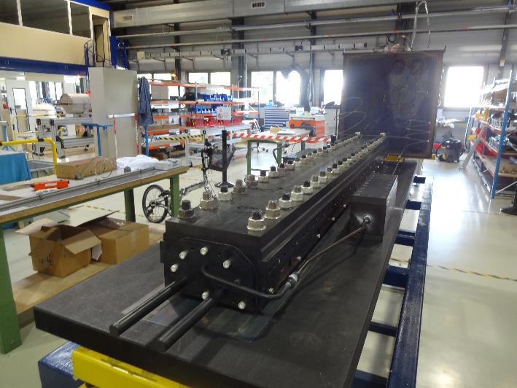
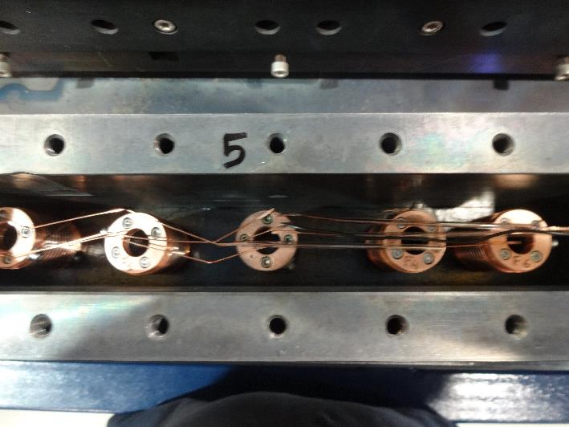
Preparation
Start date: 04/09/2015
End date: 15/09/2015
Heat cycle :
Ramp 25°C/h, hold 72h/210°C
Ramp 50°C/h, hold 48h/400°C
Ramp 50°C/h, hold 50h/665°C

Slide 4
Instrumentation layout
tc10
tc9
tc1
tc2
tc6
tc3
tc5
List of vamas and RRR samples (box before coil):
V1 – H15OC0184AF09E.001
V2 – H15OC0184AF09V.001
V3 – H15OC0184AF11E.001
V4 – H15OC0184AF11V.001
6 RRR samples (3 virgin + 3 extracted)
List of vamas and RRR samples (box after coil):
V7 – H15OC0184AF04V.001
V8 – H15OC0184AF04E.001

Slide 5
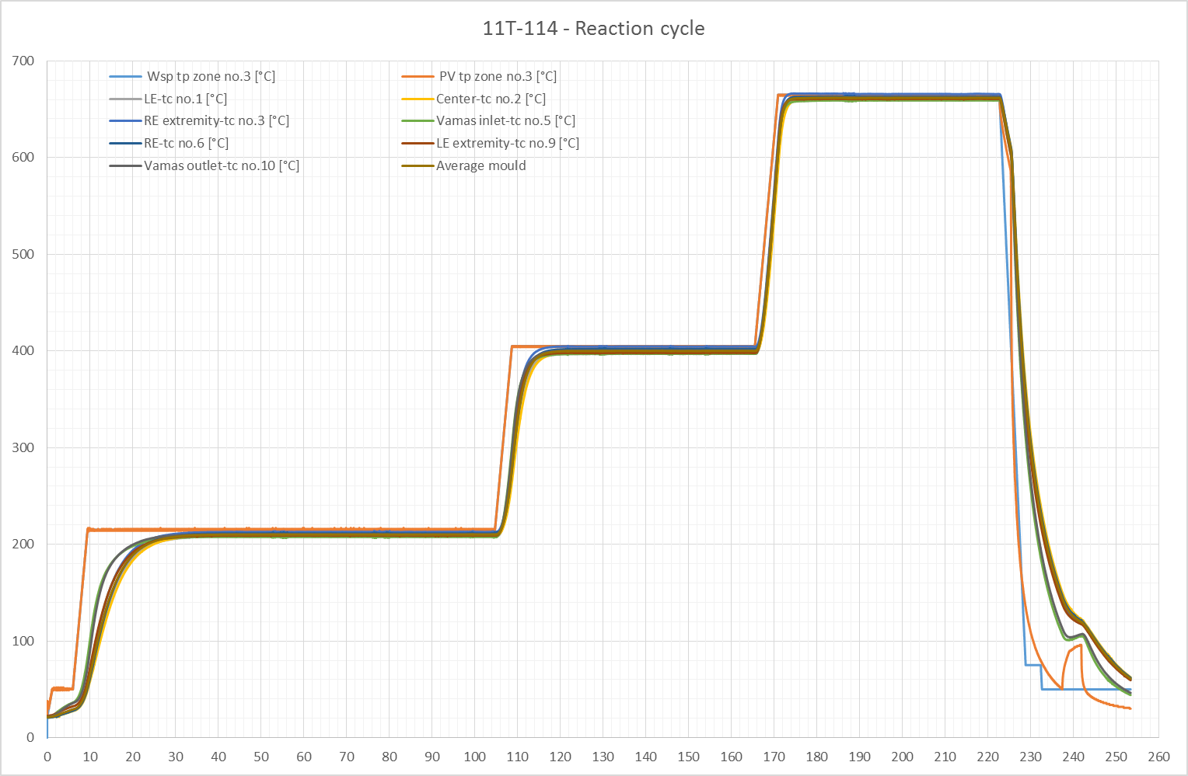

Slide 6
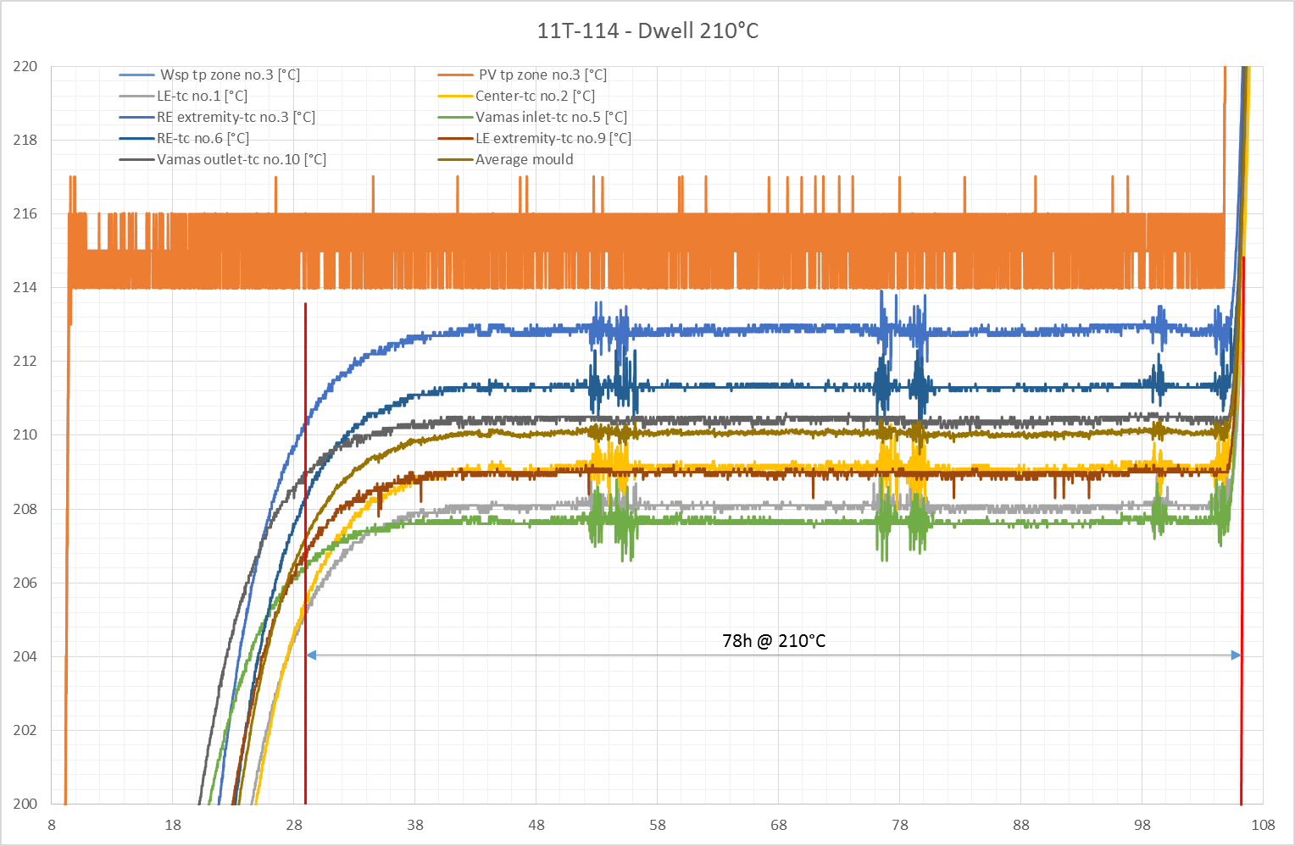

Slide 7
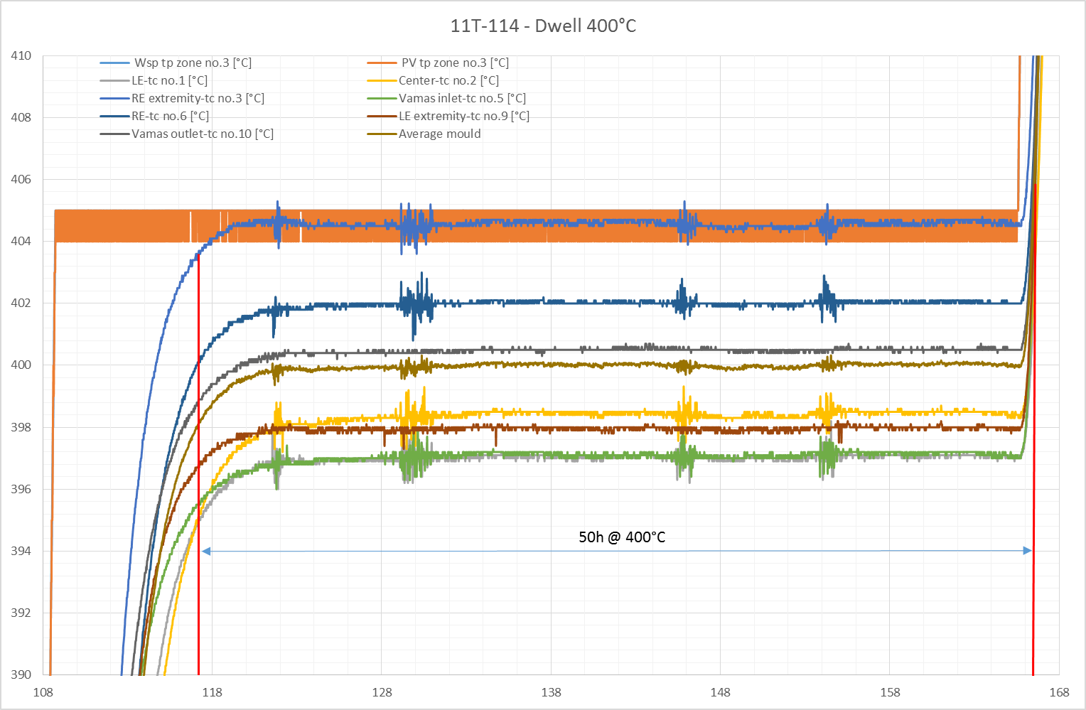

Slide 8
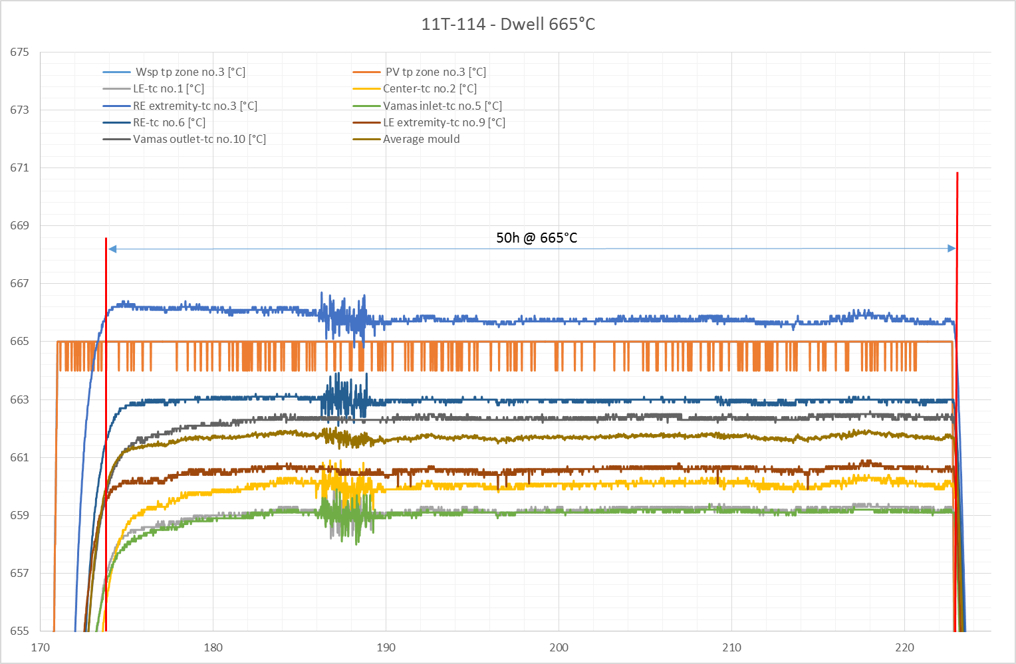

Slide 9
Remarks
No fan
New type N thermocouple calibrated
No O2 content measurement
Average temperature of the last plateau is lower than expected, 662°C instead of 665°C.

Slide 10
TE-MSC-MDT

