Slide 1
TE-MSC-MDT

Slide 2
11T_111
Reaction report
N. Bourcey
11/05/2015

Slide 3
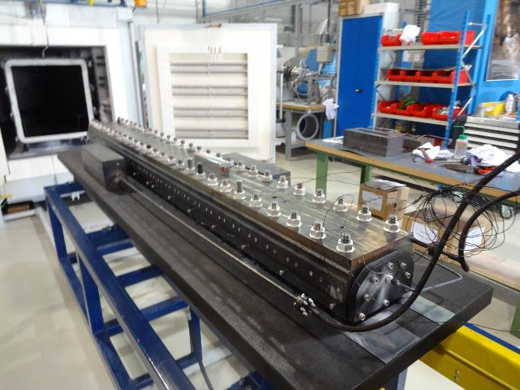
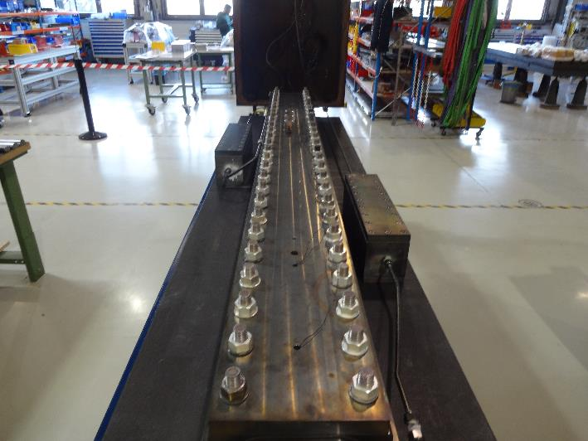
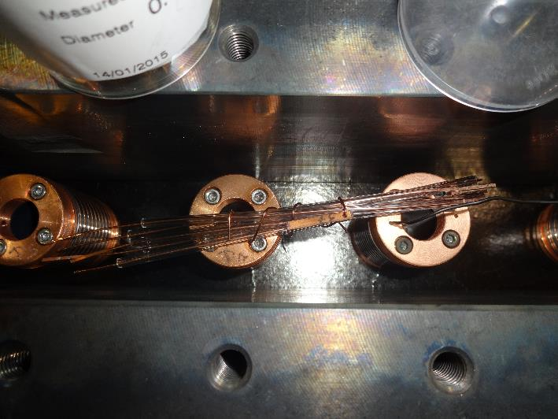
Preparation
Start date: 25/02/2015
End date: 09/03/2015
Heat cycle :
Ramp 25°C/h, hold 48h/210°C
Ramp 50°C/h, hold 48h/400°C
Ramp 50°C/h, hold 50h/640°C

Slide 4
Instrumentation layout
tc14
tc15
tc18
tc11
tc13
List of vamas and RRR samples (box before coil):
V1 – H150C0162BF12V.001
V2 – H150C0162BF08V.001
V3 – H150C0162BF09V.001
5 RRR samples (virgin, no extracted wires available)
List of vamas and RRR samples (box after coil):
V7 – H150C0162BF10V.001
V8 – H150C0162BF11V.001

Slide 5
Furnace program

Slide 6
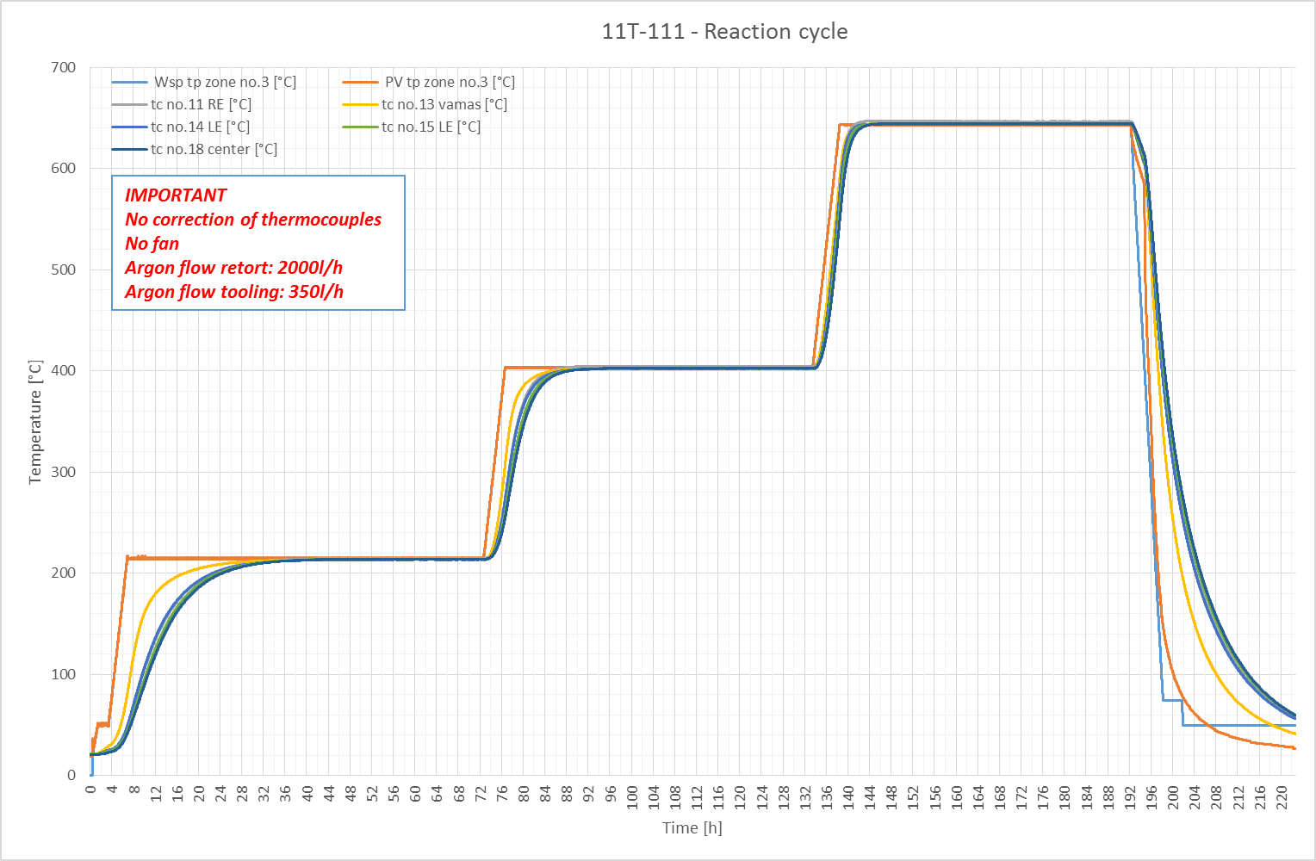

Slide 7
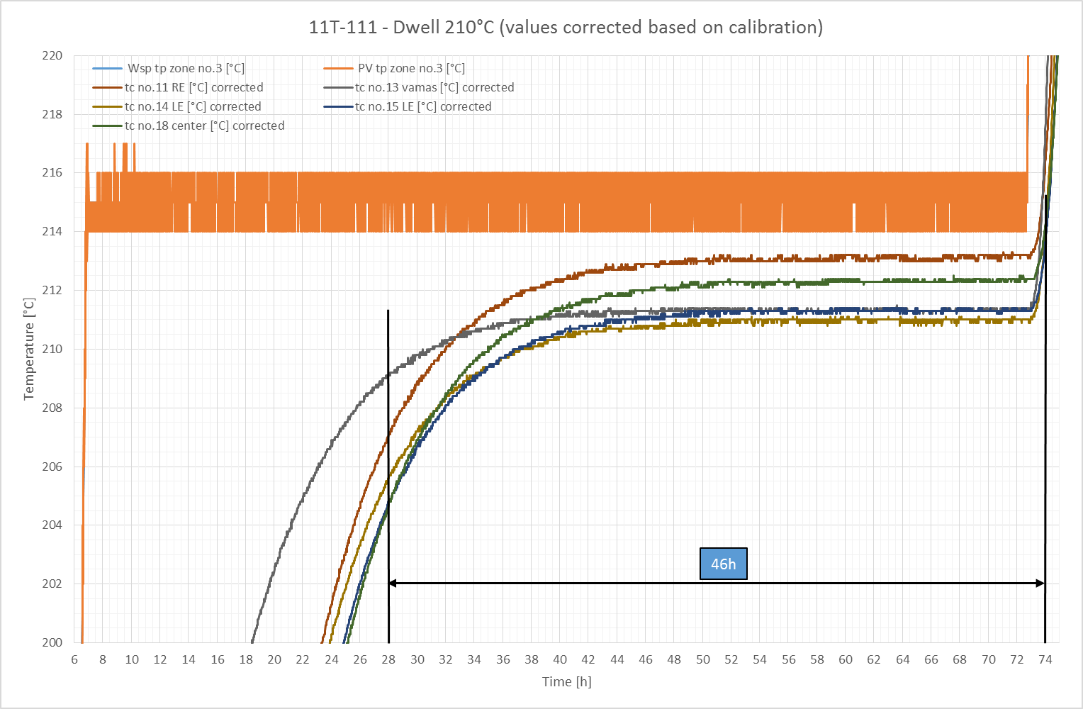

Slide 8
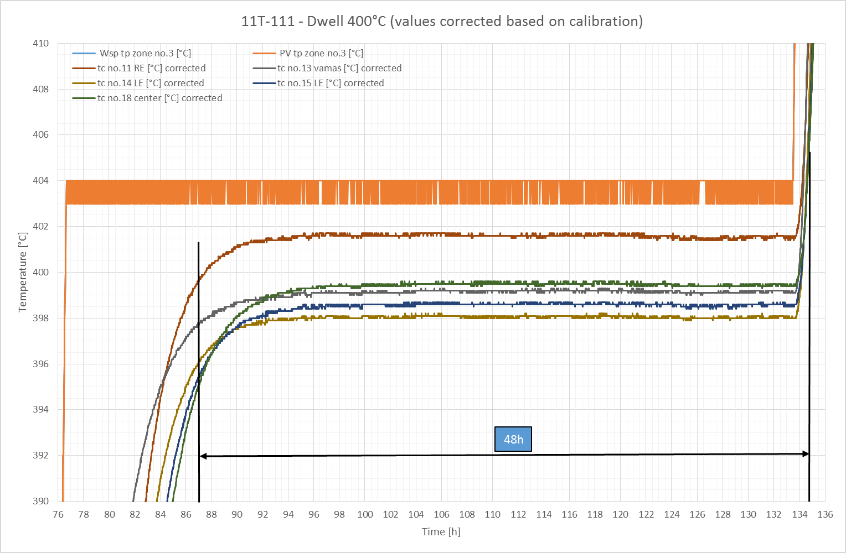

Slide 9
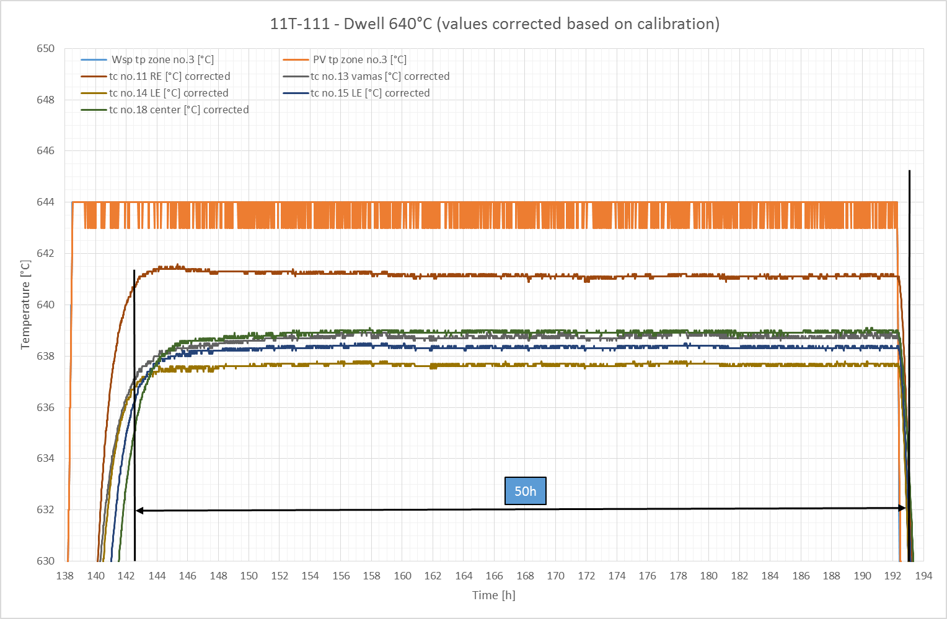

Slide 10
TE-MSC-MDT

