Slide 1
11T-109 reaction report
N.Bourcey

Slide 2
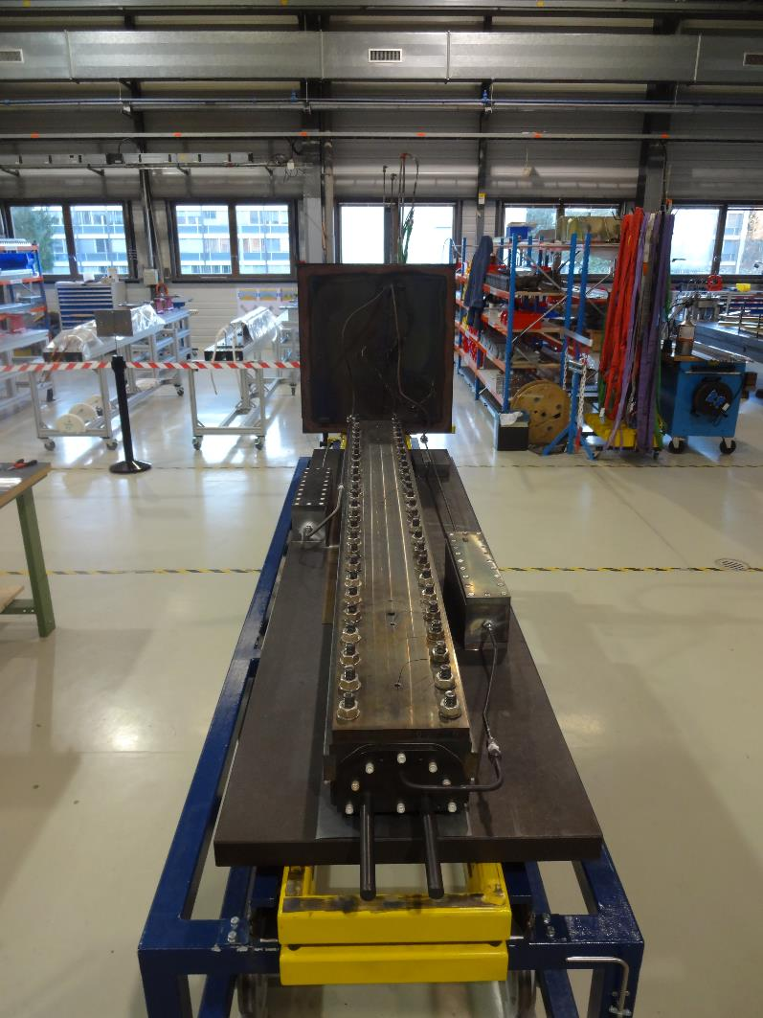
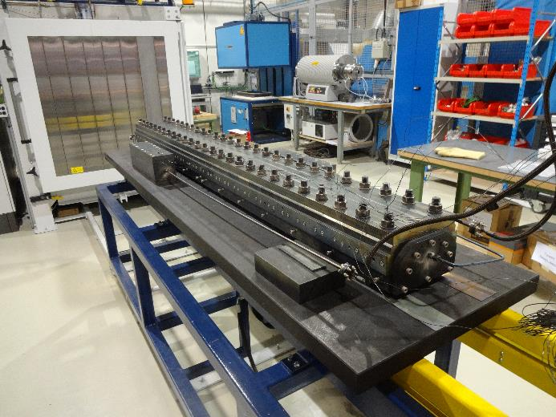
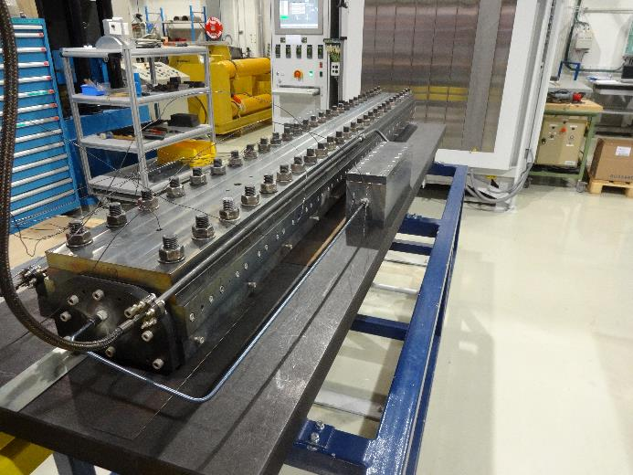
Preparation for reaction

Slide 3
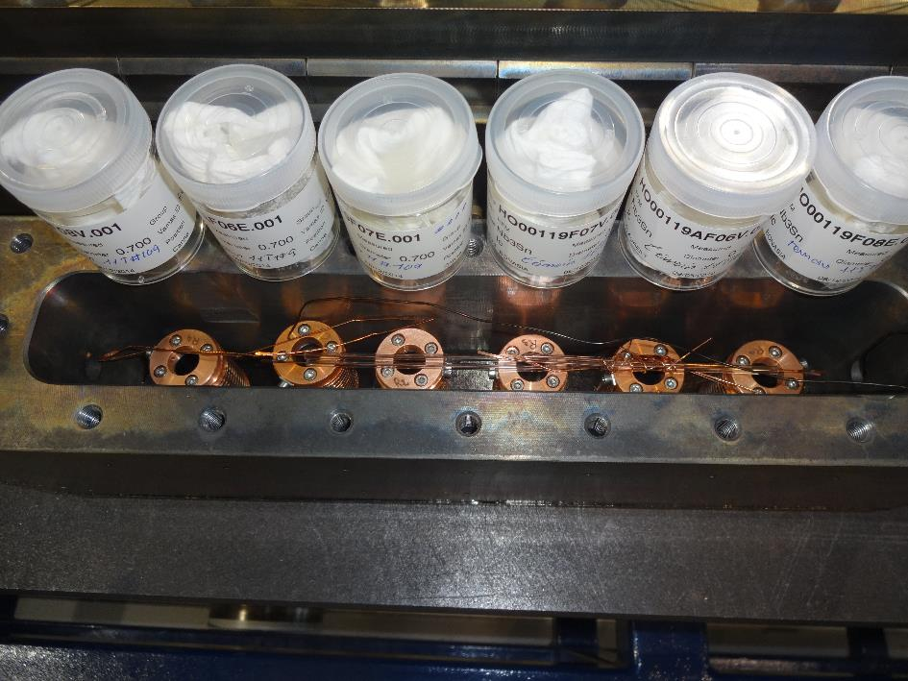
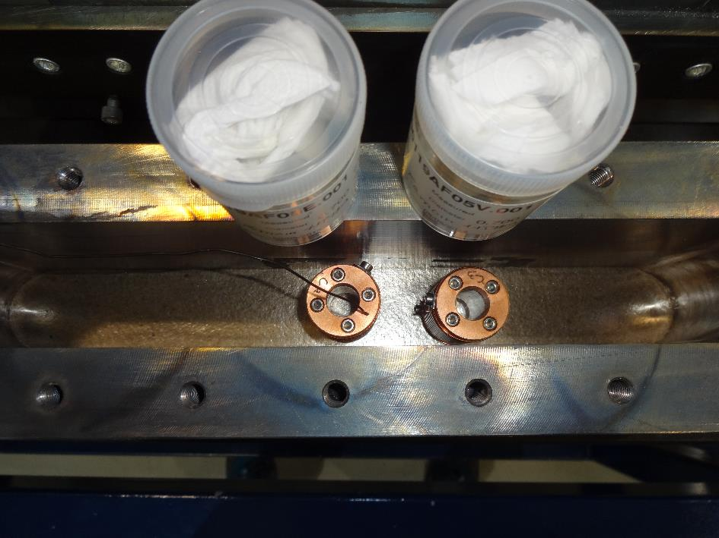
Reaction samples
Box before coil
Box after coil

Slide 4
Instrumentation layout
tc9
Tc3 (gas box)
tc14
tc15
tc13
tc11
tc18
Tc6 (gas box)
tc7
List of vamas and RRR samples (box before coil):
V1 – HO00119AF08V.001
V2 – HO00119AF06E.001 (tc7)
V3 – HO00119AF07E.001
V4 – HO00119AF07V.001
V5 – HO00119AF06V.001
V6 – HO00119AF08E.001
RRR – HO00119AF06E.002
RRR – HO00119AF06V.002
RRR – HO00119AF07E.002
RRR – HO00119AF07V.002
RRR – HO00119AF08E.002
RRR – HO00119AF08V.002
List of vamas and RRR samples (box after coil):
V7 – HO00119AF05V.001
V8 – HO00119AF05E.001 (tc9)

Slide 6
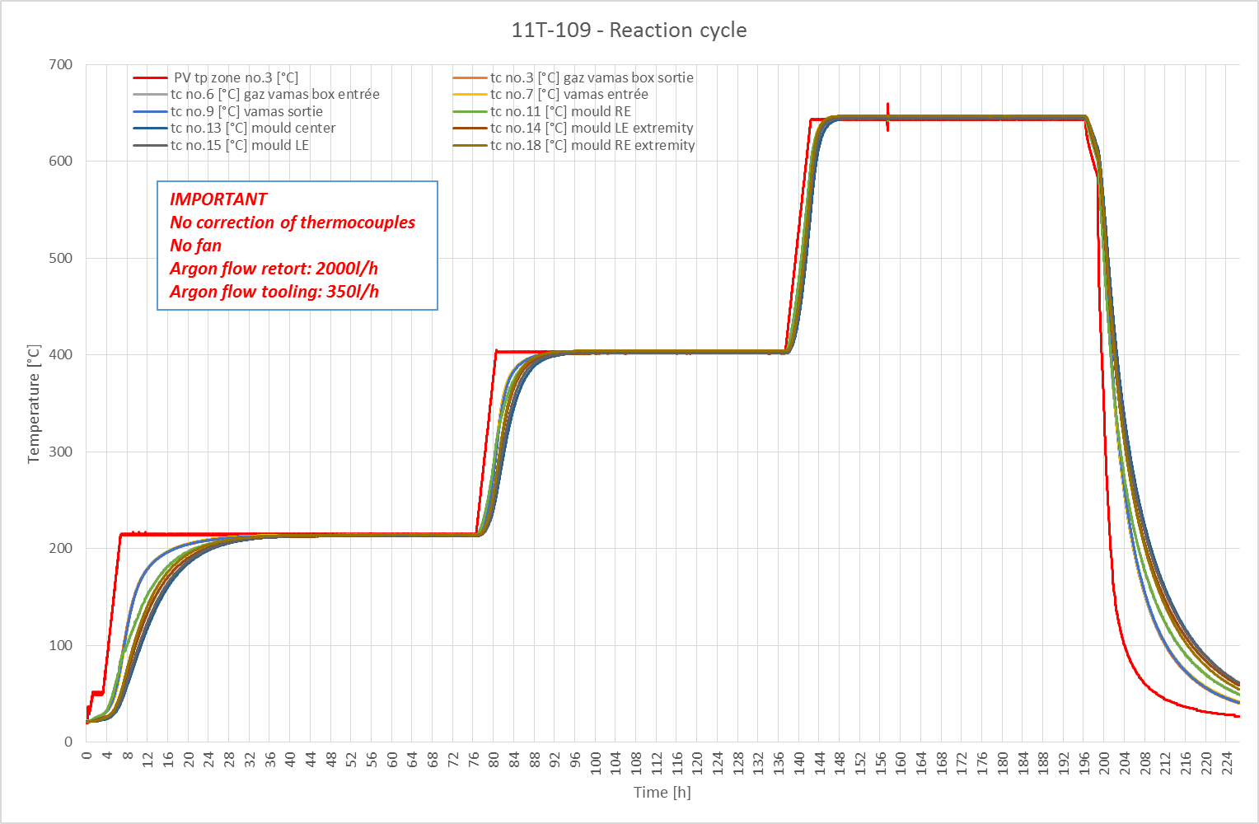

Slide 7
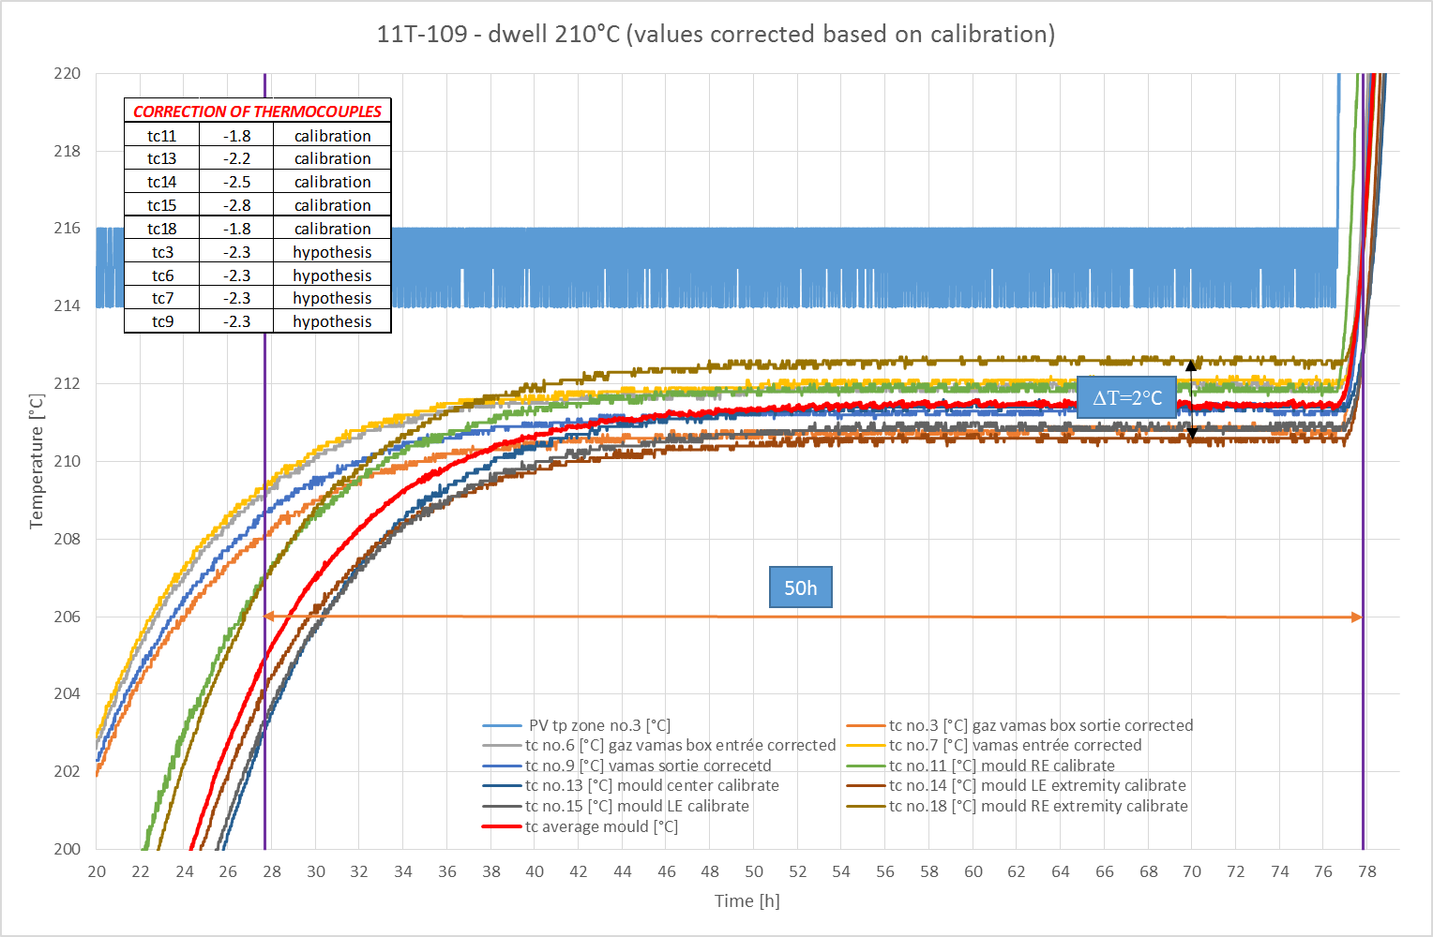

Slide 8
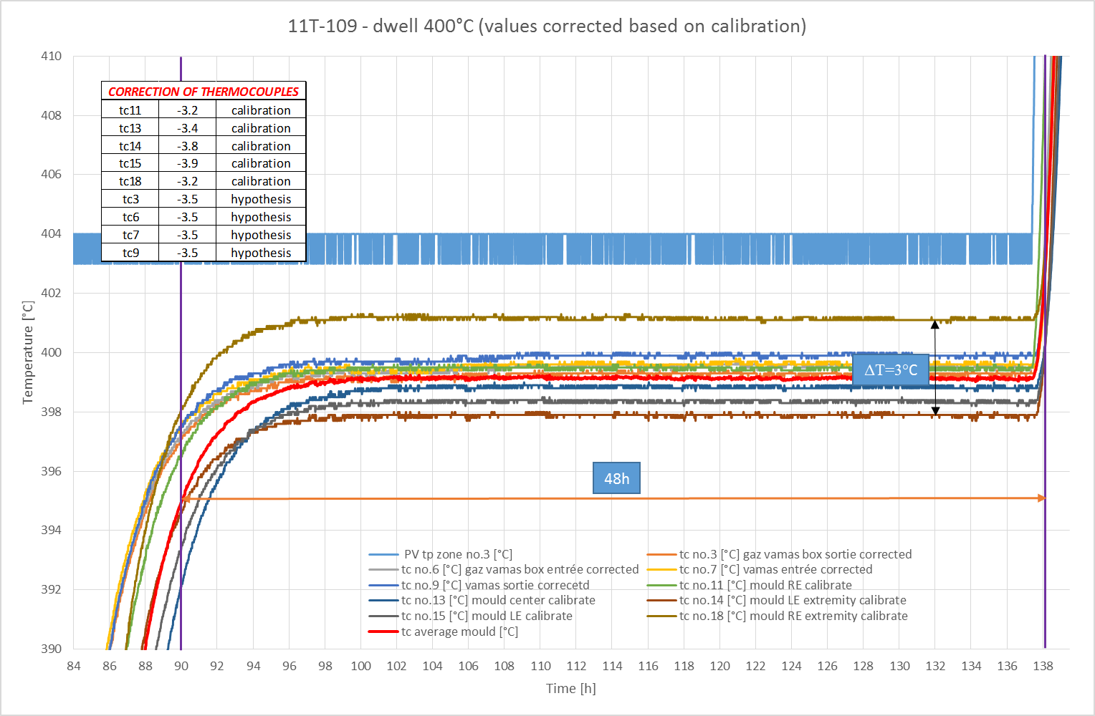

Slide 9
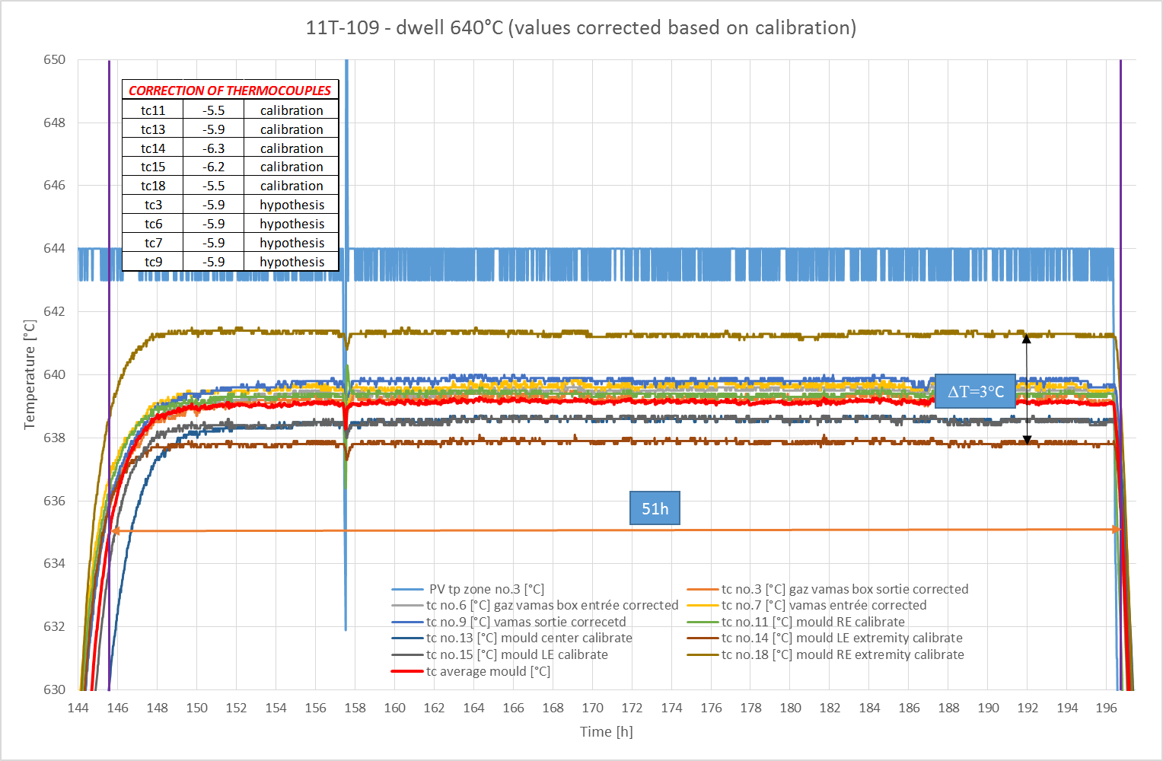

Slide 10
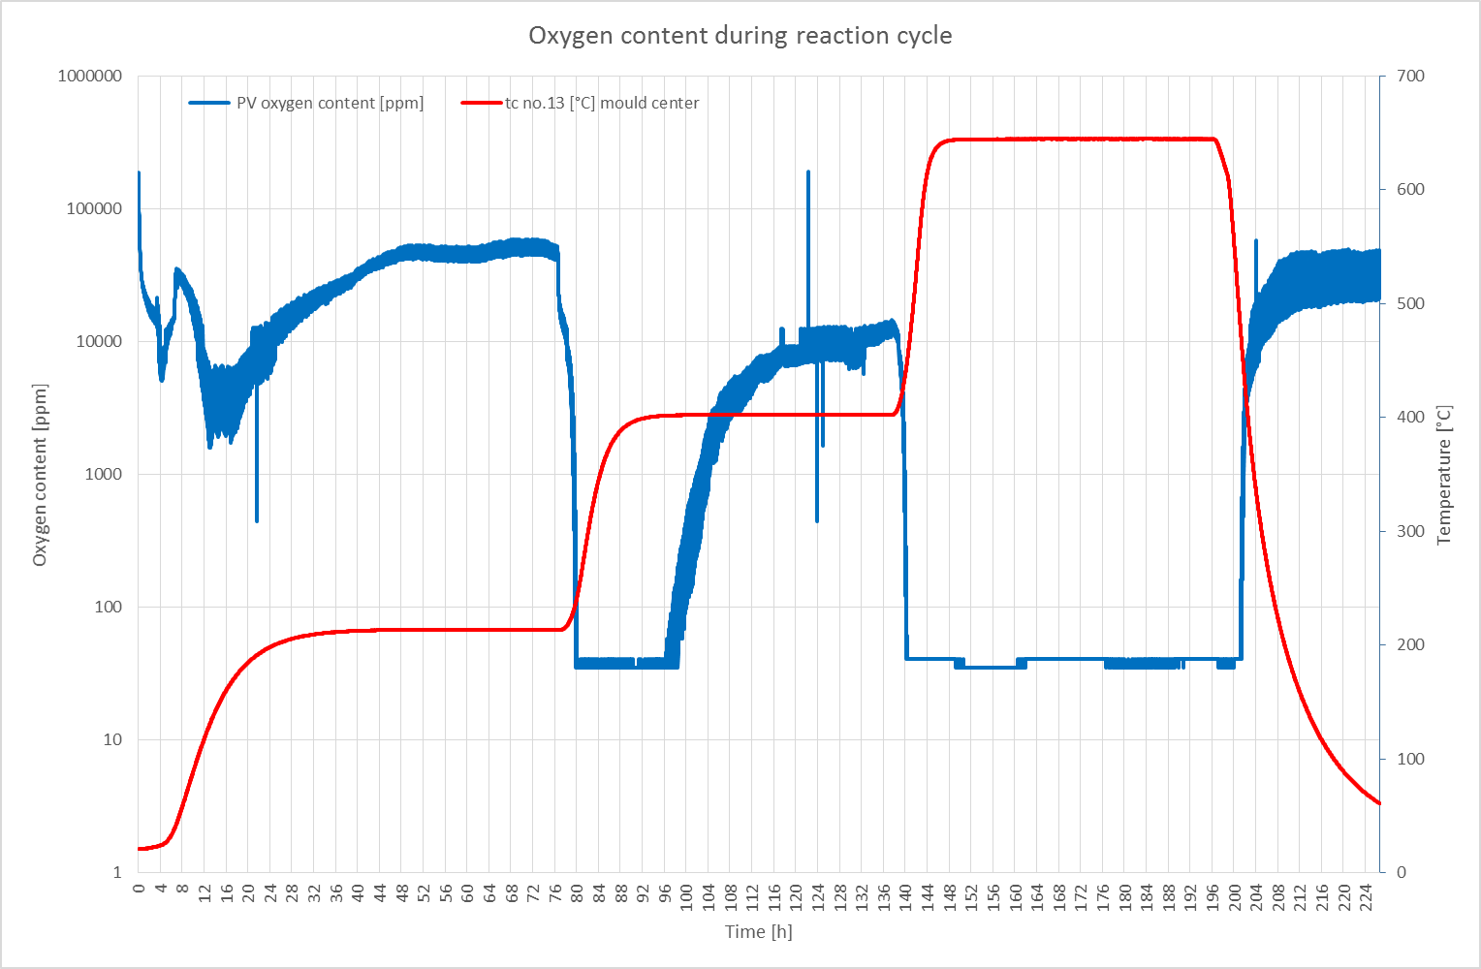

Slide 11
Summary
No problem occurred during reaction process.
Average temperature on the first plateau: 211°C
Average temperature on the second plateau: 399°C
Average temperature on the third plateau: 639°C
Good homogeneity during the dwell time (ΔT=3°C from LE to RE).
No significant difference on the vamas temperature before and after coil but 7h more on the first plateau observed on the vamas. 2h on the second plateau and no difference on the last one.
Monitoring of the oxygen content just for information because we are not confident with the measurement.

