Slide 1
REACTION MQXFS-102
N.Bourcey

Slide 2
Instrumentation layout and heat cycle
tc18
tc14 + tc15
tc11

Slide 3
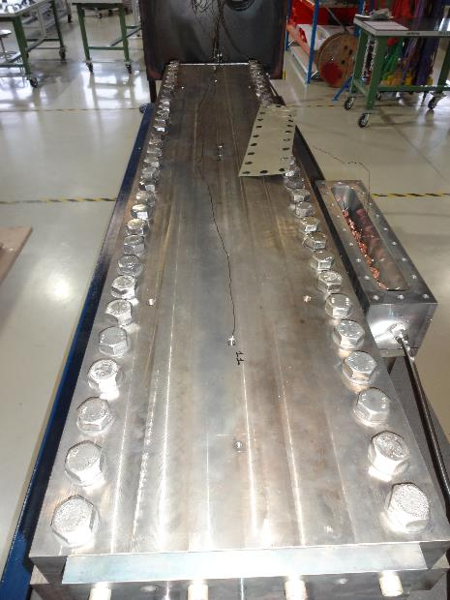
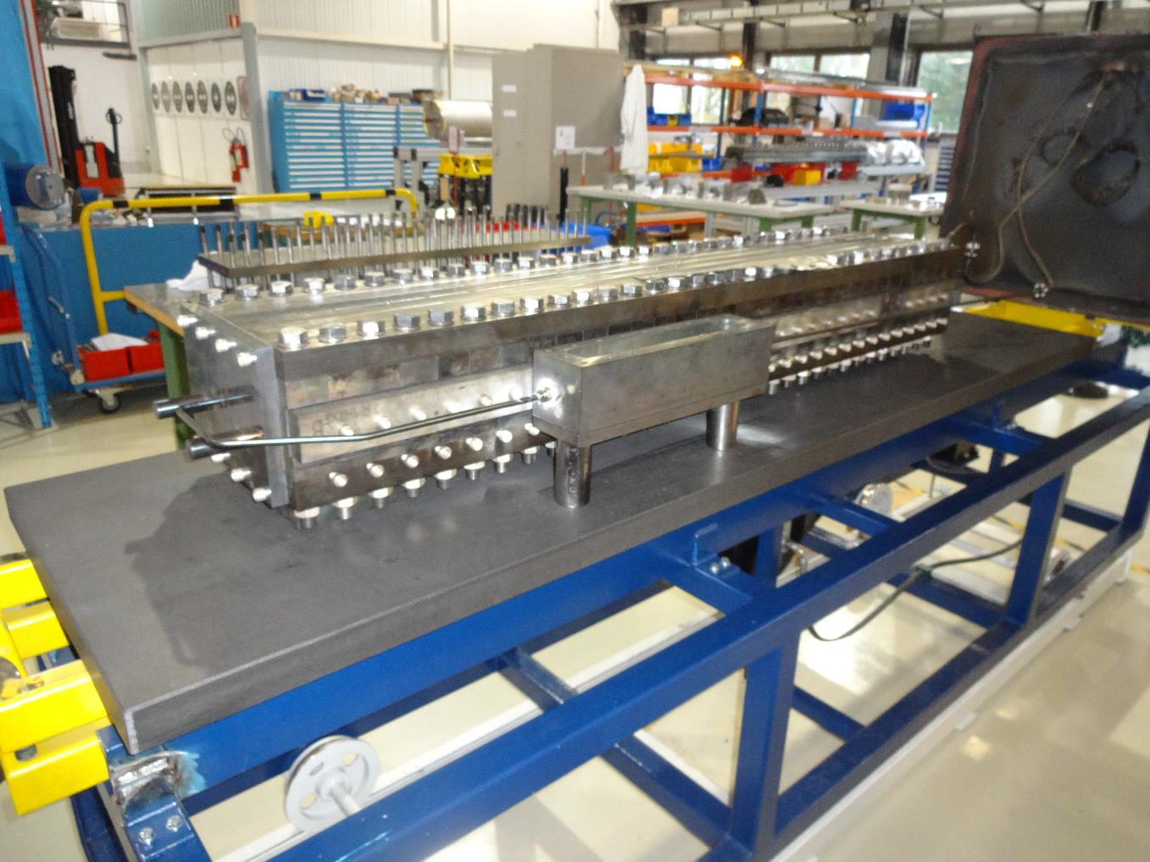
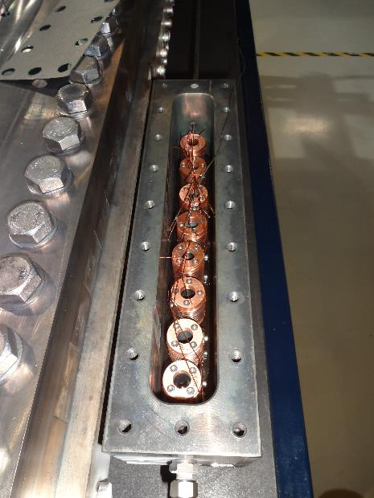

Slide 4
Furnace program

Slide 5
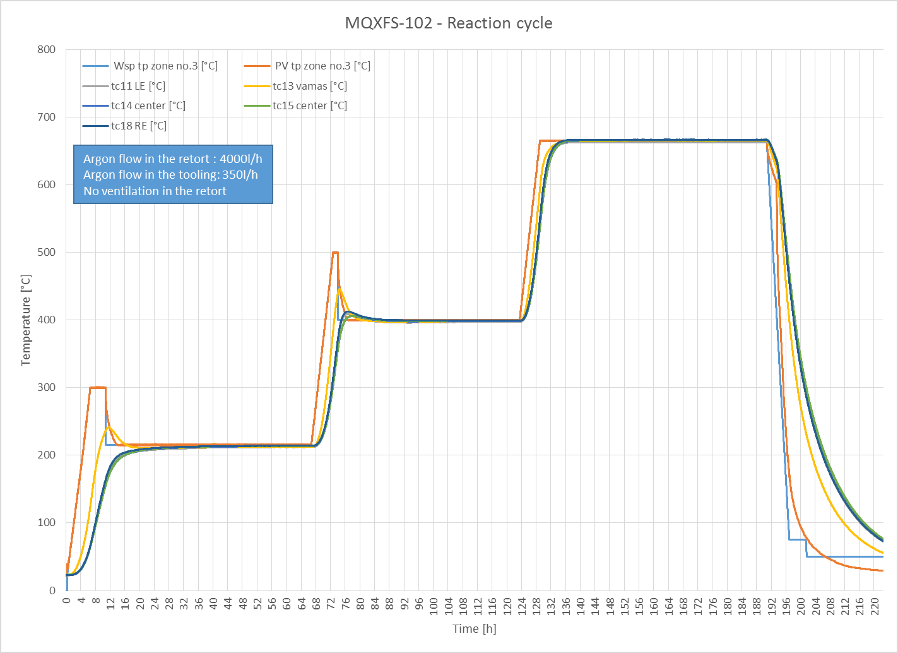

Slide 6
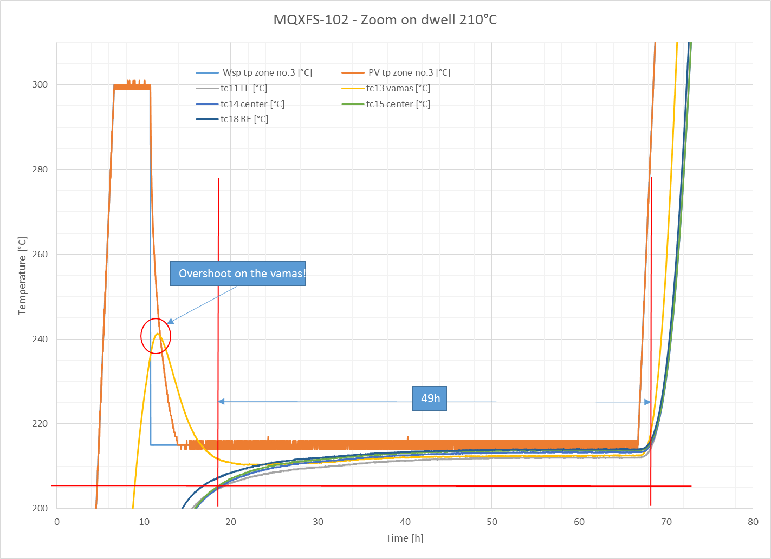

Slide 7
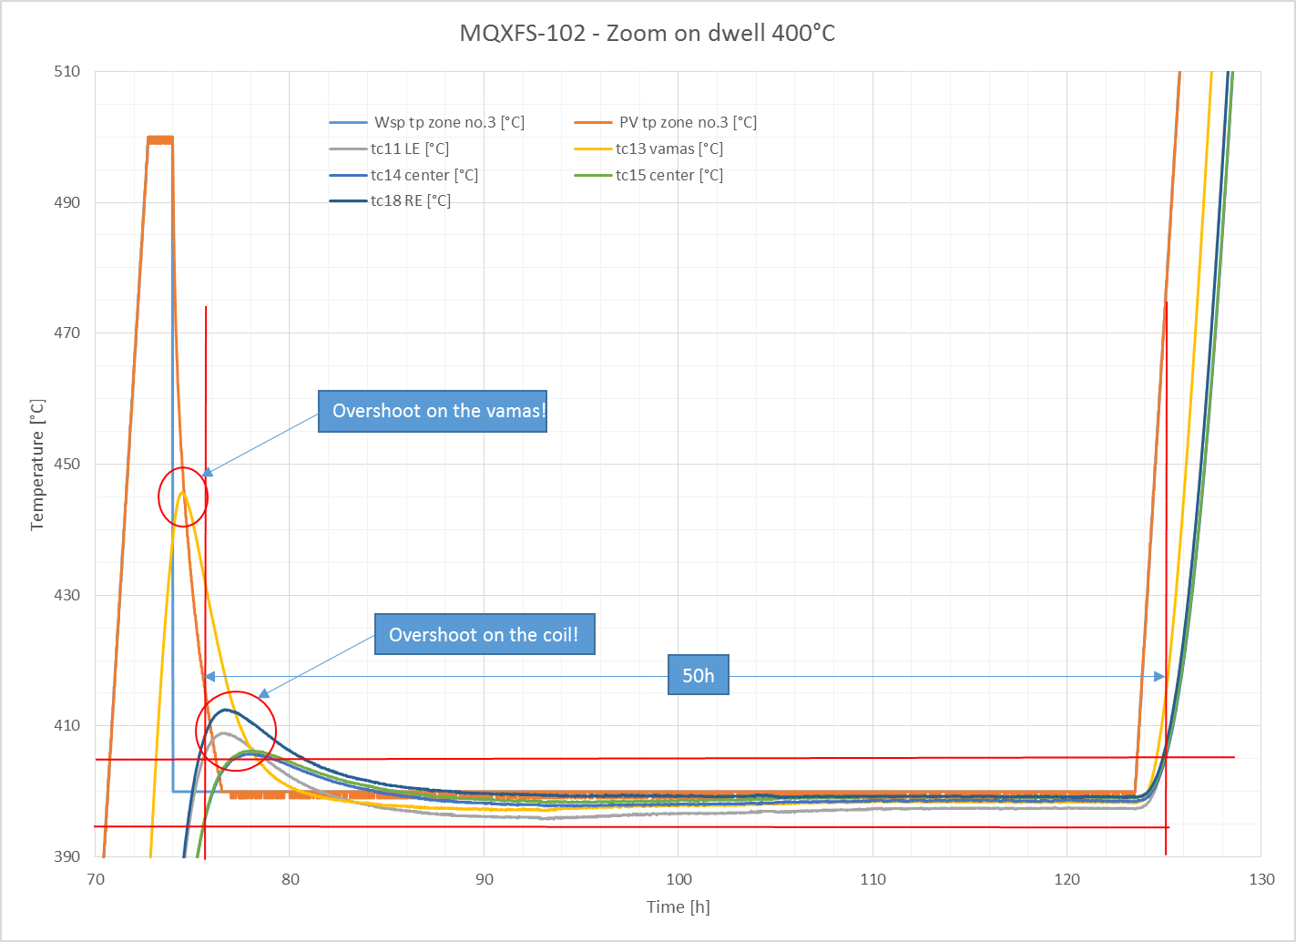

Slide 8
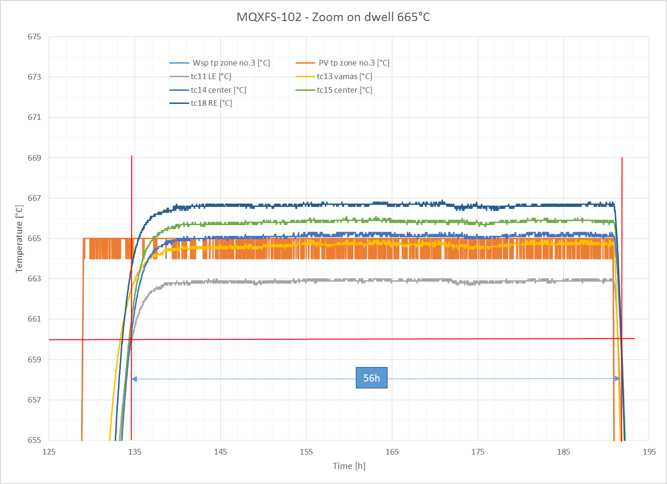

Slide 9
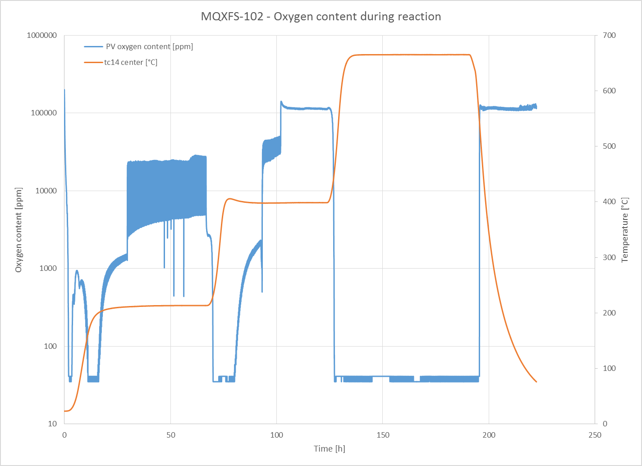

Slide 10
Summary
Some problems occurs during reaction of coil MQXFS-102:
The vamas and RRR samples have seen overshoot on the 2 first plateau
Overshoot to 240°C for the first plateau at 210°C
Overshoot to 445°C for the second plateau at 400°C
The thickness of the sample box will be increased to have a higher inertia
Small overshoot on the coil at the beginning of the plateau at 400°C
Maximum temperature seen on the RE of the coil is 411°C
Duration of the plateau are 49h at 210°C (48h expected), 50h at 400°C (48h expected) and 56h at 665°C (50h expected).
Homogeneity of temperature during the plateau is less than 4°C.
IMPORTANT: the reaction was performed without the calibration of the thermocouples. We could estimate a difference of +2°C with the real temperature at 210°C, +4°C at 400°C and +6°C at 665°C.

