Slide 1
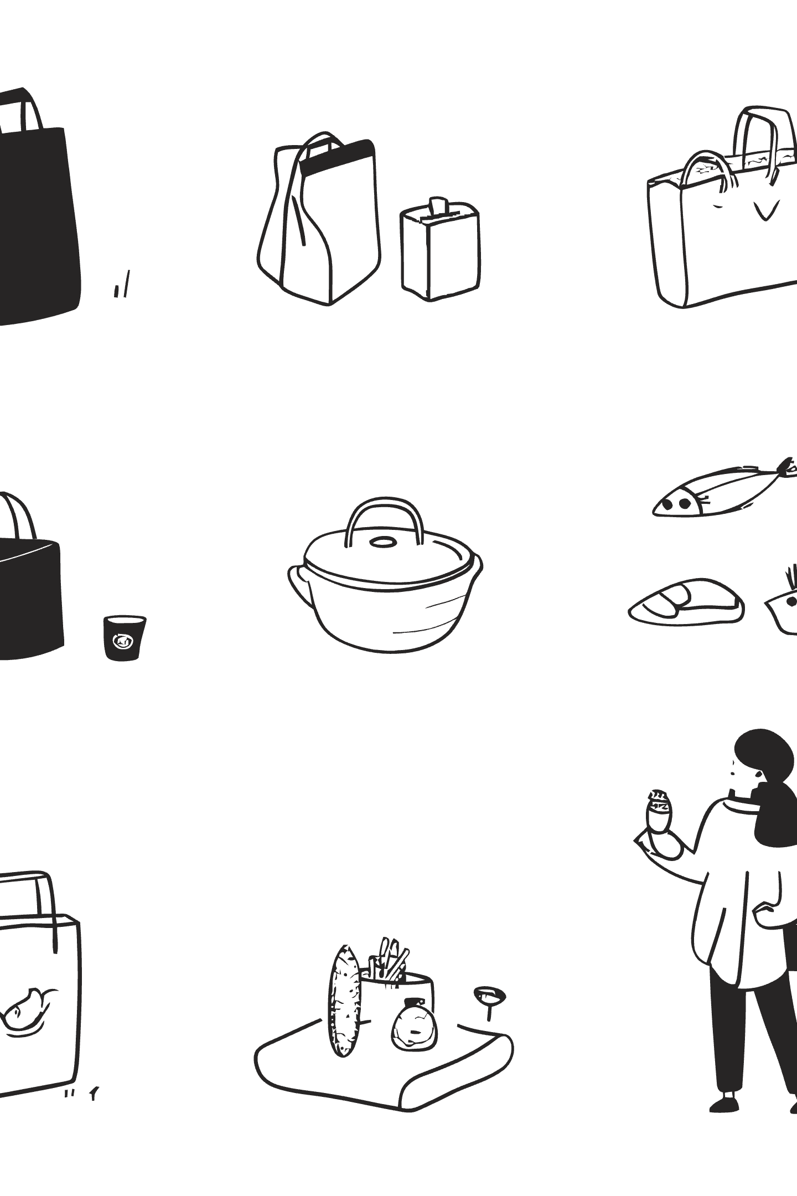
Wildberries
Russia's E-Commerce Giant
From a small fashion boutique to one of Europe's largest online marketplaces — the story of a retail revolution.

Slide 2

General information
Founded
Established in 2004 by Tatyana Bakalchuk in Moscow, Russia
Headquarters
Based in Moscow, with operations across Russia, CIS, and Europe
Slogan
"Wildberries — everything you need" — a one-stop marketplace for all categories
Workforce
Over 400,000 employees, making it one of Russia's largest private employers
International Presence
Active in Poland, Slovakia, Czech Republic, Germany, Kazakhstan, Belarus, and more

Slide 3
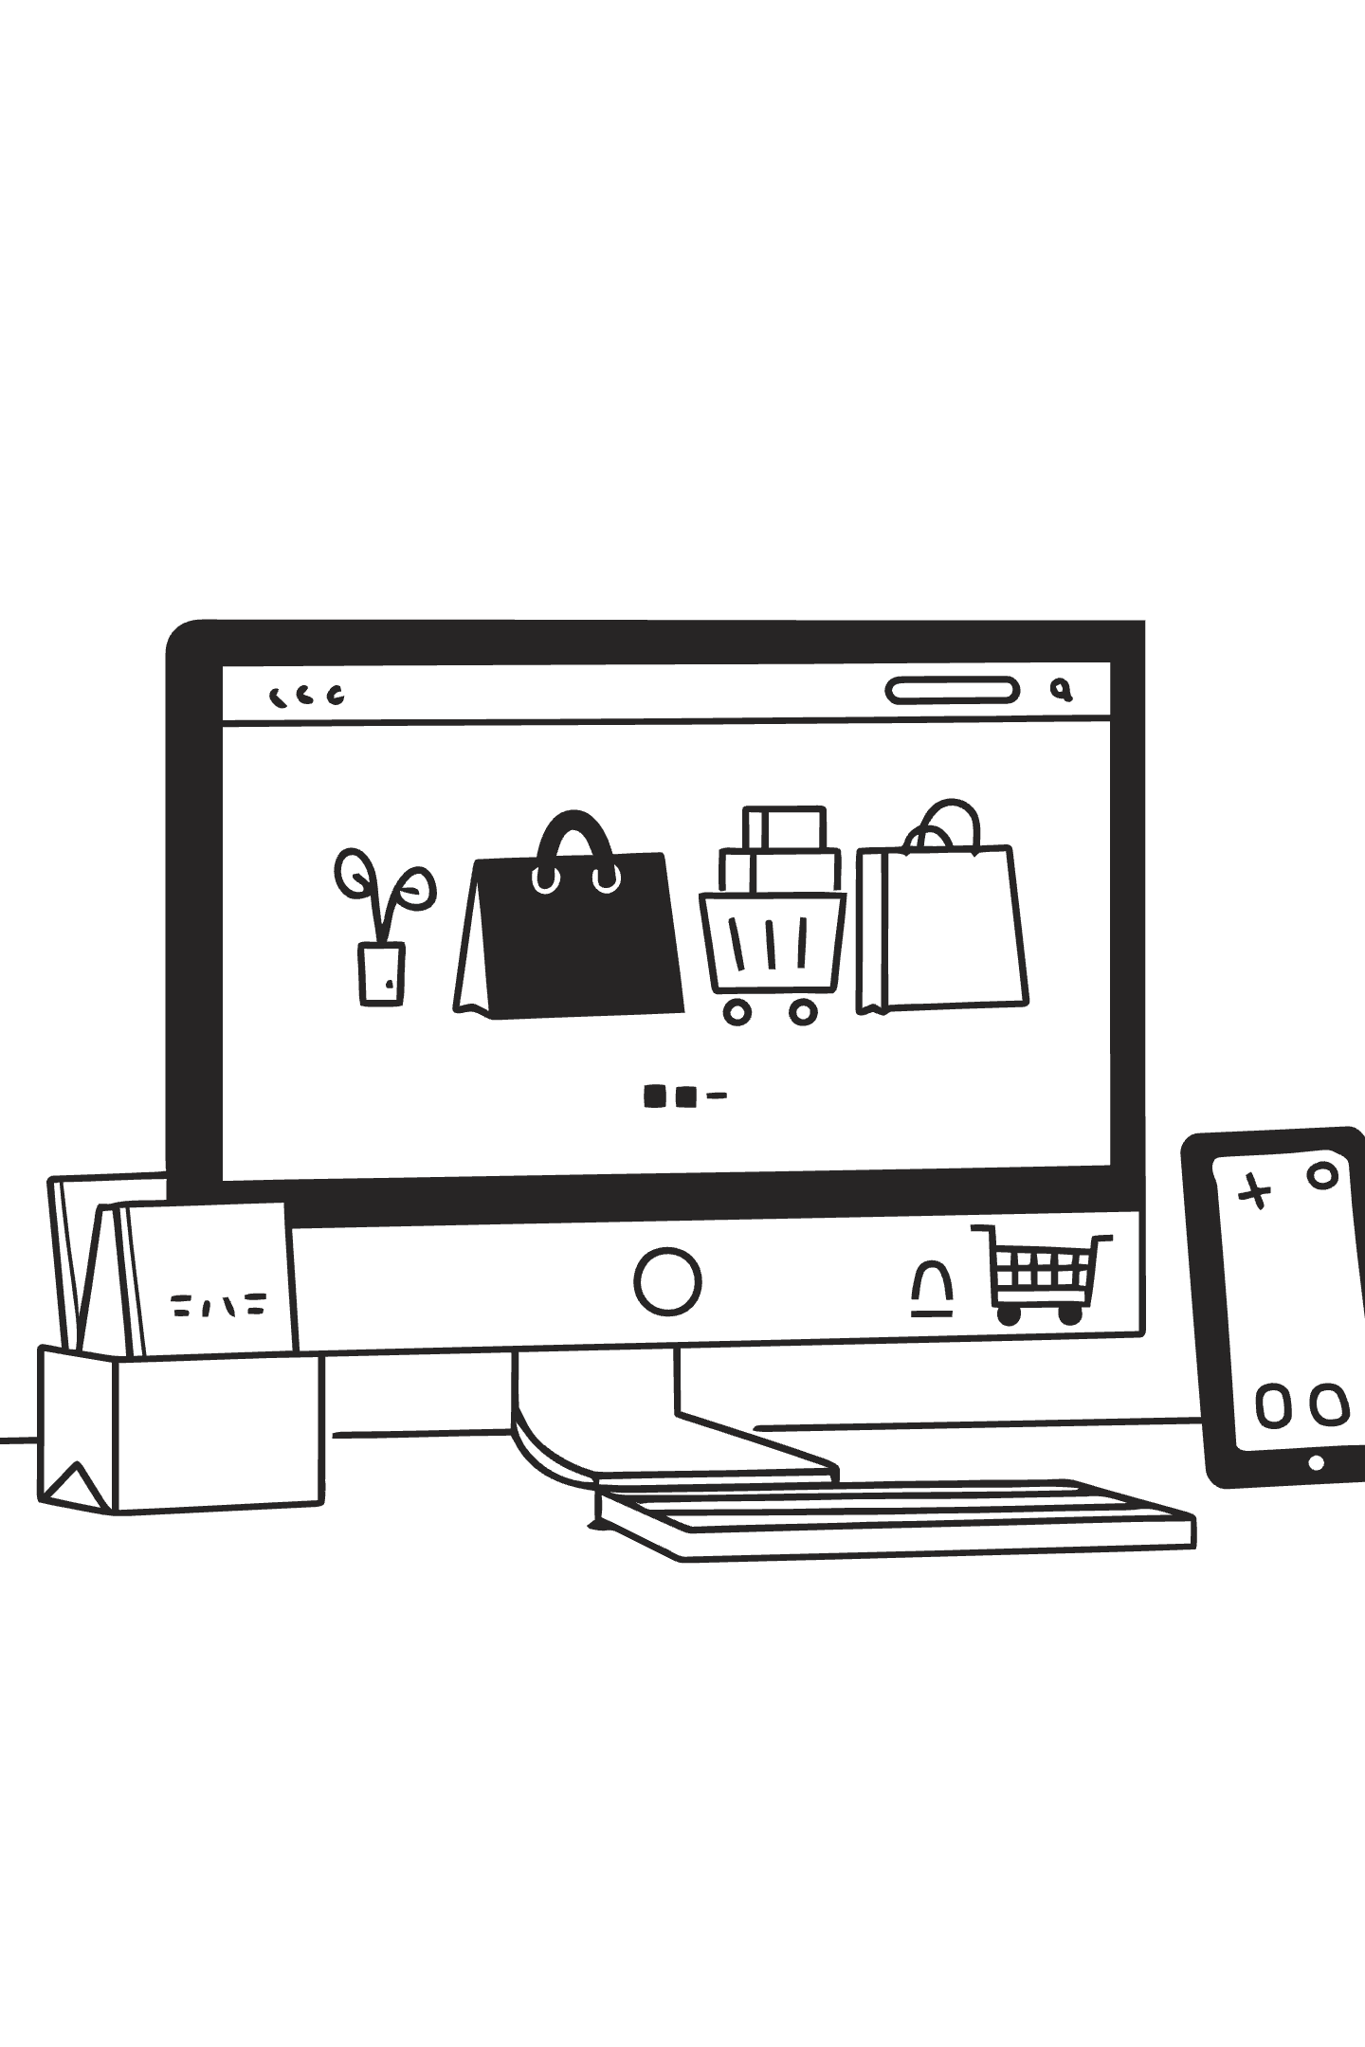
What Wildberries Sells
Wildberries operates as a full-scale marketplace with over 1,000 product categories spanning fashion, electronics, home goods, beauty, and groceries.
Fashion
Clothing, footwear, and accessories for men, women, and children — the platform's original core
Electronics
Smartphones, laptops, home appliances, and consumer electronics from leading brands
Home & Living
Furniture, decor, kitchenware, and household essentials for everyday life
Groceries
Rapidly expanding food delivery and fast-moving consumer goods segment

Slide 4
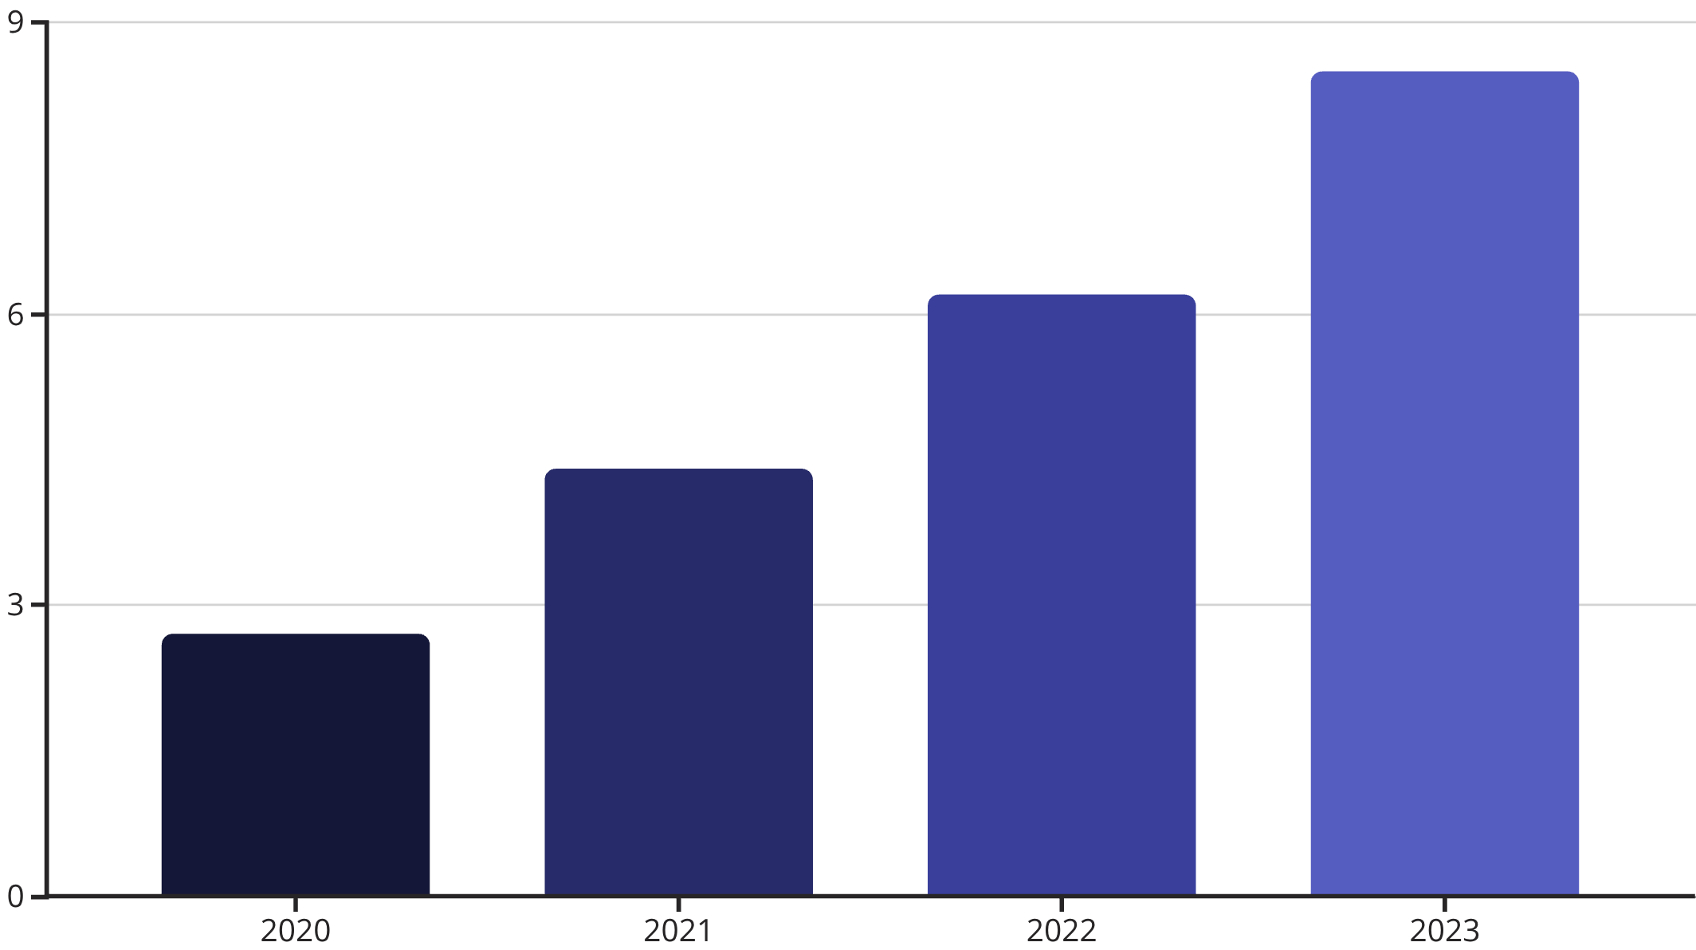
Revenue & Profitability
Key Financial Highlights
Wildberries has demonstrated consistent revenue growth, reaching an estimated $8.5 billion in 2023. The company has historically operated at thin margins, reinvesting heavily into logistics and expansion.
EBITDA
Cash Flow
Reportedly positive in recent years, though exact figures are privately held
Strong operational cash flow driven by high transaction volume and seller commissions

Slide 5
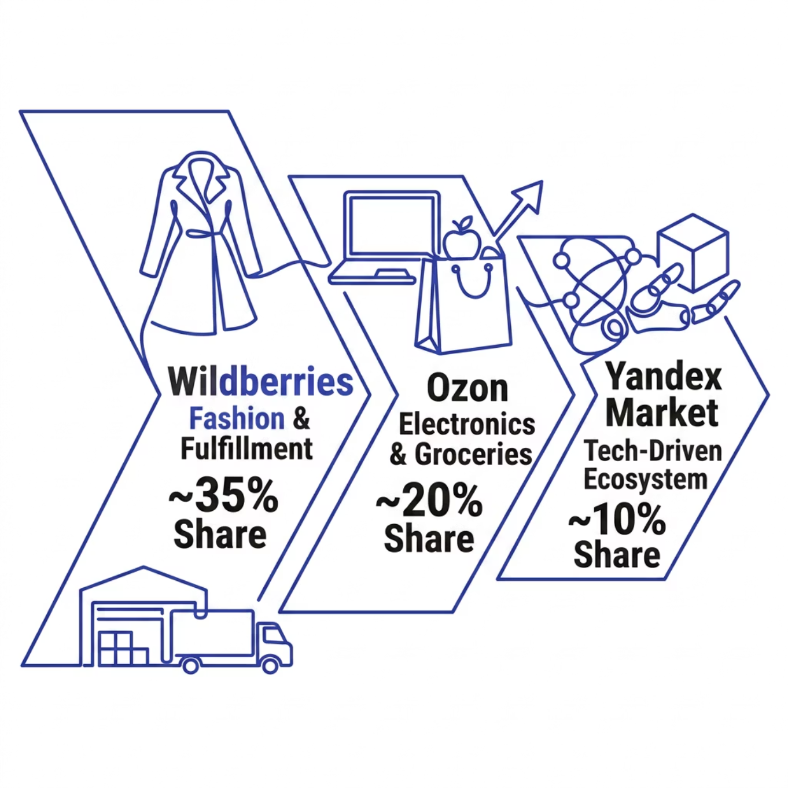

Market Share & Competitive Landscape
Dominant Market Position
Wildberries commands approximately 35% of Russia's e-commerce market, making it the clear category leader. The company continues to grow its international footprint, particularly in Eastern Europe and Central Asia.
Main Competitor: Ozon
Emerging Threat: Yandex Market
Aggressively expanding with heavy investment in logistics and advertising
Leveraging tech ecosystem and same-day delivery capabilities

Slide 6

Advertising & Brand Strategy
Digital-First Advertising
Heavy investment in performance marketing, social media, and influencer partnerships across VK, Telegram, and YouTube
Loyalty Programs
Wildberries Club and bonus point systems drive repeat purchases and increase customer lifetime value
Brand Awareness
Over 90% unaided brand awareness among Russian online shoppers — one of the strongest retail brands in the CIS
Offline Touchpoints
30,000+ pickup points double as brand ambassadors, creating physical presence without traditional retail costs

Slide 7
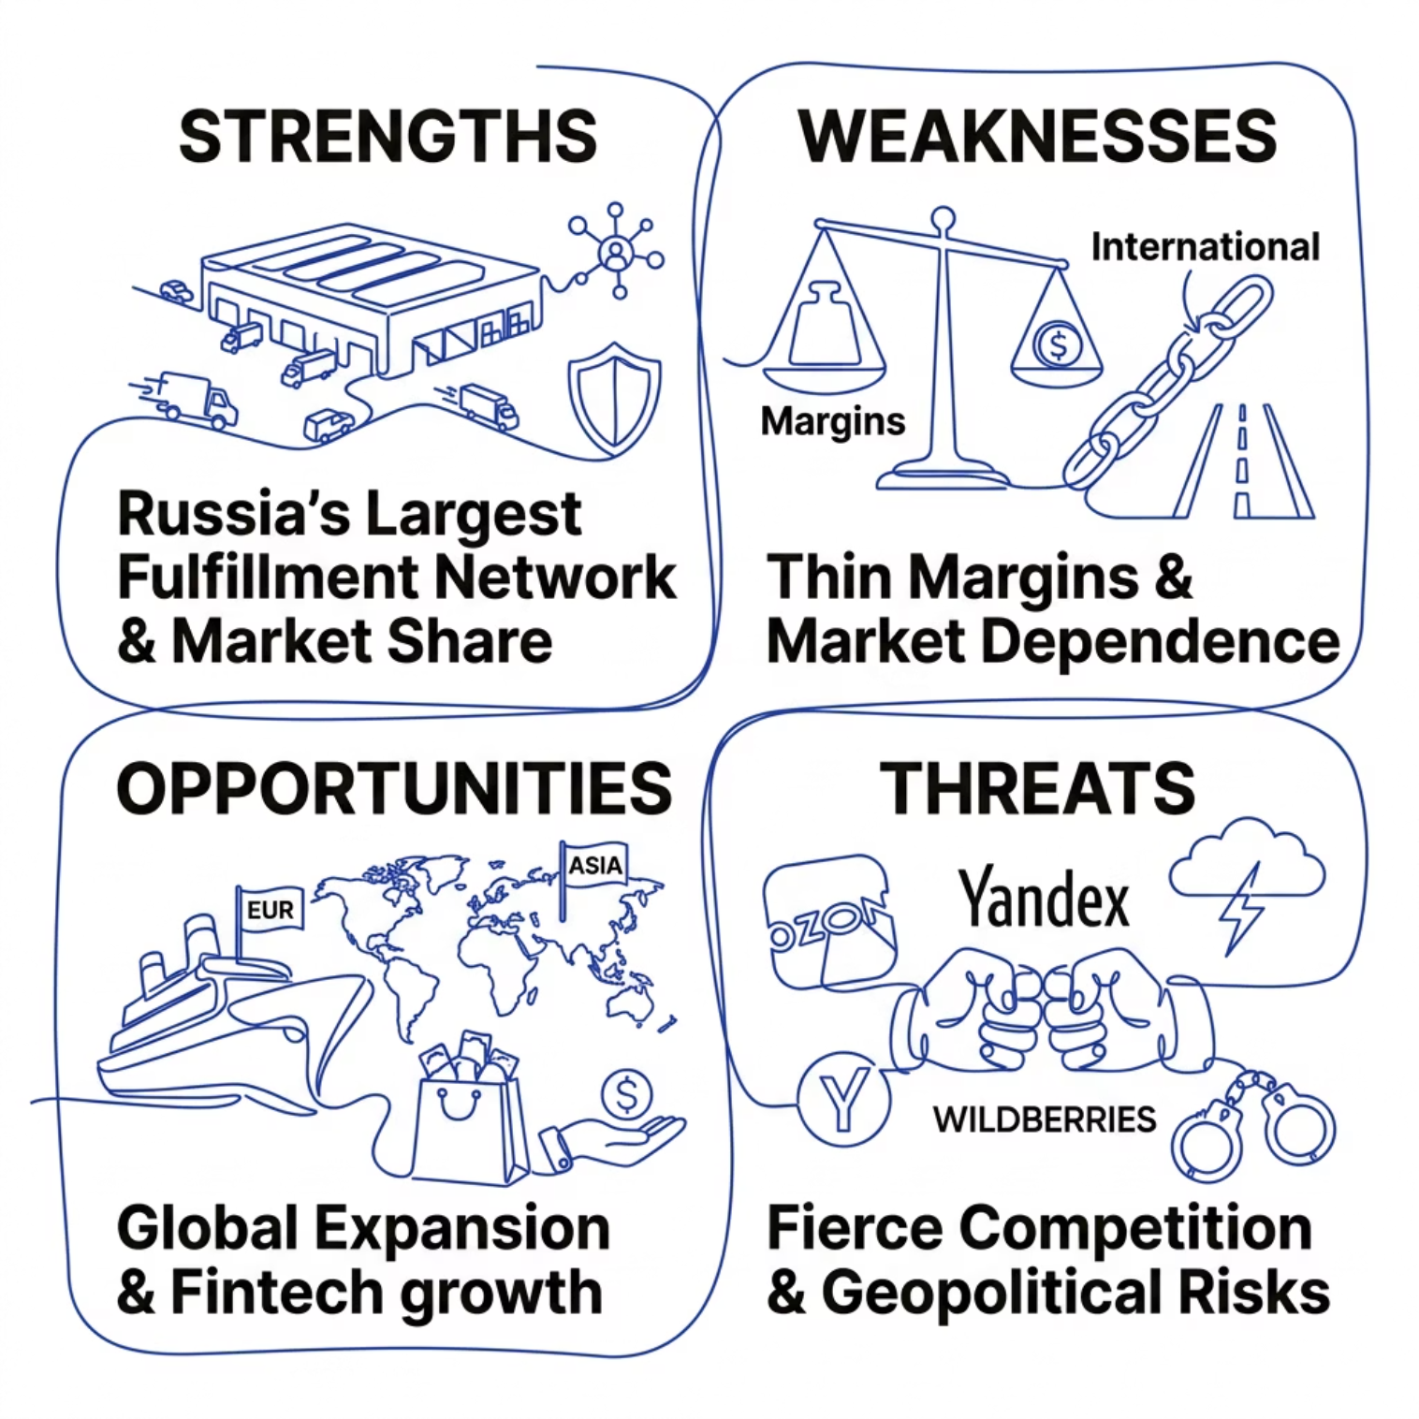

SWOT Analysis: Why Wildberries Succeeds
Key Success Drivers
1
Logistics Infrastructure
Proprietary fulfillment network with 30,000+ pickup points — a moat competitors cannot easily replicate
2
Asset-Light Marketplace Model
Wildberries holds minimal inventory, reducing risk while earning commissions from thousands of sellers
3
First-Mover Advantage
Founded in 2004, Wildberries built trust and scale before e-commerce became mainstream in Russia

