Slide 1
Predictive Modeling of TV Sales
Presented by:
Christ Naim
Sasha Nasser
Romanos Rizk

Slide 2
01
Introduction & Literature Review

Slide 3
In a dynamic world of sales forecasting, our focus is to develop forecasting models to capture the unpredictable nature of the electronics market with a focus on TV sales.
Dynamic and Adaptive Forecasting Models
Understanding Consumer Behavior and Sales Trends
Integration of Machine Learning Techniques
Especially in sectors with rapid product turnover and unpredictable market conditions.
Crucial for developing forecasting models especially in fields like TV sales forecasting
Crucial for effective forecasting

Slide 4
02
Problem Description

Slide 5




Key Challenges in Inventory Forecasting for TV Wholesalers
Towards a Data-Driven Forecasting Approach:
Our report advocates for a shift to more data-driven forecasting to navigate the fluctuating consumer electronics market effectively.
Literature Gap in B2B Supply Chain:
Existing research primarily focuses on business-to-customer (B2C) dynamics, offering limited strategies for business-to-business (B2B) inventory forecasting.
Risk of Inventory Imbalances:
Without detailed data, forecasting becomes a challenge, leading to potential shortages or overstocking of TV units
Reliance on Secondary Data Sources:
Dependence on order transactions from retailers provides only basic details like pricing and quantities, not granular consumer insights."
Limited Access to Direct Customer Data:
Wholesalers struggle with a lack of direct customer data, which limits insight into market trends and consumer buying behaviors.

Slide 6
03
Data Description

Slide 7

Dataset
8323 order transactions of televisions made by appliance retailers in Lebanon.
Lebanese wholesales company: Linkers Group S.A.L.
Casa - Pixel Density
Month - Connectivity Options (2, 3, 4 ports)
TV Brand - Energy Efficiency (A, B, C, D, E)
TV Size (inches) - Response Time (4 ms & 10 ms)
Resolution (HD, FHD, UHD) - Unit Price
Refresh Rate (60 Hz, 120 Hz) - Total Quantity
Sound Quality (Basic, Enhanced, Premium)

Slide 8
04
Methodology

Slide 9
Setting the Total Quantity as our Target Variable
Exploratory Data Analysis
Regression Models
Regression Trees
Analyzing the trends and patterns between the Total Quantity and the different factors
"Examining how various factors contribute to sales volume to enhance forecast precision
Utilizing tree-based models to capture non-linear relationships and interactions between predictors for potential improvement in forecast accuracy

Slide 10
05
Results
Exploratory Data Analysis
Regression Models
Regression Trees

Slide 11
Exploratory Data Analysis

Slide 12
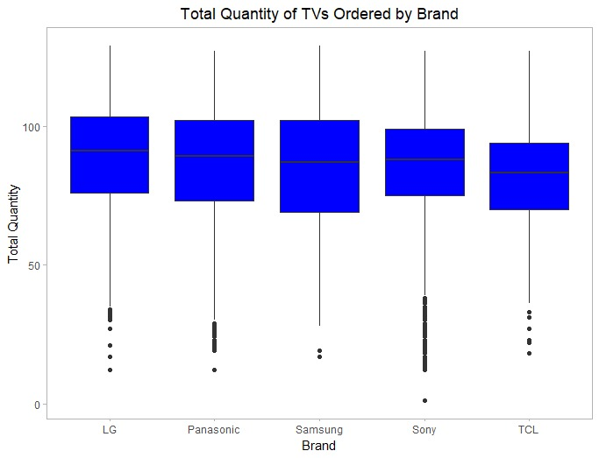
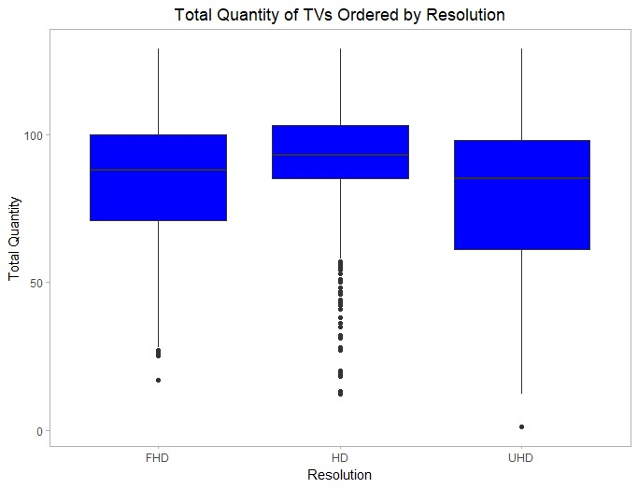

Slide 13
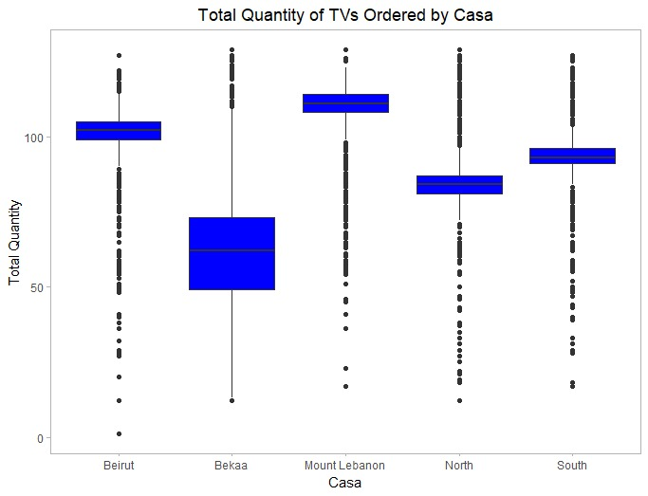
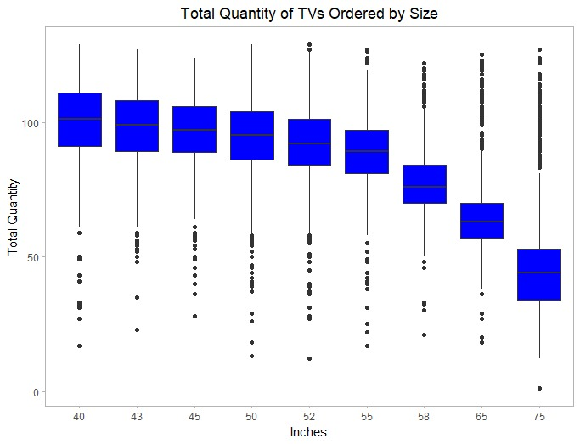

Slide 14
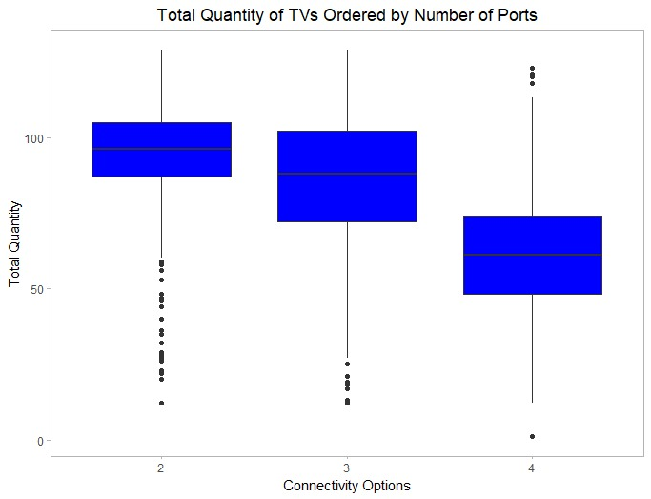
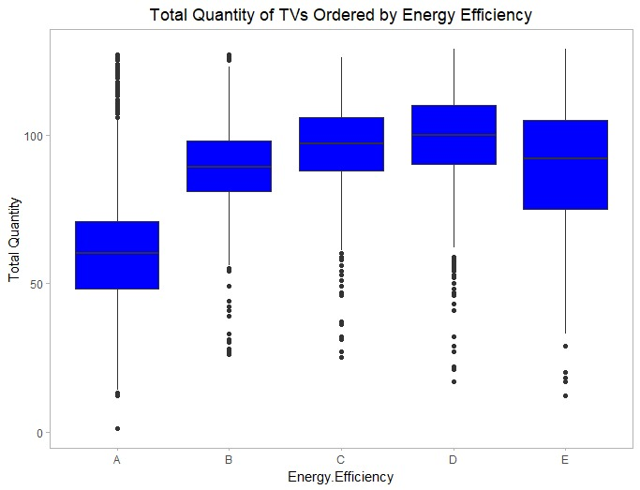

Slide 15
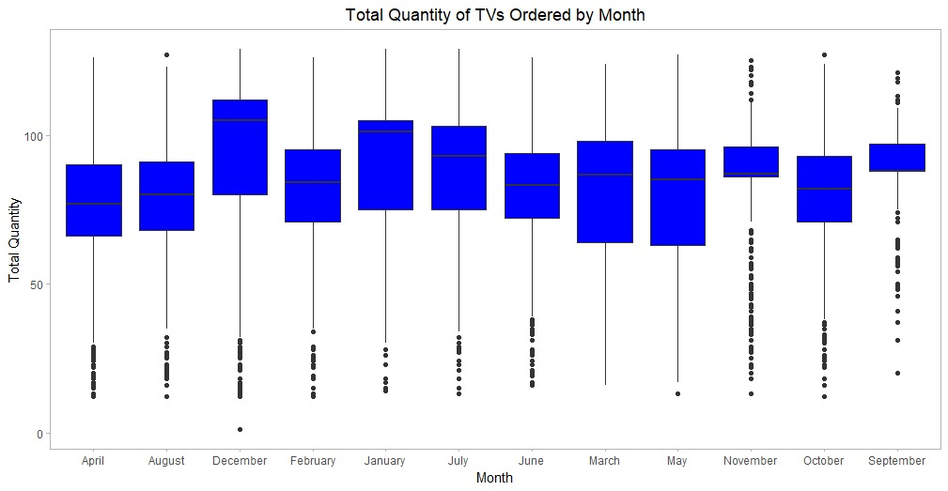

Slide 16
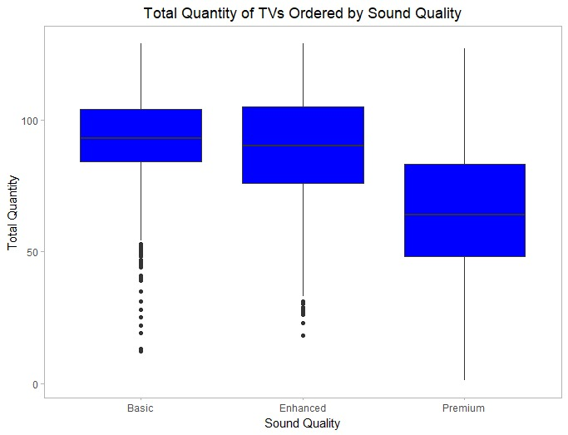

Slide 17
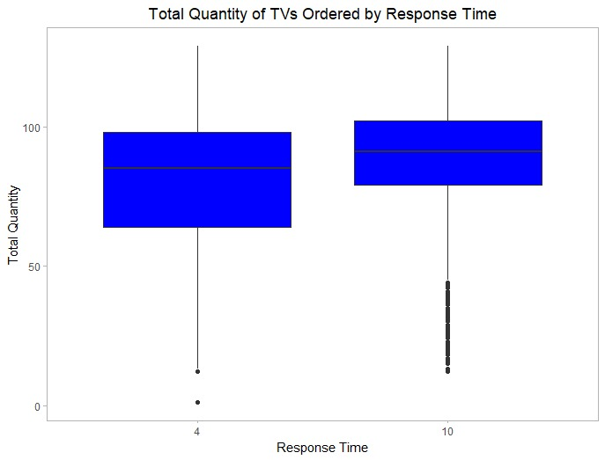
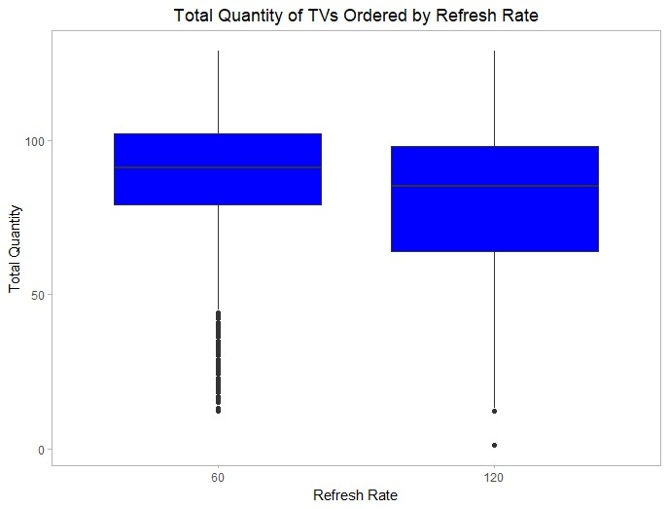

Slide 18
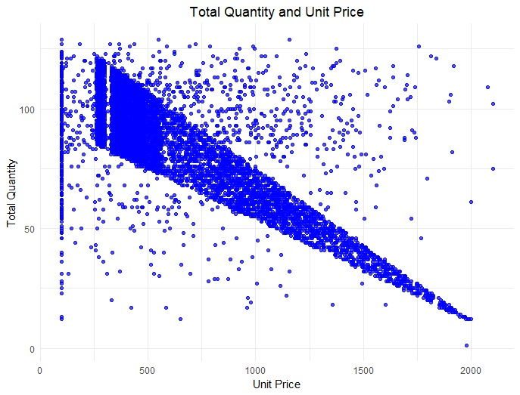
Correlation:
-0.746

Slide 19
B. Regression Models
The data was split into a training (70%) and validation (30%) dataset after setting a seed of 100 for replicability

Slide 20
Model 1
All Predictors
R Squared = 75.01%
RMSE = 11.02643 with an average total Q of 84.62 in the validation dataset
Model 1 Statistically Significant

Slide 21
Model 2
All Predictors of Model 1 except Pixel Density and Refresh Rate
R Squared = 75.01%
RMSE = 11.02625 with an average total Q of 84.62 in the validation dataset
Model 2 Statistically Significant
No Instances of Multicollinearity

Slide 22
Model 3
All Predictors of Model 2 except Response Time
R Squared = 75.01%
RMSE = 11.03070 with an average total Q of 84.62 in the validation dataset
Model 3 Statistically Significant
All Predictors are significant
No Instances of Multicollinearity

Slide 23
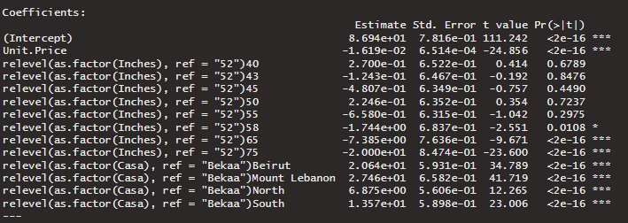
Model 4
Predictors: Unit Price, Size (Inches), Casa
R Squared = 75.01% RMSE = 11.35494 with an average total Q of 84.62 in the validation dataset
Model 4 Statistically Significant & All Predictors are significant
No Instances of Multicollinearity

Slide 24
Interaction
R Squared = 79.43%
Interaction Model is Statistically Significant with a p-value < 2.2e-16
Interactions between Unit Price and TV Sizes:
Unit.Price:relevel(as.factor(Inches), ref = "52")65: -2.187e-02
Unit.Price:relevel(as.factor(Inches), ref = "52")75: -4.157e-02
These coefficients suggest that for 65-inch and 75-inch TVs, an increase in unit price is associated with a greater decrease in sales quantity compared to the base size of 52 inches. The more negative coefficient for 75 inches implies a stronger negative impact of price on sales quantity for this size.
Interactions between Unit Price and Regions:
Unit.Price:relevel(as.factor(Casa), ref = "Bekaa")Mount Lebanon: 1.086e-03
This positive coefficient for Mount Lebanon indicates that the relationship between price and sales quantity in this region is different from the base case of Bekaa. Specifically, it suggests that an increase in unit price in Mount Lebanon is associated with a smaller decrease in sales quantity compared to Bekaa, given the positive sign.

Slide 25
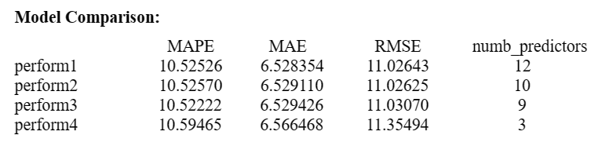
Model Comparison
Selecting the best model requires identifying the one with the least tradeoff between performance and complexity.
All the models have an approximately similar RMSE. However, model 4, with 3 predictors, is much less complex.
Thus, we choose model 4 as our predictive model for total quantity.

Slide 26
C. Regression Trees

Slide 27
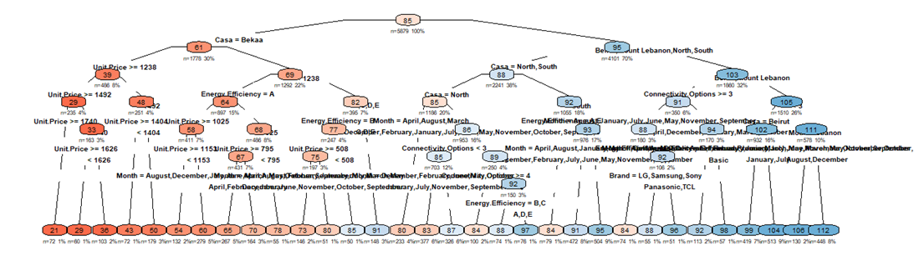
Tree 1
All Predictors
Variables actually used in tree1 construction:
Brand, Casa, Connectivity.Options, Energy.Efficiency, Inches, Resolution, Sound.Quality, Unit.Price
(cp) of 0.0001
minimum bucket size of 50
minimum split of 100
maximum depth of 10
Lowest xerror approach
root node error= 2871206/5879 = 488.38
RMSE of 10.12551
Mean quantity of 84.6248 in the validation dataset
Nodes=63
Leafs=32
Notes:
A node will be split if it would decrease the overall lack of fit by a factor of cp. A smaller value of cp allows for more complex trees, potentially capturing more detail from the data but also risking overfitting.

Slide 28
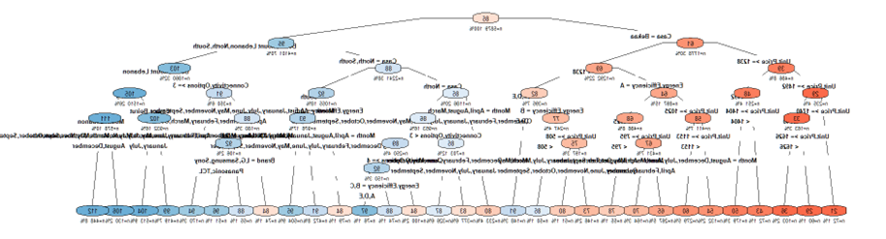
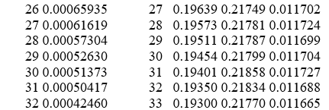
Tree 1.1
All Predictors
(cp) of 0.0001
minimum bucket size of 50
minimum split of 100
maximum depth of 10
Best Pruning Approach
Best cp by r: row 30
0.21858 + 0.011727=0.230307 > 0.21799
We can consider cp=0.00052630
RMSE of 10.574883
Nodes=61
Leafs=31

Slide 29
Tree 2
All Predictors
(cp) of 0.01
minimum bucket size of 50
minimum split of 100
maximum depth of 10
Lowest xerror approach
RMSE of 10.805772
CP nsplit rel error xerror xstd
1 0.490422 0 1.00000 1.00016 0.019982
2 0.113456 1 0.50958 0.50988 0.013895
3 0.071939 2 0.39612 0.39867 0.012596
4 0.032952 3 0.32418 0.32681 0.013012
5 0.019342 4 0.29123 0.29621 0.012623
6 0.014996 5 0.27189 0.27716 0.011766
7 0.010799 6 0.25689 0.26447 0.011554
8 0.010097 7 0.24609 0.25126 0.011591
9 0.010000 8 0.23600 0.24671 0.011631

Slide 30
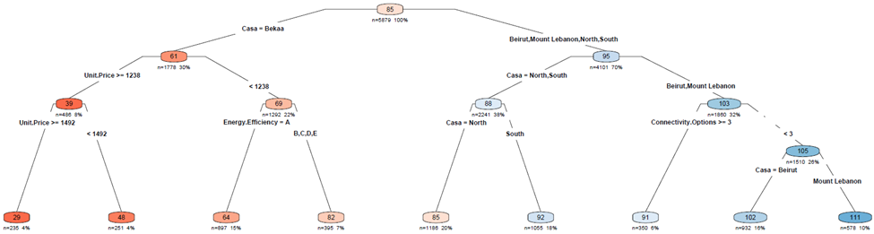
Tree 2

Slide 31
Tree 2.1
Unit Price - Inches - Casa
(cp) of 0.01
minimum bucket size of 50
minimum split of 100
maximum depth of 10
Best pruning approach
0.24671+0.011631 =0.258341>0.25126
We can consider cp=0.010097
RMSE of 11.085917
CP nsplit rel error xerror xstd
1 0.490422 0 1.00000 1.00016 0.019982
2 0.113456 1 0.50958 0.50988 0.013895
3 0.071939 2 0.39612 0.39867 0.012596
4 0.032952 3 0.32418 0.32681 0.013012
5 0.019342 4 0.29123 0.29621 0.012623
6 0.014996 5 0.27189 0.27716 0.011766
7 0.010799 6 0.25689 0.26447 0.011554
8 0.010097 7 0.24609 0.25126 0.011591
9 0.010000 8 0.23600 0.24671 0.011631

Slide 32
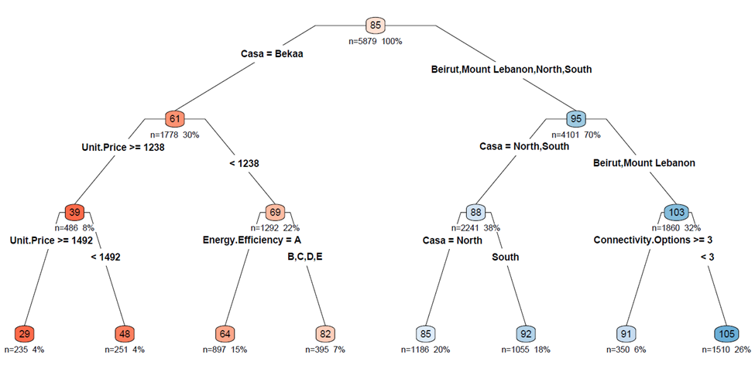
Tree 2.1

Slide 33
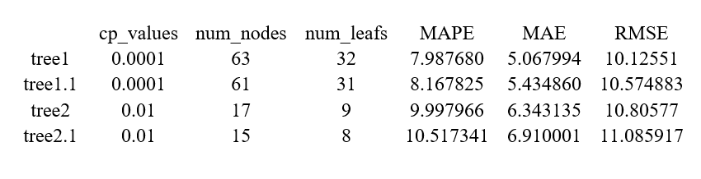
Comparing the Trees:
Tree 2's cp is 0.01, higher than Tree 1 (0.0001), reducing the risk of overfitting and making it less complex. It has 17 nodes and 9 leaves, significantly fewer than Tree 1 (63 nodes, 32 leaves) and Tree 1.1 (61 nodes, 31 leaves), simplifying interpretation and analysis.
The RMSE of 10.80577 is slightly higher than Tree 1 (10.12551) and Tree 1.1 (10.574883), but still indicates good predictive accuracy.
Tree 2.1 has a higher RMSE (11.085917) and marginally fewer nodes and leaves, making Tree 2 preferable due to its better accuracy.

Slide 34
06
Conclusion & Recommendations

Slide 35
Regression Models
1.The negative coefficient for Unit.Price indicates that price is a sensitive factor in sales quantity.
It is recommended to review the pricing strategy to find the optimal price points that can maximize sales without sacrificing profit margins too much.
2. The negative coefficients for larger sizes (65 and 75 inches) that are statistically significant imply that these models may be priced too high or not in high demand.
Consider either adjusting the price or focusing inventory on sizes that are more positively correlated with sales quantity.
3. Significant positive coefficients for regions like Beirut and Mount Lebanon indicate higher sales quantities compared to the reference region (Bekaa). This suggests that these regions may have higher demand or more effective distribution strategies.
It would be beneficial to concentrate marketing efforts and distribution resources in these areas or replicate the successful strategies from these regions in other areas.

Slide 36
Regression Trees
4. The tree shows a split at a unit price of 1238, indicating that price is a significant factor in sales volume.
The wholesaler should consider segmenting their inventory to ensure they have a variety of options above and below this price point to cater to different market segments.
5. The wholesaler should adjust their supply strategy based on regional preferences, as indicated by the splits on 'Casa'. Certain regions like 'Bekaa' show different sales patterns compared to 'Beirut' and 'Mount Lebanon'. Inventory should be allocated and marketed differently in these regions to optimize sales.
6. There is a split for energy efficiency, with category 'A' being a decision node. The wholesaler should stock a higher proportion of 'A' energy efficiency-rated TVs, as there seems to be a distinct market for these models.
7. A split occurs where the number of connectivity options is greater than 3, suggesting that TVs with more connectivity features are preferred. The wholesaler should ensure that their inventory is stocked with TVs that offer a higher number of connectivity options to meet this demand.

Slide 37
References
Büttner, D., & Rabe, M. (2021). Sales Forecasting in the Electrical Industry – An Illustrative Comparison of Time Series and Machine Learning Approaches. 2021 9th International Conference on Traffic and Logistic Engineering. https://ieeexplore.ieee.org/document/9525747
Hwang, S., Yoon, G., Baek, E., & Jeon, B.-K. (2023). A Sales Forecasting Model for New-Released and Short-Term Product: A Case Study of Mobile Phones. Electronics, 12(3256). https://www.mdpi.com/2079-9292/12/15/3256
Sleiman, R., Mazyad, A., Hamad, M., Tran, K.-P., & Thomassey, S. (2022). Forecasting Sales Profiles of Products in an Exceptional Context: COVID-19 Pandemic. International Journal of Computational Intelligence Systems, 15(99). https://link.springer.com/article/10.1007/s44196-022-00161-x
Xu, Q., & Sharma, V. (2017). Ensemble Sales Forecasting Study in Semiconductor Industry. Springer International Publishing. https://link.springer.com/content/pdf/10.1007/978-3-319-62701-4_3.pdf

Slide 38
Thank You

