Slide 1
.Net programming using C# -Final project
GyeongEun Lee (200412976) Cassandra Courchesne Evans(200398437)
Kripa Kumar Bhujel (200434804) Fatima Jalil (200447003)

Slide 2
Purpose of the Application
An inventory management system for a home personal pantry
Show what food someone currently has at home
Keep track of quantity, location(fridge/freezer/cup board),expiry date
Add/update/delete/read items from the inventory

Slide 3
Features
Log into form
Acquire data from an external source(SQL Server)
Sort the data
Search items by name
Use an export function to download an Excel file
Read/create/update/delete data
Error Handling

Slide 4
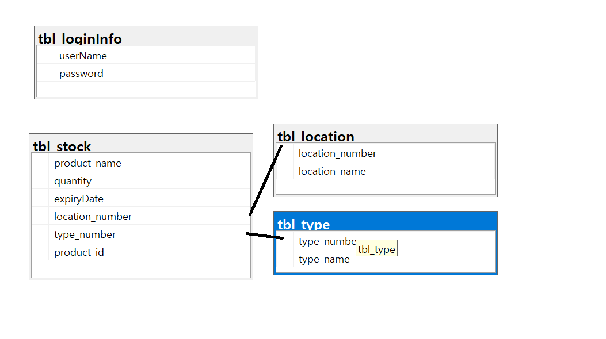
Database -table structure (1NF)

Slide 5
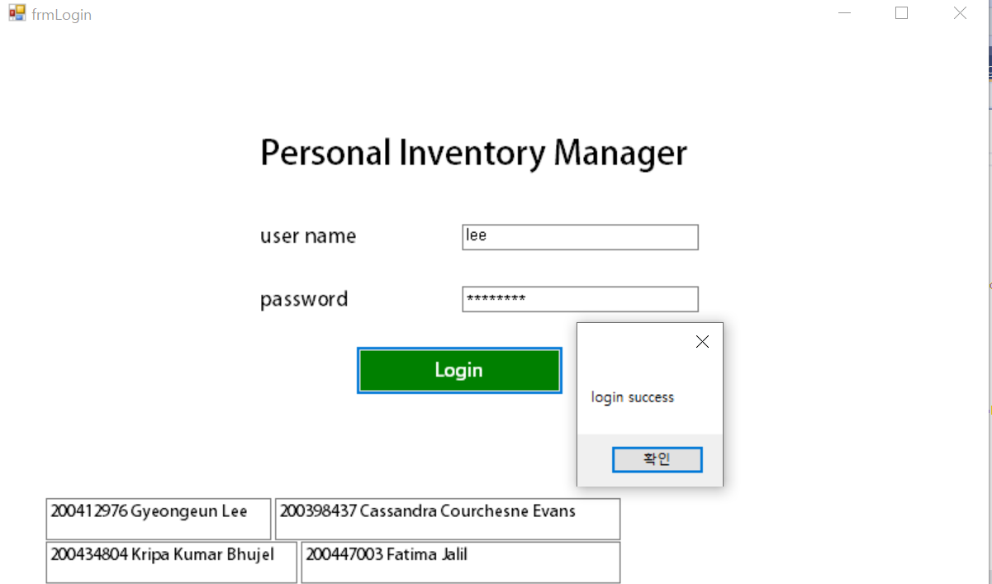
Login Form

Slide 6
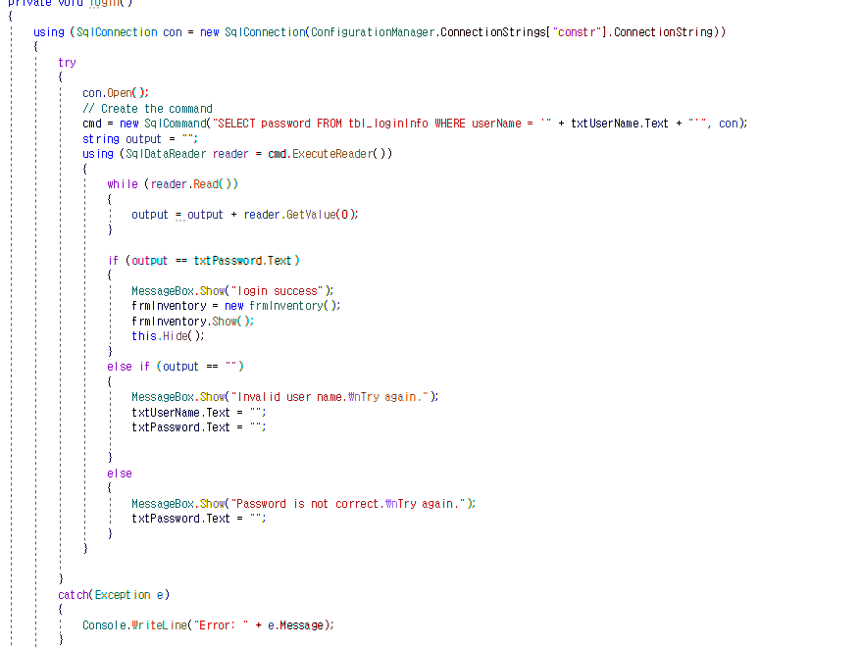
Login Form
If a textbox is blank, the message box shows up
Connect DB
If a textbox is blank, the message box shows up
Check if the user name and password are correct
Error handling (try ~ catch)

Slide 7
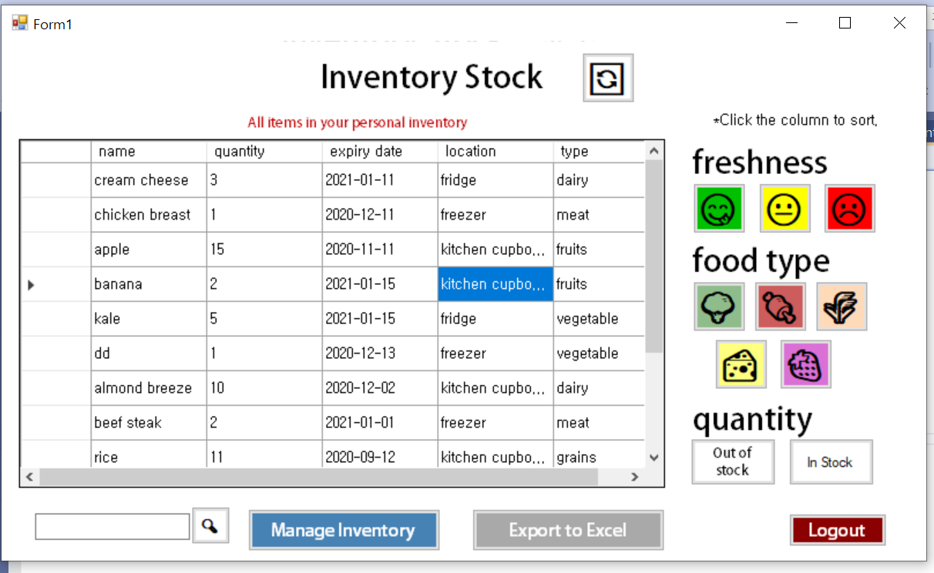
Inventory Form -View

Slide 8
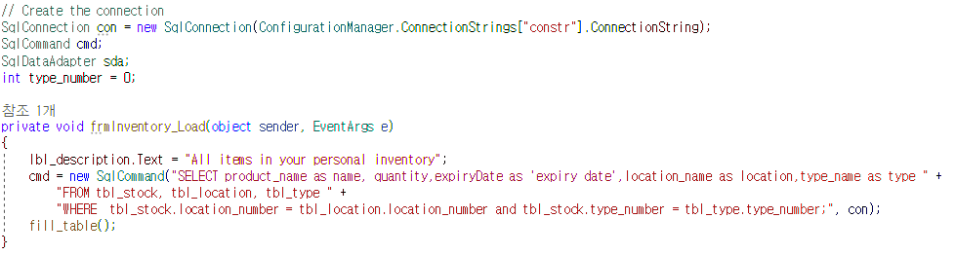
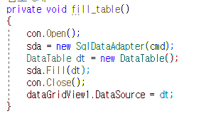
Inventory View Form -load table
Connect DB
Get data from table and show them on the grid view

Slide 9
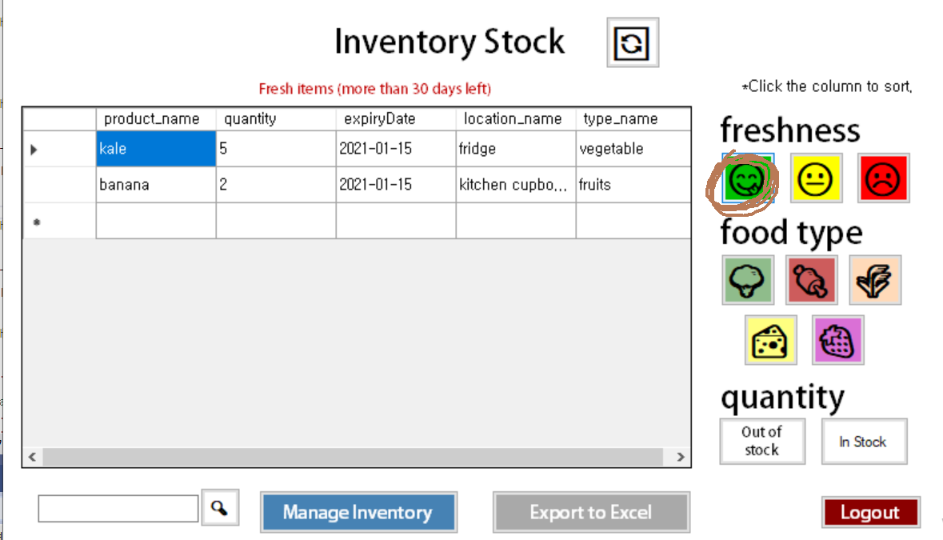
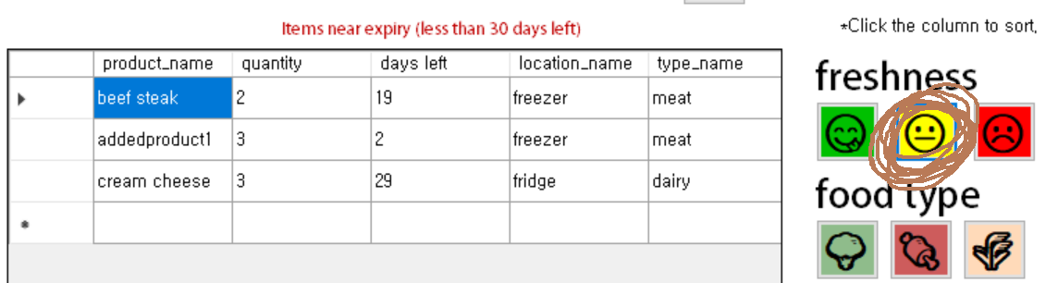
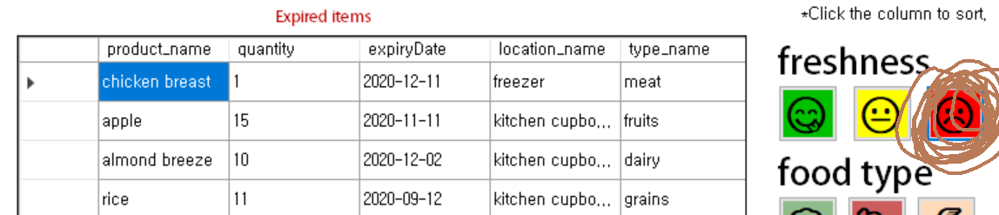
Inventory Form -group by freshness

Slide 10
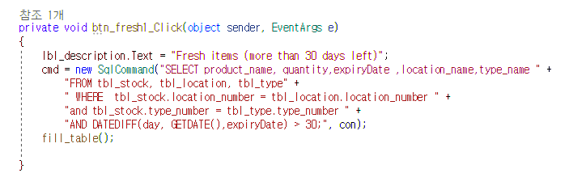
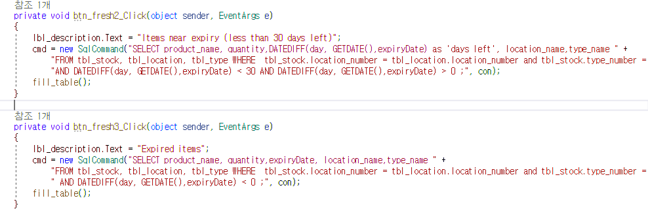
Inventory View Form -group by freshness
Check if the item is fresh or close to expiry date or already expired, by calculating the differences between two date values
DATEDIFF(today, expiry date)

Slide 11
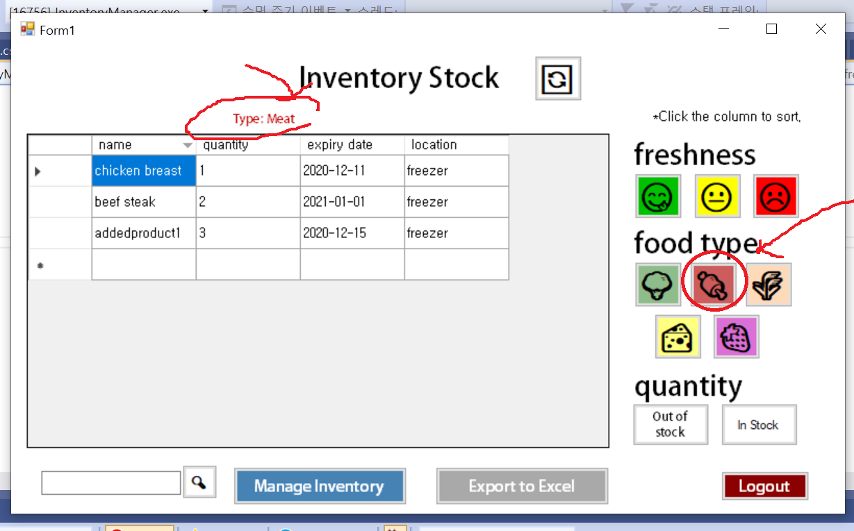
Inventory Form -group by food type

Slide 12
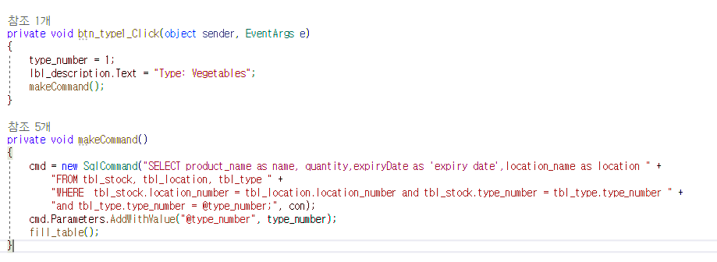
Inventory View Form -group by food type
Show food type
Use a join clause to combine rows from two or more tables

Slide 13
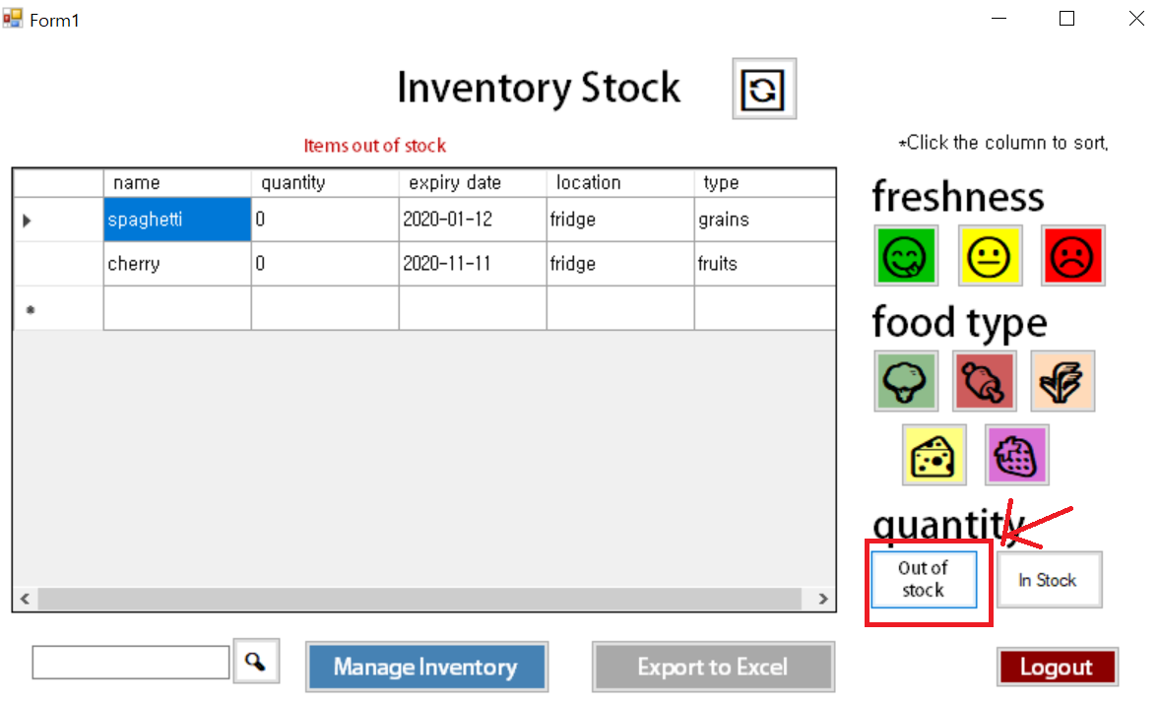
Inventory Form -group by stock quantity

Slide 14
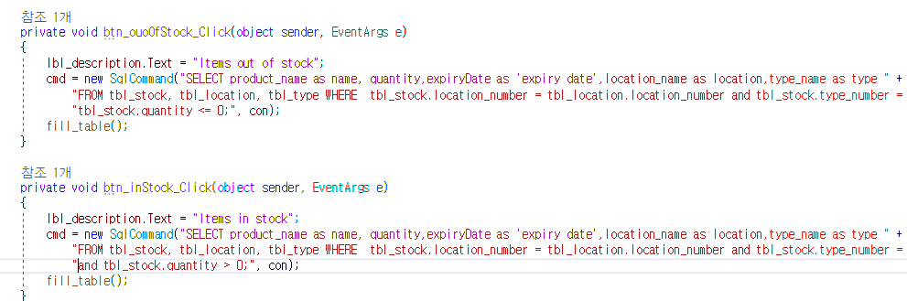
Inventory View Form -group by stock quantity
User can check if some item is out of stock (quantity = 0),
or in stock (quantity > 0)

Slide 15
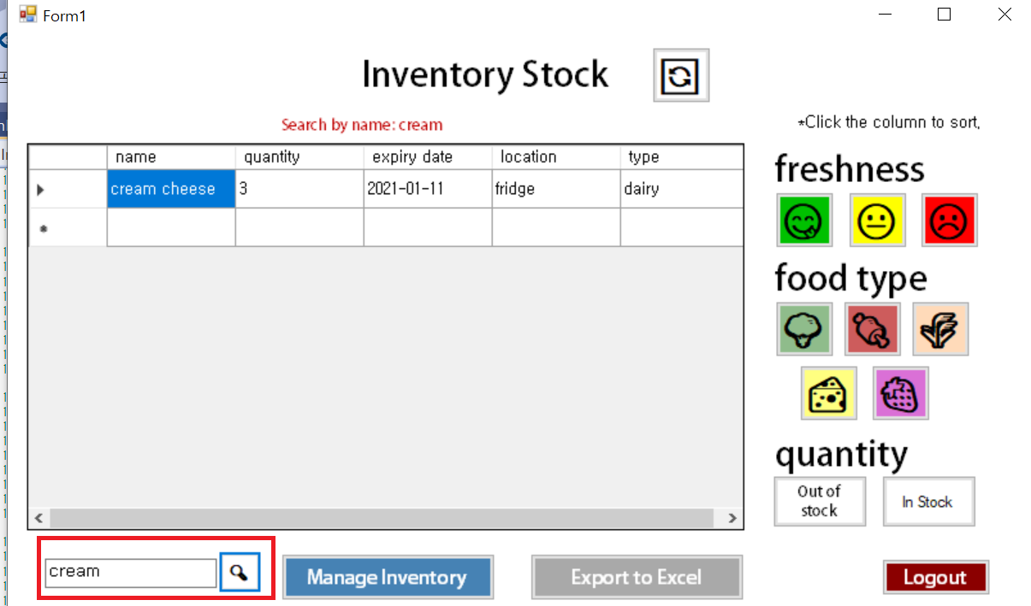
Inventory Form -search

Slide 16
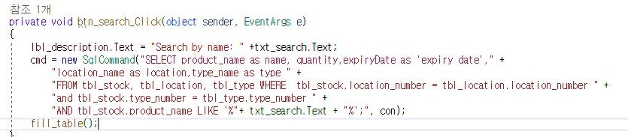
Inventory View Form -search
Users can search items by name
Show rows with product name including search term, (using LIKE operator, wildcard characters)

Slide 17
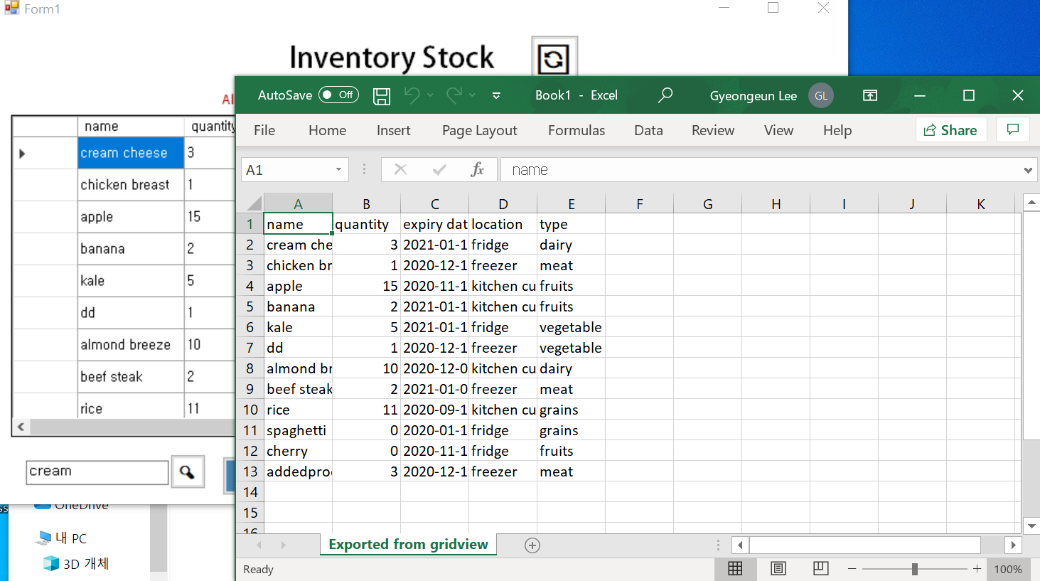
Inventory Form -export

Slide 18
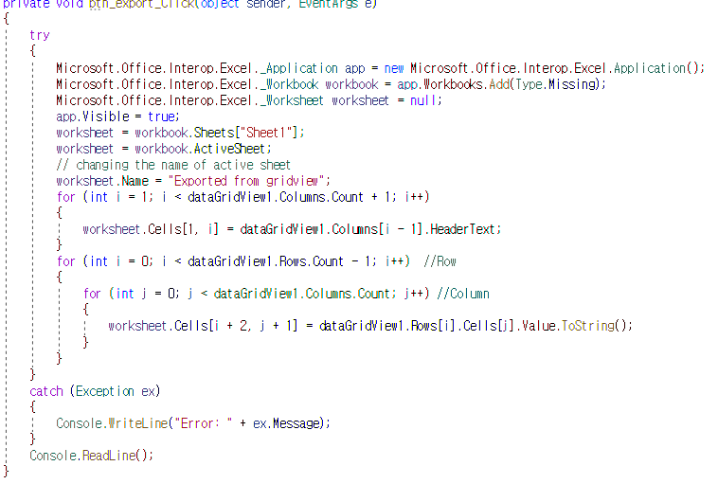
Inventory View Form -export
Microsoft.Office.Interop.Excel
Create a new Excel sheet and store rows and columns into it

Slide 19
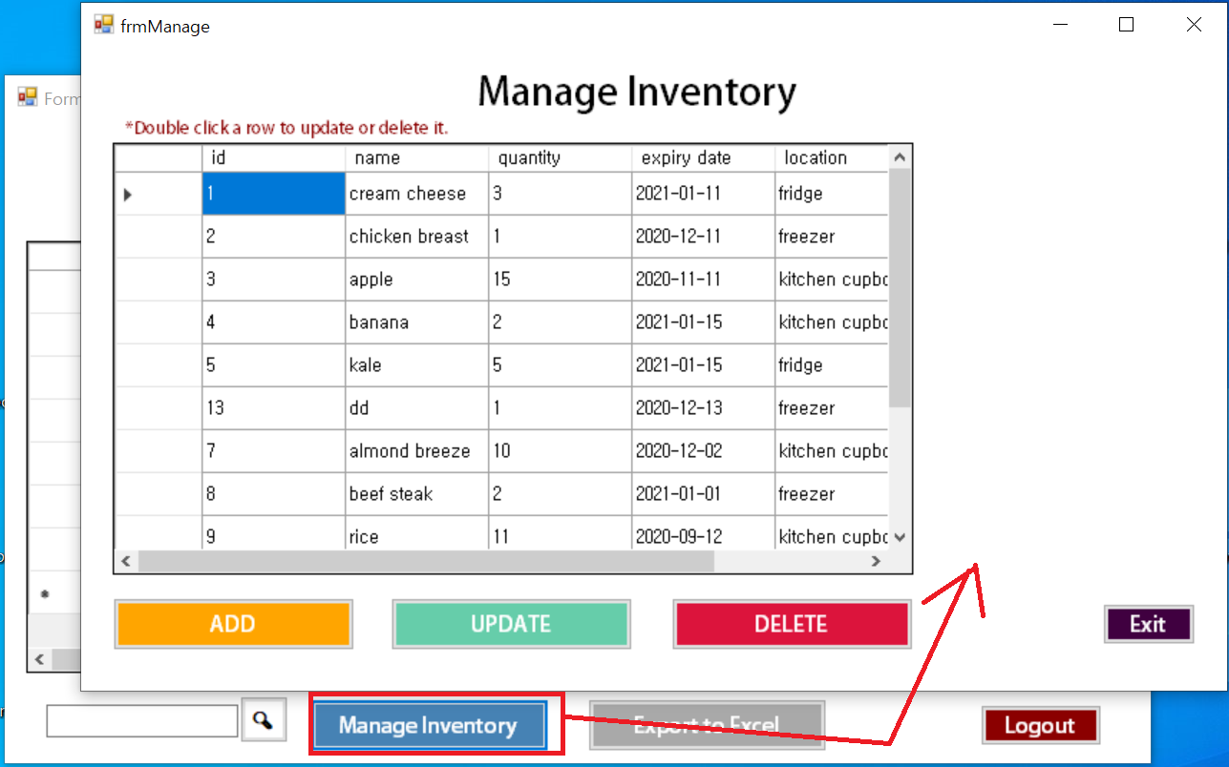
Inventory Form -show new form

Slide 20
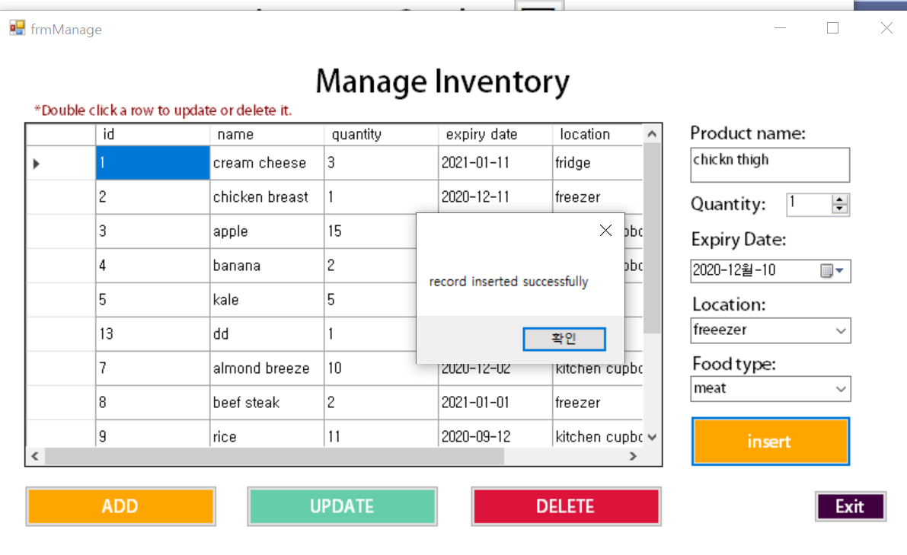
Manage Inventory Form -ADD

Slide 21
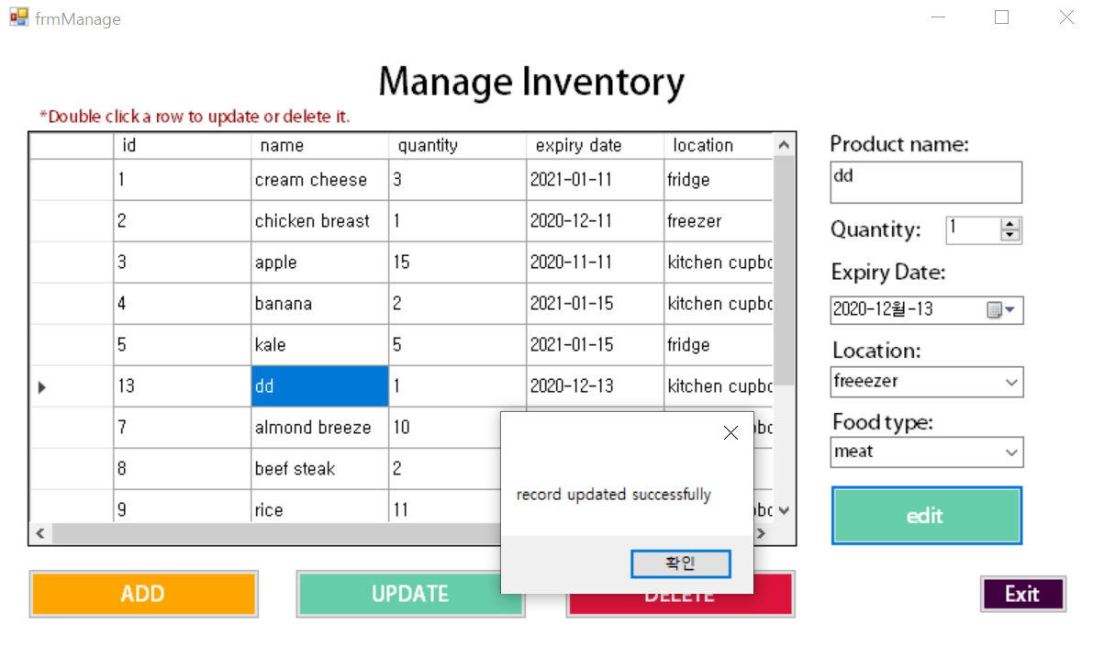
Manage Inventory Form -UPDATE

Slide 22
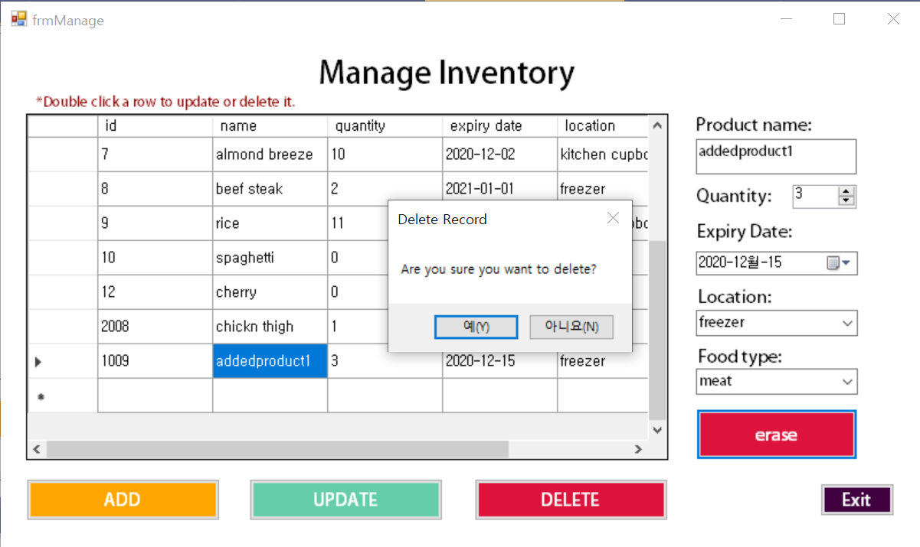
Manage Inventory Form -DELETE

Slide 23
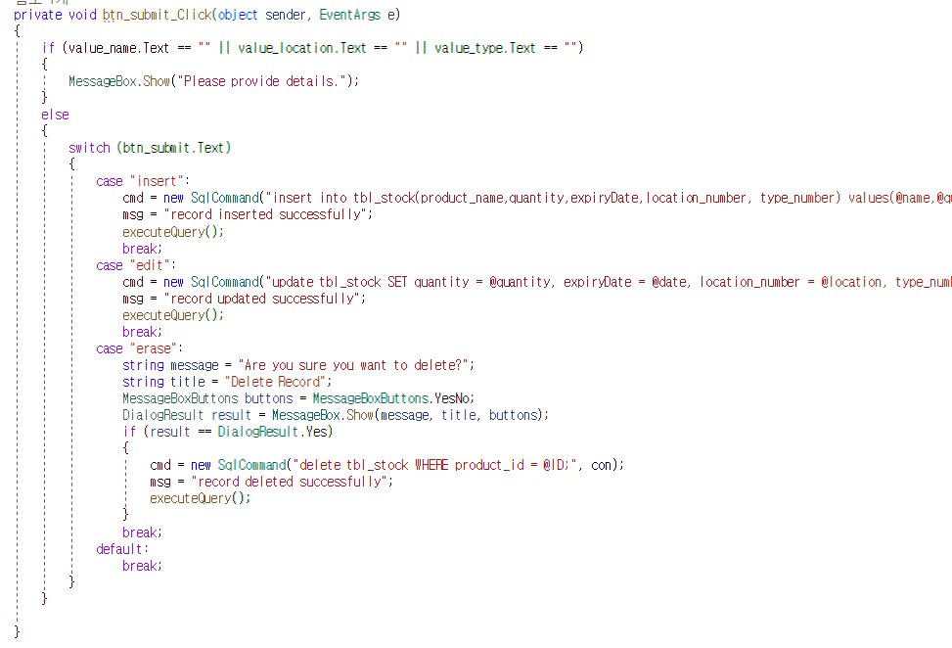
Manage Inventory Form -CRUD
insert, update, delete data using “product_id”
Show Message box with buttons to check if users are sure they want to delete the row.
Show message box after executing query

Slide 24
Final Project Group 14
Thank you!

