Slide 1
Final presentation
Internship results of Maximilian Hanauske or
how to use the code
04.08.2023

Slide 2
The code in a nutshell
0. Background: What was the stage of affairs regarding Pb analysis when I arrived ?
1. Overview: How is the code structured
2. Understand your data
3. Distill your data
4. Fit the data
5. Summarize the fit results
6. Goals for the last week:
7. Outlook:
- What do you expect from the last week ?
- How do you want the code to be handed over ?

Slide 3
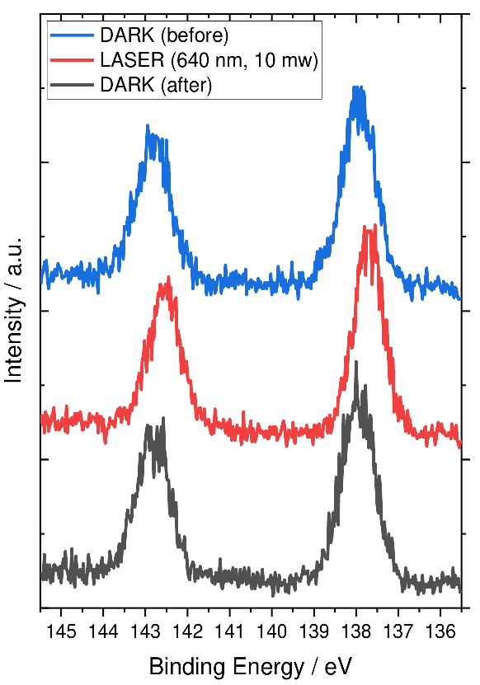
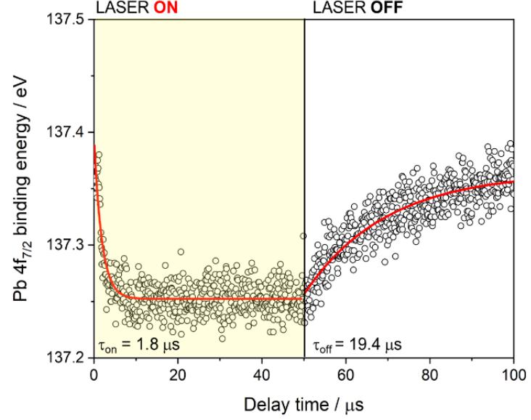
Pb main features were quantifiable – but not minor features
Pb 4f
Pb 4f
Pb²⁺
Pb⁰
Static XPS measurements of Pb 4f core level with Pb²⁺ environment shifts and traces of Pb⁰.
Pb 4f TR-PES data treatment showing the binding energy of the Pb 4f state as a function of time, as the laser light at 640 nm is turned on and off.

Slide 4
Interlude: Object oriented makes readable, maintainable and reusable code
I would like to have a cake

Slide 5
Interlude: Object oriented makes readable, maintainable and reusable code
I would like to have a cake
Sequential
Recipe:
1. Ingredients
2. Step by step Instructions
You: Get the ingredients
follow step by step instructions,
Cake

Slide 6
Interlude: Object oriented makes readable, maintainable and reusable code
I would like to have a cake
Sequential
Object oriented
Recipe:
1. Ingredients
2. Step by step Instructions
Recipe:
1. Ingredients
2. Modular Instructions
Cake-pan
Do: contain dough
Oven
Do: Bake
You: Get the ingredients
follow step by step instructions,
You: Get the ingredients,
follow modular instructions
Cake

Slide 7
Interlude: Object oriented makes readable, maintainable and reusable code
I would like to have a cake
Sequential
Object oriented
Roomate
Do: Steal dough
Recipe:
1. Ingredients
2. Step by step Instructions
Recipe:
1. Ingredients
2. Modular Instructions
Cake-pan
Do: contain dough
Oven
Do: Bake
You: Get the ingredients
follow step by step instructions,
You: Get the ingredients,
follow modular instructions
Cake

Slide 8
Interlude: Object oriented makes readable, maintainable and reusable code
I would like to have a cake
Sequential
Object oriented
Roomate
Do: Steal dough
Recipe:
1. Ingredients
2. Step by step Instructions
Recipe:
1. Ingredients
2. Modular Instructions
Cake-pan
Do: contain dough
Oven
Do: Bake
You: Get the ingredients
follow step by step instructions,
You: Get the ingredients,
follow modular instructions
Cake

Slide 9
Overview: One class containing all functions – experiment oriented usage
TR-PES analysis script
Start
Import lmfit script and standard packages
lmfit fitting functions

Slide 10
Overview: One class containing all functions – experiment oriented usage
TR-PES analysis script
Start
Import lmfit script and standard packages
lmfit fitting functions
Import packages, import Julian Hochhaus’ functions

Slide 11
Overview: One class containing all functions – experiment oriented usage
TR-PES analysis script
Start
Import lmfit script and standard packages
lmfit fitting functions
Import packages, import Julian Hochhaus’ functions
define class TRPESAnalysis , attributes,
and functions for data treatment
= data refinement methods
Long list of function definitions
= fitting methods

Slide 12
Overview: One class containing all functions – experiment oriented usage
TR-PES analysis script
Start
Import lmfit script and standard packages
lmfit fitting functions
Import packages, import Julian Hochhaus’ functions
define class TRPESAnalysis , attributes,
and functions for data treatment
= data refinement methods
Long list of function definitions
= fitting methods
For each experiment: new code cell using TRPESAnalysis methods
Stop

Slide 13
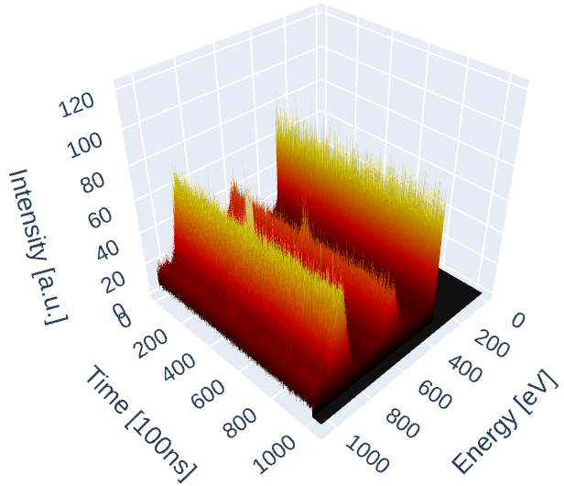
1. Understand your data
TRPESAnalysis.import_data()
- loads data and keeps them within the class object loaded as self.data and self.datac (datac for data cleaned)
→ prints data changes and plots the resulting changes
TRPESAnalysis.plot_3d()
- Takes self.data and plots the 3D data

Slide 14
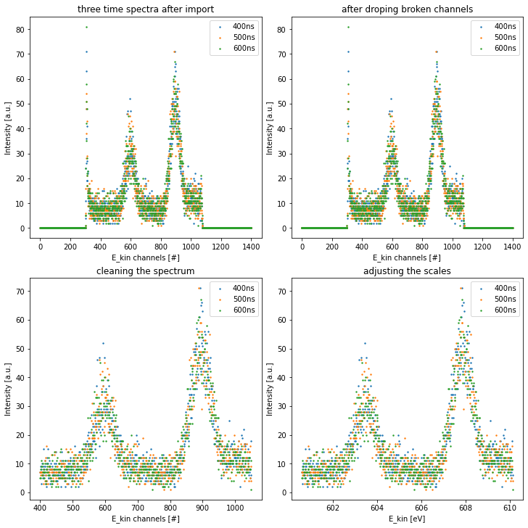
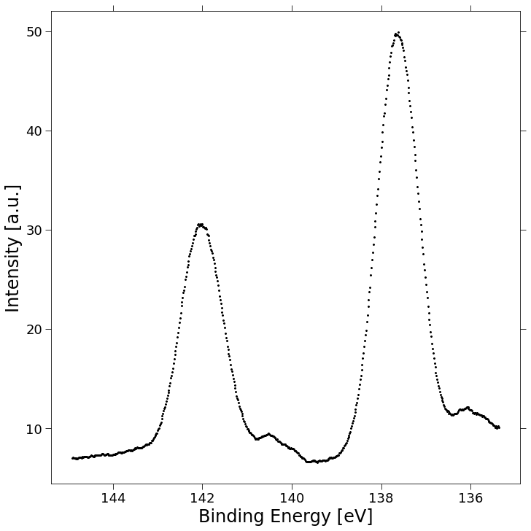
2. Distill your data
TRPESAnalysis.import_data()
- loads data and
1. Plots raw spectrum
2. Drops buffer energy channels in time
3. Cuts data range to region of interest
4. Adjustes axis scales according to focus energy
TRPESAnalysis.save_data()
-saves individual slices of data cube into directory
TRPESAnalyis.combine_data_files()
- loads csv files and adds intensity values together
TRPESAnalysis.smooth_data()
- takes self.datac and performs rollling average over time and energy. Resulting dataframe called self.datas
(for data smoothed)
1
2
Pb 4f
Pb²⁺
Pb²⁺
3
4
Pb⁰
Pb⁰

Slide 15
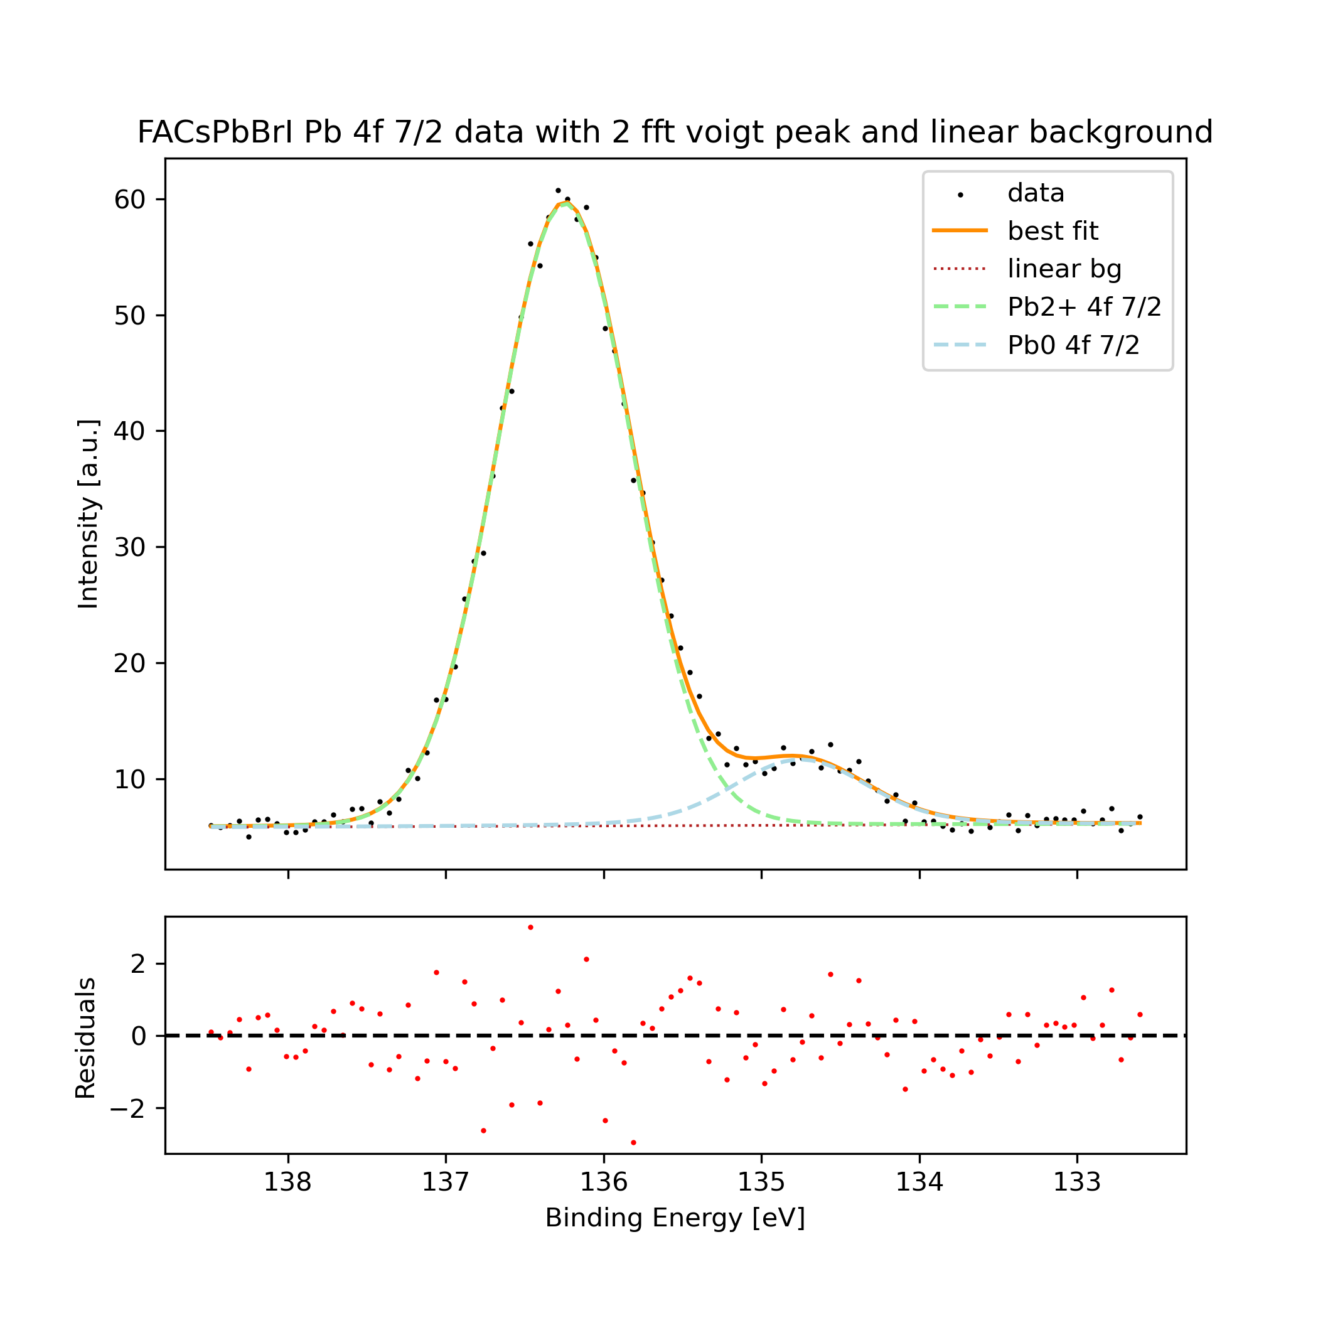
3. Fit your data
fft_voigt
- fast fourier transform accelerated voigt function definition
FFTVoigtModel()
Lmfit model defition based on fft_voigt definion – carefull: Amplitude in lmfit refers to area under function, not function amplitude
Multiple fit functions, some of them being deprecated, which is said in the docstrings
e.g.
fit_two_fftvoigt_functions()
- takes spectrum data and initial fit parameter for two voigt model functions and a linear background and optimizes the fit with least-square method
→ all changes regarding intial fitting parameter or method of fitting in here !
Returns: fit plots (e.g. see left), fit reports and fit save files , such that lmfit could load the exact fit in the future
TODO after 1. fitting:
1. Check for zero fits and refit if necessary
2. Extract FWHM ratio constant
→ Redo all fits with FWHM ratio constant
=> Yields set of analysable data

Slide 16
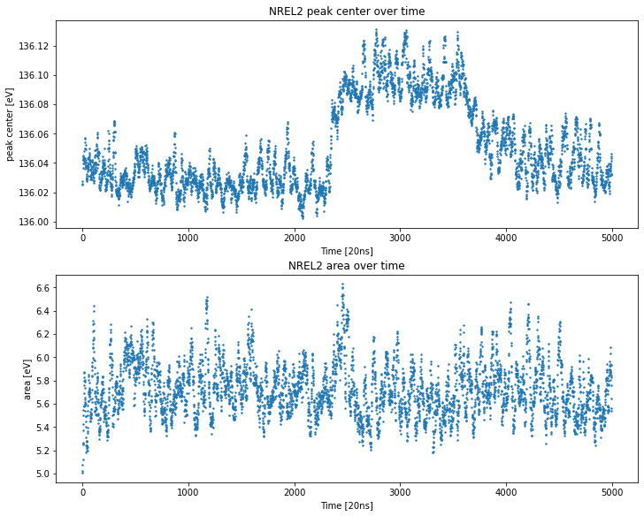
4. Summarize the fit results
TRPESAnalysis.read_fit_parameter()
- reads in all the fit reports and extracts the fit parameter
→ saves a fit_summary.csv file which contains the extracted results for up to 4 voigt functions and background choice
TRPESAnalysis.split_Pb4f_fit_data()
- splits the fit_summary.csv into fixed arrays representing the Pb4f signatures
→ all changes regarding which fit parameter should be recorded in here and the dependent functions
Multiple TRPESAnalysis.plot_X functions, all meant for visualizing the fit results. Some are functional, most arent, this is said in the docstrings
e.g. :
TRPESAnalysis.plot_figure_grid()
- plots four plots showing a single attribute of the two Pb2+ and two Pb0 peaks (e.g. peak center shifts of all four peaks)
TRPESAnalysis.plot_correlation_matrix_seaborn()
- plots the correlation matrix of two peaks and two attributes in seaborn layout style
...

Slide 17
Outlook
- What do you expect from the last week ?
- How do you want the code to be handed over ?

