Slide 1
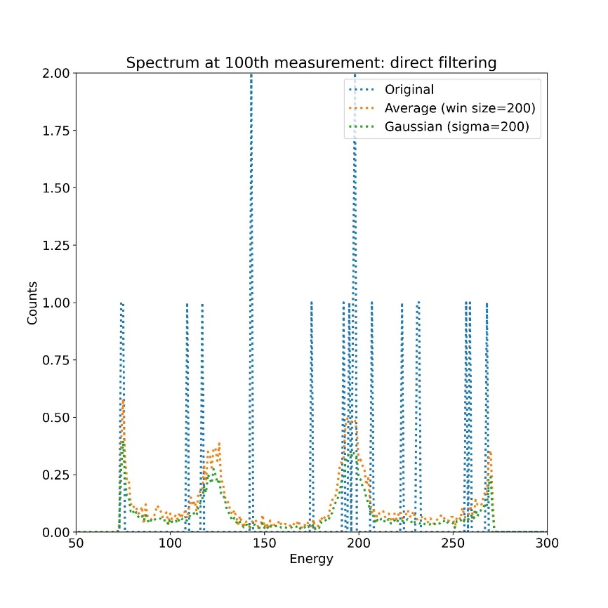
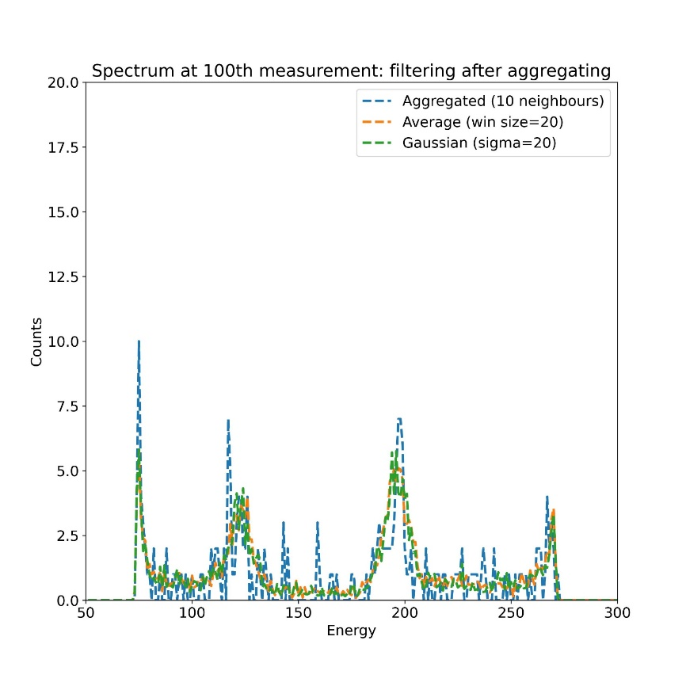
Original data (5100 spectra)
Aggregation: sum of neighboring spectra (here 10)
Averaging over neighboring spectra (here 10 x 20 = 200)
510 spectra
Averaging over aggregated spectra (here 20)
5100 spectra
Results illustrated with sample: NREL1_TRPES_Pb4f_40mW_0003_ATR_00000_00000_

Slide 2
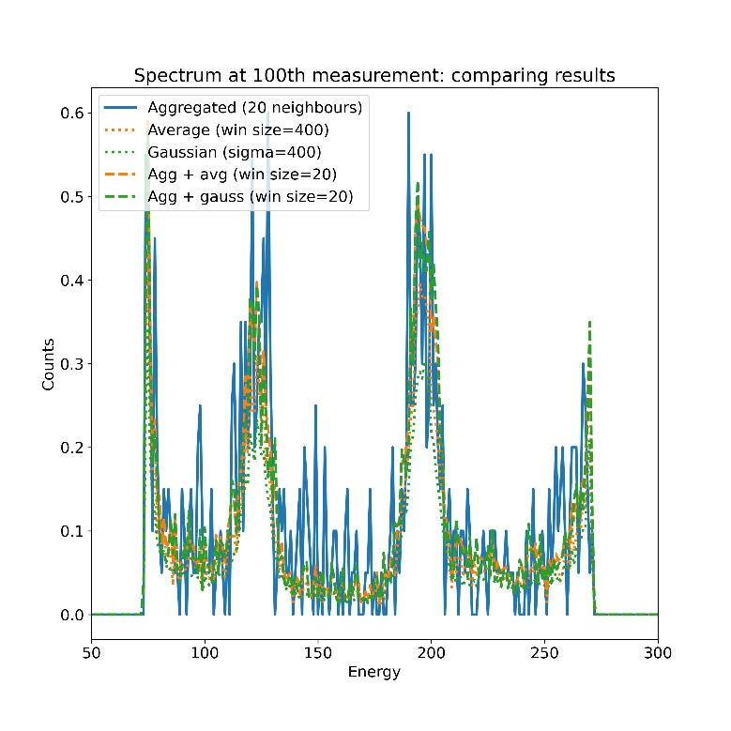
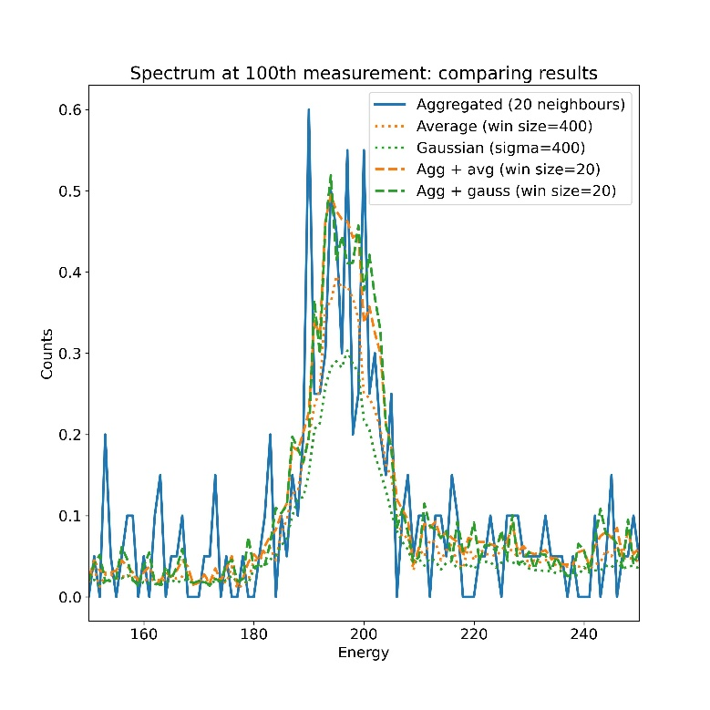
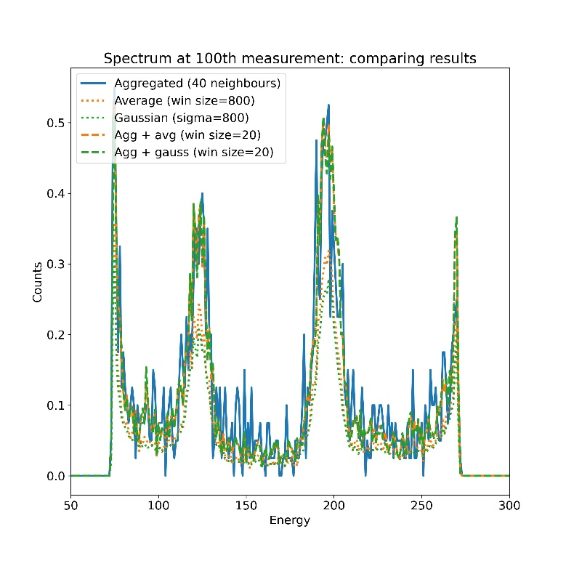
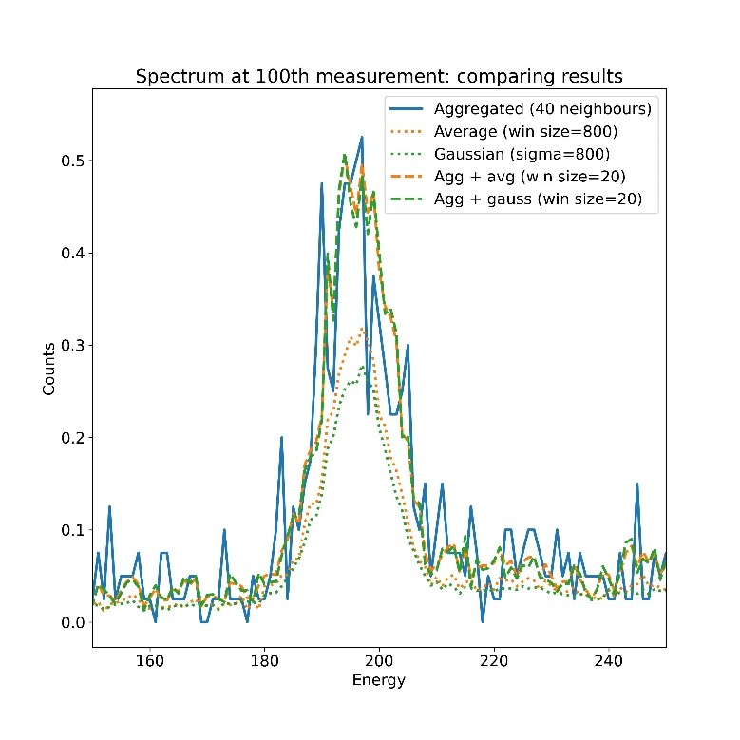
Two configurations selected:
Aggregation over 20 neighbors
Averaging over 20 aggregated spectra
Output: 255 spectra
Using aggregation step allows to smooth strongly without distortion of the data, visible with pure averaging.
No clear difference between simple average or Gaussian weighted average: simple average is sufficient
Aggregation over 40 neighbors
Averaging over 20 aggregated spectra
Output: 128 spectra

Slide 3
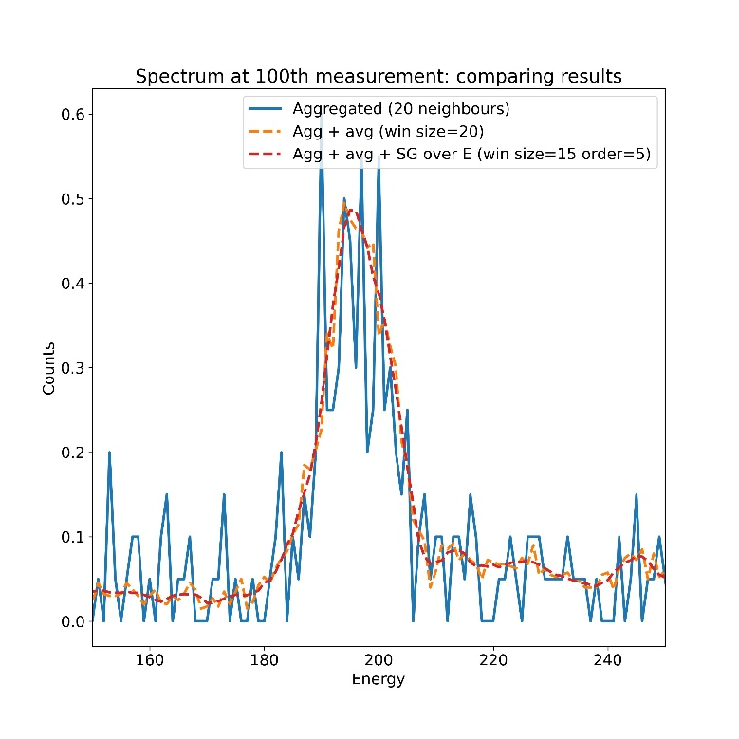
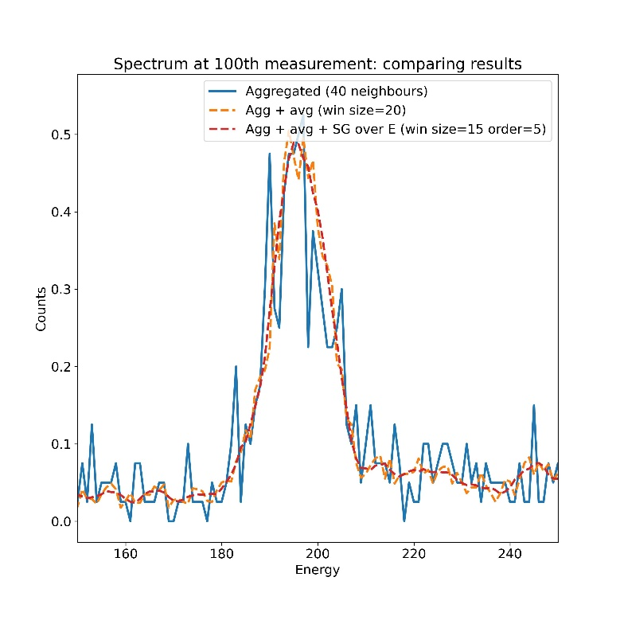
Aggregation over 20 neighbors
Averaging over 20 aggregated spectra
Output: 255 spectra
Filtering along energy: Savitzky-Golay filter with window size 15 and polynomial order 5
Good noise reduction without modification of physical meaning
Aggregation over 40 neighbors
Averaging over 20 aggregated spectra
Output: 128 spectra
Filtering along energy: Savitzky-Golay filter with window size 15 and polynomial order 5

