Slide 1

Monte Carlo Simulations for Option Pricing
gas & power

Slide 2
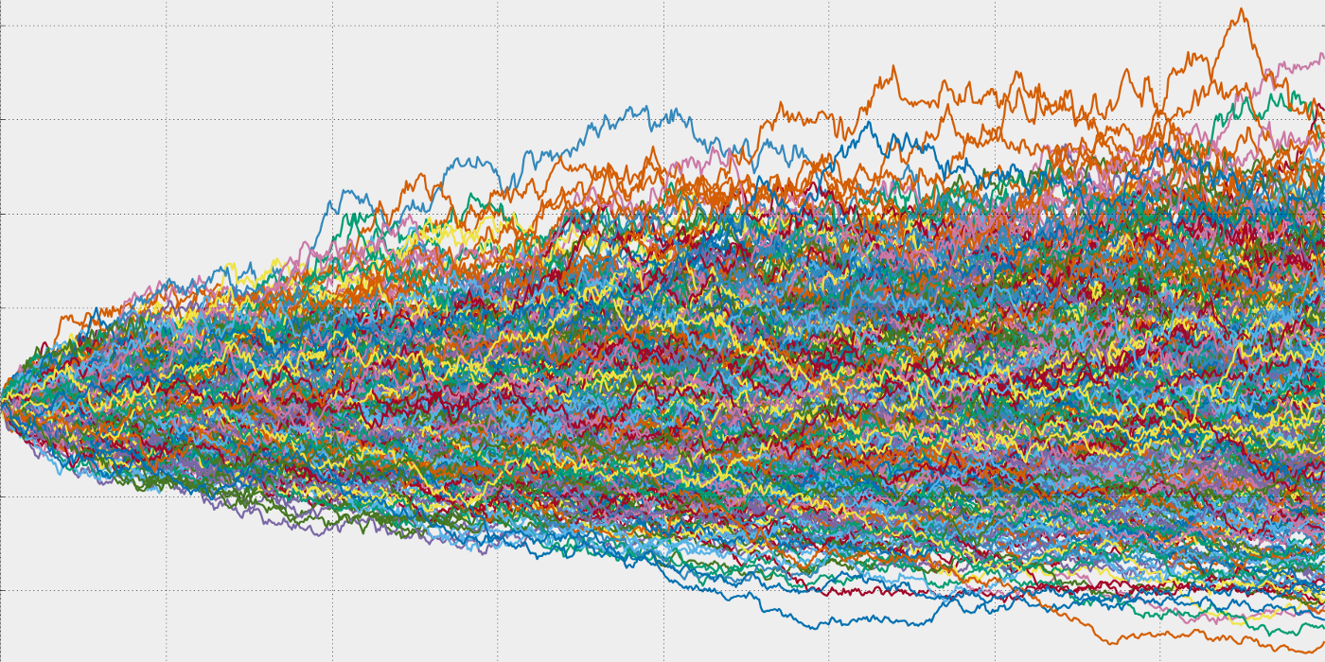
Definition
Monte Carlo simulations are used to model the probability of different outcomes in a process that cannot easily be predicted due to the intervention of random variables.
Diffuse your underlying N times to have N terminal underlying prices
Each path will be different since this is a stochastic process
The higher the volatility the more different the paths
Compute option value for each path
Average and then discount
Equiprobable tree pricing
For Europeans path is irrelevant
For Americans and Swing it isn’t

Slide 3
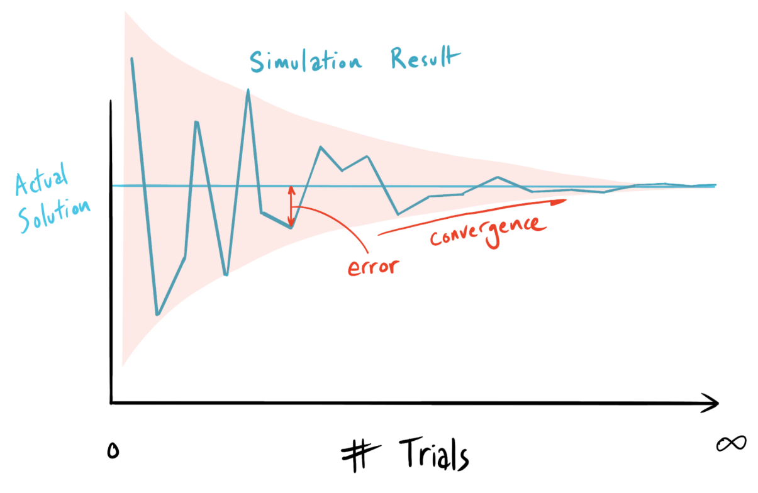
Disadvantages
There are a large number of paths that an unerlying can take and so a large number of option prices will be generated
How much are enough ? When do averages converge ?
Derivation is not possible and so numerical approximations of greeks is needed.
Numerical approximation is hard and not reliable

Slide 4
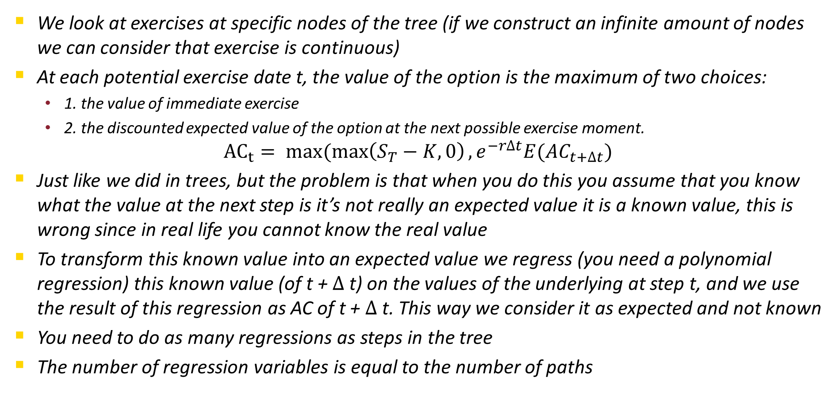
Long Staff Schwartz MonteCarlo for early/multiple exercise options
We look at exercises at specific nodes of the tree (if we construct an infinite amount of nodes we can consider that exercise is continuous)
At each potential exercise date t, the value of the option is the maximum of two choices:
1. the value of immediate exercise
2. the discounted expected value of the option at the next possible exercise moment.
$${AC}_{t}= max⁡(\max\left(S_{T}−K, 0\right), e^{−r∆t}E({AC}_{t+∆t})$$
Just like we did in trees, but the problem is that when you do this you assume that you know what the value at the next step is it’s not really an expected value it is a known value, this is wrong since in real life you cannot know the real value
To transform this known value into an expected value we regress (you need a polynomial regression) this known value (of t + $∆$t) on the values of the underlying at step t, and we use the result of this regression as AC of t + $∆$t. This way we consider it as expected and not known
You need to do as many regressions as steps in the tree
The number of regression variables is equal to the number of paths

