Slide 1

Basic Market Finance Knowledge
gas & power

Slide 2
Definitions
Asset: a stock, a bond, a commodity, a financial derivative, cash… (anything with value)
Spot Contract: Contract for immediate delivery of an asset
Spot Price: the price of the spot contract of the asset at this given second so price of the asset
Future Price: the price of an asset at a point in the future. In the European Energy markets, we have prices for delivery for each month in the future until 4 years ahead. If we plot these prices as a function of time we obtain a curve, the forward curve also called term structure. Future prices change each second and so so does the forward curve
A financial derivative: Contract (financial instrument) that has its value as a function of the price (immediate or future) of an asset
Future contract: A standerdized contract for future delivery and payment of an asset. You agree to pay the future price at a point in the future and have the asset delivered to you at that point in the future. This contract is free. Future prices fluctuate and so if you agree now on having 1 MWh of gas delivered to you in Jan-22 at 20 €/MWh because the future price is 20 €/MWh in 10 mins this future price can be 19 €/MWh and so you have a loss of 1 €/MWh. The future price at which you agree on in the future contract becomes your strike price

Slide 3
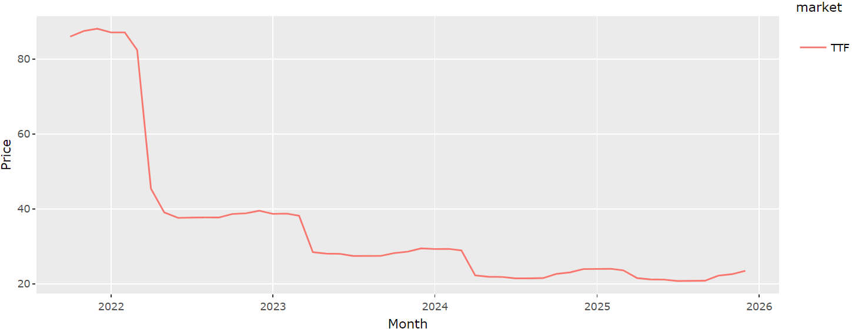
Gas TTF Monthly Price Forward Curve (13/10/2021 10:32:41 – prices in €/MWh)

Slide 4
Tading Gas on the Energy markets
Gas is always traded in units of energy which are supposed to represent a volume. If a trader trades 1 MWh of gas he is trading the volume of gas that is needed to generate 1 MWh of energy.
Gas is traded in Euro/MWh or in pence/Therm (1 pence = 0.01 GBP)
Gas can be bought sold, for the next day, next weekend, next week , next week only business days (short term market) or for next month, quarter, season, year, year after next year (Long Term Market)
Weather, Supply and Demand these are the fundementals that set the prices for the short term market
Other commodity prices (coal, electricity, CO2, Oil) as well as policies
Products function as follows:
Buying 1 MW @ 20 € for the next day means you are buying 1 MWh for each hour of next day so technically you are buying 24 MWh of volumes of gas. So you pay 20*24 € for this product
Buying 1 MW for the next year means you are buying 1 MWh for each hour of next year so technically you are buying 24 * 365 MWh of volumes of gas. So you pay 20*24 * 365 € for this product

Slide 5
Options
An option is a financial contract (financial instrument/derivative) that gives the holder the right, but not the obligation, to buy (if it is a call option) or sell (if it is an option) a certain underlying asset at a strike price (usually denoted K or X). This contract like any other expires the date at which it expires is called the maturity date. This contract has a price as opposed to a future contract
Underlyings assets can be literally anything. For now we will stick to:
Spot contracts
Future contracts
A European option is an option that can be only exercised (right demanded) when the option reaches the maturity date. An American option in an option that can be exercised anytime between start date and maturity date. A Bermudan option is an option that can be exercised before maturity date, but not anytime, rather on specific dates. Before exercising an american/Bermudan you should evaluate if is better to exercise or to sell the option
If I own (am long) an american call option on 10 MW of the Jan-22 gas future contract with a strike of 20 €/MWh with a maturity date of 01/12/2021, anytime the price of this future contract is above 20 €/MWh (let’s say it is trading at 22) I can ask to buy the future contract at 20 €/MWh. My gain is 10 * (22 – 20) * 31 * 24 = 14 880 €

Slide 6
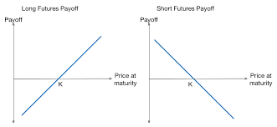
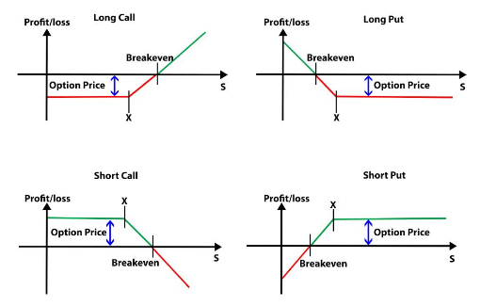
Payoffs - The intrinsic value of a contract
A payoff is the amount of profit or loss that one would make if the underlying price of a financial contract changes. The payoff plot is the graphic representation of this . Note that you can represent the payoff as a function of other parameters, but usually you choose the underlying asset’s price.
Long Call Payoff = max(S – K; 0) - Price Short Call Payoff = - max(S – K; 0) + Price
Long Put Payoff = max(K – S; 0) - Price Short Put Payoff = - max(K – S; 0) + Price
Long Future Payoff = S – K Short Future Payoff = K - S

Slide 7
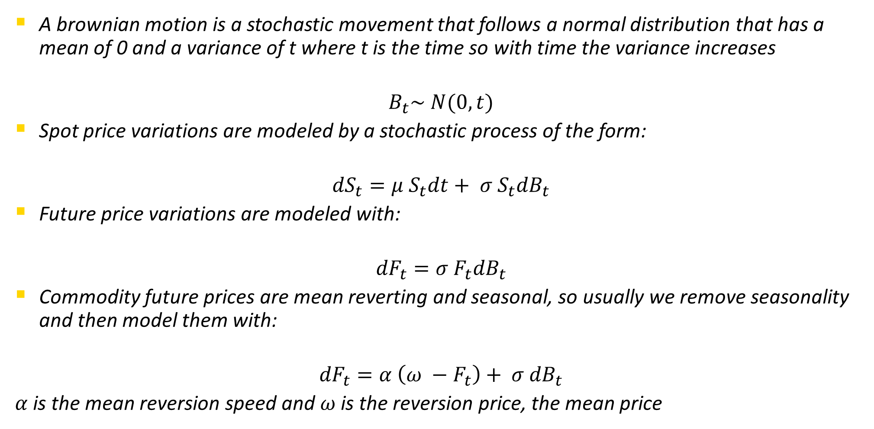
Spot/Future Price Diffusion
A brownian motion is a stochastic movement that follows a normal distribution that has a mean of 0 and a variance of t where t is the time so with time the variance increases
$$B_{t}\sim N(0, t)$$
Spot price variations are modeled by a stochastic process of the form:
$${dS}_{t}=μ S_{t}dt+ σ S_{t}{dB}_{t}$$
Future price variations are modeled with:
$${dF}_{t}=σ F_{t}{dB}_{t}$$
Commodity future prices are mean reverting and seasonal, so usually we remove seasonality and then model them with:
$${dF}_{t}=α \left(ω −F_{t}\right)+ σ {dB}_{t}$$
$α$is the mean reversion speed and $ω$is the reversion price, the mean price

Slide 8
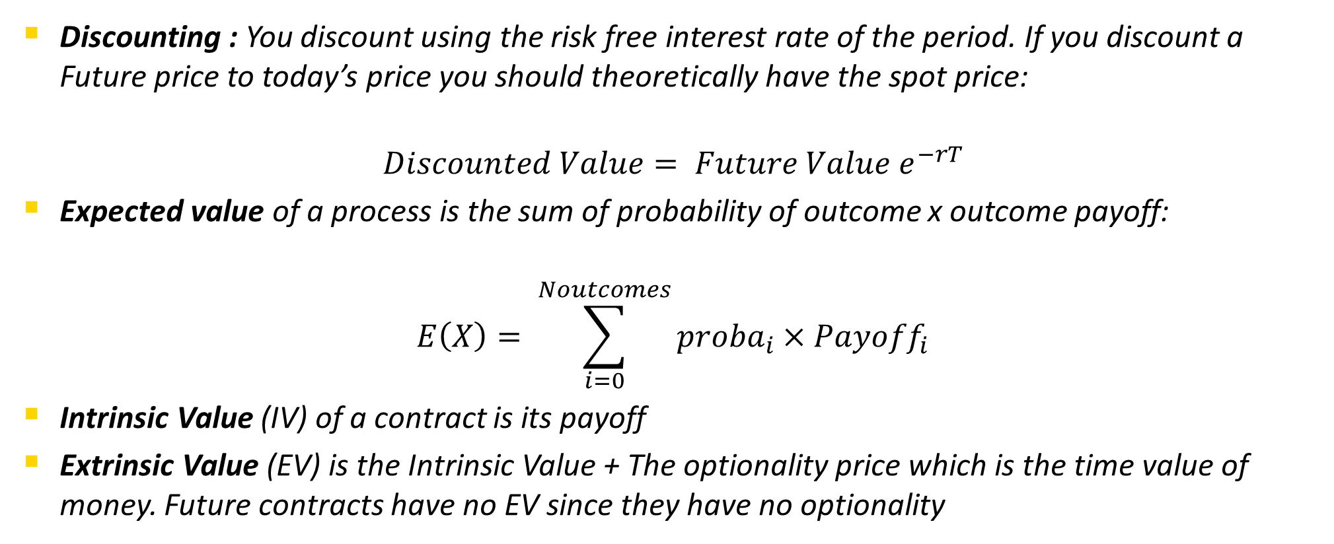
What is the price of anything ?
The price of anything is the discounted expected payoff (or cash flow) that it can produce. Money’s value changes with time. 1 € 5 years ago can buy more than what 1 € can buy today (inflation). Discounting means to take a future value, payoff or price and have it in todays value
Discounting : You discount using the risk free interest rate of the period. If you discount a Future price to today’s price you should theoretically have the spot price:
$$Discounted Value= {Future Value e}^{−rT}$$
Expected value of a process is the sum of probability of outcome x outcome payoff:
$$E\left(X\right)= \sum_{i=0}^{Noutcomes}{{proba}_{i}×{Payoff}_{i}}$$
Intrinsic Value (IV) of a contract is its payoff
Extrinsic Value (EV) is the Intrinsic Value + The optionality price which is the time value of money. Future contracts have no EV since they have no optionality

Slide 9
Binomial or Trinomial Trees for pricing
Binomial trees are for non mean reverting processes
Trinomial trees are for reverting processes (commodities)
Look at Excel

Slide 10
Swing Option – what you will work on:
A swing option is an option that can be exercised many times between its start date and maturity date. Each time it is exercised the holder of the option can choose the ammount of gas she wants to buy (call swing)/sell (put swing), this amount of gas has to be between a minimum and maximum flow (qmin and qmax).
At maturity the holder of the option must have exercised enough rights to have taken out more gas then Qmin, but less gas then Qmax
The main difficulty with this option is that it usually comes with a future contract and the flows can be modulated up and down – they become like a full storage that is modulated with respect to prices
They can be priced with a trinomial tree forest, but this pricing method has its limits

