Slide 1
MOVIE BUSINESS:A DATA-DRIVEN APPROACH
Insights for new movie studio by Group 2

Slide 2
INTRODUCTION
Recognizing the growing trend of major corporations producing original content, our company is embarking on the creation of a successful movie studio.
To overcome our limited experience in film production, this project leverages a comprehensive analysis of various film industry datasets.
Our objective is to extract data-driven insights that will illuminate the most profitable, well-received, and promising areas for investment.
By integrating these datasets, we aim to identify current industry trends and provide actionable recommendations to guide our studio's film prioritization strategy

Slide 3
BUSINESS UNDERSTANDING
The company wants to create a new movie studio to maximise profits and reduce risks.
The evolving landscape of streaming, global cinema, and digital distribution has transformed film production into a complex intersection of art and high-stakes business.
To understand the drivers of film success, a thorough analysis of box office performance, critical reviews, audience preferences, and market trends is essential.

Slide 4
Key Questions
Our company aims to launch a new movie studio but lacks expertise in film production. To maximize success, we need data-driven insights on:
Which movie genres tend to receive the highest rating?
Which genres generate the highest revenue and return on investment (ROI)?
What budget range is optimal for different film types?
When is the best time to release a movie for maximum earnings?
Does critical acclaim (e.g., IMDb/Rotten Tomatoes ratings) correlate with box office success?

Slide 5
Goals
Ensure a strategic,well informed entry into the movie sector.

Slide 6
Data Understanding
i)Data sources
Box office Mojo
IMDB
Rotten Tomato
The movies Database

Slide 7
Risk Minimization
Data guides smart investments by identifying high-performing genres rating,revenue generation and return on investment as well as optimal range for different film types.

Slide 8
Business Strategy Support
Data-driven decisions align production with audience demand and commercial viability.

Slide 9
Data Analysis
This project utilizes a powerful combination of industry datasets, each contributing unique insights to our understanding of the global film landscape:
The Numbers: Providing crucial financial details such as production budgets and revenues, enabling accurate ROI calculations.
Box Office Mojo: Offering data on gross earnings and overall box office performance.
Rotten Tomatoes: Supplying critic and audience scores, along with valuable insights into review sentiment.
TheMovieDB: Delivering rich metadata on movies, encompassing genres, languages, production countries, popularity metrics, and more.
IMDb Links: Providing unique identifiers to facilitate cross-referencing of movies across all datasets.

Slide 10
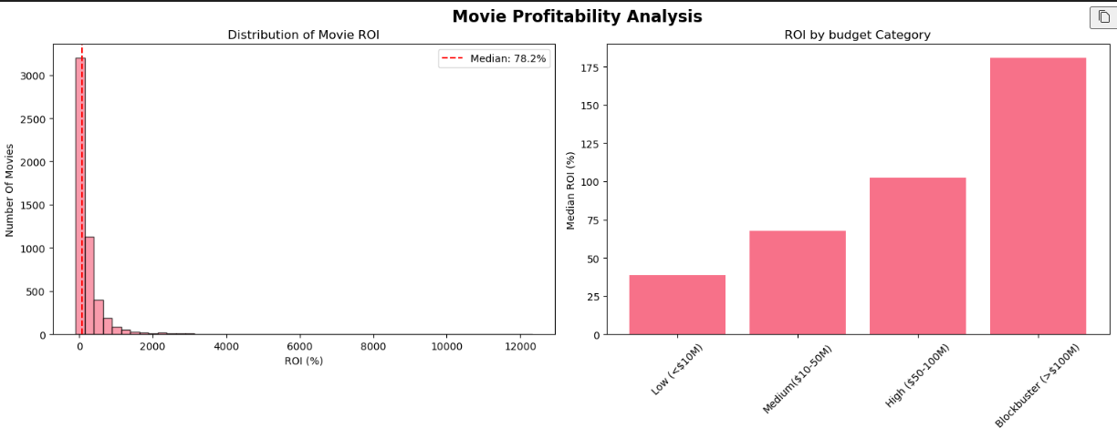
Risk vs Reward: Categories with higher standard deviation (risk) but also higher mean ROI suggest that while these movies are riskier investments, they have the potential for higher returns.

Slide 11
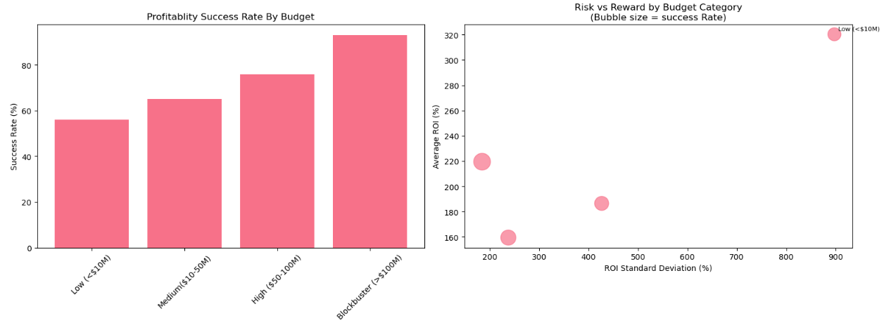
Success Rate: The size of the bubbles indicates the success rate; larger bubbles represent higher success rates, providing a visual cue to the profitability of each budget category. Budget Category Comparison: This visualization allows for a comparative analysis of how different budget categories balance risk and reward, aiding in strategic decision-making for investments in the movie industry

Slide 12
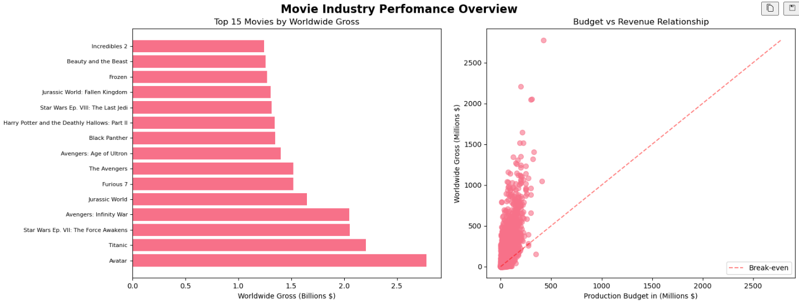
Movie industry Perfomance

Slide 13
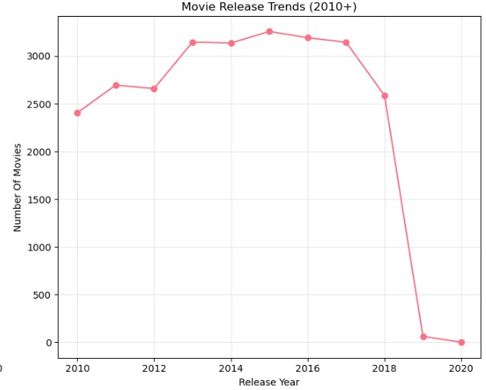
Movie Release trend 2010 to 2020

Slide 14
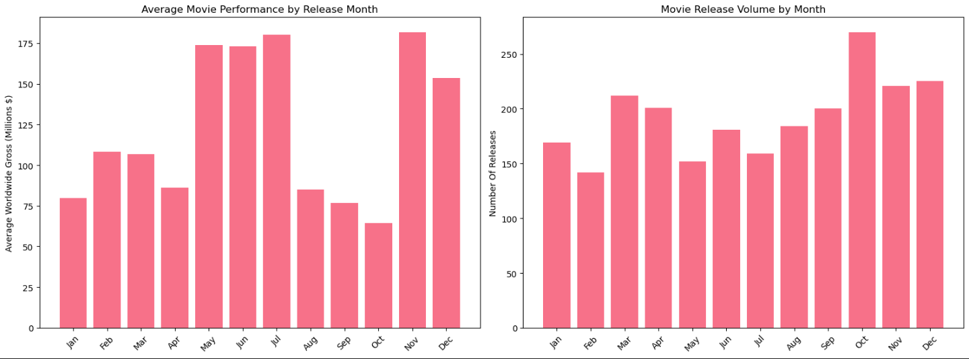
Average movie performance by month interms of release volume per month and gross revenue generated

Slide 15
Business Recommendations
1.Focus On High impact Genres-Prioritize genres with commercial and critical ratings like documentaries and cult films.
2.Balance Ratings and Returns – Use low budget, high-ROI genres like horror for early projects.
3.Commision pilot projects in high-ROI genres.
4.Reassess strategy bi-annually with updates data and Markets trends.

Slide 16
Group 2 Members
1.JEROME JUMA
2.BRIAN MBURU
3.SUSAN MAINA
4.MARY ASUNTA
5.KABIRA TIMOTHY
THANKYOU.

