Slide 1
MOVIE BUSINESS:A DATA-DRIVEN APPROACH
Insights for new movie studio by Group 2

Slide 2
INTRODUCTION
Recognizing the growing trend of major corporations producing original content, our company is embarking on the creation of a successful movie studio.
To overcome our limited experience in film production, this project leverages a comprehensive analysis of various film industry datasets.
Our objective is to extract data-driven insights that will illuminate the most profitable, well-received, and promising areas for investment.
By integrating these datasets, we aim to identify current industry trends and provide actionable recommendations to guide our studio's film prioritization strategy

Slide 3
BUSINESS UNDERSTANDING
The company wants to create a new movie studio to maximise profits and reduce risks.
The evolving landscape of streaming, global cinema, and digital distribution has transformed film production into a complex intersection of art and high-stakes business.
To understand the drivers of film success, a thorough analysis of box office performance, critical reviews, audience preferences, and market trends is essential.

Slide 4
Key Questions
Our company aims to launch a new movie studio but lacks expertise in film production. To maximize success, we need data-driven insights on:
Which movie genres tend to receive the highest rating?
Which genres generate the highest revenue and return on investment (ROI)?
What budget range is optimal for different film types?
When is the best time to release a movie for maximum earnings?
Does critical acclaim (e.g., IMDb/Rotten Tomatoes ratings) correlate with box office success?

Slide 5
Goals
Ensure a strategic,well informed entry into the movie sector.

Slide 6
Data Understanding
i)Data sources
Box office Mojo
IMDB
Rotten Tomato
The movies Database

Slide 7
Risk Minimization
Data guides smart investments by identifying high-performing genres rating,revenue generation and return on investment as well as optimal range for different film types.

Slide 8
Business Strategy Support
Data-driven decisions align production with audience demand and commercial viability.

Slide 9
Data Analysis
This project utilizes a powerful combination of industry datasets, each contributing unique insights to our understanding of the global film landscape:
The Numbers: Providing crucial financial details such as production budgets and revenues, enabling accurate ROI calculations.
Box Office Mojo: Offering data on gross earnings and overall box office performance.
Rotten Tomatoes: Supplying critic and audience scores, along with valuable insights into review sentiment.
TheMovieDB: Delivering rich metadata on movies, encompassing genres, languages, production countries, popularity metrics, and more.
IMDb Links: Providing unique identifiers to facilitate cross-referencing of movies across all datasets.

Slide 10
Im.db (SQL data base) which is veyry detailed database on movies.

Slide 11
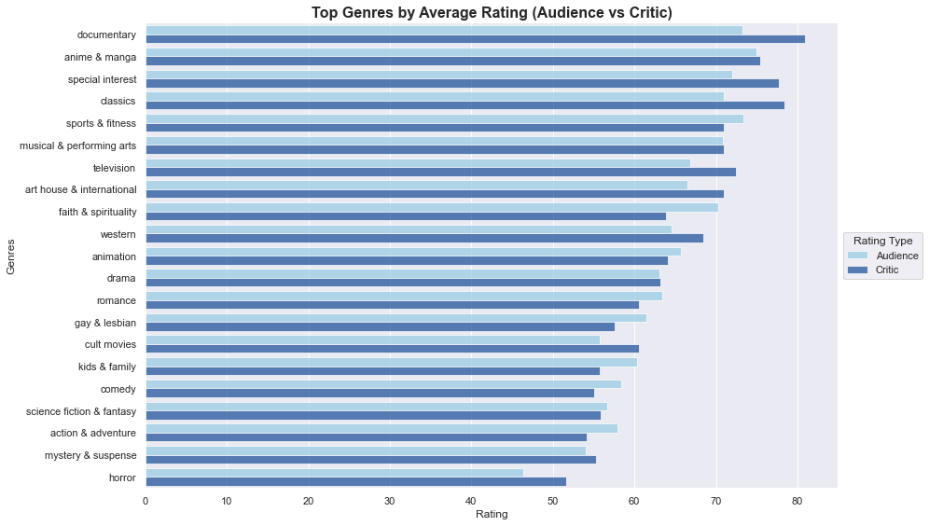
The bar chart provides a comparison of average audience and critic ratings across various genres.

Slide 12
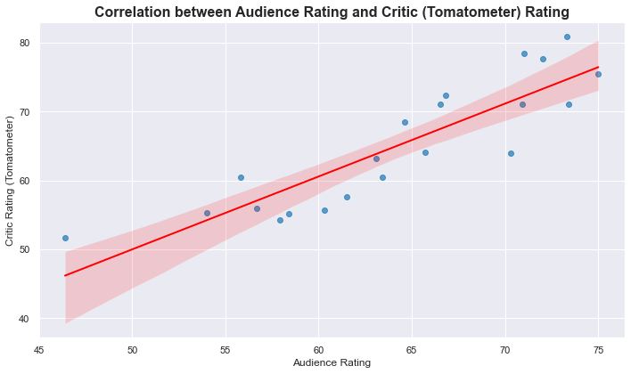
The scatter plot shows a clear positive relationship between audience and critic ratings: - Positive correlation: The regression line slopes upward, indicating that genres favored by viewers often receive strong critic reviews, supporting the idea that appealing to audiences and critics can go hand in hand. - Noticeable variance: Even with similar audience scores, critic ratings vary—highlighting the importance of considering both metrics rather than relying on audience sentiment alone.

Slide 13
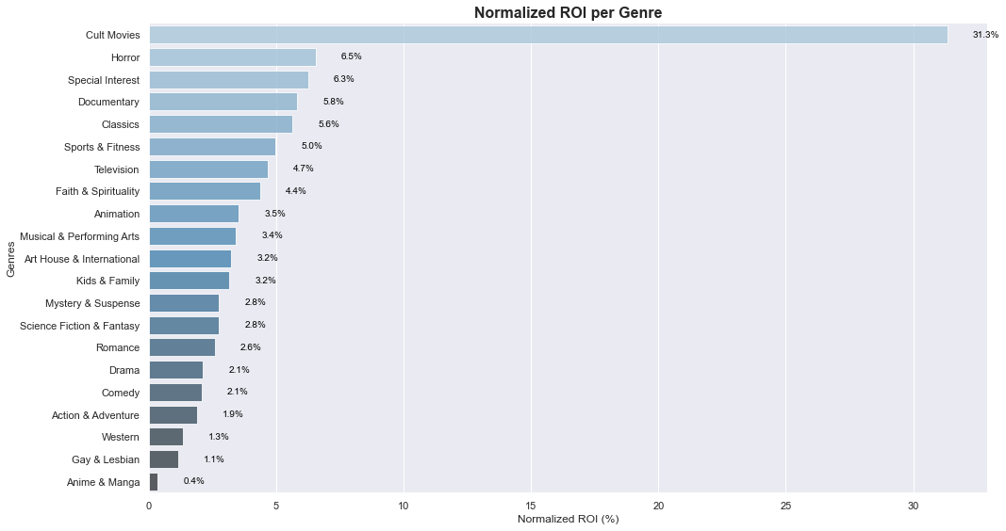
Movie industry Perfomance

Slide 14
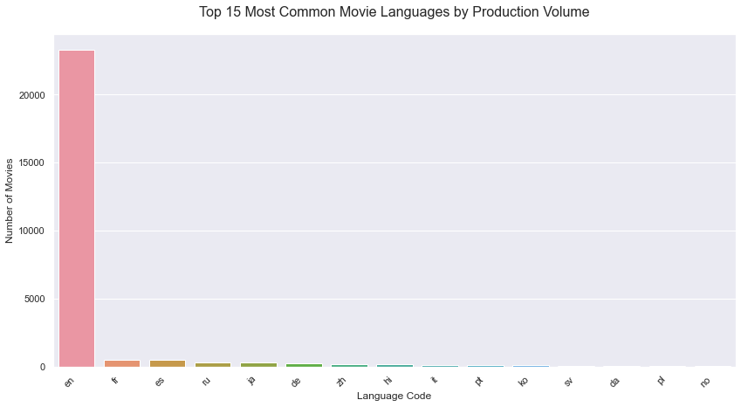
From the chart, we observe that: - English (en) dominates with over 20,000 movies, far exceeding any other language. - French (fr) and Spanish (es) follow as the second and third most common languages.

Slide 15
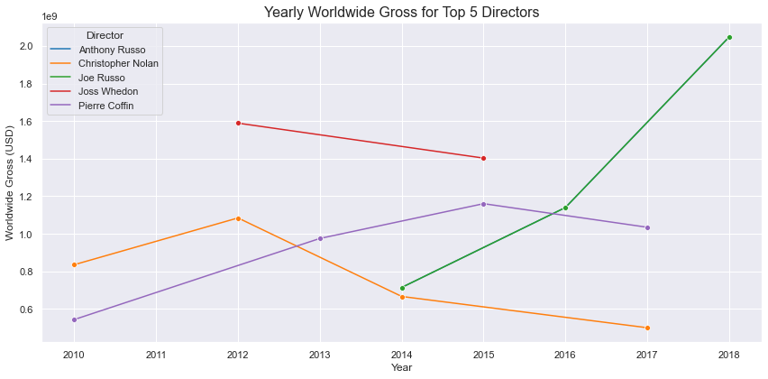
Yearly Gross Trends: Director Insights & Strategy

Slide 16
Business Recommendations
1.Focus On High impact Genres-Prioritize genres with commercial and critical ratings like documentaries and cult films.
2.Balance Ratings and Returns – Use low budget, high-ROI genres like horror for early projects.
3.Commision pilot projects in high-ROI genres.
4.Reassess strategy bi-annually with updates data and Markets trends.

Slide 17
Group 2 Members
1.JEROME JUMA
2.BRIAN MBURU
3.SUSAN MAINA
4.MARY ASUNTA
5.KABIRA TIMOTHY
THANKYOU.

