Slide 1
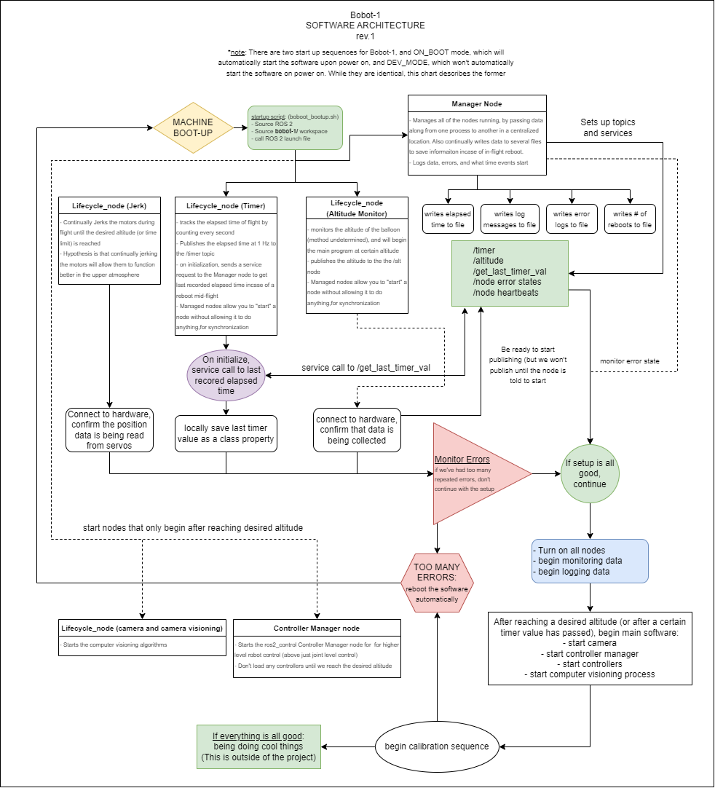
Core Software Architecture Of A Balloon Robot (BOBOT)
Romeo Perlstein, 0102
Project Abstract
To monitor and inspect high altitude balloon payloads mid-flight, the Balloon Payload Program is developing a 4-DoF balloon robot, or BOBOT, named Bobot-1. Due to the extreme conditions that high altitude balloons face during flight, a robust software stack is required. Utilizing the features in ROS 2, ros2_control and ROS 2’s managed nodes, an event-driven system is being designed and tested for initial autonomous flights of Bobot-1, with the end goal of full teleoperation.
Code/Logic/Figure
Project Status
Currently the project is in the development phase. The software structure is being written and tested on a smaller platform, called BB-Bobot-1, to verify the techniques used.
Next Steps
Current next steps are to finish writing and testing the first pass of the software. After that, a URDF and kinematic model of the arm needs to be made for simulation and testing of controllers

