Slide 1
Real-Time Position and Velocity Control of a Brushless DC Motor
Romeo Perlstein
ENPM818J Final Project

Slide 2
Team
Romeo Perlstein:
Aerospace Engineering Masters Student
Likes space robots, human spaceflight, and human/robot collaboration in space

Slide 3
Project Overview
Mission Statement:
Control the position of a hobby-grade brushless DC motor

Slide 4
Requirements
Mission Level Requirements:
Fast control loop to implement basic PD controller
Position encoder to track live position of motor
Brushless DC motor
Brushless DC motor driver

Slide 5
Requirements
Mission Level Requirements Reasonings:
PD controller needs to run at a relatively fast rate for good tracking
Need positional sensor readings in order to command position using PD controller
Need physical actuator to drive system, brushless DC motors are relatively challenging to work with compared to brushed DC motors and enable a more challenging project
Need a drive to convert command signals to phase current cycles (developing a custom one deemed out-of-scope)

Slide 6
Requirements Cont’d
System Level Requirements:
Control loop that can run on the order of ~1kHz
Ability to read encoder pulses at frequency of ~10kHz
Ability to generate pulse-width-modulated (PWM) signal at frequency of roughly ~20kHz
Ability to send digital outputs at a fast rate (~1kHz)
Control input circuit (a.k.a potentiometer) for position commands

Slide 7
Requirements Cont’d
System Level Requirements Reasoning:
Position PID control of motors needs to run at frequencies on the order of kHz or faster for stable and smooth control
High-resolution encoders generate pulses faster than typical while loops or interrupt service routines can handle
High frequency PWM signals enable smooth motor motion
Digital output for direction has to change at the same rate of the control loop
User input to demonstrate motor control

Slide 8
Final System

Slide 9
Final System (labeled)

Slide 10
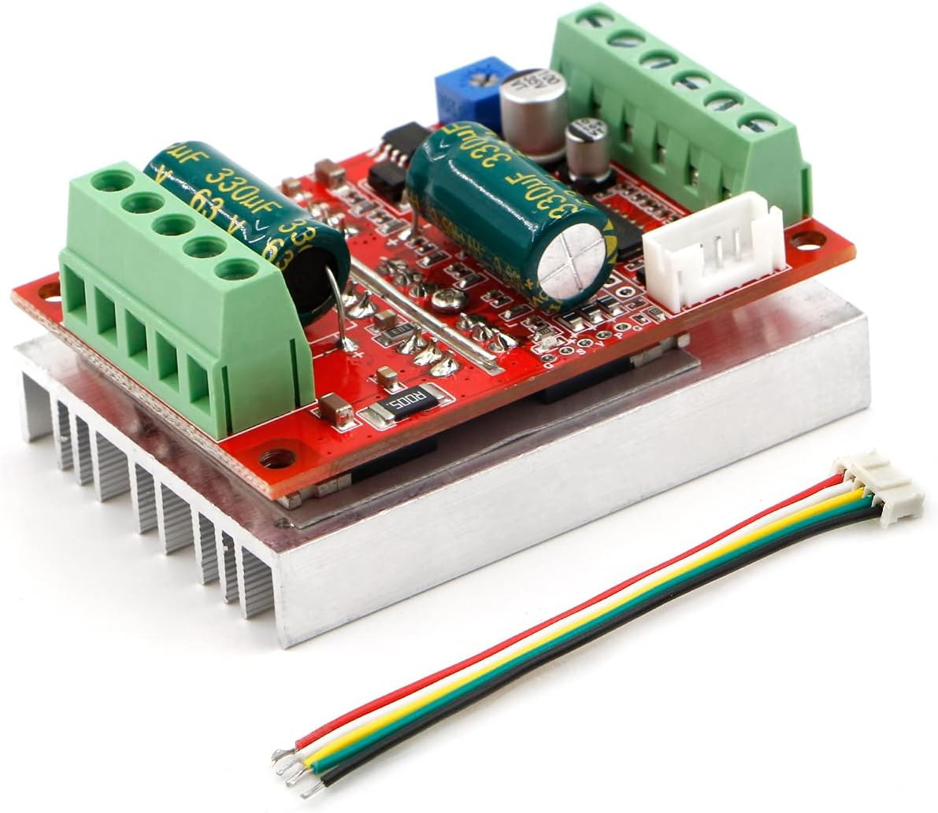
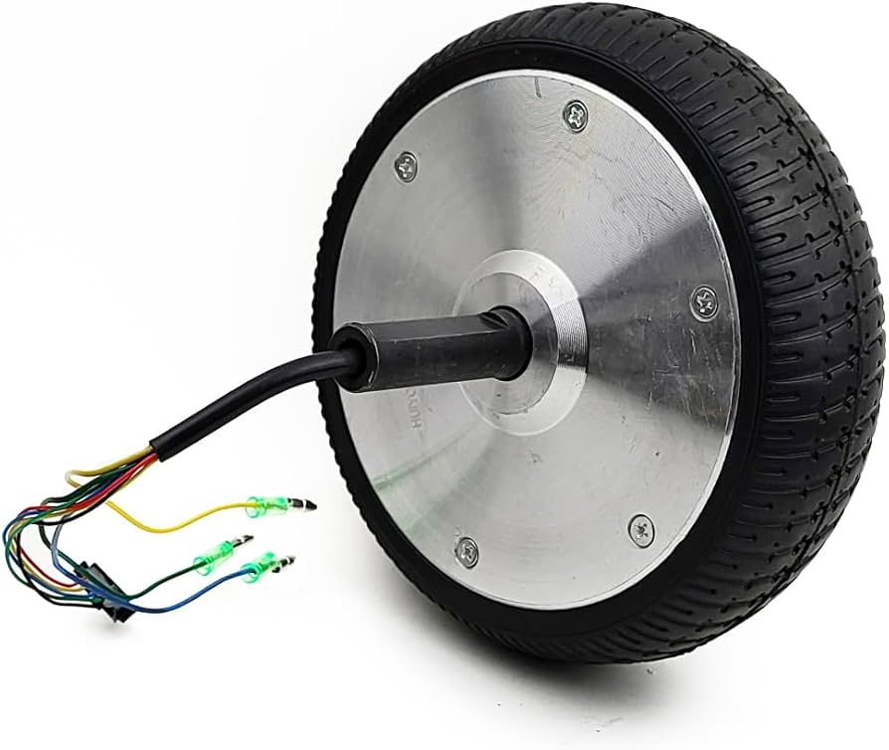
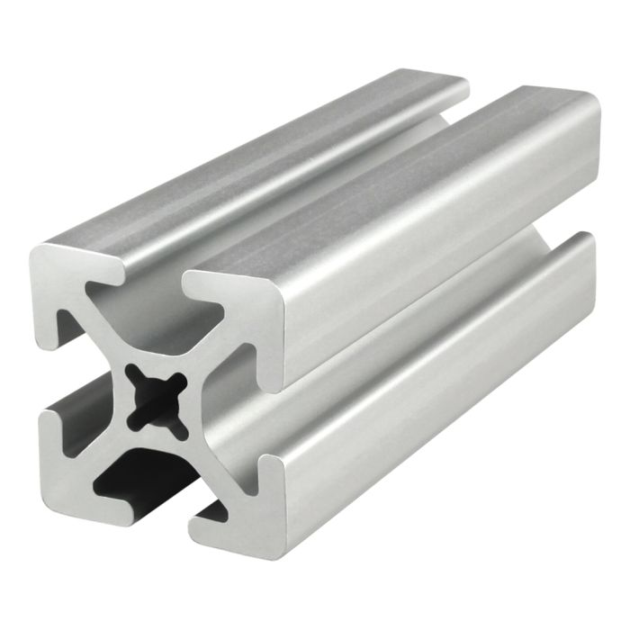
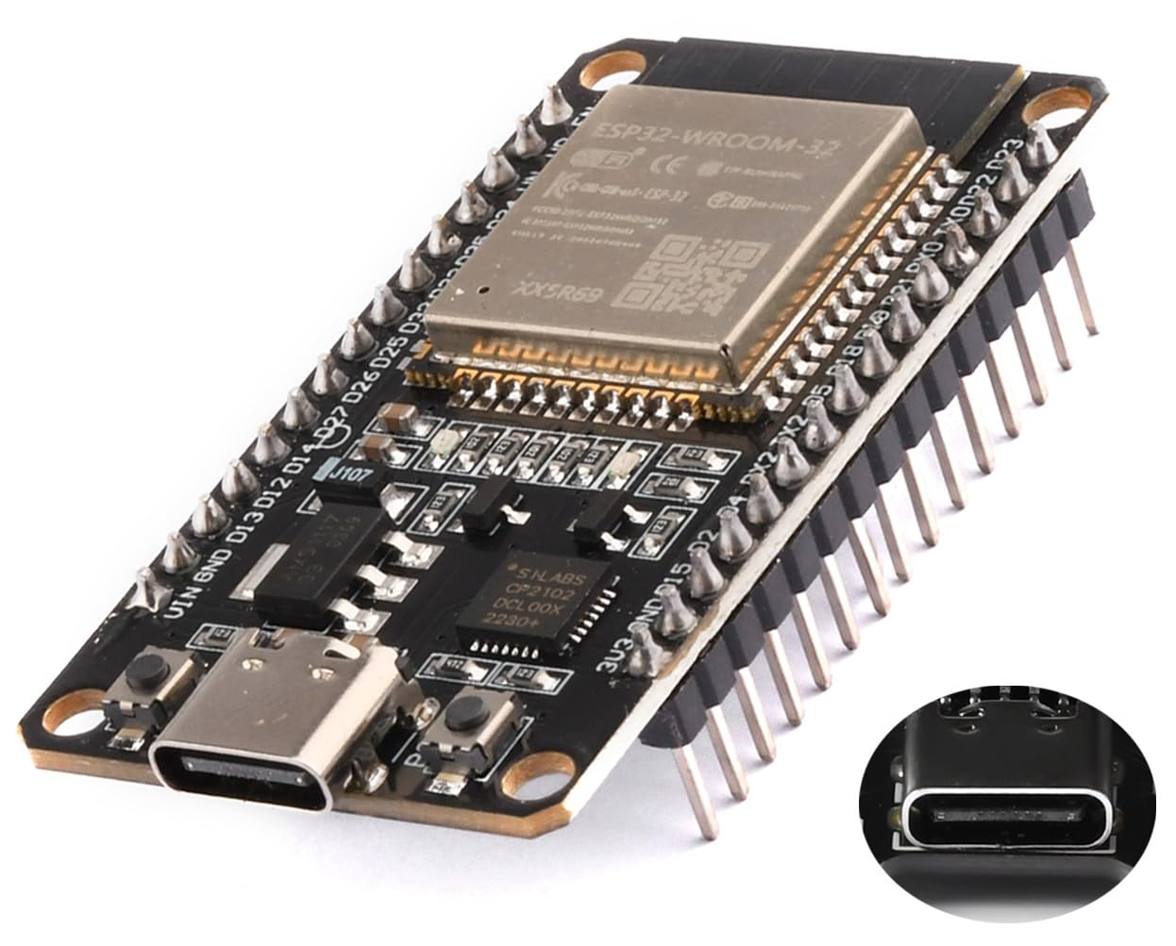
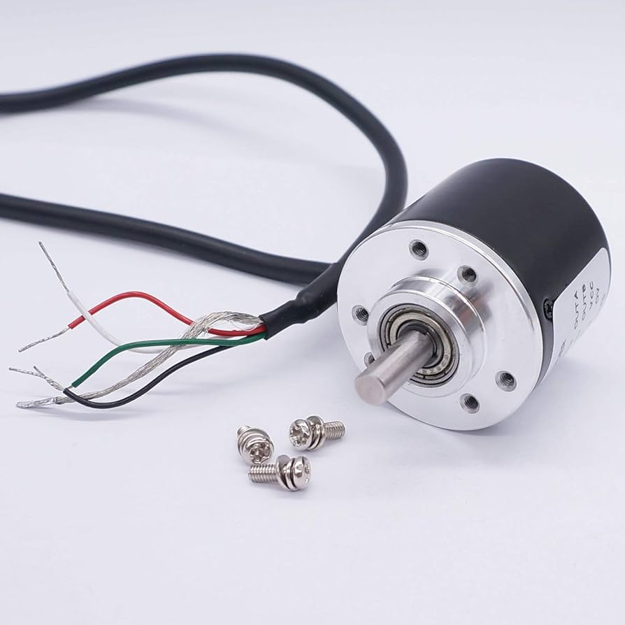
Core Components
RioRand 3-Phase Brushless DC motor driver with PWM input
Hoverboard motor
1515 80/20 extrusion
ESP32 WROOM
Quadrature Encoder

Slide 11
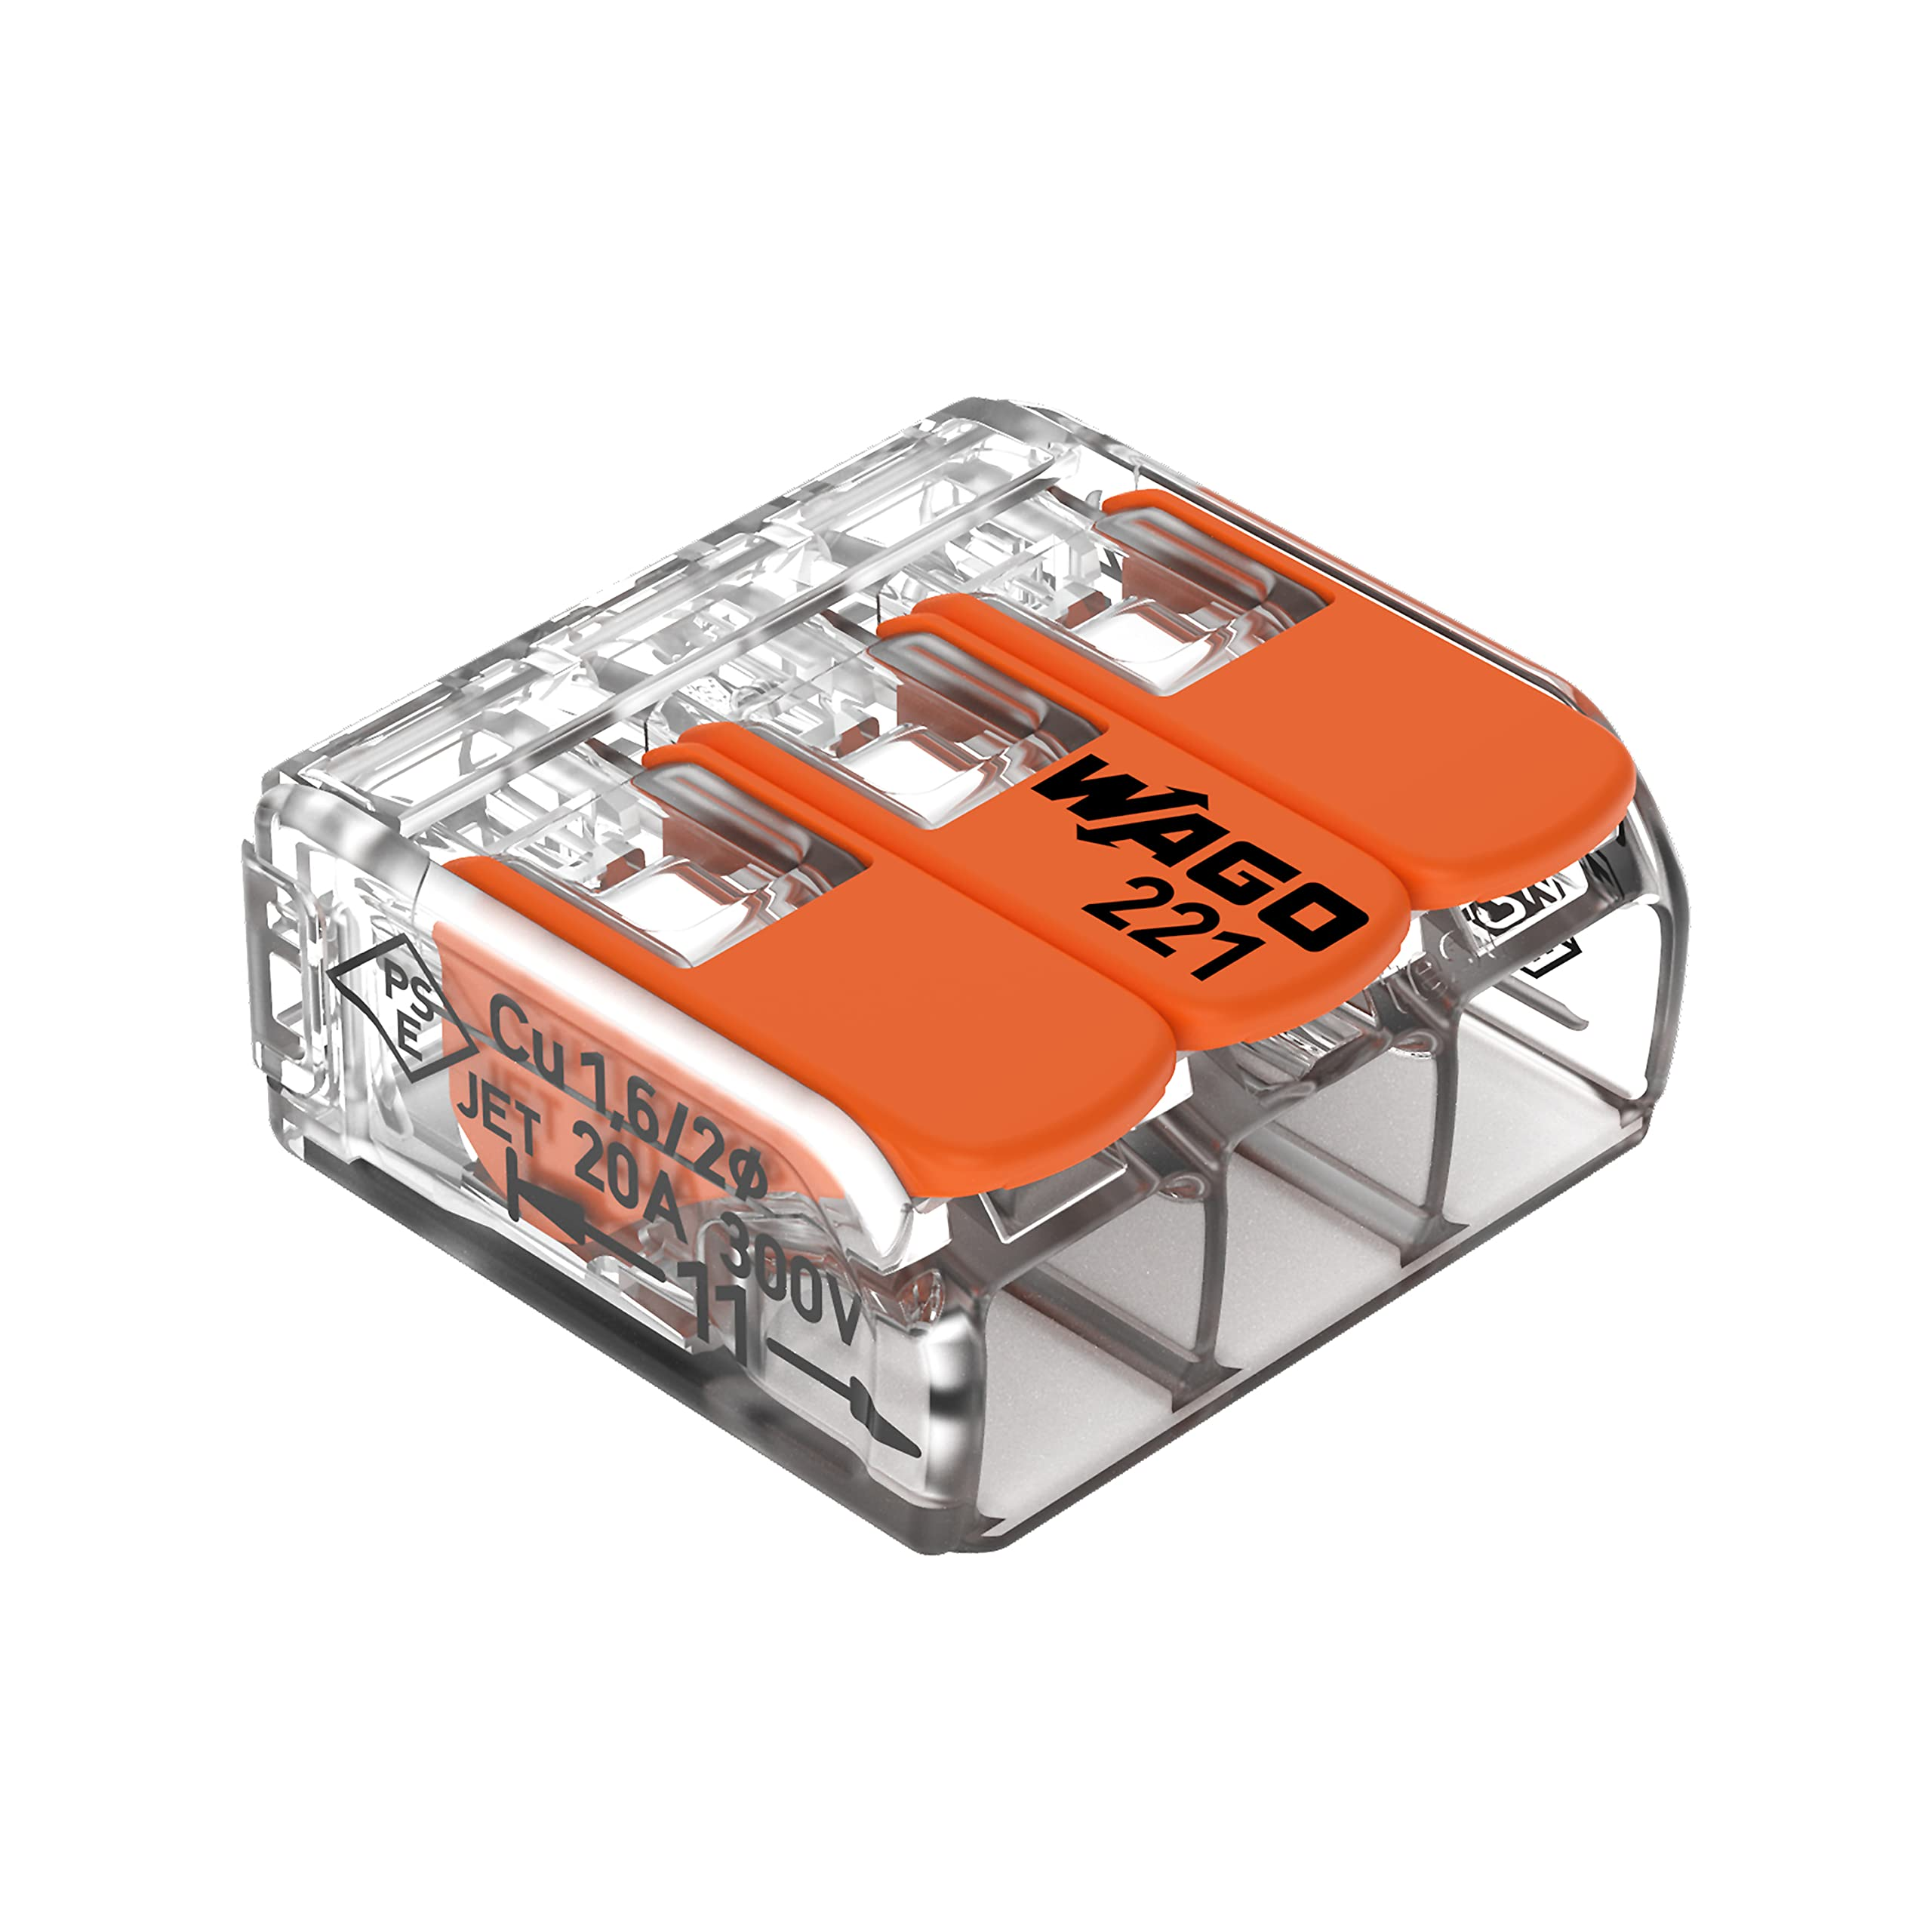
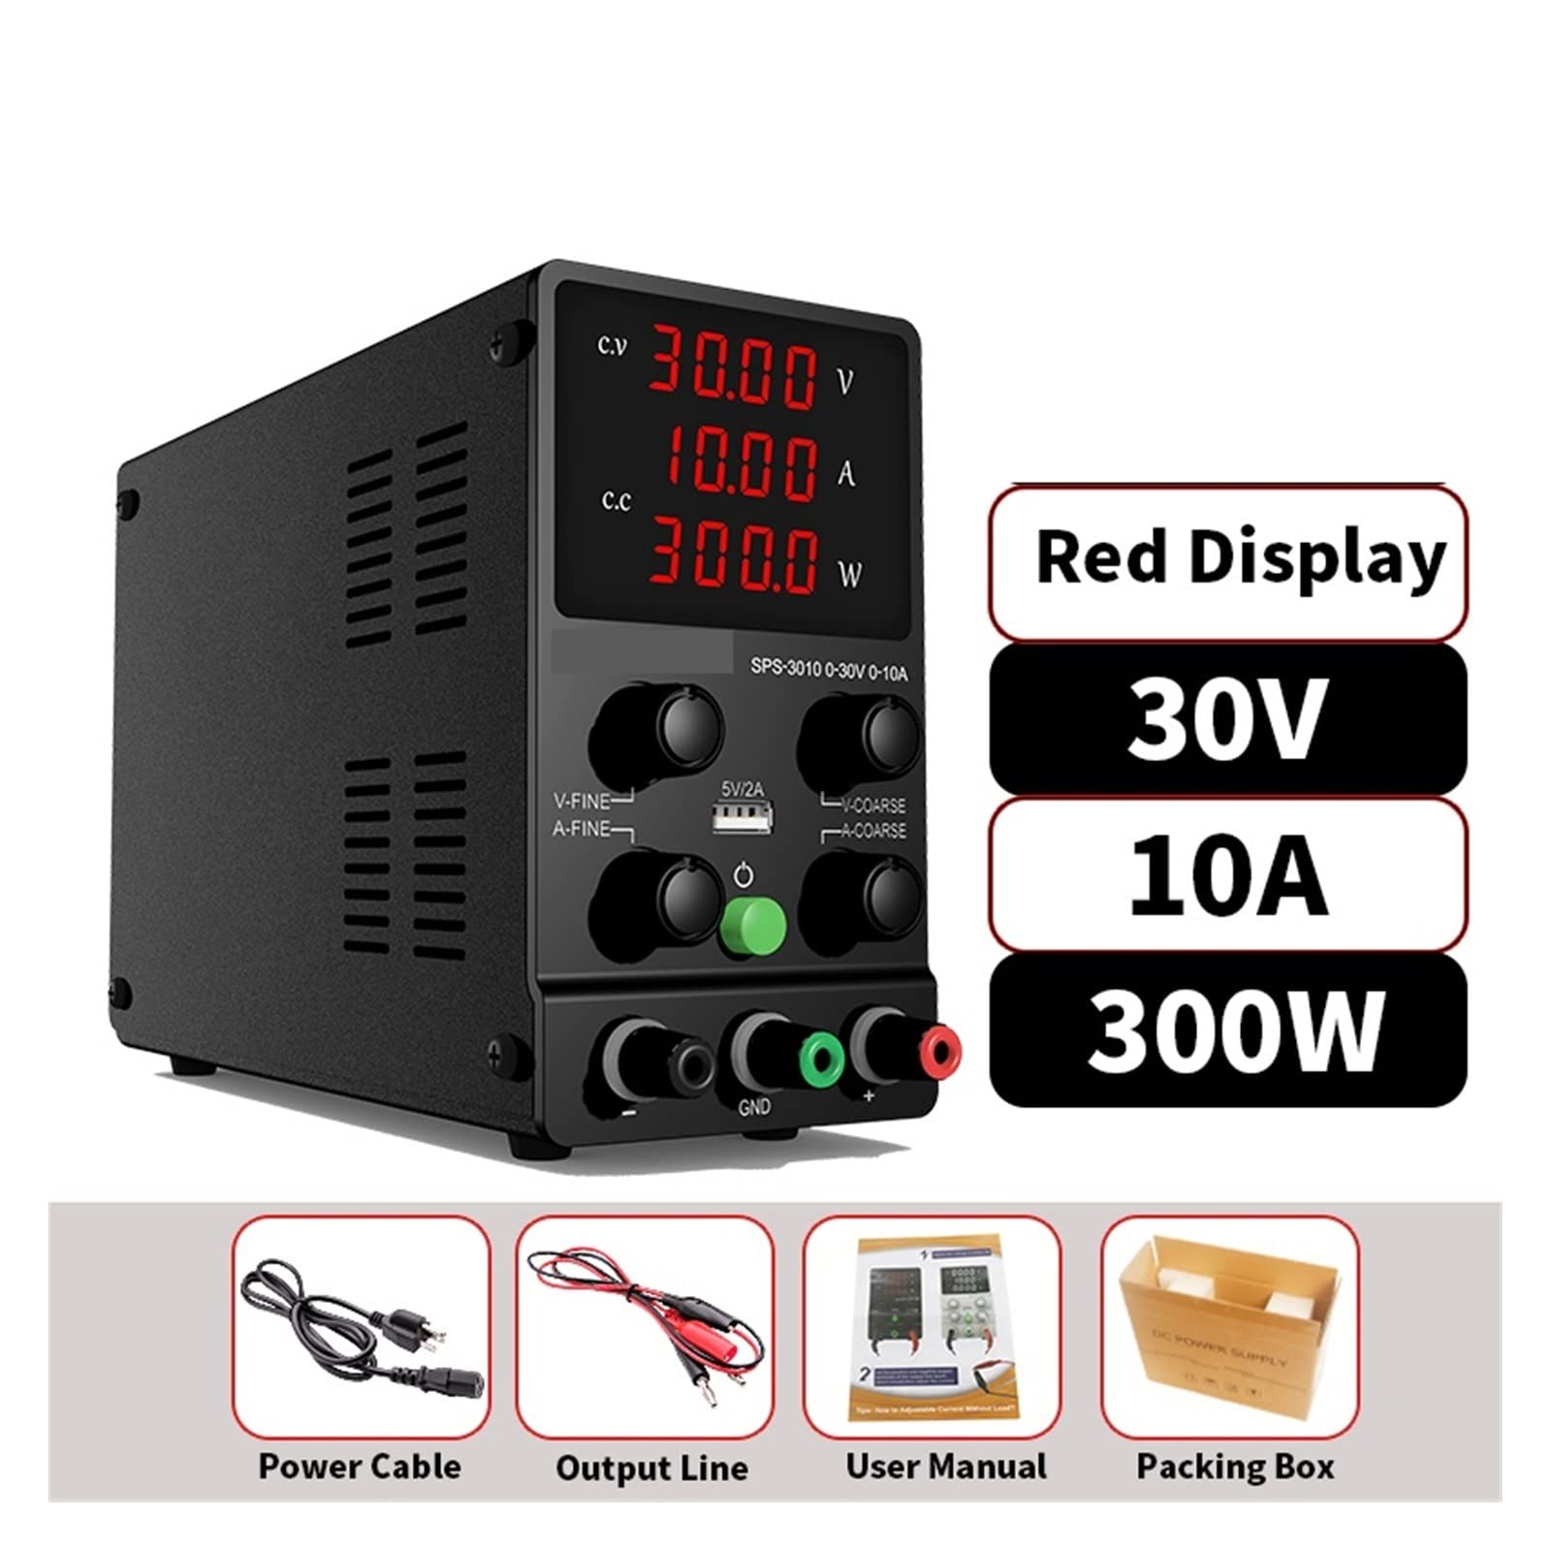
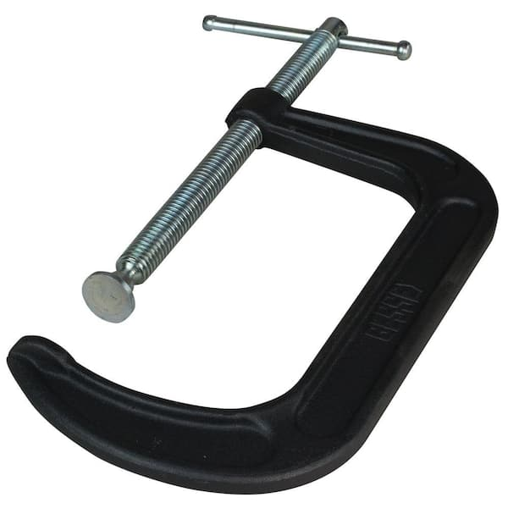
Additional Components
WAGO lever-lock connectors
Breadboard
30V-10A power supply
Enable/disable switch
Potentiometer
C-clamp

Slide 12
Operational Parameters
PWM frequency: 20kHz
PID Control loop: 1kHz
PD controller gains (did not spend a lot of time tuning)
Kp = 0.6
Kd = 0.025
User control input frequency: 100Hz
Data logging frequency: 10Hz

Slide 13
Software Overview
Main Control task runs on ESP32 CORE 1 with priority 1
User Input control task runs on ESP32 CORE 0 with priority 1
Data logging loop task runs on ESP32 CORE 0 with priority 2
Data is shared between cores and tasks using global buffers
See video overview for more in-depth information

